Slide 1

EduInsight
By Brandon, Daniel, Jamie, and Avery

Slide 2

What is EduInsight?
EduInsights is a website that ranks students using machine learning by analyzing educational habits and backgrounds.
This tool helps teachers identify and support students needing extra attention, fostering personalized and effective education.

Slide 3
What’s our mission?
Our mission is to provide teachers with crucial information about students.
Through our website, we also aim to supply useful tools to educators that allow for efficient learning in the classroom.

Slide 4

Various Applications
Effective student grouping
Roster/ranking of students
Take estimate of student’s mental and physical wellness
Can be used in conjunction with student survey information

Slide 5

EduInsight’s Useful Tools
Student Wellness Status - indicates the wellness of each student based on the machine learning data model
Peer Connector - allows a teacher to automatically generate student teams with balanced skill levels for class projects

Slide 6
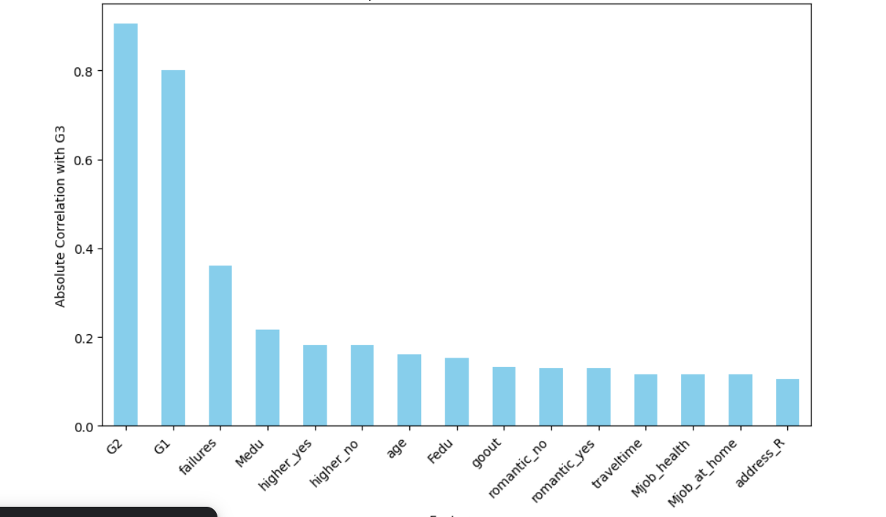
We found that past GPA, previously failed courses, and the education level of the student’s mother have the highest correlation to future success

Slide 7
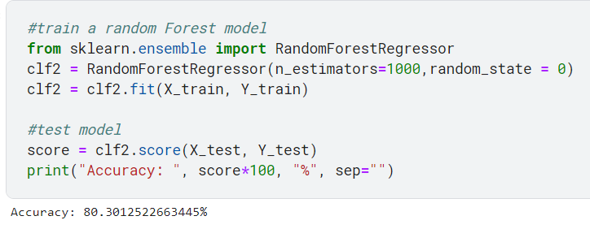
Random Forest Model Approach
A random forest model was used to make predictions based on the data. This model uses a collection of decision trees, each trained on subsets of the overall data.

Slide 8
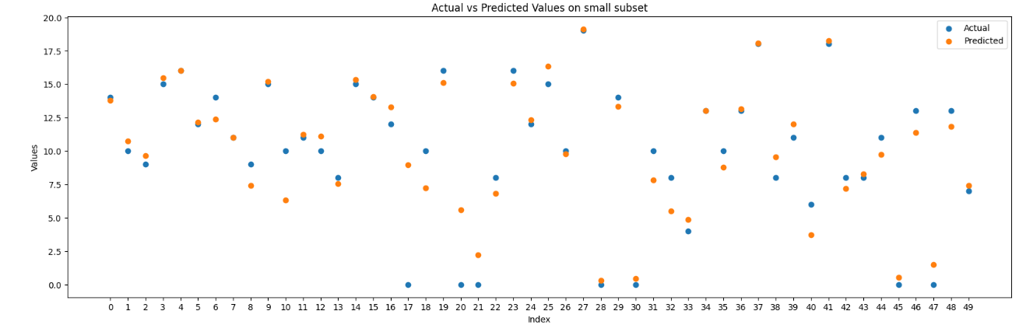
This scatterplot is a visual representation of our algorithm’s predictive accuracy. Overall, it was 80.3% accurate.

