Slide 1

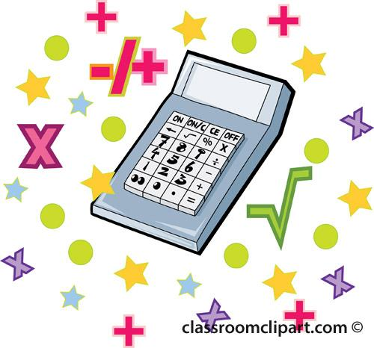
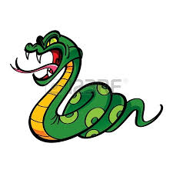
NYCDSA Python Project
By Daniel Rahman

Slide 2
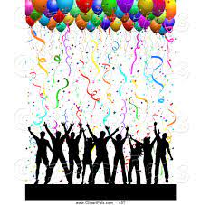

Introduction
Goal = To find out which party types and locations are the hottest and which receive the most/least amount of noise complaints and then recommend a party based on these findings.

Slide 3
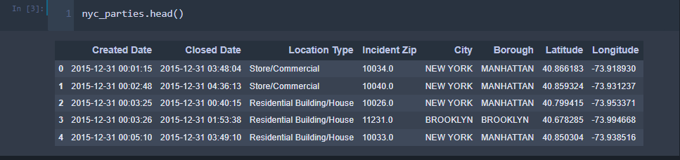
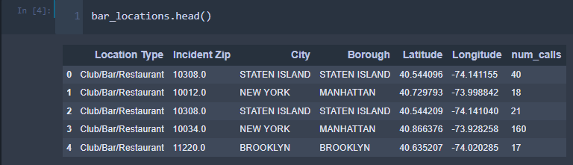
Datasets
party_in_nyc.csv = Shows the party times, location types and locations of where the parties took place.
bar_locations.csv = Shows the location type, location and number of calls for each party in a bar.

Slide 4
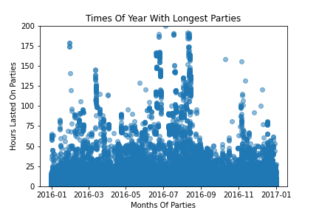
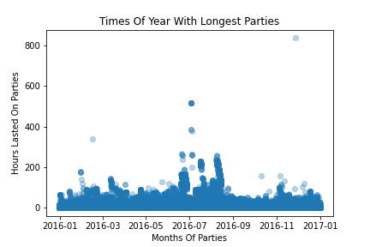
Time of Year with Longest Parties Before Shutdown

Slide 5
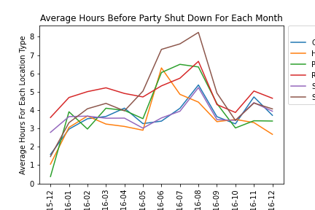
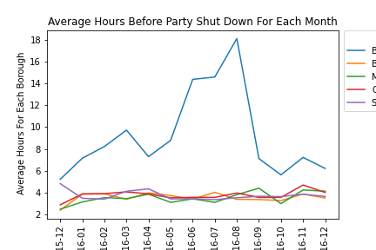
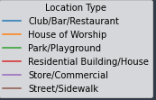

Average Hours Before Party Shut Down For Each Month

Slide 6
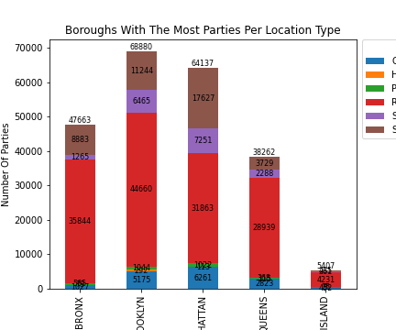
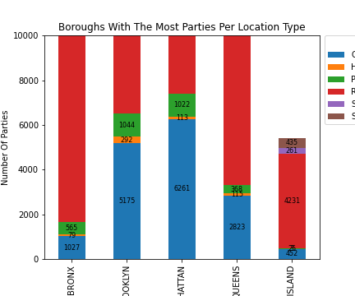
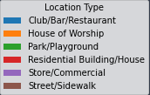
Boroughs With The Most Parties Per Location Type
BRONX
BRONX
BROOKLYN
MANHATTAN
QUEENS
STATEN ISLAND
BRONX
BROOKLYN
MANHATTAN
QUEENS
STATEN ISLAND
Borough
Borough

Slide 7
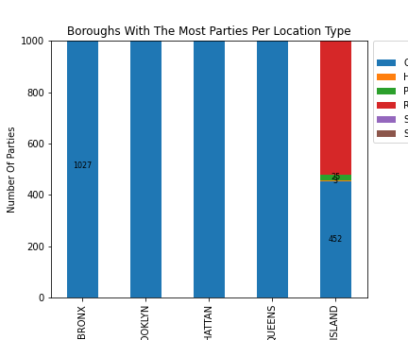
Boroughs With The Most Parties Per Location Type Cont
BRONX
BRONX
BROOKLYN
MANHATTAN
QUEENS
STATEN ISLAND
Borough

Slide 8
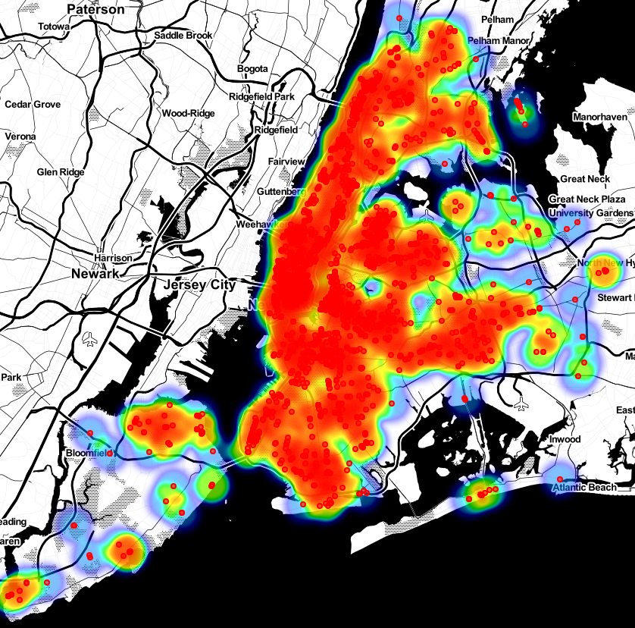
NYC Bar Party Heatmap

Slide 9
Conclusion
Party Recommendations:
Bars = Manhattan or outer boroughs close to Manhattan.
Manhattan = Downtown, Midtown, 2nd Avenue (Upper East Side) and near George Washington Bridge.
Houses and Streets = Bronx.
Streets/Sidewalks = Best when weather is warmer.

