Slide 1
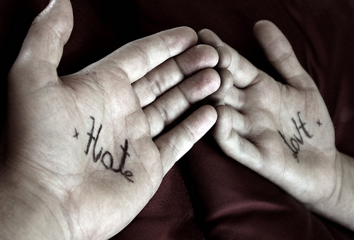
Dogs hate cats

