Slide 1
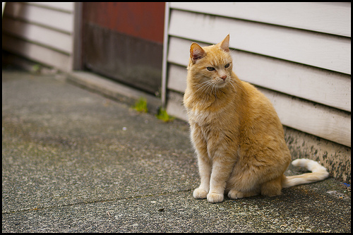
michelle has cat ears now

Slide 2
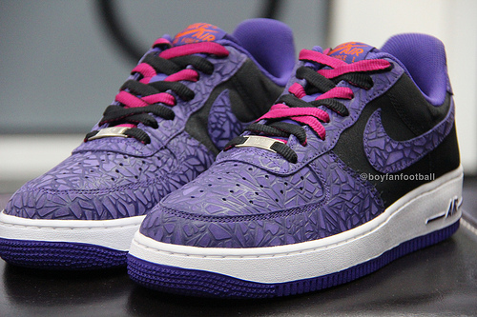
They are purple and black and white

