Slide 1
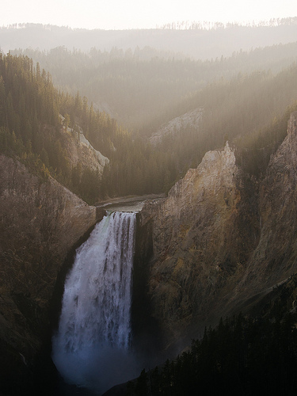
A trip to yellowstone national park can be amazing

Slide 2
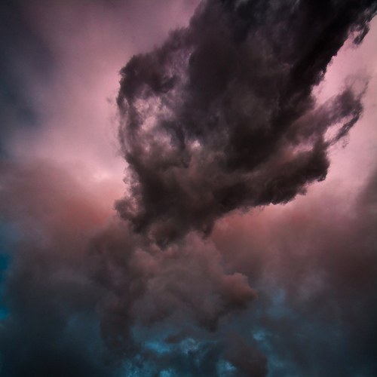
Another must see is are the eruptions in yellowstone

Slide 3
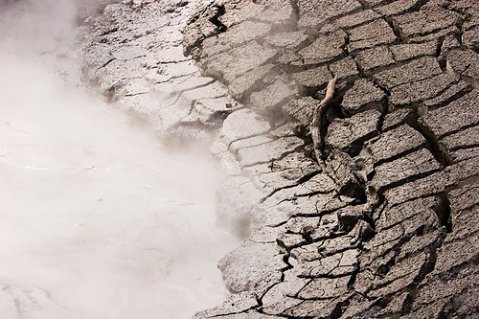
Gaze at a misty hot spring or a mysterious mudpot

Slide 4
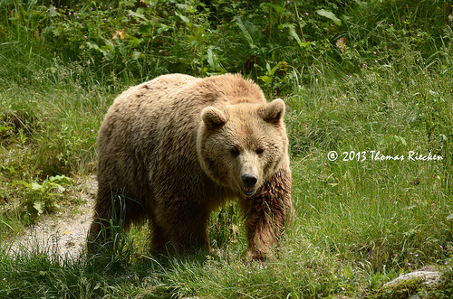
Or instead steal a glance at grizzly bear

Slide 5
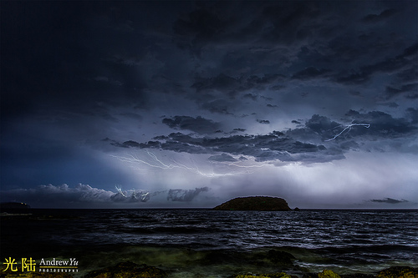
Or see a awe striking lightning storm

Slide 6
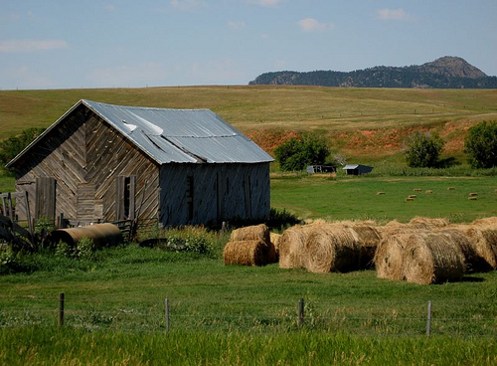
Plan a trip to wyoming to see the amazement

