Slide 1
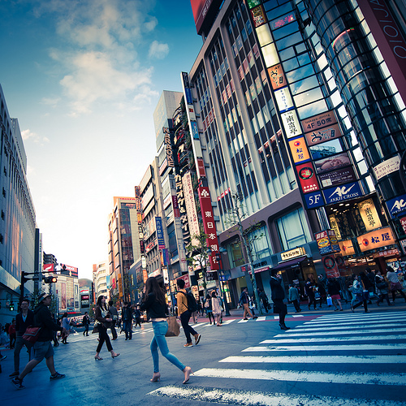
Why you should come to tokyo

Slide 2
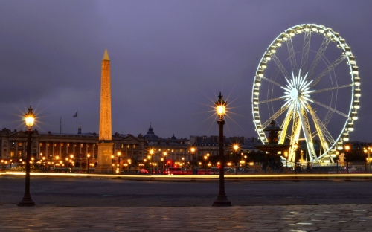
Because tokyo is a great shopping place

