Slide 1
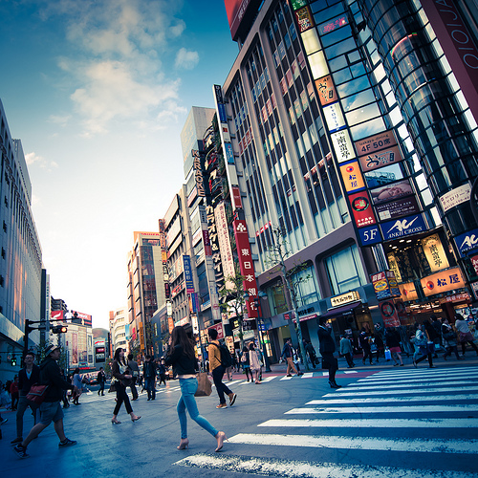
tokyo is awesome

