Slide 1
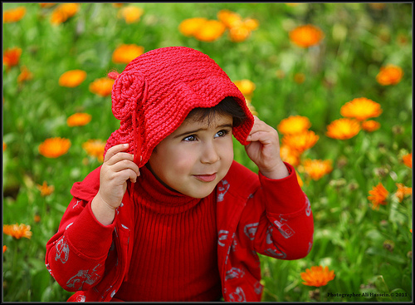
my name is bob and i like animals

