Slide 1
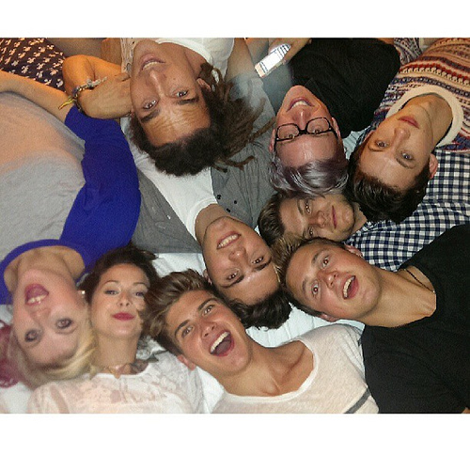
minecraft jeromeasf youtubers

