Slide 1
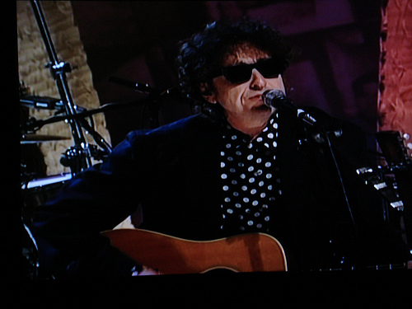
Hello my name is dylan

