Slide 1
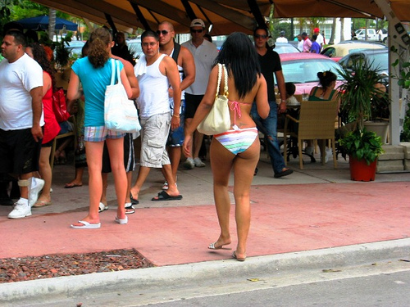
florida is really hot

Slide 2
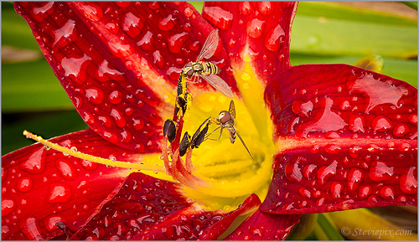
Rainy season starts from May and ends in july

Slide 3
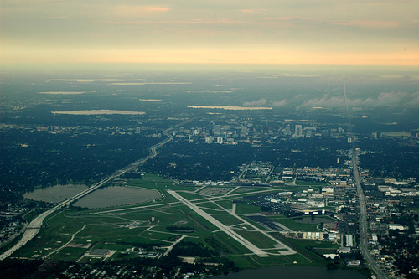
There are several major theme parks in orlando

Slide 4
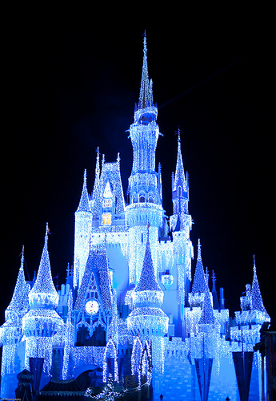
One is World disney Resort and the other is Universal Studios

