Slide 1
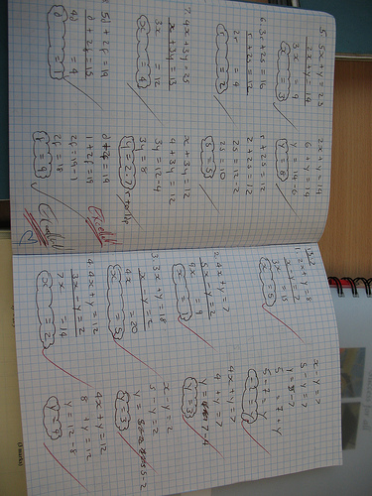
Hi this is an example of my presentation

