Slide 1
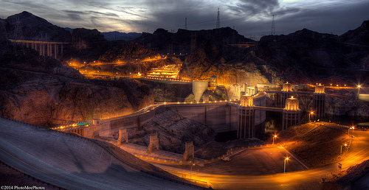
Thirty eight percent of carbon emissions are from electric power and solar power is no part of this

Slide 2

shouldn’t we reduce our carbon emissions to help the environment

