Slide 1
Rocky

Slide 2
Table of Contents
Our datasets
Decompilation
Parsing for standard tokens
Storage format
Parsing for ngram-like tokens (token tuples)
Optimizations implemented and future direction

Slide 3
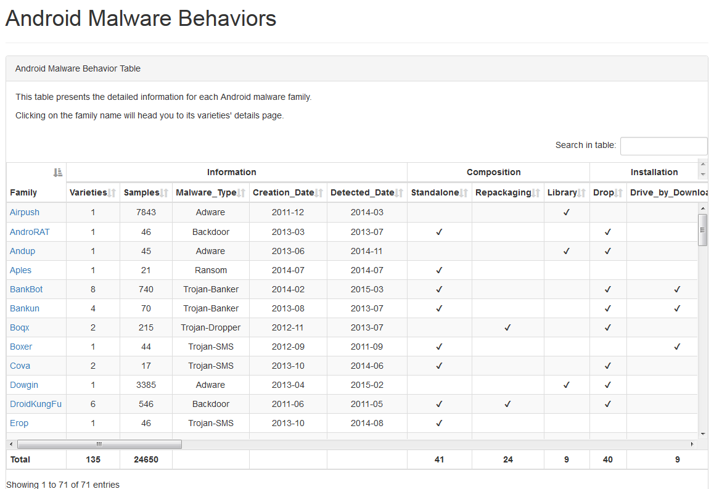
Malicious Dataset
http://amd.arguslab.org/
Collected by ArgusLabs at University of South Florida
Contains 24650 malicious apks, categorized into one of 71 families and 135 varieties, ranging from 2010 to 2016.
Dataset is skewed – some families are under-represented, while a single family represents 31.8% of the dataset.
While not taken into consideration presently, the dataset also categorizes the behavior displayed by every single family.

Slide 4
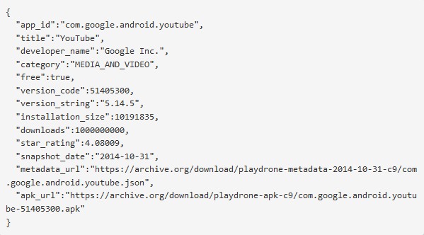
Benign Dataset
https://github.com/nviennot/playdrone
A snapshot of Google Play, taken over two weeks between 19/10/2014 – 31/10/2014
Contains download links to 1,402,894 apks as well as additional metadata, provided in json format
There is no guarantee that every apk is benign – a small portion have already been classified as malicious by the local machine antivirus.

Slide 5
Our Dataset
We expect to use 25,000 samples from the benign dataset and the whole malicious dataset.
Two possible directions: 1:1 ratio between benign samples and malicious samples, or 97:3 ratio between benign samples and malicious samples
1:1 ratio simulates an environment where samples are received after some filtration (heuristics, signature based, etc..)
97:3 ratio simulates the conditions in the android environment, where approximately 3% of all applications are malicious.

Slide 6



Decompilation and Groundwork
.
.
.
Decompile
Extraction
Merger
Decompile
Extraction
Merger
Universal Feature Extractor
Decompile
Extraction
Merger
.
.
.

Slide 7
Decompilation and Extraction
We use APKTOOL to extract smali code, resources and permissions from the apk.
dex2jar is used to extract source code from the apk.
A time intensive process – approximately 1 apk / 2 minutes.
A space intensive result – 7 times the original disk space.
Our feature extractor only makes use of the source code generated by this method.

Slide 8
Decompiled APK Structure
Common characteristics of organized programming is present in 92% of the malicious apks.
Organized in a folder hierarchy into subfolders such as “Android”, “com”…
Heuristic – Only process files in the “com” folder.

Slide 9
Decompilation and Groundwork
.
.
.
Decompile
Extraction
Merger
Decompile
Extraction
Merger
Universal Feature Extractor
Decompile
Extraction
Merger
.
.
.

Slide 10
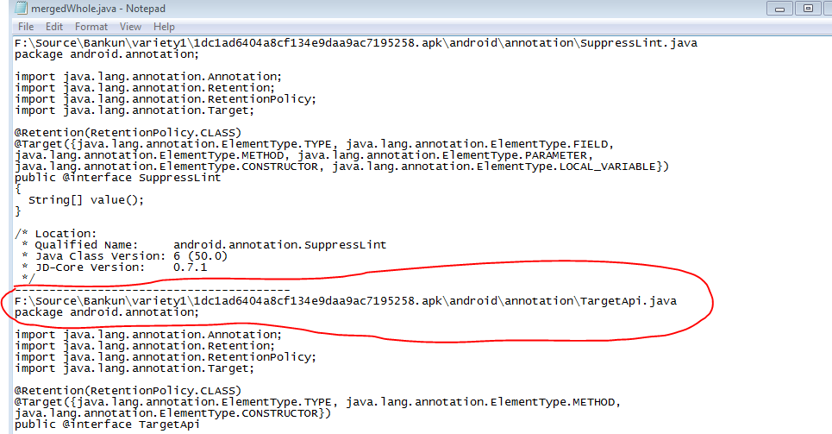
Merging Source Files
Approximately 300 source files per apk.
Concatenation eliminates disk block usage inefficiency.
Decreases runtime by reducing I/O operations by 2 orders of magnitude.

Slide 11
Our Extractor vs Other Tools
An attempt was made to use scikit learn’s tokenizer.
Results in memory errors when used over the whole dataset.
Performance issues, worsening as ngram-size increases.
A need rises to create a feature extractor that can handle large volume of files as per need.
This extractor will be ran once and create feature matrices which will be used as features for our classifier.

Slide 12
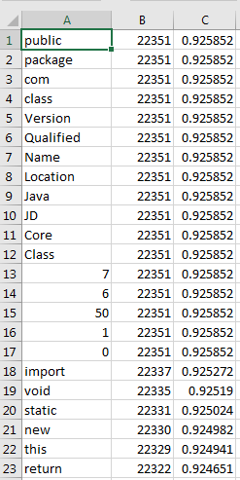
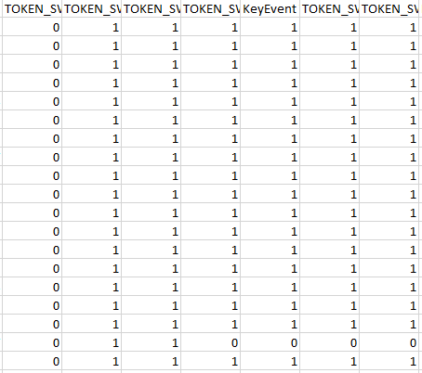
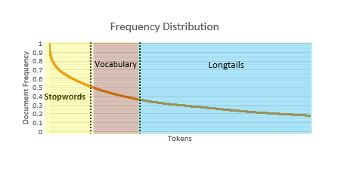
The Feature Extraction Process
Merged APK Files
Repeat For Ngrams

Slide 13
The Feature Extraction Process
Merged APK Files
Repeat For Ngrams

Slide 14
Document Definition
Two approaches different approaches:
A document as the whole apk.
A document as a single java file.
Initially, document will be defined as apk.
Document as the whole apk
Document as a single java file
Classify
Malicious
Classify
Benign
Classify
Benign
Classify
Classify
Benign
Malicious

Slide 15
Token Delimiter
Changing delimiters entails repeating the process.
Proposed delimiters:
Space delimiter – Preserves context, creates redundant information.
Punctuation delimiter – Preserves words, our delimiter of choice.
Camel Case Delimiter – Adds camel case differentiation to the punctuation delimiter.
X=new fireNuke( “fireNuke” )
Tokens =
{X=new, fireNuke(, “fireNuke”, )}
Tokens =
{X, new, fireNuke}
Tokens =
{X, new, fire, nuke}
Punctuation delimiter
Camel Case delimiter
Space delimiter

Slide 16
Token Frequency Dictionary Creation
A map between a token to its document frequency
The base step – everything else is based on the correctness of this dictionary.
To prevent memory issues a dictionary is created for every X apks.
These dictionaries are later merged using a batch merge algorithm.
Frequency dictionary

Slide 17
The Feature Extraction Process
Merged APK Files
Repeat For Ngrams

Slide 18
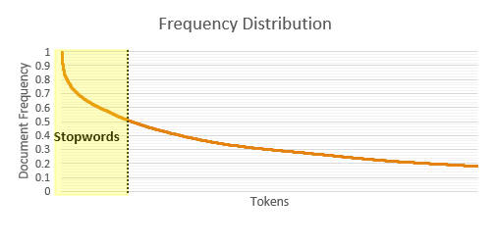
Token Feature Matrix Creation – Stopword Definition
Stopwords are tokens which appear very frequently in our collection.
Stopwords are frequently language constructs.
Our current thresholds for stopwords are tokens which appear in over 85%/90%/95% of the documents in the collection.

Slide 19
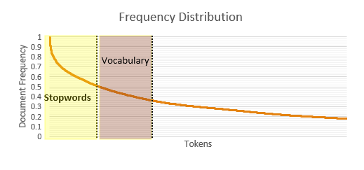
Token Feature Matrix Creation – Vocabulary Definition
Vocabulary are the tokens we use as features
The first X tokens after the least frequent stopword.
In our current configurations, X = 500, 1000, 1500

Slide 20
Token Feature Matrix Creation – Longtail Definition
Longtails are tokens which appear infrequently.
These are the tokens that were not included in the stopword set or our vocabulary.
Significant when generalizing to produce better results.

Slide 21
The Feature Extraction Process
Merged APK Files
Repeat For Ngrams

Slide 22
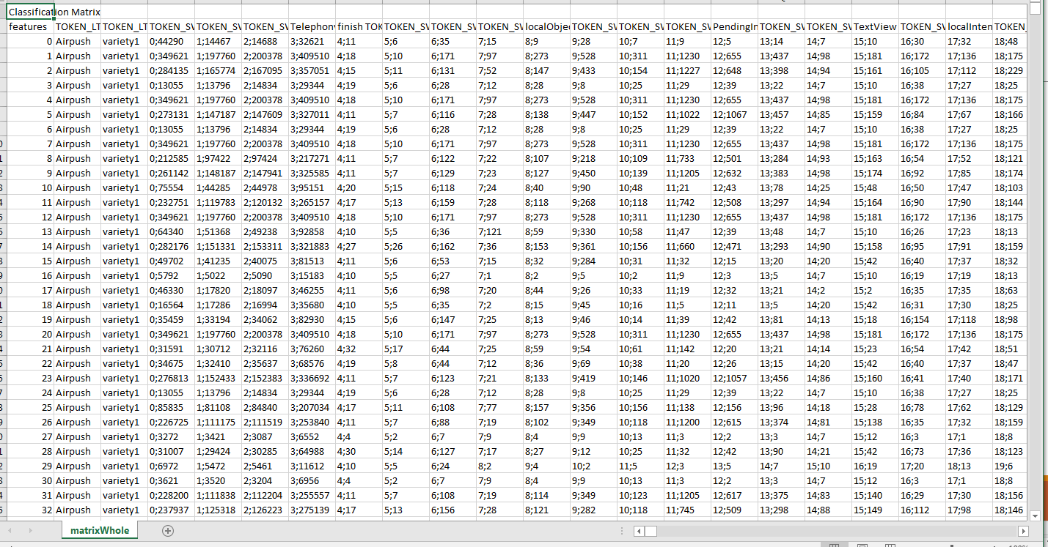
Token Feature Matrix Creation – Feature Matrices
We create a compact representation which we convert to feature matrices.
We currently make 5 types of feature matrices:
Binary Feature Matrix
Term Frequency Feature Matrix
Normalized Term Frequency Feature Matrix
tfidf Feature Matrix
Normalized tfidf Feature Matrix
Intermediary Matrix

Slide 23
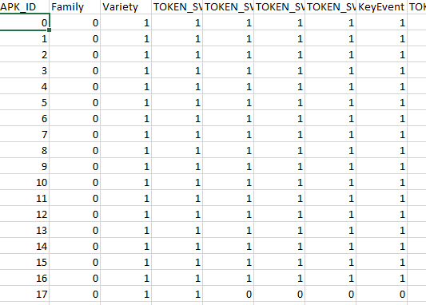
Binary Feature Matrix
A feature matrix where every cell in the matrix represents whether the feature (column) is present in the document (row) in a binary format – 1 for present, 0 for not present.

Slide 24
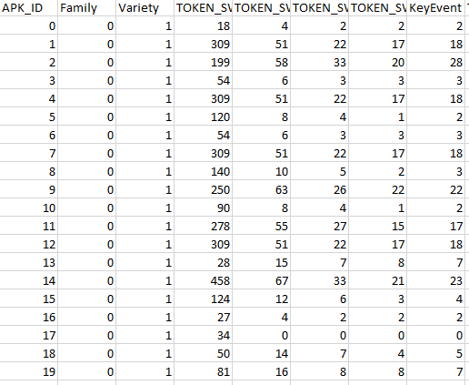
Term Frequency Feature Matrix
A feature matrix where every cell in the matrix is the term frequency of the feature in the document.

Slide 25
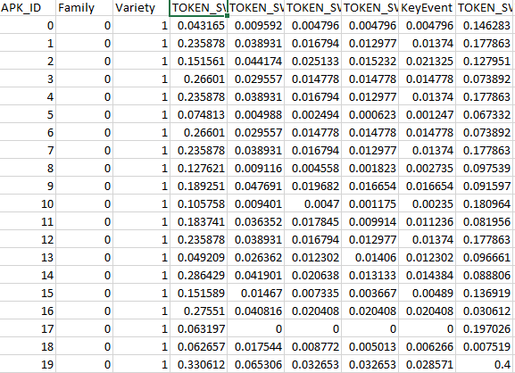
Normalized Term Frequency Feature Matrix
A feature matrix where every cell in the matrix is the normalized term frequency of the feature in the matrix.
The normalization is done by dividing all the frequencies in a row by the maximum frequency in that row.

Slide 26
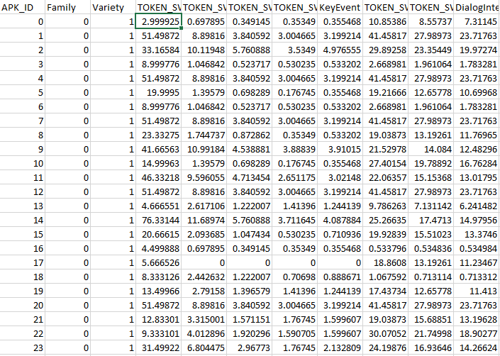
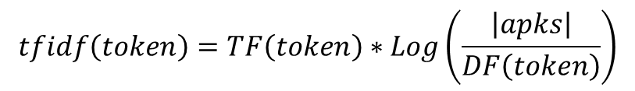
tfidf Feature Matrix
tfidf Feature Matrix is a feature matrix where every cell is the multiplication of the term frequency with the inverted document frequency of the feature.
Consider TF to be the token frequency of a token and DF to be the document frequency of a token, then the equation is given by:
$$tfidf\left(token\right)=TF\left(token\right)∗Log\left(\frac{\left|apks\right|}{DF\left(token\right)}\right)$$

Slide 27
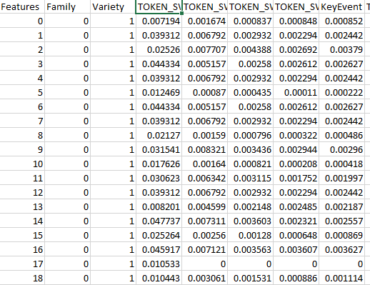
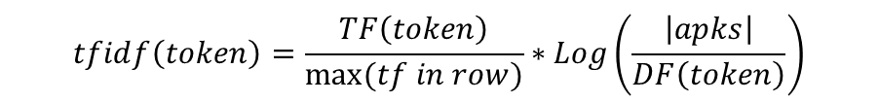
Normalized tfidf Feature Matrix
Normalized tfidf Feature Matrix is a tfidf Feature Matrix where every cell is divided by the maximum token frequency of the features in the row.
$$tfidf\left(token\right)=\frac{TF\left(token\right)}{max⁡(tf in row)}∗Log\left(\frac{\left|apks\right|}{DF\left(token\right)}\right)$$

Slide 28
The Feature Extraction Process
Merged APK Files
Repeat For Ngrams

Slide 29
Stopword and Token Count Configuration
When creating features using token-ngrams, we use the concept of stopwords and longtails as well.
We use the same configurations as before (85%/90%/95% stopword threshold, 500,1000,1500 tokens).
The remaining tokens are replaced with the longtail constant (TOKEN_LT in our configuration).
The significance is longtail is solidified here.
int x = 5 + 3 * 7
Stopwords
=
+
5
Vocabulary
int
x
*
2-Ngrams = {(int x), (x SW), (SW SW), (SW LT), (LT *), (* LT)}

Slide 30
Token Dictionary Creation
This is the reason why the uni-token-ngram configuration must be ran first, as that is where the token frequency dictionary is first created.
The token frequency dictionary is used to create our stopword and vocabulary sets using the previously defined configurations (tokens in neither of these sets are assumed to be longtails).
These sets remain in memory for the whole process.

Slide 31
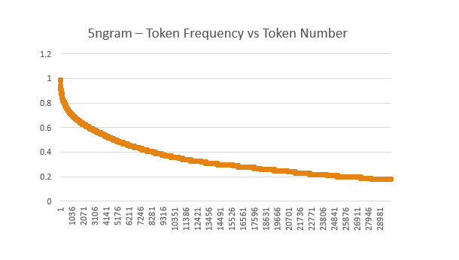
Ngram Frequency Dictionary Creation
The exact same process is repeated here as with unigram tokens.
The higher the ngram size, the higher the memory cost, thus a smaller chunk size is needed.

Slide 32
Ngram Feature Matrix Creation
The same process as with standard tokens is completed with ngrams.
This also entails the use of stopwords and vocabulary size as with standard tokens to best select ngram features.
The 5 feature matrices previously described are made for ngram features as well, for each possible configuration.
As with standard tokens, this phase requires going over the dataset again to calculate the term frequency of each ngram.

Slide 33
Number of Feature Matrices
We select the token ngram size from 2 to 5.
We define the stopword threshold for our vocabulary to be 85/90/95%.
We take the next 500/1000/1500 tokens to be our vocabulary for ngram creation.
We skip the top 85/90/95% ngrams when we define create the feature matrices as they are defined stopwords.
We take the next 500/1000/1500 ngrams to be our features in our features matrices.
We create 5 feature matrices from each configuration.
4*3*3*3*3*5 = 1620 feature matrices created in the current phase.

Slide 34
Illustration
Ngrams
3
SW Threshold
0.85
Vocab Size
1500
SW
Ngram Threshold
0.85
Ngram Vocab Size
1500
Feature Matrices
5 feature matrices per configuration

Slide 35
Optimization 1
Ngrams
3
SW Threshold
0.85
Vocab Size
1500
SW
Ngram Threshold
1.0
Ngram Vocab Size
50000
Feature Matrices
45 feature matrices per configuration

Slide 36
Optimization 2
Ngrams
3
SW Threshold
1.0
Vocab Size
10000
SW
Ngram Threshold
1.0
Ngram Vocab Size
50000
Feature Matrices
405 feature matrices per configuration

Slide 37
What’s next for Rocky?
Deduce ngram of size x from ngram of size y.
Implement multithreaded approach.
Eliminate redundant feature matrix creation.
Implement camel-case differentiation and extract feature matrices with it.
Implement “com” code folder heuristic.

Slide 38
Questions?

