Slide 1
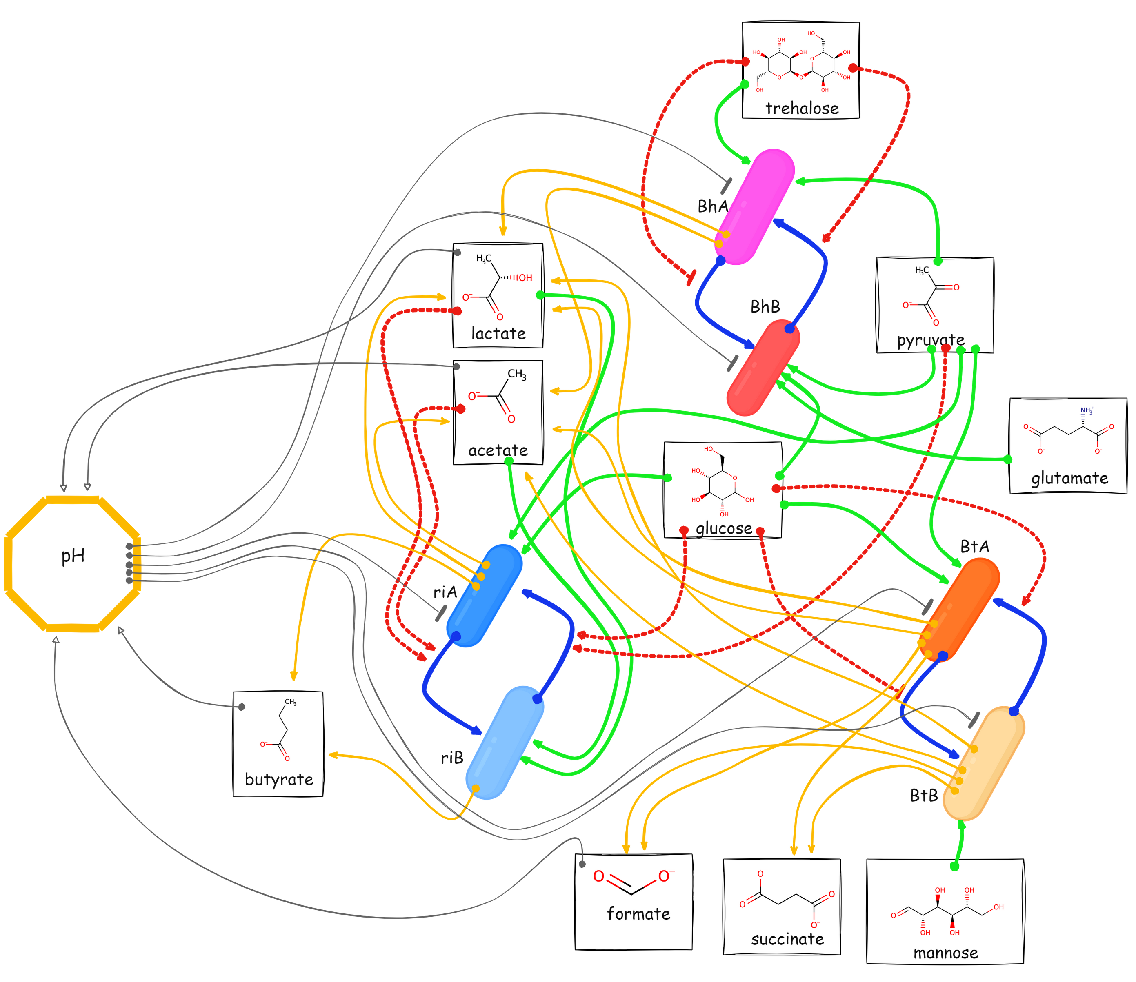

Slide 2
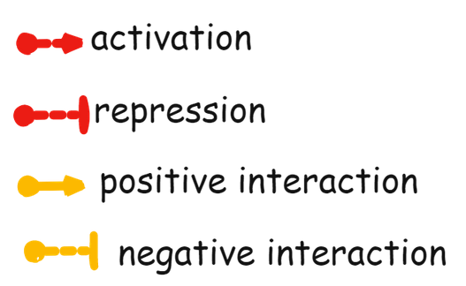
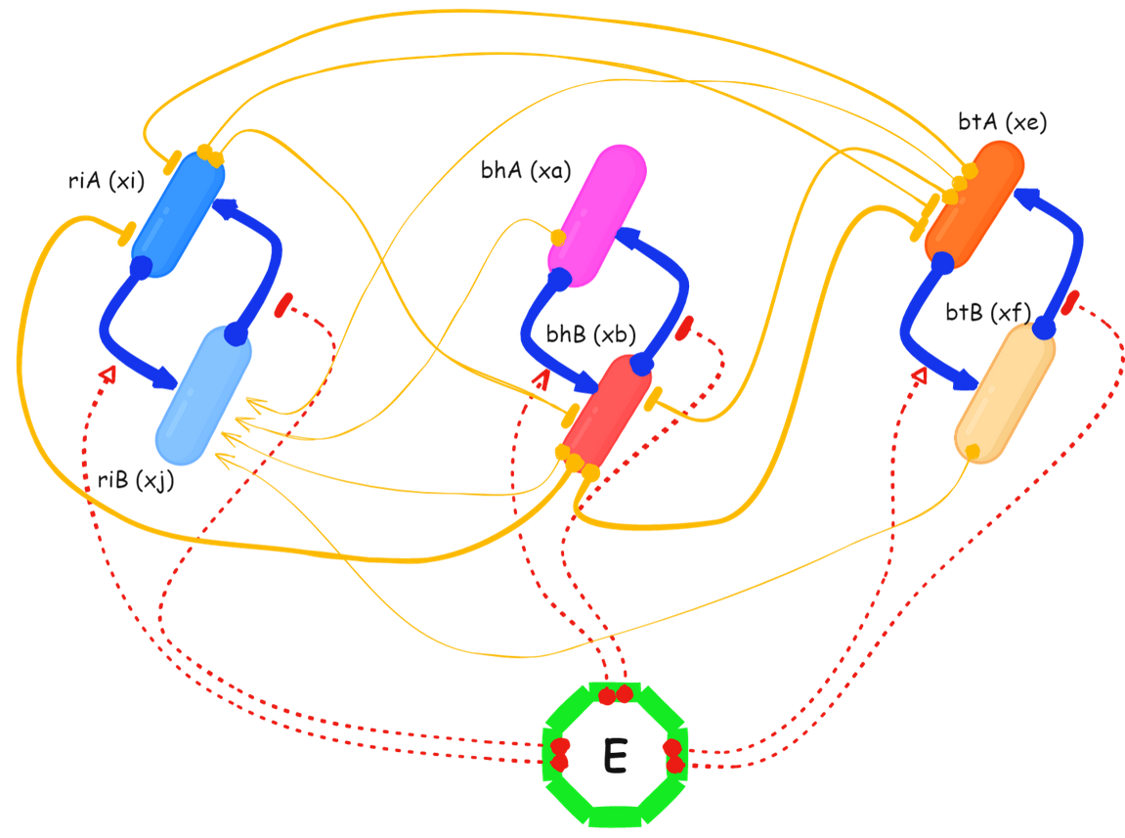
Phenomenological model
Toy interaction matrix

Slide 3








Equations

Slide 4
