Slide 1
Example old slides

Slide 2
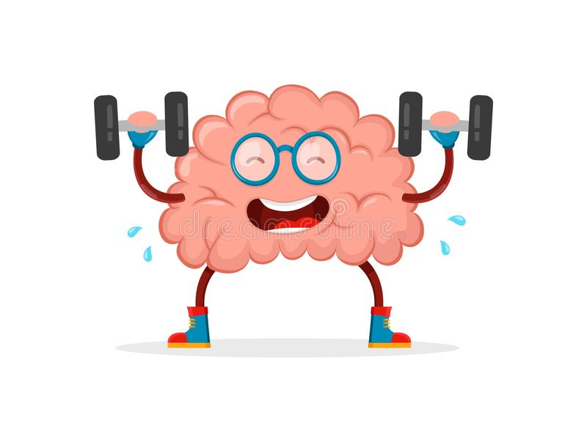
Why people use icons
Here is some statement or a question (Smith et al, 2014)
Here’s a second longer statement that requires two lines instead of one (Jones & Jones, 2019)
This is the third and last statement, but it’s still unbalanced

