Slide 1
Introduction
Words are usually remembered better when presented visually rather than aurally (Smith 1985; Jones, Ragalooshian, and Bosner, 1992)
Visual imagery is helpful in encoding words into memory (Rork and Wendel, 1972; Rosenkrantz and Guildenstern, 1997)
these studies always used visual presentation of words

Slide 2
Methods (cont.)
Design:
IV #1: visualizability of word (high visual imagery, low visual imagery)
within subjects
IV #2: modality of word presentation (visual, auditory)
between subjects
DV: number of words correctly recalled

Slide 3
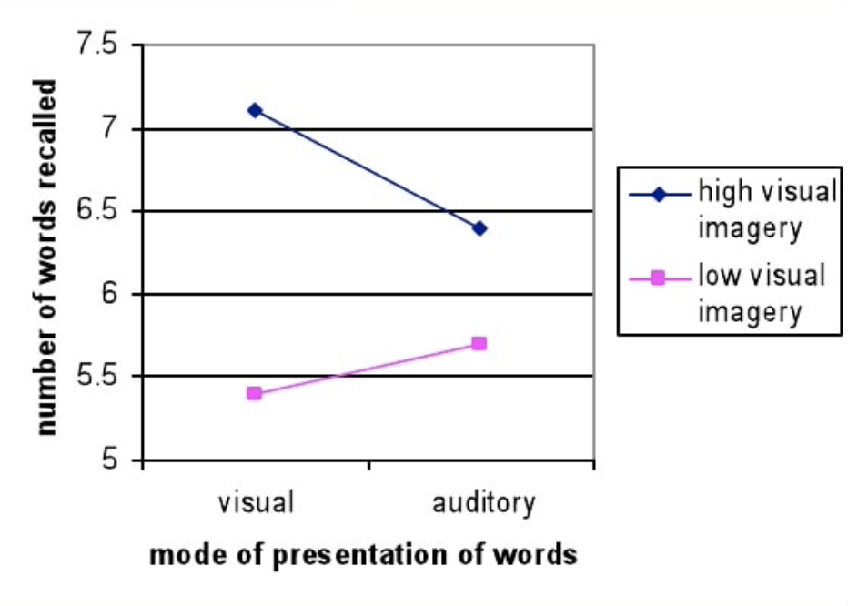
Results

