Slide 1
PROGRESSIO LOGO HERE (1)
Our Tutor Guarantees:
1. STUDIED AT A RUSSELL GROUP UNIVERSITY
2. UNDERTAKEN OUR COMPREHENSIVE TUTOR DEVELOPMENT PROGRAMME
3. HAVE AN ENHANCED DBS CHECK AND HAVE COMPLETED NSPCC TRAINING
4. ACHIEVED AN A/A* AT A-LEVEL IN THEIR TUTORING SUBJECT (OR EQUIVALENT)
5. ARE SELECTED AFTER A THOROUGH APPLICATION & INTERVIEW PROCESS
Student Login*
About us*
Parent Login*
Become a Tutor*
Tutor Login*
Integrated video
Teacher Login*
Find a Tutor Now*
School Admin Login*
Link to TrustPilot review page, which will show the most recent review here.*
Notes:
HOMEPAGE
-Each login will have the Latin word as a kind of ‘motif’
-Integrated video for testimonials must be integrated directly and can play with one click
-Trustpilot (MATT)
-General style and adaptions on our logo design (MATT)
-There are links to other things that this page will require, including but not limited to: link to our safeguarding and child protection policies, link to our Schools page (what are we calling the Schools thing?)
-Clicking the progressio logo must always take users back to this page
-What does it look like if they are already logged in? (MATT)

Slide 2
PROGRESSIO LOGO (1A)
Picture of Jacob
Picture of Lily
Text
-This will include images/Latin motifs?
Notes:
ABOUT US

Slide 3
PROGRESSIO LOGO (1B)
Why should you become a tutor?
Text about the benefits etc.
Fill in the Form:
-A few questions for our records (these need to automatically go into GDPR compliant database & we need to be notified on the admin email) (MATT)
-This then allows them to setup an inactive tutor profile that must be fully completed prior to interview (query on interview – MATT)
Notes:
BECOME A TUTOR

Slide 4
PROGRESSIO LOGO (2)
JOIN LESSON*
Logout*
Past Lesson Summaries*
Upcoming Lessons:
Messages
Archived Messages*
LBLB
16th January at 3:30pm – English Literature.
ENGLISH
14th Jan: Well done, Joe. That was an excellent lesson.
LB
MATHEMATICS
10th Jan: I’ve sent through your past paper, Joe.
JM
JM
21st January at 4:15pm – Mathematics.
Notes:
PUPIL HOMEPAGE
-Where the small circles are tutors this must be substituted with the tutor profile picture (the initials will be used for pupils that will not have profile pictures)
-When a message is selected the messages box fill with that conversation (Facebook messenger style)
-”Join Lesson” only activates 1 minute before the start time

Slide 5
PROGRESSIO LOGO (2A)
JOIN LESSON*
Logout*
Past Lesson Summaries*
Upcoming Lessons:
Archived Messages
Return to Messages*
LBLB
16th January – English Literature.
ENGLISH
14th Jan: Attached are the past exam papers :-)
EL
MATHEMATICS
10th Jan: Good luck with your exams!
TG
JM
21st January – Mathematics.
Notes:
PUPIL HOMEPAGE (ARCHIVED MESSAGES)

Slide 6
PROGRESSIO LOGO (3)
LESSON REPORT
Back to profile*
TUTOR: LILY B
SUBJECT: ENGLISH LITERATURE, A CHRISTMAS CAROL
SUMMARY: In this lesson, we covered …
WHAT WENT WELL: Joe contributed well throughout the lesson…
Previous lessons:
EG…
JM
16th January
Lesson with Jacob.
Maths – Expanding Brackets.
VIDEO RECORDING OF LESSON
Notes:
LESSON SUMMARY FOR PUPIL
-Small circles require tutor profile picture (every time a tutor’s name is present, it should be accompanied by the profile picture)
-”Maths” is the subject selected by teacher, the “Expanding Brackets” is the subject from the tutor’s lesson report
-The video recording needs to be automatically integrated into the report after the lesson (MATT)
>How long can they be stored for? Practical considerations on this? (MATT)
>We will discuss this with regard to the online lesson space anyway (MATT)

Slide 7
PROGRESSIO LOGO (4)
Logout*
Set availability*
View past sessions & invoices*
Edit profile*
Tutor Training*
Upcoming sessions
ETC.
Messages:
ETC.
Maths
18th January
3:30pm*
START*
JJ
Cannot attend*
JJ
JJ
MATHS
15th February
I have attached the past paper below.
Notes:
TUTOR HOMEPAGE
-Upcoming sessions and messages must work identically to the PUPIL HOMEPAGE
>START only ‘clickable’ 10 minutes before the lesson starts
-When a tutor clicks “cannot attend” a confirm/cancel popup must appear saying “*************”
-Where can tutors see pupils’ past information? By clicking on their profile initials in the messages or something?

Slide 8
PROGRESSIO LOGO (4A)
Pupil Profile
Student Name:
School Year:
Number of Lessons with Progressio:
Pupil’s Past Lessons:
EG…
LESSON REPORT
JM
16th January
Lesson with Jacob.
Maths – Expanding Brackets.
TUTOR: LILY B
SUBJECT: ENGLISH LITERATURE, A CHRISTMAS CAROL
SUMMARY: In this lesson, we covered …
WHAT WENT WELL: Joe contributed well throughout the lesson…
Notes:
EXAMPLE PUPIL PROFILE
-Works in the same way as the tutor looking at all their past sessions, but this time just for the pupil

Slide 9
Back to profile*
Recommendations:
-Providing regular availability so that teachers can provide continuity for their pupils. If you can mark for the whole term it will increase your chance of getting pupils!
PROGRESSIO LOGO (5)
One week calendar (ability to move to next week and so on)
-Clock: 8am-7pm mon-fri.
-In 15 min segments, easy to highlight available times
“Copy to next week” button, to make it easier if tutor has same availability each week.
-Highlight ‘peak’ times in light colour/crosshatching (e.g., after-school hour etc., difficult until we have data on this)
Notes:
TUTOR AVAILABILITY CALENDAR

Slide 10
PROGRESSIO LOGO (9)
Automatically arrive here after lesson
Lesson Overview
Return to profile*
Student Name:
Subject:
Date:
Level:
Teacher Report
Lesson Report:
Pupil Name:
Subject:
Current Grade:
Predicted Grade:
Exam Board:
Pupil Learning Style:
Lesson Notes:
Lesson Title:
What we covered:
What the pupil did well:
What we will cover next time:
What the pupil struggled with:
SUBMIT
Notes:
LESSON REPORT FOR TUTOR TO FILL IN
-”Teacher Report” is an uneditable version direct from the teacher’s booking (see “Progressio Logo (8)” at slide 15)
-Return to profile goes back to ”Tutor Homepage”
-Tutor to fill in the three “Lesson Report” boxes (five separate answers to the five questions). Whole report goes to teacher, only first two boxes go to pupil
-Lesson is not marked as complete until this has been submitted (i.e., tutors cannot be paid for the session until submit has been pressed)
-Tutors can edit their report at any time by clicked on it in their “Past Lessons” and clicking “edit”
-Lesson overview is all auto-filled
-SUBMIT marks the lesson as completed and ready for payment (MATT)

Slide 11
Back to profile*
PROGRESSIO LOGO (9A)
Completed Lessons:
e.g.
Etc.
Invoices:
-Discuss with accountant how we display this
-Two boxes – one for schools and one for private (two new pages with the grid on past lessons etc.)
LBLB
English
16th January at 3:30pm
Edit Report*
Notes:
VIEW PAST SESSIONS & INVOICES
-”Edit report” will just take tutor to the “Lesson Report for Tutor to Fill In” page and they click submit and return here after making their changes
-Completed lessons is a scroll down function (if they have had lots of lessons)

Slide 12
PROGRESSIO LOGO (9B)
Ability to add/edit the following things:
Profile picture and name
University and uni subject
Price (only for private, not for schools)
Number of lessons tutored
How I Approach Tutoring
About Me
Notes:
EDIT TUTOR PROFILE

Slide 13
PROGRESSIO LOGO (12)
Compulsory training videos:
Pre-interview
Post-interview
Helpful non-compulsory videos and resources:
Return to Profile
Video 1
Video 1
Video 2
Video 3
Video 4
Video 2
English Resources
Maths Resources
Notes:
TUTOR TRAINING

Slide 14
PROGRESSIO LOGO (6)
Logout*
Book a tutor*
View tutor lesson reports*
Upcoming Bookings:
Contact us:
AA
Maths with Jacob.
18th January.
CANCEL*
BB
English Language with Lily.
20th January.
CANCEL*
CC
English Literature with Lily.
25th January,
CANCEL
Notes:
TEACHER HOMEPAGE
-Tutor profile picture displays in the small circles that currently have letters in
-If the teacher cancels the booking there needs to be a confirm/cancel popup saying “CANCEL BOOKING: cancellations made less than 12 hours prior to the lesson will not be refunded” (MATT)
-Contact us will go direct to our accounts (a single chat box, directly embedded on the page) (MATT)

Slide 15
PROGRESSIO LOGO (7)
Return to profile*
PUPIL SELECTION
SUBJECT
NUMBER OF SESSIONS
DAY
LEVEL
TIME
One week timetable, blanking off current week.
-Recommend 5-10 tutors that fit the search criteria, marking out available times in separate colours
-Same timetable style as for tutor availability
Summary of selection:
Mon 17th Jan at 3:30pm
Mon 24th Jan at 3:30pm
Tues 1st Feb at 4:00pm
Etc.
Write Teacher Notes*
Notes:
BOOK A TUTOR FILTER SECTION
-Pupil Selection allows more than one pupil to be selected (only for the same subject and times etc.)
>Can we integrate 2-1 and 3-1 lessons too? (MATT)
-In ”Pupil Selection” the teacher can start typing the name of the pupil and a drop-down menu refines the suggestions
-I think the number of sessions box can remain and we remove “Number of Sessions Per Week” (see next point – MATT)
-Self-refining timetable (avoids it looking too fiddly, begin with a mon-fri, 9am-8pm grid in 15min grids) (MATT)
-How can we ensure that the suggested tutors are (a) random, or (b) more likely to appear if they are reliable? We do not want it to work alphabetically based on name etc. or John Zzzzz is never going to get any work (MATT)
>Give options of tutors for teachers, use colours to represent this? (MATT)
>How do teachers see the tutor profile, if they hover over a tutor will it show profile pic or something? Or is this unnecessary as teachers do not need to see the tutor beforehand?
-Summary of selection is self-updated as teacher makes/unmakes various selections
-When a lesson is booked it also updates school admin account

Slide 16
PROGRESSIO LOGO (8)
Back to time selection*
Teacher Request
Pupil Name:
Lesson Notes:
Faint text in the background with examples of text (see below):
Our tutors have been trained to follow your guidance (specific or more general) to get the best results.
E.g. Pupil needs to work primarily on his XYZ. It would be useful if you could start by looking at XYZ (especially XYZ) and, once you have covered that, perhaps see if you can give him some guidance on XYZ.
Subject:
Summary of selection:
Mon 17th Jan at 3:30pm
Mon 24th Jan at 3:30pm
Tues 1st Feb at 4:00pm
Etc.
Current Grade:
Target Grade:
Exam Board:
View Booking Summary*
Advice for working with this pupil:
Notes:
TEACHER REQUEST FORM
-”Pupil Name” and “Subject” need to autofill
-”Current Grade” “Target Grade” “Exam Board” are compulsory
-”Advice for working with this pupil” and “Lessons Notes” are optional
-The faint background text disappears when the teacher starts typing
-”Finalise Booking” comes up with a confirm/cancel popup (the lesson is booked once confirm is selected)
-Arrows at bottom for when teacher is booking for more than one pupil (individual form for each one)

Slide 17
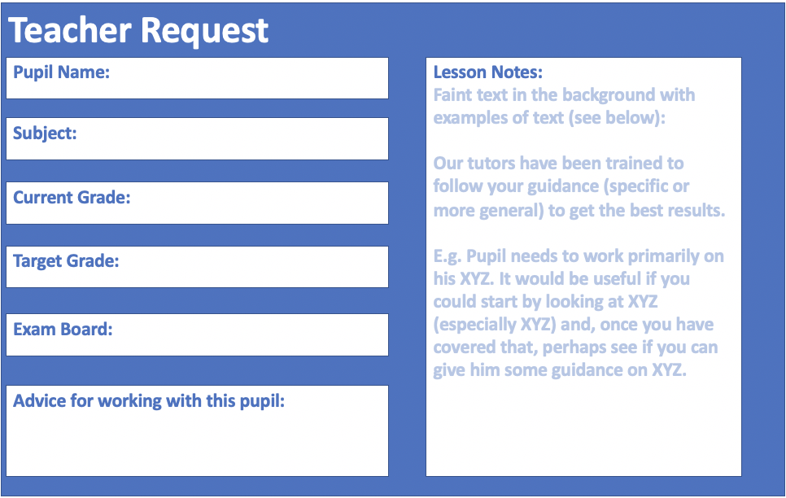
PROGRESSIO LOGO (8A)
Timeslots Selected:
Tutor Profile Summary
Finalise Booking*
Notes:
BOOKING SUMMARY
-”Finalise Booking” comes up with a confirm/cancel popup (the lesson is booked once confirm is selected)
-Another arrow system for if the teacher is booking for more than one student (the tutor profile summary and teacher request will change)

Slide 18
PROGRESSIO LOGO (8B)
LESSON REPORT
Return to profile*
TUTOR: LILY B
SUBJECT: ENGLISH LITERATURE, A CHRISTMAS CAROL
SUMMARY: In this lesson, we covered …
WHAT WENT WELL: Joe contributed well throughout the lesson…
Etc.
Search for a pupil
JM
16th January
Lesson with Jacob.
Maths – Expanding Brackets.
VIDEO RECORDING OF LESSON
Notes:
TEACHER’S VIEW OF LESSONS REPORTS
-This is exactly the same as viewing past lesson reports for the tutor profiles, but the teacher has access to all reports for their school. To find a student, they type the name (with a refining drop-down menu of pupils in their school) and, once selected, they can see the reports for the selected student on the left

Slide 19
PROGRESSIO LOGO (10)
Contact us:
Here, a chat box will ideally be embedded into the page. It will be like an instant messenger box that MyTutor has.
PURCHASE LESSONS*
Logout*
BOOK A LESSON*
ADD/REMOVE TEACHER*
ADD/REMOVE PUPILS*
VIEW LESSON REPORTS*
VIEW ANNUAL REPORTS & IMPACT ASSESSMENTS*
Notes:
SCHOOL ADMIN HOMEPAGE
-Contact Us box is the same as the teacher’s one
-Book a tutor works in an identical way to the teacher one
-”View Lesson Reports” should be identical to the one for teachers
-”View annual reports & impact assessments” just needs to go to a page where we can upload PDF documents and put a date above each one (these will only be uploaded once a year anyway)

Slide 20
PROGRESSIO LOGO (10A)
Back to Profile*
Add a Teacher*
Teacher Name
Teacher Email
How many sessions they have booked this academic year (reset Sept.1st)
Notes:
ADD/REMOVE TEACHERS
-When the ‘add a teacher’ is clicked the school admin just inputs the email addresses and clicks send, this will automatically email the teachers so they can set up an account (only needs name)

Slide 21
PROGRESSIO LOGO (10B)
Back to Profile*
Add a Pupil*
Pupil Name & School Year
Pupil Email
How many sessions they have had on progressio?
Notes:
ADD/REMOVE PUPILS
-Identical to previous slide, with the above exception

Slide 22
PROGRESSIO LOGO (11)
Lessons Purchased by My School
Lessons Purchased by the Community
Return to profile*
Number of lessons left
Amount spent
-??
Number of lessons left
Amount spent
-??
Notes:
LESSONS PAGE FOR SCHOOL ADMIN
-To discuss***

Slide 23
PROGRESSIO LOGO (13)
SUBJECT
GENDER PREFERENCE
AIMS (select as many as you’d like):
Improve examination grades
Practise & Mark examination questions
Build confidence
Catch-up missed content
Other
LEVEL
Tutor Profile Summaries
-Click on them to be expanded to the full profile
Notes:
TUTOR MARKETPLACE
-All can be drop-down menus that you can also type into and the menu refines
-Under “Aims” are tickboxes – the selection here (if any) should be communicated to the tutor(s) that they message automatically

Slide 24
PROGRESSIO LOGO (14)
Ability to see the following things in a user-friendly manner:
Profile picture and name
University and uni subject
Price (only for private, not for schools)
Number of lessons tutored
How I Approach Tutoring
About Me
Ratings from parents (only private clients can leave ratings – both parents and pupils)
Notes:
TUTOR PROFILE LAYOUT
-This is the content we want – we just need to put it in a good-looking place
Profile picture and name
University and university subject
Price (only for private, not for schools)
Number of lessons tutored
How I Approach Tutoring
About Me
Ratings (only for private, not for schools)

