Slide 1


Data Governance @ SneakerPark
Prepared by: Daniel Freitas
Submitted on: 11/19/2022

Slide 2
Background
SneakerPark is an online shoe reseller that allows people to buy and sell used and new shoes. Buyers can bid for shoes or buy them outright, and sellers can set a price or sell to the highest bidder.
Each buyer and seller must have an active account in order to sell, bid, or purchase sneakers using SneakerPark’s website.
SneakerPark authenticates the shoes before shipping them to the buyer, so before listing an item, the seller must ship it to SneakerPark’s warehouse. Upon receipt, SneakerPark assigns an item number to each pair of sneakers and notifies the seller that they are now free to list their item. If the item is not listed within 45 days, SneakerPark returns it to the seller and sends an invoice to the seller for the shipping cost.
If the item is found to be inauthentic or in an unacceptable condition, it is also returned back to the seller in a similar fashion.
When the item sells, the buyer’s account is credited with the purchase price minus the SneakerPark service fee and shipping fees to deliver the item to the buyer.
Currently, SneakerPark only supports sales within the United States.

Slide 3
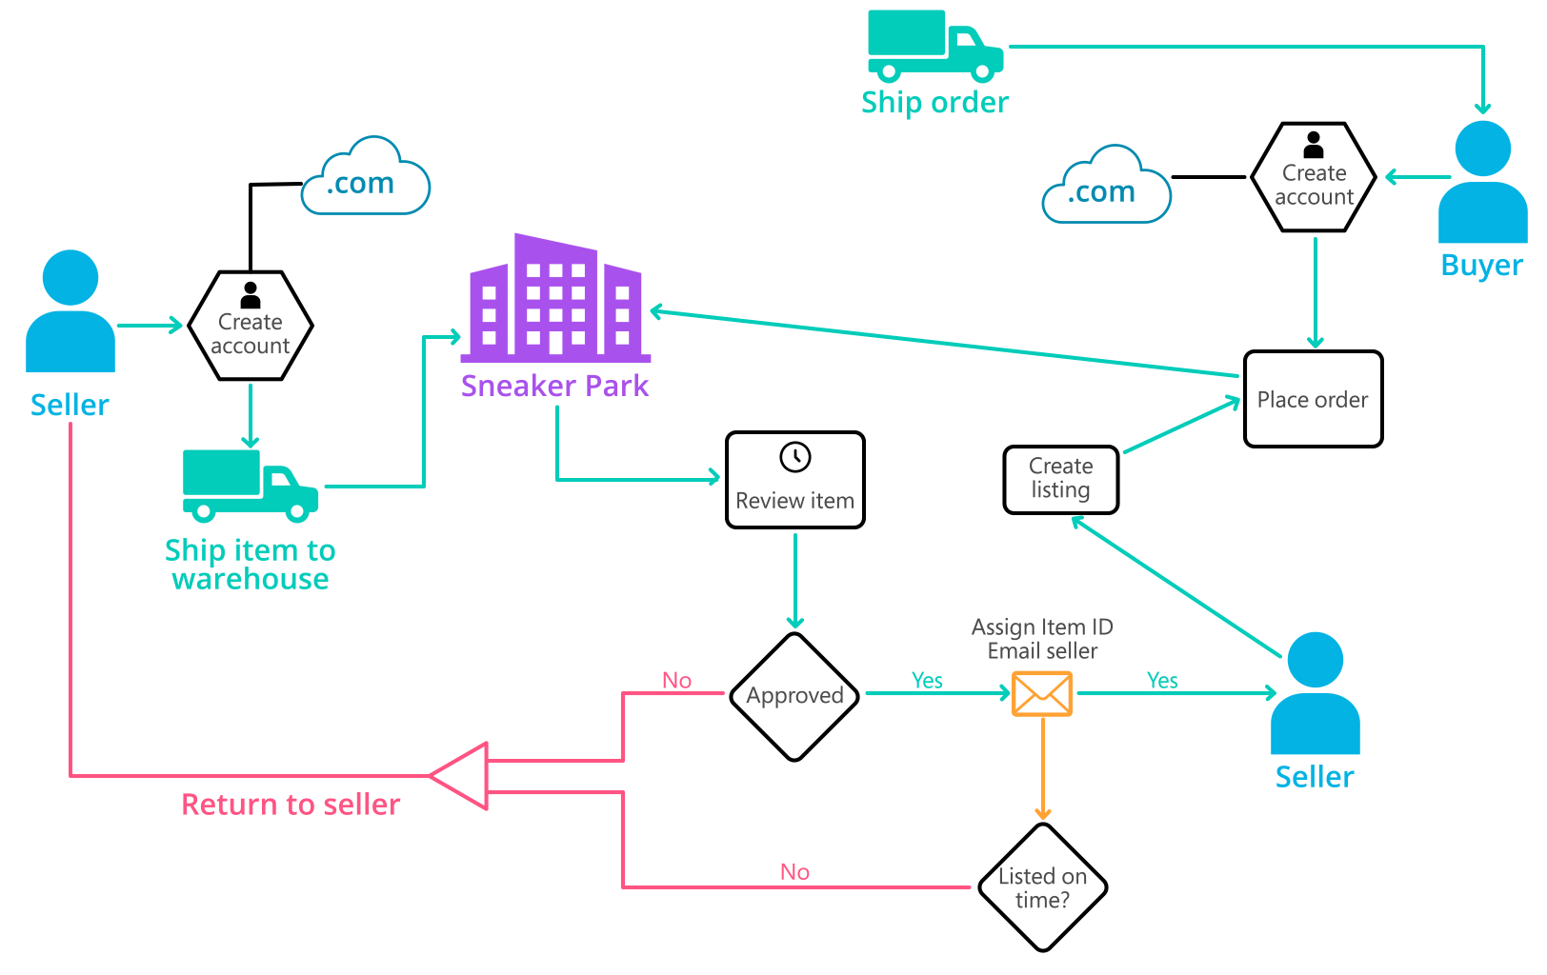
Background (cont’d)
Below you can see a diagram that will hopefully help you visualize some of SneakerPark's business processes. Keep in mind that it does not capture ALL processes and every nuance, but simply serves as another artifact to use in your project.

Slide 4
Step 1
Enterprise Data Catalog Part 1: Enterprise Data Model

Slide 5
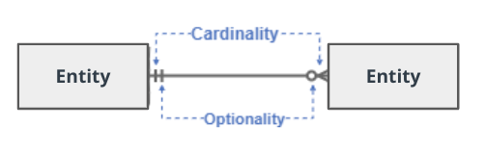
Create a conceptual data model that will provide SneakerPark with a holistic view of its data systems and help you grasp the organization's important entities and relationships, which will be instrumental as you move further in the project. You can use Lucidchart or any other diagramming tool of your choice, but please use the Crow’s Foot/IE Notation and please be sure to indicate both cardinality (the type of a relationship such as 1:N or N:N) and optionality (whether the relationship is optional or mandatory).

Slide 6
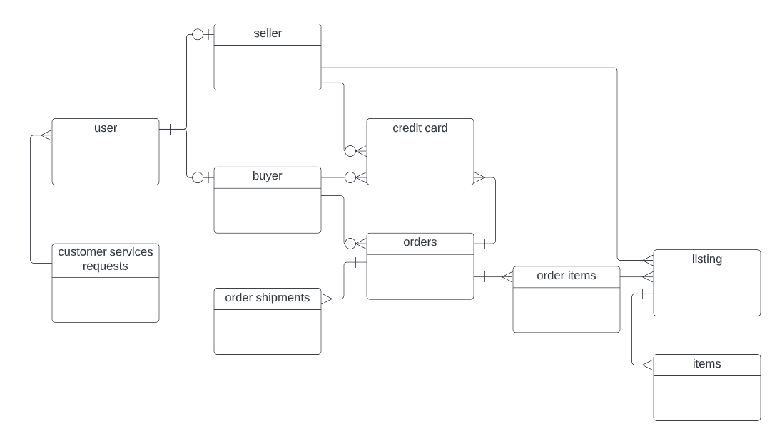
Conceptual Data Model of SneakerPark

Slide 7
Step 2
Enterprise Data Catalog Part 2: Metadata

Slide 8
Create the first version of the Metadata Catalog by documenting the metadata from all systems in the "Data Dictionary" and the “Enterprise Data Catalog” tabs of the provided Sheets template.
Please note that you are required to fill out all fields in both tabs.
Student’s note: The Solution sheet is in the zip file provided in the submission.

Slide 9
Step 3
Data Quality
Part 1: Profiling and Cleansing

Slide 10
Profile the data to identify at least 3 data quality issues you see in the data. Also provide at least 1 data quality issue that you haven’t yet seen in the data, but can foresee occurring in the future. Based on the issues you’ve identified, come up with the data quality rule for each data quality issue, including for the one that you foresee.
Make sure you fill out all columns in the "Data Quality Issues" tab with your answers in the provided Sheets template.
Student’s note: The Solution sheet is in the zip file provided in the submission.

Slide 11
Step 4
Data Quality
Part 2: Monitoring

Slide 12
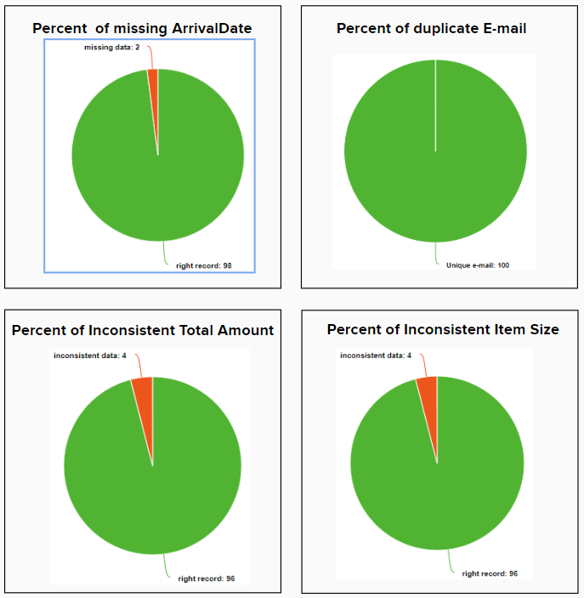
Using the metrics you've created in the last step, please create a mock-up of a data quality monitoring dashboard that will be used to monitor the data to ensure compliance with your data quality rules.
Please make sure to label your metrics clearly on your mock-up.
Monitoring Dashboard - Data Quality Metrics

Slide 13
Step 5
Master Data Management
Part 1: MDM Architecture

Slide 14
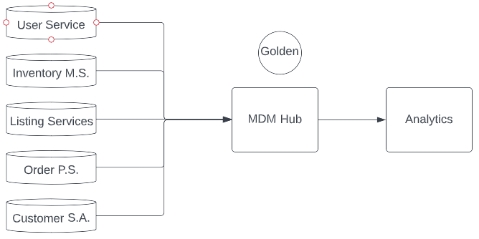
Based on what you’ve read about SneakerPark’s systems and business model, sketch out a proposed MDM implementation architecture, and write a detailed explanation of why you chose this specific approach.
Student’s Note: SneakerPark has its data distributed in a variety of sources. Those are: User Service, Inventory Management Service, Listing Services, Order Processing Service, and Customer Service Application. According to the Technical Details document, Inventory Managemente Service and Customer Service Application are largely isolated from the other systems and from each other. Given that, we should expect data inconsistencies across systems. Knowing that many of these systems carry business essential records, also known as master data, such as customer data, asset data and so on, there should be a master data management system in which golden records are generated. For the SneakerPark, the MDM system architecture should be Consolidated given nature of SneakerPark business the proposal has to be minimally disruptive. This is achieved with the Consolidated MDM because it won't affect existing source systems and also is not so expensive to implement.
MDM Architecture - Consolidated MDM

Slide 15
Step 6
Master Data Management
Part 2: Master Record

Slide 16
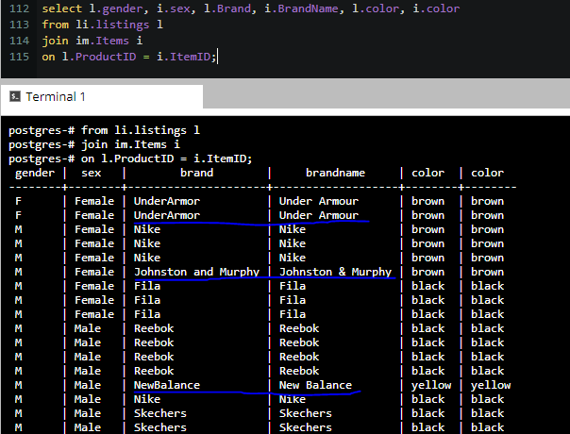
In this step, you will define a set of matching rules that will be used by the SneakerPark's MDM Hub to match item and customer entities between the company's different systems.
Items
Match the Brand Name of the Listing on the Listing Services System and the Brand Name of the Item from the Inventory Management Service System

Slide 17
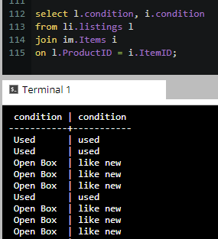
Items
Match the Condition of the Listing on the Listing Services System and the Condition of the Item from the Inventory Management Service System

Slide 18
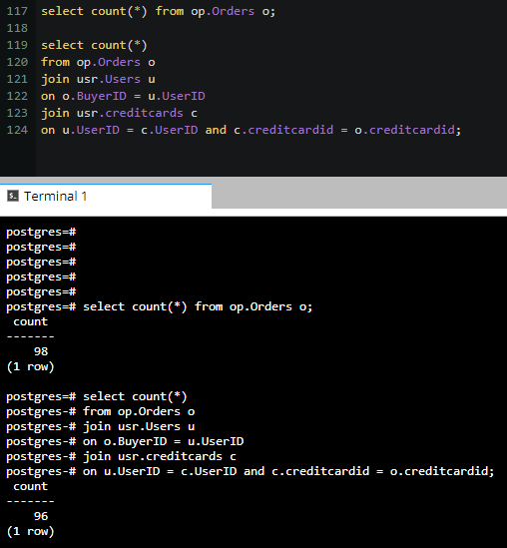
Customer
Match the CreditCard of the Buyer placing the Order from the Order Processing Service System and the CreditCard from the User of the User table joined with the Credit Card table from the User Service System.

Slide 19
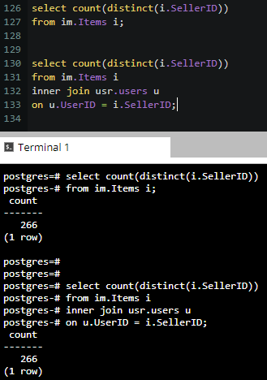
Customer
Match the SellerID from the Listing on the Listing Services System and the SellerID in the Item table from the Inventory Management Service System.

Slide 20
Step 7
Data Governance:
Roles and Responsibilities

Slide 21
Student’s note:
Data Steward
The Data Steward should be responsible for updating the data dictionary business context in the SneakerPark’s Metadata Management in case of either a new addition (tables or columns) as well as business description changes.
This role can be taken by Jessica as she already has business understanding of every part of the organization along with one new hire to join Jessica on this role because she already has another responsibilities. This way, Jessica can divide the workload with a new employee.
Data Architect
The Data Architect should be responsible for defining the workflow of the Data Quality Management and Metrics, as well as the Master Data Management architecture for the entire system, in order to find an automated and smart way to identify breaches and data quality issues.
This role can be taken by Daniel Freitas as he is a data architect that has a solid experience on building such platforms.
Data Engineer (ProdOps)
The Data Engineer focused on ProdOps will be responsible for providing IT production support on the Data Quality Management as well as the Master Data Management. Production support is key to keep consistency, accuracy and timeliness of the data.
SneakerPark can put Jake on that role as he has ownership of IT Support, therefore he already has expertise on handling such situations. However, Jake will have to go through a specialization on data matter to provide high standard support.

Slide 22
Standout Suggestions

Slide 23
Create a Business Glossary for SneakerPark and define common terms such as Item, Buyer, etc. Think and discuss how SneakerPark can improve on the consistency of the terms that its systems currently use. (You can use the “Business Glossary” tab of the same Sheets template you’ve been using for the other parts of this project to get you started.)
Document SneakerPark’s current naming conventions. Can you think of any improvements? (You can use the “Standard Naming Conventions” tab of the same Sheets template you’ve been using for the other parts of this project to get you started.) Some examples of Naming Conventions include;
Do not use spaces or special characters.
Use only LOWERCASE.
All identifier fields should end in “_id”.
Avoid acronyms and abbreviations.
Write SQL scripts for the matching rules that you’ve created in Step 6.

