Slide 1
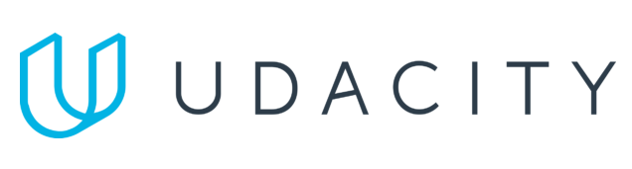
Data Lake Value Proposition
Medical Data Processing Company
Daniel Freitas
Udacity IPS Version 1.0
Notes:
Hi, I am Daniel, I am the data architect that will present the value proposition of a Data Lake platform for the Medical Data Processing Company.

Slide 2
Agenda
What is a Data Lake
Components of a Data Lake
Data Lake vs Data Warehouse
Business Value of Data Lake Solution
Proposed Data Lake Architecture for Medical Data Processing system
Udacity IPS Ver. 1 2/2020
Notes:
The agenda is as follows. First, I will talk about concepts related to a Data Lake. We will discuss in details what are the benefits of the Data Lake architecture and how it comes to solve the current issues of the existing solution. I will also talk about the diferences between data lake and data warehouse, along with the business value of it and at the end I will show the architecture of the new system

Slide 3
What is a Data Lake
Executive summary
Data Lake is a centralized place where all data objects from a company should reside. It allows multiple types of data formats as well as serve data to the end users such as business analysts and data scientists.
Notes:
We should start everything by defining a data lake system. Data Lake is a repository of data in which all the company’s data is placed. It is a central queryable source that provides data for Every componente that needs it, such as machine learning platforms as well as business analysts dashboards and visualization tools.
Data lake have become widely used across the industry because its type of storage is getting cheaper as day goes by, and that is relevant concern in the big data world since data is growing faster than it was in the past.

Slide 4
Components of Data Lake
Ingestion – entry point of data
Storage – where the data is stored
Processing – where the data is processed
Serving – where the users consume the data
Security– where the controls and audit are made
Scheduling – what orchestrates the flow
Notes:
The data lake consists of multiple entities.
The ingestion layer is the interface between external sources and the system itself. In our case it is responsible to acquire data from the medical facilities. In the ingestion layer it is important to enable different ways of to acquire data so that the external sources can input data for diferente business cases.
The storage is Where the data is actually kept. Usually the storage of a data lake allows multiple types of data structure. For instance, vídeos, pictures, raw text, tables and so on are acceptable. In our case, the types of text are CSV, TXT and XML defined by technical requirements.
The processing layer is responsible to deduplicate, clean the data and transform to put it in a usable format. This step matters because it enhances the data in many ways. To give some examples, in this part of the process , the data is put in enterprise standards to enable joins between diferente data objects.
The serving has the visualization tools as well as the Machine Learning tools. Through the serving layer the end user will be able to consult the data, to create dashboards and visualize patterns in order to drive insights. The machine learning enginges also connect to the data through a serving layer, extracting the data and running AI models on it.
Security controls access and also maintain logs for auditing purpose. However, it is out of the scope of this platform proposed.
Last but not least, the scheduling orchestrate the flow and execution across the entire data flow. Thus, any dependency management is handled by this componente.

Slide 5
Data Lake vs Data Warehouse
Notes:
Now let’s talk about the diferences between data lake and data warehouse solutions and why data lake fits perfectly for the medical data processing company.

Slide 6
Data Warehouse
Data Lake
Structured data only
Demands processing
Need to know the data beforehand
Optimized for query
Flexible
Multiple sources
Leverage Machine Learning
Cheap
Udacity IPS Ver. 1 2/2020
Notes:
Data warehouse is a reasonable architecture for transaction systems Where the data is structured, When the data is known beforehand and it usually also demands a lot of processing before consumption. Data warehouses are Applicable for companies that have to deal with structured tables with high consistency and high speed.
In the medical data processing company, the use case is slightly diferente. In that case, a data lake fits best When taking into account the technical and business requirements. Data warehouse wouldnt be a reasonable choice because, although it solves part of the company’s use cases, it does not solve for all.
For example, in our case, the data ingested have multiple formats other than structured, which requires flexibility. Flexibility is one of the highlights of a data lake as it allows many data formats. Data lake can stored data coming from a variety of sources.
Another thing to mention is that data lake leverages machine learning since it accepts multiple data formats. Then, it can serve the machine learning engine with the type of data it needs, without having to reprocessing.
Data lake type of storage has also become cheaper over the last years. therefore it is not so expensive to scale When compared to a data warehouse.

Slide 7
Business Value of Data Lake
Remove data silos
Fast data delivery
Leverage capability such as building Machine Learning models
Near real-time dashboards
Notes:
With a data lake infrastucture the medical data processing company will be able to remove the data silos of multiple teams having diferente patterns of data. With that in place, the data will be enhanced given that now all the data can connect together. Other than that, the access will be given to a unique place Where They will know all the data They need is there. Do not have to bother with getting data from multiple sources. The data lake already does that for you.
For example, without data silos, the end user is able to connect vacancy rooms in a medical facility with the finance sector and how that implies in savings.
Data will be timely delivered to the end users because of distributed processing, increasing performance taking advantage of big data tools.
The data lake will also serve data for machine learning models that wil provide additional insights for the business
The new approach will also leverage near real-time dashboards and analytics because of the streaming capability addition
The real time capability opens a lot of possibilities, such as having a live dashboard of urgent cares needs . Deliver right data timely is crucial When dealing with peoples life.

Slide 8
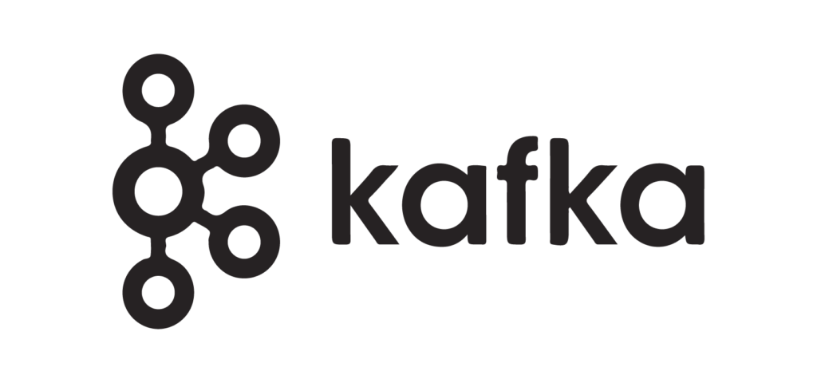

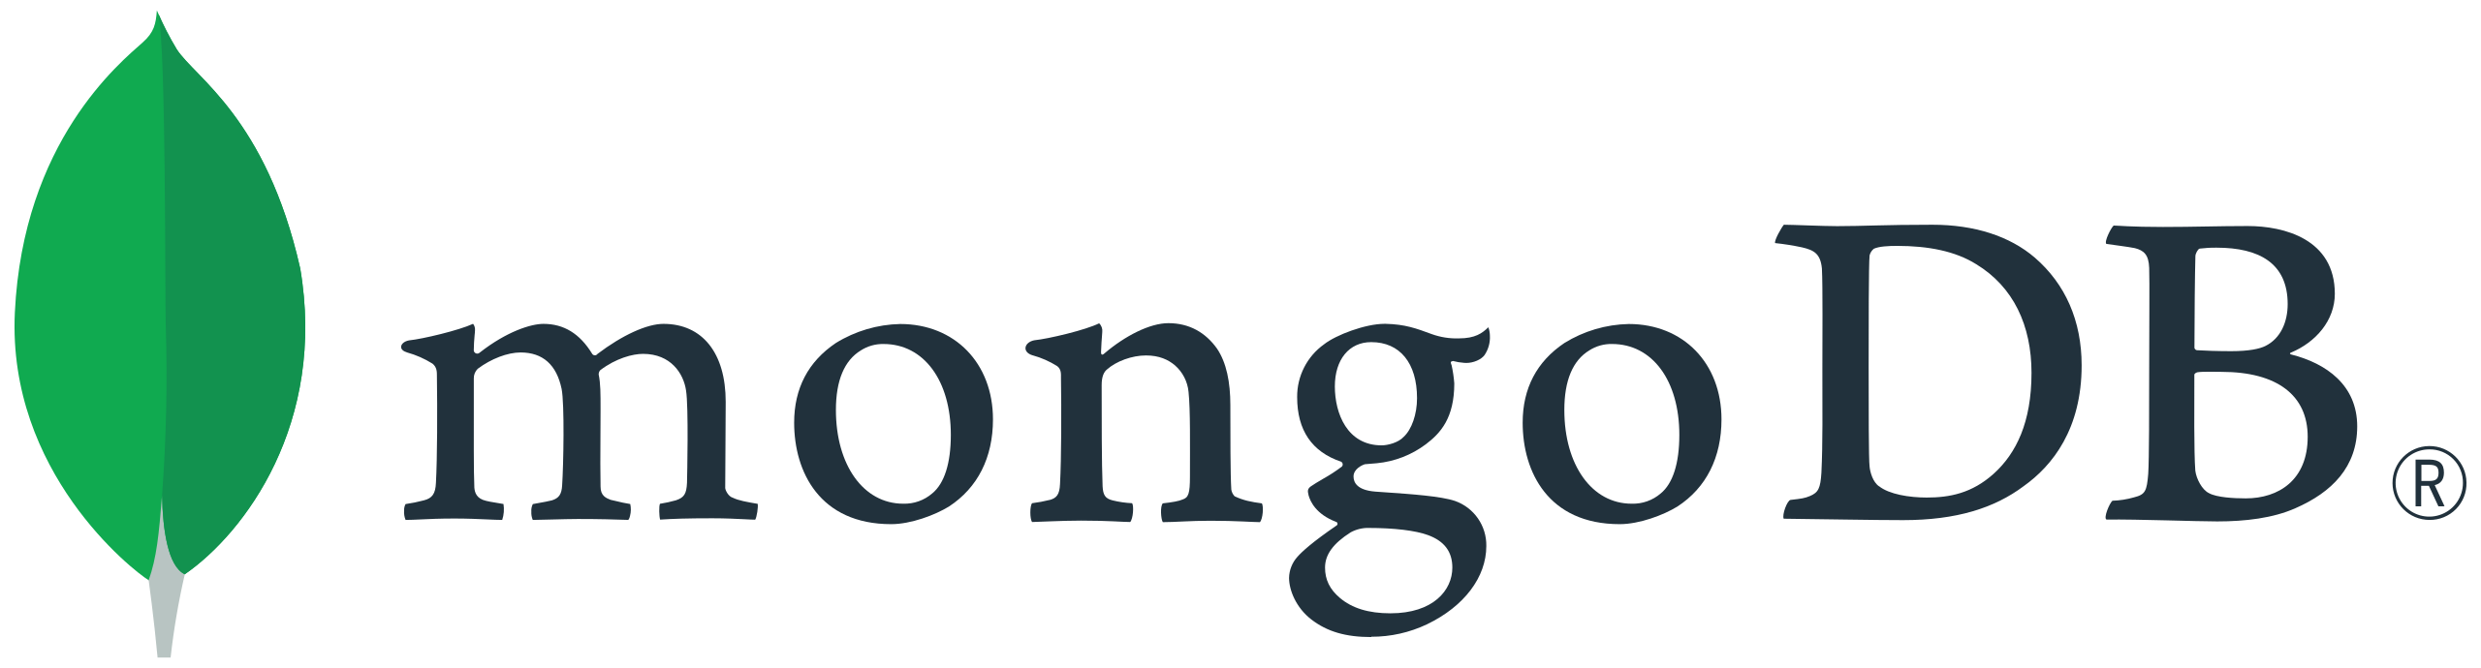
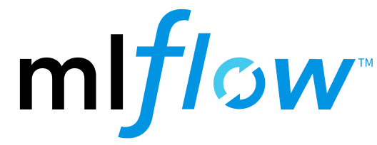

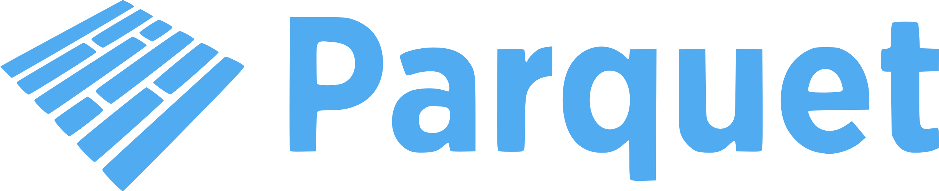
Embrace open-source
Notes:
On this architecture we are embracing open-source solutions with the intent of following industry standards and also avoid vendor lock-in.
To mention some of them, in this project we are using mongoDB for metadata storage,apache kafka for real time processing, apache spark for distributed processing, mlflow for ml pipelines, parquet as an open data format,
Apache iceberg for CDC and upsert capability.

Slide 9
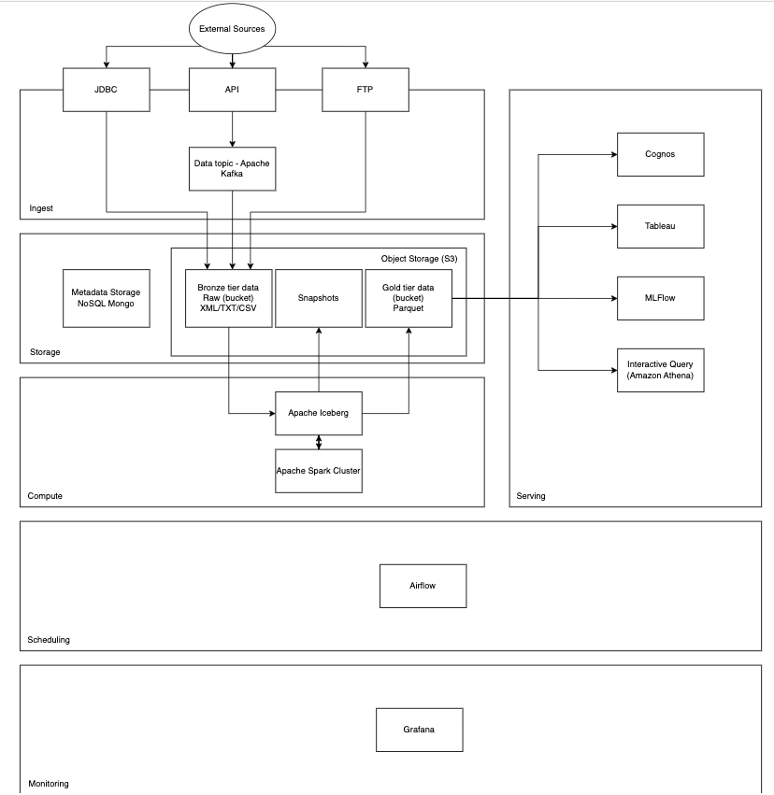
Data Lake Architecture
Notes:
In this slide there is a thorough diagram of the data lake architecture proposed as an alternative of the existing solution.

Slide 10
THANK YOU
Udacity IPS Version 1.0

