Slide 1


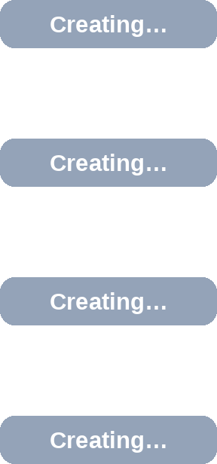
Challenge 3 · Never Ready
Nothing marks the composed resources Ready, so the XR stays not Ready.
aws
AWS Account
EKS Cluster
argo
Applications
APPLICATIONS TILES
AWS
▣ Applications
⧉ ApplicationSets
⚙ Settings
checkout
SYNC
REFRESH
DELETE
★
Project: team-payments
Status:
♥
Healthy
Synced
◌ Progressing ✓ Synced
✓
Path: apps/checkout
S3
Bucket
composed resource
XR
IAM
Role
composed resource
MyApp
Ready: False
IAM
Policy
composed resource
IAM
Attachment
composed resource

Slide 2

Challenge 3 · Never Ready
Nothing marks the composed resources Ready, so the XR stays not Ready.
aws
AWS Account
EKS Cluster
argo
Applications
APPLICATIONS TILES
AWS
S3
▣ Applications
⧉ ApplicationSets
⚙ Settings
checkout
SYNC
REFRESH
DELETE
★
Project: team-payments
S3 bucket
Status:
♥
Healthy
Synced
◌ Progressing ✓ Synced
✓
IAM
Path: apps/checkout
S3
Bucket
composed resource
Ready ✓
IAM role
XR
IAM
Role
composed resource
Ready ✓
MyApp
Ready: False
IAM
Policy
composed resource
IAM
Attachment
composed resource

Slide 3
Challenge 3 · Never Ready
Nothing marks the composed resources Ready, so the XR stays not Ready.
aws
AWS Account
EKS Cluster
argo
Applications
APPLICATIONS TILES
AWS
S3
▣ Applications
⧉ ApplicationSets
⚙ Settings
checkout
SYNC
REFRESH
DELETE
★
Project: team-payments
S3 bucket
Status:
♥
Healthy
Synced
◌ Progressing ✓ Synced
✓
IAM
Path: apps/checkout
S3
Bucket
composed resource
Ready ✓
IAM role
XR
IAM
IAM
Role
composed resource
Ready ✓
MyApp
IAM policy
Ready: False
IAM
Policy
composed resource
Ready ✓
IAM
IAM
Attachment
composed resource
Ready ✓
policy attachment

Slide 4
Challenge 3 · Never Ready
Nothing marks the composed resources Ready, so the XR stays not Ready.
aws
AWS Account
EKS Cluster
argo
Applications
APPLICATIONS TILES
AWS
S3
▣ Applications
⧉ ApplicationSets
⚙ Settings
checkout
SYNC
REFRESH
DELETE
★
Project: team-payments
S3 bucket
Status:
♥
Healthy
Synced
◌ Progressing ✓ Synced
✓
IAM
Path: apps/checkout
S3
Bucket
composed resource
Ready ✓
$ kubectl get myapp checkout
IAM role
XR
NAME SYNCED READY AGE
IAM
Role
composed resource
checkout True False 30m
IAM
Ready ✓
MyApp
IAM policy
Ready: False
IAM
Policy
composed resource
Ready ✓
IAM
IAM
Attachment
composed resource
Ready ✓
policy attachment

Slide 5
Challenge 3 · Never Ready
Nothing marks the composed resources Ready, so the XR stays not Ready.
aws
AWS Account
EKS Cluster
argo
Applications
APPLICATIONS TILES
AWS
S3
▣ Applications
⧉ ApplicationSets
⚙ Settings
checkout
SYNC
REFRESH
DELETE
★
Project: team-payments
S3 bucket
Status:
♥
Healthy
Synced
◌ Progressing ✓ Synced
✓
IAM
Path: apps/checkout
S3
Bucket
composed resource
Ready ✓
$ kubectl get myapp checkout
IAM role
XR
NAME SYNCED READY AGE
IAM
Role
composed resource
checkout True False 30m
IAM
Ready ✓
Pipeline mode: a function must mark each composed resource ready. None did → the XR is never Ready and Argo CD waits forever
MyApp
IAM policy
Ready: False
IAM
Policy
composed resource
Ready ✓
IAM
IAM
Attachment
composed resource
Ready ✓
policy attachment

