Slide 1
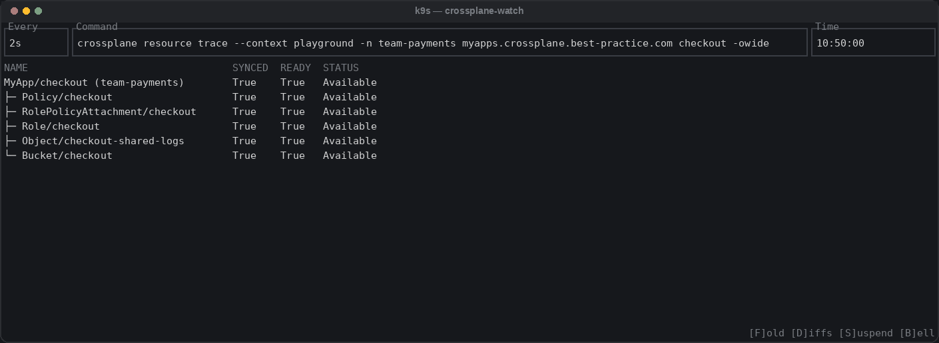
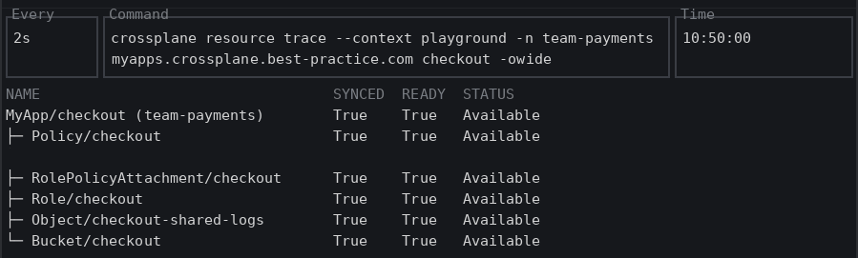
Inspect it live – crossplane resource trace
On a live cluster: the whole MyApp tree, and where it is stuck, in one command
crossplane resource trace
$ crossplane resource trace \
myapps.crossplane.best-practice.com/checkout -n team-payments
NAME SYNCED READY STATUS
MyApp/checkout (team-payments) True True Available
├─ Policy/checkout False True ReconcileError…
├─ Policy/checkout True True Available
├─ Policy/checkout True True Available
├─ RolePolicyAttachment/checkout True True Available
├─ Role/checkout True True Available
├─ Object/checkout-shared-logs True True Available
└─ Bucket/checkout True True Available
myapp.yaml · the order
1 apiVersion: crossplane.best-practice.com/v1alpha1
2 kind: MyApp
3 metadata:
4 name: checkout
5 namespace: team-payments
6 spec:
7 team: payments
8 region: us-east-1
9 extraPolicyActions:
10 - s3GetObjectTagging # typo – no "s3:" prefix
10 - s3:GetObjectTagging # fixed

Slide 2
Inspect it live – crossplane resource trace
On a live cluster: the whole MyApp tree, and where it is stuck, in one command
k9s · crossplane-watch
k9s plugin · plugins.yaml
crossplane-watch:
shortCut: Shift-V
confirm: false
description: "Crossplane Watch"
scopes:
- all
command: sh
background: false
args:
- -c
- |
if [ -n "$NAMESPACE" ]; then
viddy -pw 'crossplane resource trace --context $CONTEXT
-n $NAMESPACE $RESOURCE_NAME.$RESOURCE_GROUP $NAME -owide'
else
viddy -pw 'crossplane resource trace --context $CONTEXT
$RESOURCE_NAME.$RESOURCE_GROUP $NAME -owide'
fi

