Slide 1
TWITTER TOPIC SUMMARIZATION USING SPEECH ACTS
DINESH V B(2010103037)
DANIEL SAM PETE T(2010103065)
GOPINATHAN A(2010103620)
(GUIDED BY)
DR.A.P.SHANTHI
(Associate Professor, DCSE)

Slide 2
INTRODUCTION
As we all know that twitter is one of the popular micro-blogging sites. According to a survey report, twitter spews out over 200 millions tweets per day.
It consists of thousands of tweets on each topics. As a human being we can’t simply go through all the tweets on a specific topic.
In this context, where our project helps the user to go through the tweets and give a brief summary on the given topic by simply entering the topic name you are interested in.

Slide 3
ABSTRACT
In a micro-blog such as twitter there is a wide array of tweets on each topic of interest according to the user. The tweets can be a part of a conversation, express opinions and suggestions and may notify of a change of events in the current trend and may be even filled with noise.
In order to enable users to quickly view a summary about a topic searched, a system is proposed in which it involves two major steps.

Slide 4
ABSTRACT Cntd...
1.Speech-act based classification of the tweets
2.Generating the summary with the classified tweets

Slide 5
Objectives
Get a information-rich summary of the topic searched for by clearing out noise and using information rich tweets.
Get a lucid and coherent summary based on the relevance of the tweets.

Slide 6
Speech Acts:
Searle’s Types | Our Types | Example Tweets
Assertive | Statement | Libya Releases 4 Times Journalists http://www.photozz.com/?104k
Directive | Question | #sincewebeinghonest why u so obsessed with what me n her do?? Don’t u got ya own man??? Oh wait…
 | Suggestion | RT @NaonkaMixon: I will donate 10$ to the Red Cross Japen EarthQuake fund for every person that retweet this! #PRAYFORJAPAN
Expressive | Comment | is enjoying this new season of #CelebrityApprentice… Nikki Taylor=Yum!!
Commissive | Miscellaneous | 65. I want to get married to someone I meet in highschool. #100factsaboutme
Declarative

Slide 7
Why use Speech Acts
To exclude information deficient tweets so as to not bring into the summary ie.to neglect a majority of the tweets.
Extraction of Information is easier

Slide 8
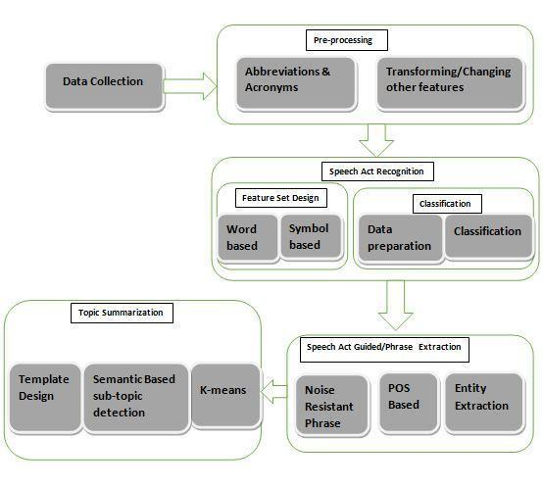
SYSTEM

Slide 9
SYSTEM(CONT..)
Data Collection:
Using Twitter Api to get the tweets which are used for our Topic Summarization
Preprocessing
a) Abbreviations and acronyms:
A module in which abbreviation of all acronyms which are used in social networking sites like im, 4ever etc is done.
b) Transforming/Changing other features:
Translated into lower cases
Email addresses,urls are removed and tagged
Emoticons are looked up with the database and tagged
Unwanted characters are removed(excess of full stops).

Slide 10
SYSTEM(CONT..)
Speech act Recognition
Feature Set Design:
a)Word based features:
1. Cue Word:
If the sentence is properly formed, the sentence would be pos tagged and depending on specific grammatical rules, which is highly likely would also help to enhance the classifier.<state as a verb>
A BOW<Bag of Words> features set
Unigrams, bigrams, trigrams

Slide 11
SYSTEM(CONT..)
2.Non Cue Word
Abbreviations and acronyms commonly used on the internet like “tq”,”4ever” etc.
Emoticons
Vulgar word
These could enhance the classifiers ability to classify correctly.
b)Symbol based features:
“?” , ”!” , Twitter Specific symbols are RT (Retweet), @ (directed towards a person through acts of dialogue), # (denotes a topic or comment).A RT strongly indicates the presence of a statement.

Slide 12
SYSTEM(CONT..)
Classification Evaluation:
a)Data Preparation
An Annotated data set for a supervised classification algorithm is used.
b)Classification:
A module in which tweets are classified in each topic using different feature sets employing SVM algorithm using a linear kernel or logistic regression .
A cross validation is done and a feature set is mixed up and used to see which feature set is the best and removal of redundant features.

Slide 13


LOGISTIC REGRESSION
The hypothesis function for LR is
Where x(i) stands for the feature vector for the ith tweet
The sigmoid function g(x) is as follows

Slide 14

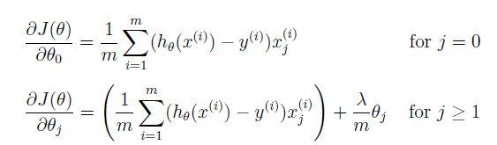
The cost function J(o)
Vectorizing Gradient

Slide 15
SYSTEM(CONT..)
Speech act guided keyword/phrase extraction
a)Noise Resistant Phrase Extraction
In this module we try to extract key words and phrases from the tweets of major speech act types after removing stop words. A list of stop words are collected from an online resource. Then all the less informative words are removed and n grams are extracted.

Slide 16
SYSTEM(CONT..)
b)POS based Phrase Extraction
statement-relevant word - noun, or ‘/N/’, phrase is a noun phrase, such as ‘/Adj/ /N/’(e.g., high quality) and ‘/Adj/ /N/ /N/’ (e.g., sexual abuse charges).
comment-relevant POS patterns (statement relevant)Have atleast one opinion word (e.g., good thing) judged from SentiWordNet and the compilation of words.
suggestion-relevant word - verb, or ‘/V/’ (e.g., hate), phrase is verb-centered, such as ‘/Adv/ /V/’ (e.g., truly wish) and ‘/V/ /N/ /N/’ (e.g., sell health drugs).
Question-relevant word - a verb or a noun, or (/‘N’/ /‘V’/) (e.g.,reason), noun phrase or a verb-centred phrase, such as ‘/Adj/ /N/ /N/’ (e.g., dirty ass mirror).

Slide 17
SYSTEM(CONT..)
c)Entity Extraction
The basic entities like person, place, organization needs to be recognized. The entities are recognized and extracted in each of the tweets using templates and using nltk package.

Slide 18
SYSTEM(CONT..)
Topic Summarization:
a)Semantic-based subtopic detection:
Dynamic Topic Model to capture subtopics in the tweet stream.

Slide 19
SYSTEM(CONT..)
b) k-means:
A summarization algorithm is used to summarize all the sentences so far extracted from the text based on global relevance, crowd endorsement ,Word Sentence Score, Keyword Score, Ngram score and IDF score. K means algorithm is used so as to remove out similar set of tweets and it is able to give out a summary.
.

Slide 20
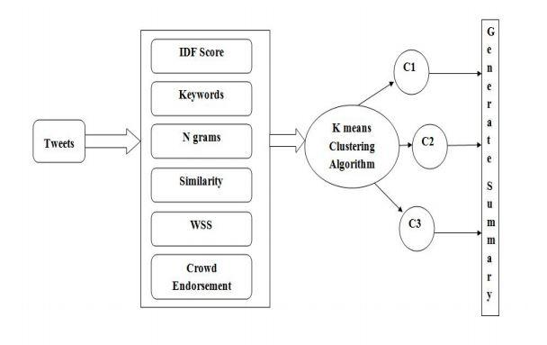
k-means

Slide 21

Crowding Endorsement Score:
Keyword Score:
0.2 is added for each keyword
N Gram Score:
0.4 is added for each n gram(bi gram and tri gram)

Slide 22

Global Relevance Score:
IDF Based Score:
Novel features are found out
IDF scores are normalised
WSS(Word Sentence Score):
WSS(Si)=0.1+1/(TF ALL(Si))

Slide 23
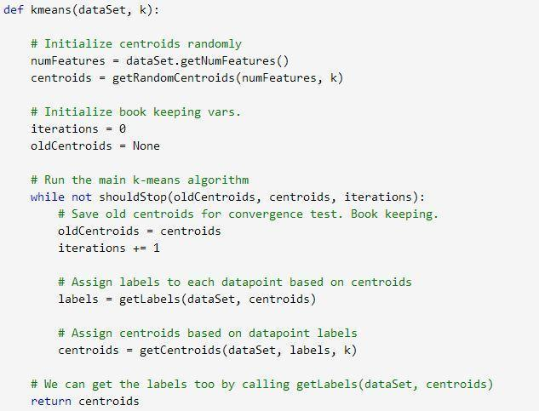
K-means algorithm

Slide 24
System(Cont..)
c)Template Design:
Insert the information so far gathered and putting them in slots of a basic template .

Slide 25
Issues & Challenges:
Redundancy of Information
Noisy Data
Adultered Information
Rhetorical Questions

Slide 26
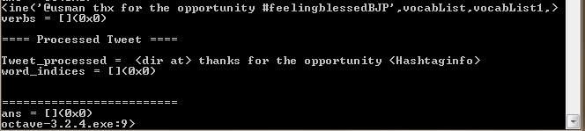
Screenshots
Preprocessing:

Slide 27
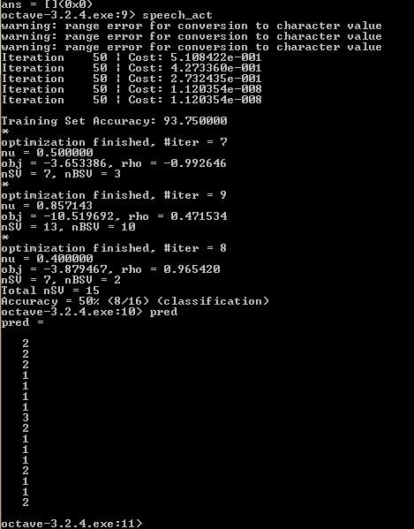
Screenshots Cntd..
Speech Act

Slide 28
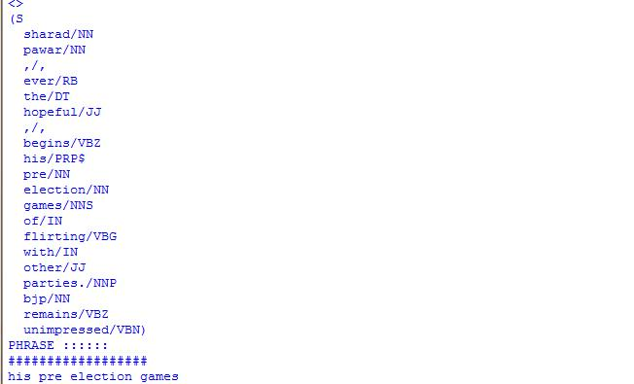
Screenshots Cntd..
Phrase Extraction

Slide 29
Screenshots Cntd..
Summary:

Slide 30
Evaluation
Manual Checking
The summaries generated are manually checked for correctness.
Classification Evaluation
i. Preparation
A suitable data set for a supervised classification algorithm is used.

Slide 31
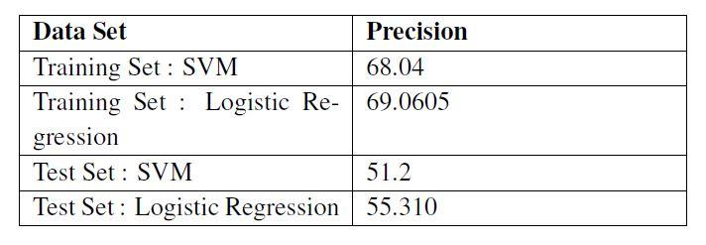
Evaluation Cntd...
ii. Classification
Precision scores are calculated to find out the effectiveness of the summary.

Slide 32
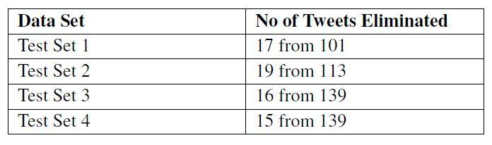
Evaluation Cntd...
iii) Summarization

Slide 33
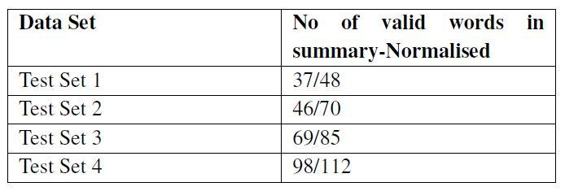
Evaluation Cntd...
iii)Summarization

Slide 34
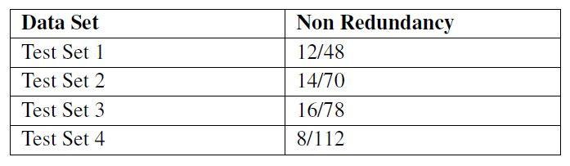
Evaluation Cntd...
iii)Summarization

Slide 35
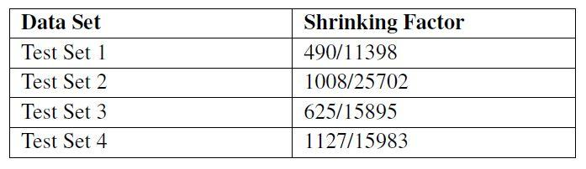
Evaluation Cntd...
Measure of shrinking

Slide 36
Thank You !!

