Slide 1


Moo 1.0 – A UMass Version Wireless Identification Sensing Platform
Department of Computer Science
University of Massachusetts, Amherst
Hong Zhang
Lab of PRISMS, Department of Computer Science,
University of Massachusetts, Amherst

Slide 2
Contents
1. How does Moo 1.0 work?
2. What are Moo 1.0’ kernels?
3. What will do in the future?

Slide 3
Contents
1. How does Moo 1.0 work?
2. What are Moo 1.0 kernels?
3. What can do in the future?

Slide 4
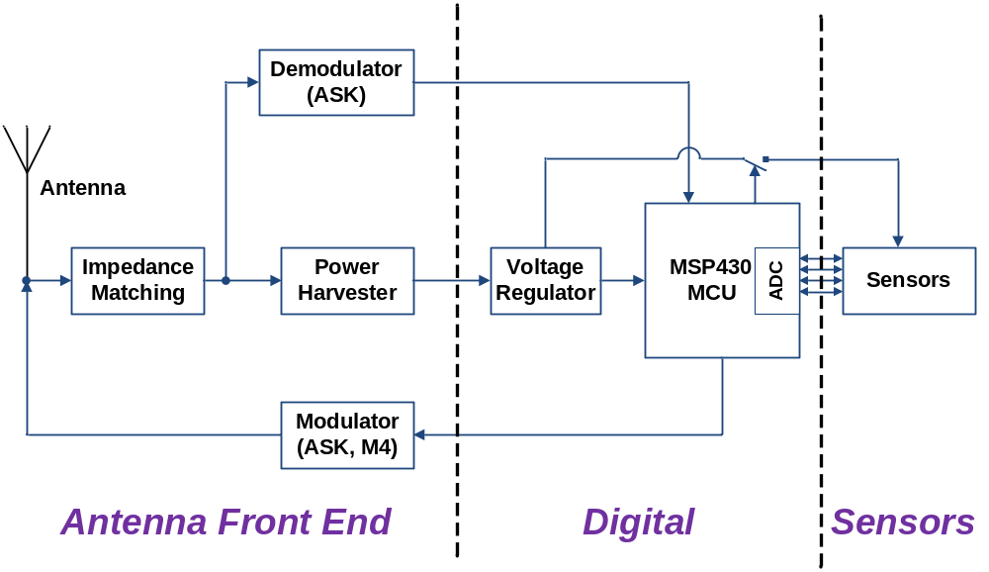
1. How does Moo 1.0 work?
Block Diagram
Notes:
Passive wireless microsystems can be loosely classified into categories:
near-field-coupled: d < wavelength/(2pi), f = 916MHz, wavelength = 32.8cm, d < 5.2cm; magnetic (inductive) coupling, input voltage is typically large enough;
far-field-coupled: d > wavelength/(2pi); back scattering (Reflecting the energy back to respond) data encoded by Miller sub-carrier with M=4, capacitive coupling, input voltage is significantly smaller.

Slide 5
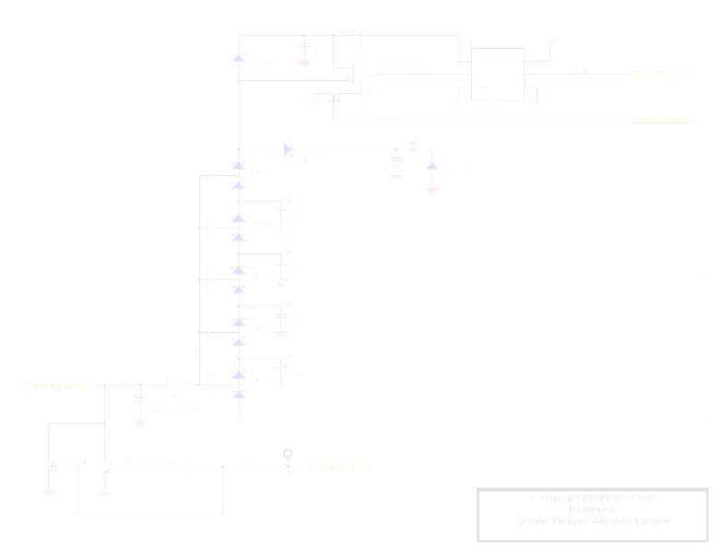
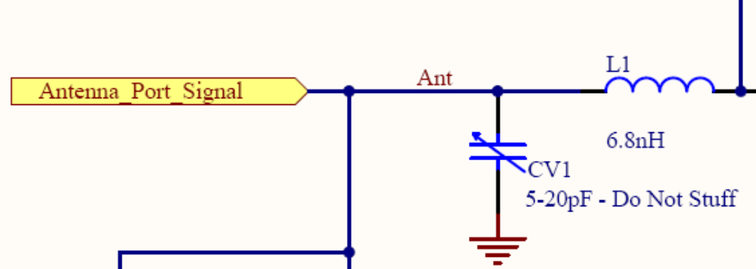
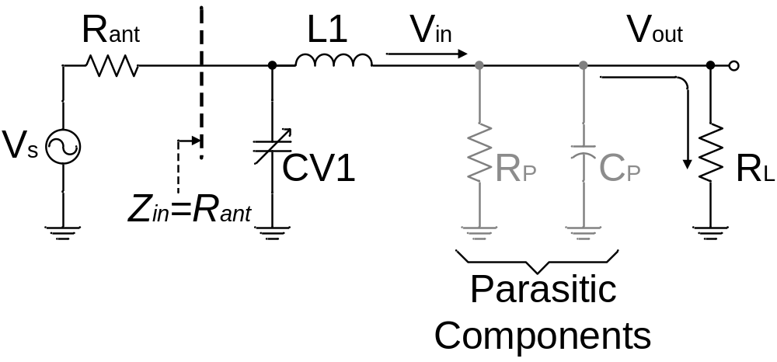
1. How does Moo 1.0 work?
Impedance Matching
Notes:
Rant of Moo is ~ 70 ohm + a little (-j)
CV1, L1 are non-dissipative components.
[1]Ping Zhao, Thomas Hollstein and Manfred Glesner. “Analysis on Power Harvesting Circuits with Tunable Matching Network for Improved Efficiency”
[2] A. Shameli, A. Safarian, A. Rofougaran, M. Rofougaran and F. D. Flaviis, “Power Harvester Design for Passive UHF RFID Tag Using Voltage Boosting Technique,” IEEE Trans. Microw. Theory Tech., Vol. 55, no. 6, pp. 1089-1097, June 2007.

Slide 6
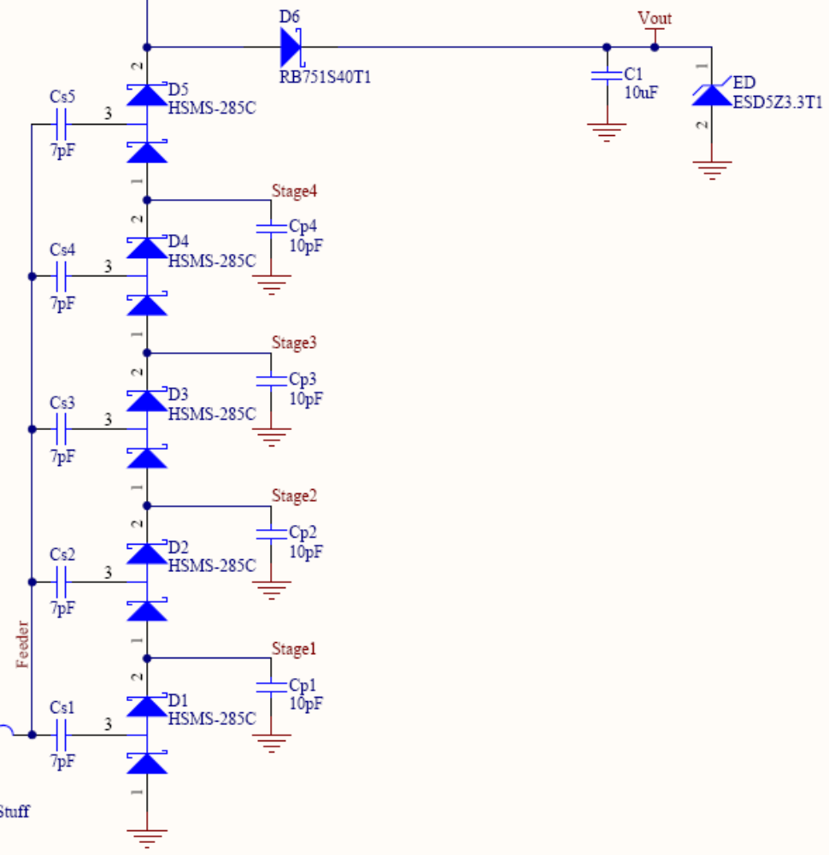
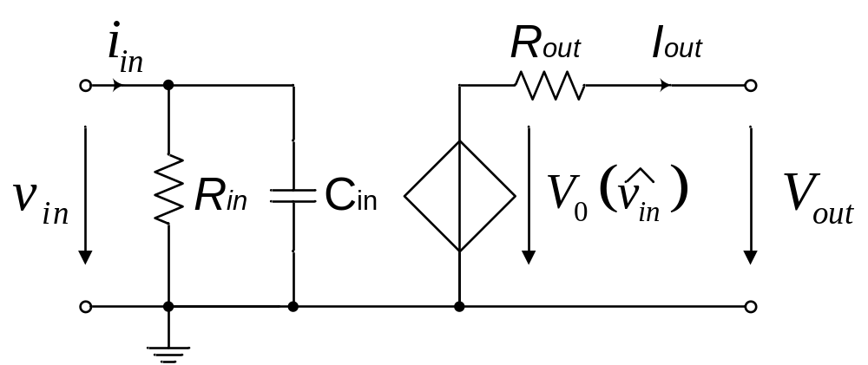
1. How does Moo 1.0 work?
Power Harvester
Notes:
In an idea Steady-state model

Slide 7
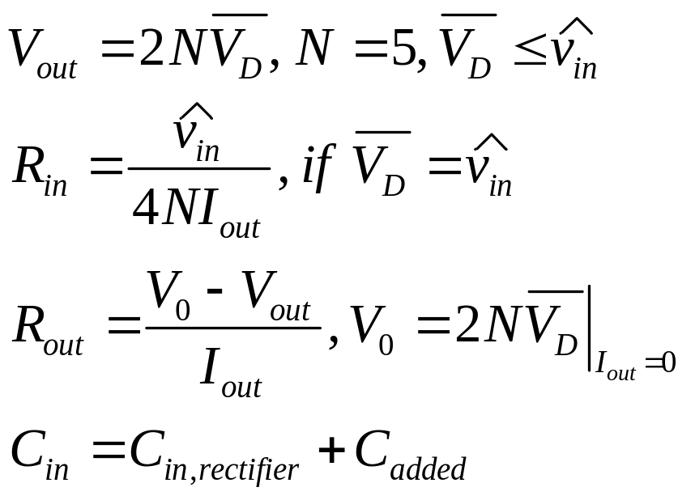
1. How does Moo 1.0 work?
Power Harvester
Notes:
If the transistors are ideal (or the diodes are identical, 0 reverse current, 0 forward voltage drop), V_{D} = amplitude of V_{in}
Cin, rectifier is the mean capacitance of measured C-V curves over one period of signal using the steady-state voltage solution, where V = V_{D}+V_{in}*sin(wt)
Cadded is the capacitor of summing RF input pad capacitors and layout capacitors
Moo: HSMS285C: forward voltage drop 150mV ~ 250mV, C_{D} = 30pF
[3] J.-P. Curty, N. Joehl, F. Krummenacher, C. Dehollain and M. J. Declercq, ”A Model for u-Power rectifier Analysis and Design,” IEEE Trans. Circuits Syst. I, Reg. Papers, Vol. 52, no. 12, pp. 2771-2779, Dec. 2005.

Slide 8
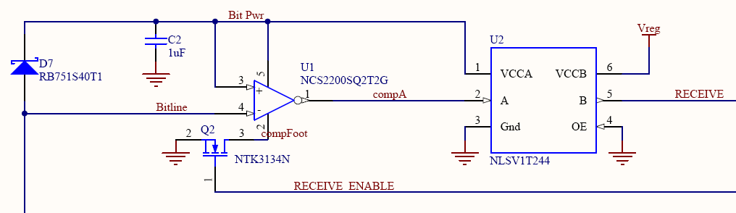
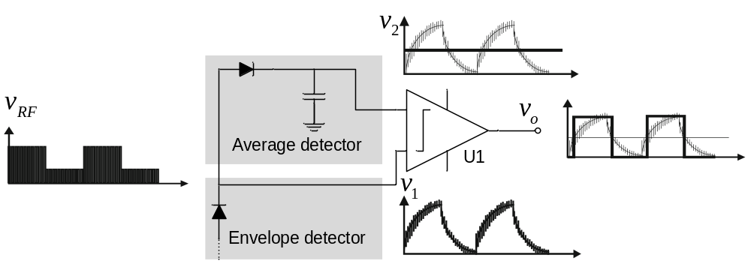
1. How does Moo 1.0 work?
Demodulator (ASK – Amplitude-Shift Keying)
Notes:
NLSV1T244: 1-Bit Dual-Supply Non-Inverting Level Translator

Slide 9
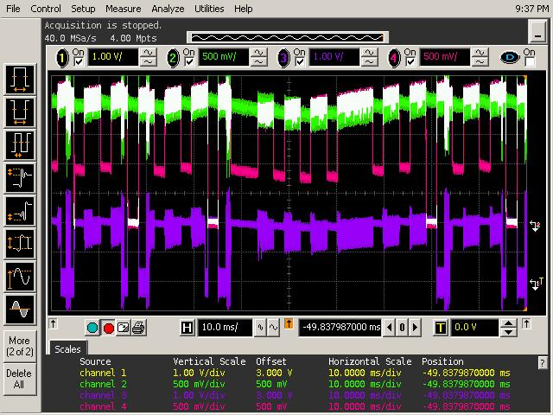
1. How does Moo 1.0 work?
Demodulator (ASK – Amplitude-Shift Keying)
Green: Bit Power
Pink: Bit Line
Purple: CompA
Notes:
Using Comparators with Schmitt Triggers with Hysteresis to effectively eliminate the uncertainty

Slide 10
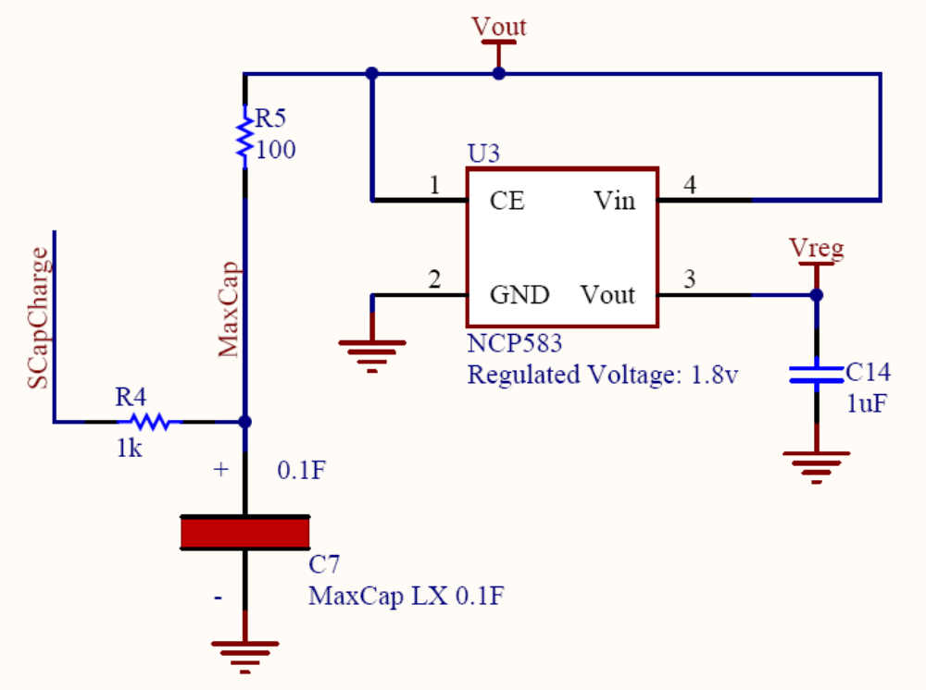
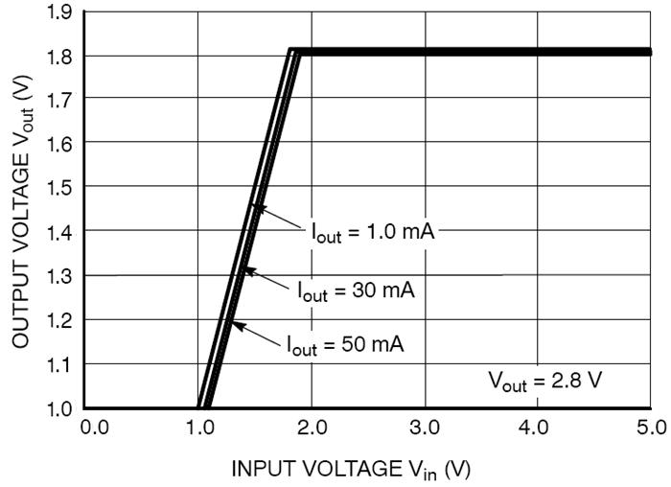
1. How does Moo 1.0 work?
Voltage Regulator

Slide 11
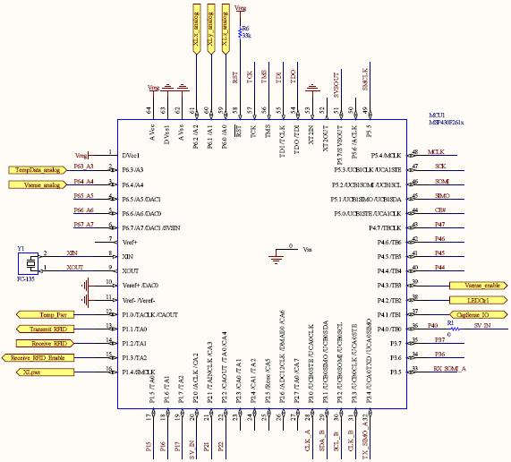
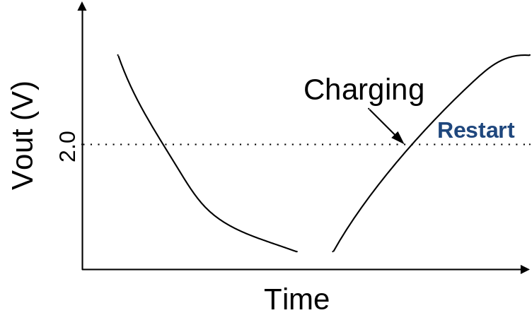
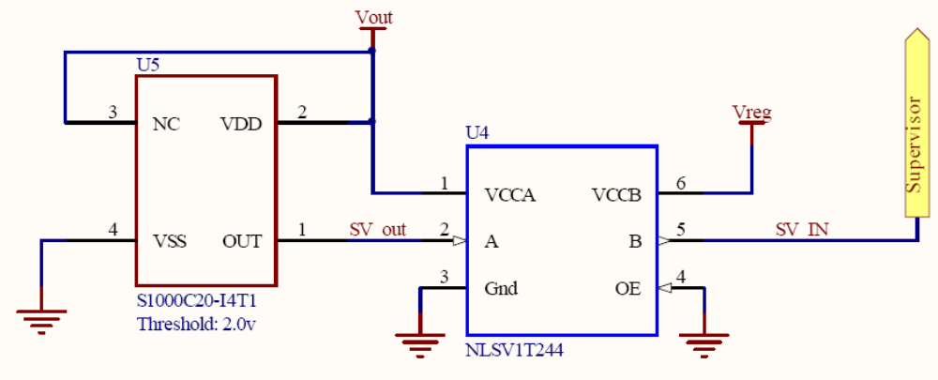
1. How does Moo 1.0 work?
MSP430 Micro-Controller
Notes:
When charging voltage is higher than 2.0v, the supervisor triggers to restart the MCU. Nothing to do when the voltage drops below 2.0v until MCU dies.

Slide 12
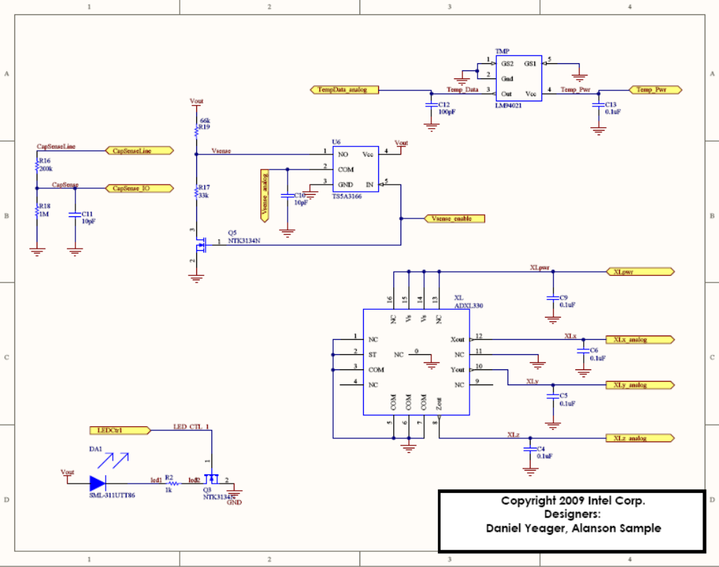
1. How does Moo 1.0 work?
Sensors
For external Sensor
Temperature Sensor
Voltage Sensor
LED
Accelero-meter
Notes:
1. TS5A66 is a 0.9Ohm analog switch, IN controls the connection between NO and COM

Slide 13
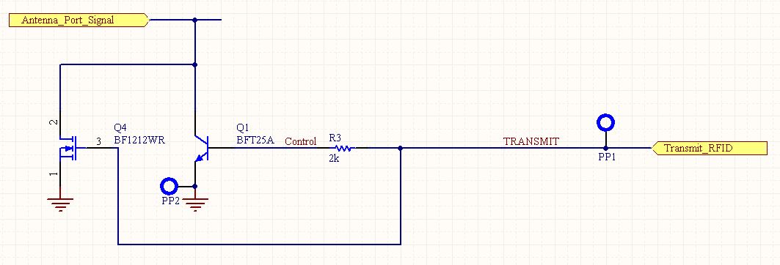
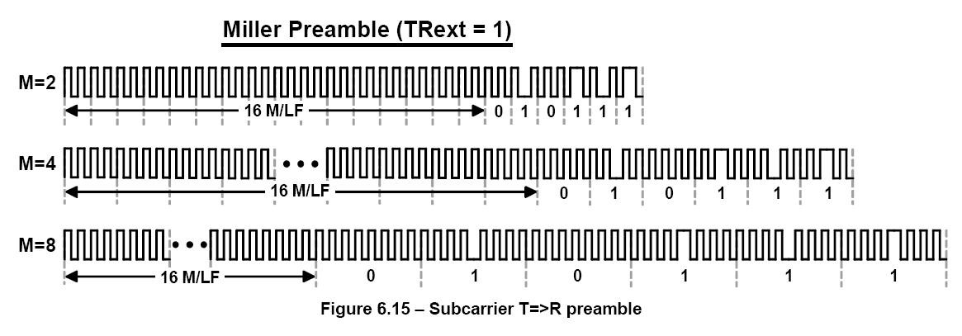
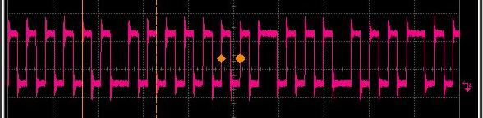
1. How does Moo 1.0 work?
Modulator (ASK, M=4)
Notes:
The width of pulse is 2us or 4us. One bit is about 16.3us. Thus, the data rate is about 61.2kbps.
We use Miller modulation with M=4 to encode the data transmit to RFID reader
[4] Alanson P. Sample, Daniel J. Yeager, Pauline S. Powledge, and Joshua R. Smith. “Design of a Passively-Powered, Programmable Sensing Platform for UHF RFID Systems”.

Slide 14
Contents
1. How does Moo 1.0 work?
2. What are Moo 1.0 kernels?
3. What can do in the future?

Slide 15
2. What are Moo 1.0 kernels?
MCU: MSP430F2618
MCU |  | MSP430F2618
Package |  | 64-PIN QFP
Memory Size | Flash | 116KB+256B
 | RAM | 8KB
Power Consumption | Supply Voltage | 1.8V to 3.6V
 | Active Mode | 365uA@1MHz, 2.2V
 | Standby Mode | 0.5uA
 | Off Mode | 0.1uA
Architecture |  | 16-Bit RISC Architecture 62.5ns Instruction Cycle Time 32-kHz Crystal 12-bit ADC/DAC
ADC | Supply Voltage | 2.2V ~ 3.6V
 | Supply Current | 0.65mA@2.2V, 0.8mA@3V

Slide 16
2. What are Moo 1.0 kernels?
Memory: External Flash
Type # | SST25WF040
Description | On Moo 1.0
Memory Size | 4M (512K x 8)
Speed | <= 20MHz
Supply Voltage | 1.65v ~ 1.95v
Active Current | 2mA @ 20MHz
Standby Current | 2uA
Interface | SPI Compatible: Mode 0 and Mode 3
R/W/E time | Byte program (Byte Write): 50us Chip-erase: 125ms Block-erase: 62ms
Package | 8-lead SOIC (150 mils)
Size | LxW = 5.80mm x 5.00mm

Slide 17
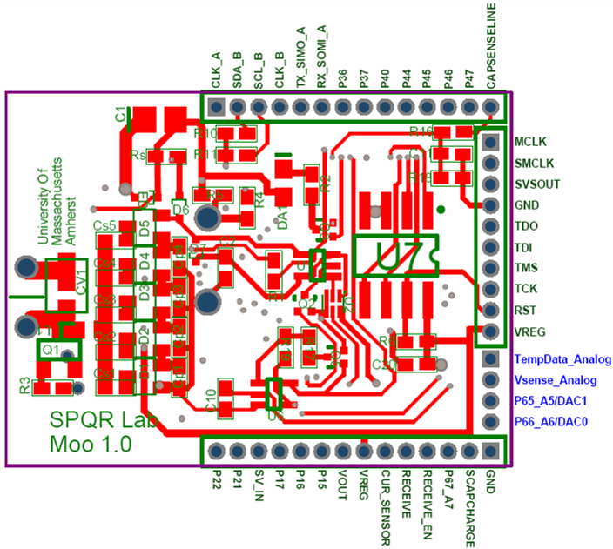
2. What are Moo 1.0 kernels?
42 I/O Ports: GPIOs, ADC/DAC, SPI buses

Slide 18
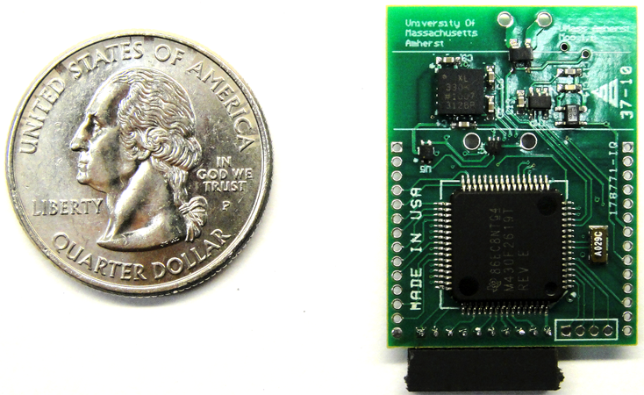
2. What are Moo 1.0 kernels?
Size: Moo 1.0 vs a quarter dollar coin

Slide 19
2. What are Moo 1.0 kernels?
Some estimation about power consumptions
  When Moo 1.0 is about 1.3ft from RFID reader, the power harvester can harvest about (3V)^2/(12.65kOhm) = 0.7mW. The current is about 237uA.
  When the 10uF capacitor is fully charged, it has a voltage of about 5.4V. Before the voltage of it drops to 3V, it can provide (5.4^2-3^2)/2*10^(-5) = 0.1mJ
  When Moo 1.0 works actively and ADC is converting, the power consumed is about 3V*(365uA+0.8mA) = 3.5mW
  With a full charged capacitor and harvesting from RFID reader at 1.3ft above, a rough estimation of continuous work time of Moo 1.0 is: 0.1mJ/(3.5mW-0.7mW)=35.7ms
  Without harvesting, the work time is: 0.1mJ/3.5mW = 28.6ms

Slide 20
Contents
1. How does Moo 1.0 work?
2. What does Moo 1.0 improve?
3. What can do in the future?

Slide 21
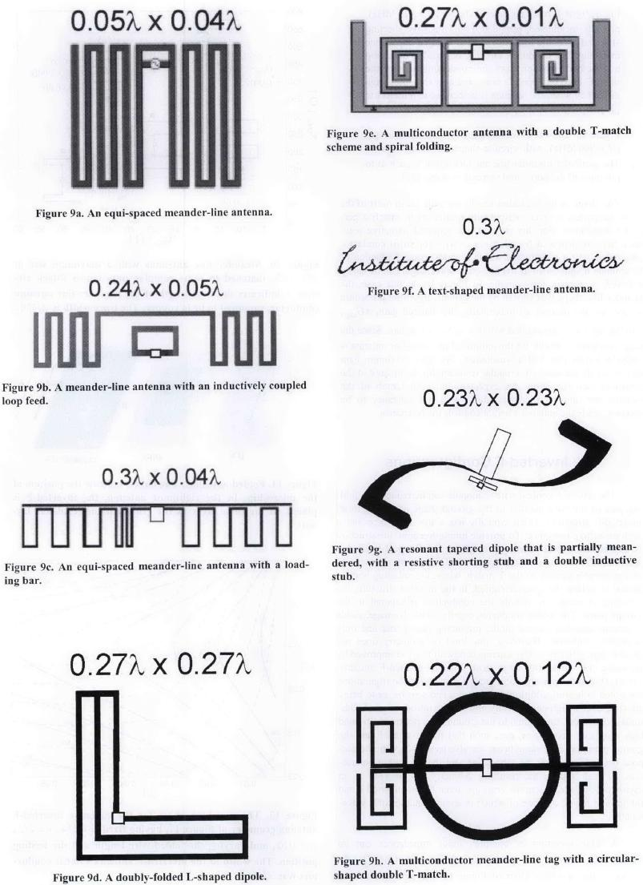
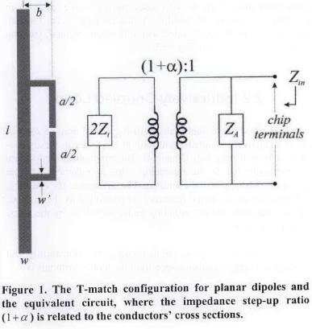
3. What can do in the future?
Antenna shape
  Dipolar vs Meander

Slide 22
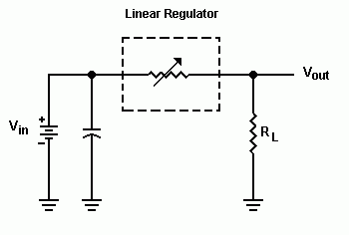
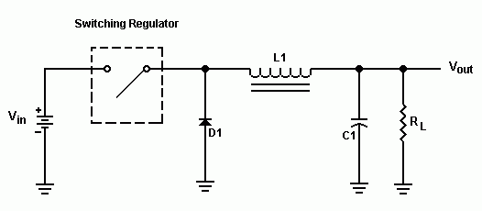
3. What can do in the future?
Regulator
  Linear vs Switch
Notes:
The primary advantage of a switching regulator is very high efficiency (80% ~ 95%), a lot less heat and smaller size.
1. The linear regulator is really nothing more than a variable resistor. The resistance of the regulator varies in accordance with the load resulting in a constant output voltage.
2. The switching regulator is really nothing more than just a simple switch. This switch goes on and off at a fixed rate usually between 50Khz to 100Khz as set by the circuit.

Slide 23
3. What can do in the future?
Adaptive firmware
  Mementos
  …

Slide 24
Thanks!

