Slide 1
How does a bike-share navigate speedy success?
07.25
Created by : Daniel Sandler

Slide 2
Prelog
Hello, and welcome to my Google Data Analytics Case Study. My name is Daniel, and this project marks the culmination of my foundational learning journey through the Coursera Google Data Analytics Professional Certificate.
Over the past three months, I have dedicated myself to mastering the core concepts of data analytics—from asking the right questions to preparing, processing, analyzing, and visualizing data. This case study serves as a practical application of these skills, where I aim to translate theoretical knowledge into actionable insights.

Slide 3
The problem
Company
Context
Problem statement
Design marketing strategies aimed at converting casual riders into annual members
Cyclistic’s nance analysts have concluded that annual members are much more profitable than casual riders. Although the pricing flexibility helps Cyclistic attract more customers, Moreno believes that maximizing the number of annual members will be key to future growth.
The team needs to better understand the differences in usage patterns between annual members and casual riders, and how digital media could affect their marketing tactics.

Slide 4
Prepare and process the data
Source of the data
Tool I used
The Processes I Used
The data came from Divvybikes using the following licence. The data I used is:
Divvy 2019 Q1
Divvy 2019 Q2
Divvy 2019 Q3
Divvy 2019 Q4
In this project I chose the R programing language, the reason for it was the size of the data sets.The total size was 3.8 million rows which is too big for spreadsheets. The project is possible to make using SQL and tableau. In the future a second case study will be made using them. The packages used is: tidyverse, janitor, lubridate, readr and scales
I loaded the data sets in R made copies to make sure not to harm the original data. Matched the column names and combined them into one data sets. Finally before starting the analysis I cleaned the data.

Slide 5
More about the cleaning
First I made sure that all column names matched and were easy to use.
Then I combined all the quarterly data sets into one yearly data set.
After this I removed all the empty rows, and filtered out all trips which duration in seconds were below 0 and higher then 7200(3 hours).
Decided to focus on this time span in order to focus the report to this group because in earlier analysis I notice that the same trends were followed in 3 hours as in longer rides. In addition I did not include customers which birth year were 1940 and earlier, to make the visualisation more readable and there weren’t many of that age group.

Slide 6
Analysis
For the analysis a day of the ride column was added and the month of the ride, also in temporary table a column of subscribers to customer ratio column were added to show the difference between the subscriber percentages.

Slide 7
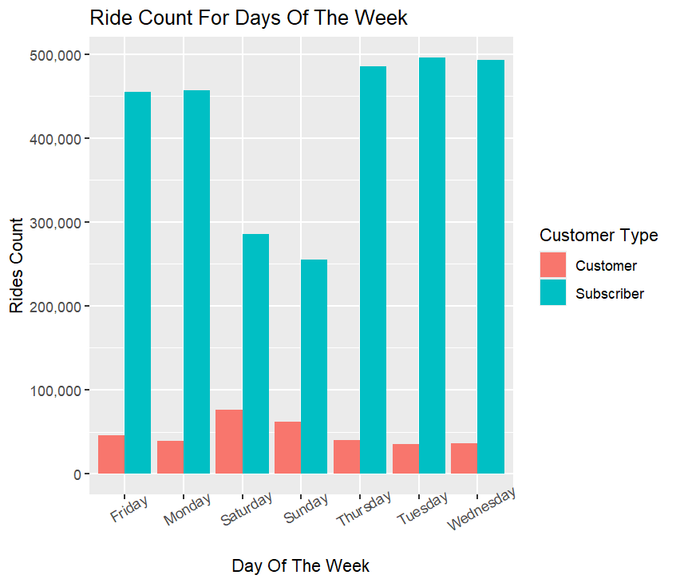
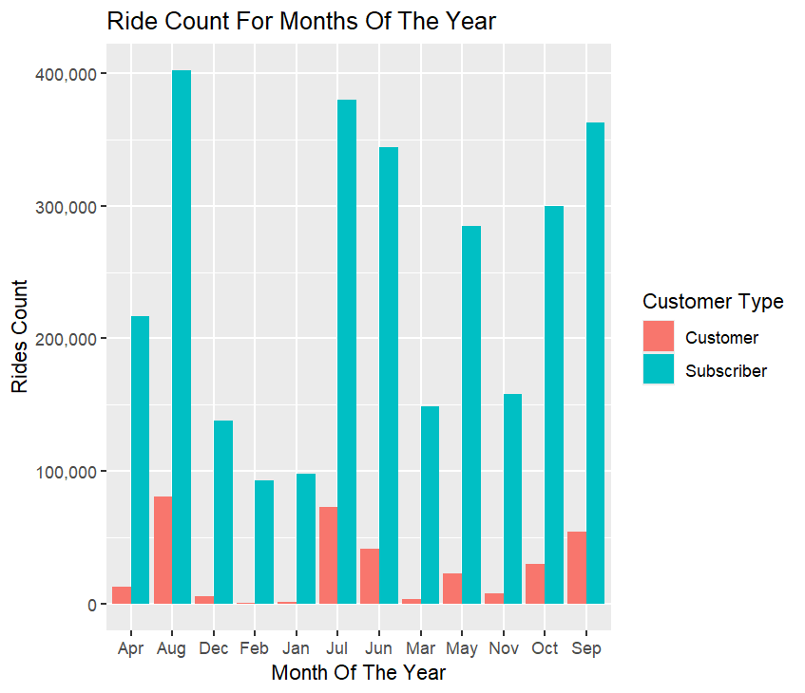
Rides distribution per day/month
As we can see in the right chart While subscribers generate a consistent, high volume of rides throughout the weekday, casual rider usage surges significantly on weekends. And on the left chart we see that Casual rider activity peaks during the warmer months of June through October, with August being the most popular.

Slide 8
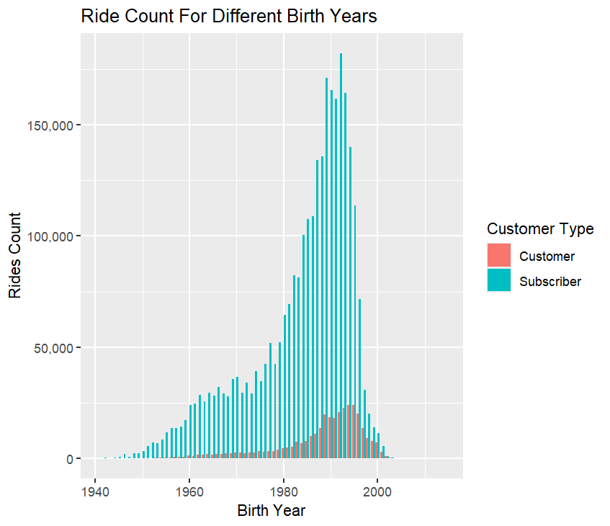
Rides distribution per birth year
In this chart we can see the data indicates that the core group of casual riders, born between 1988 and 1997, is slightly younger than the peak subscriber group

Slide 9
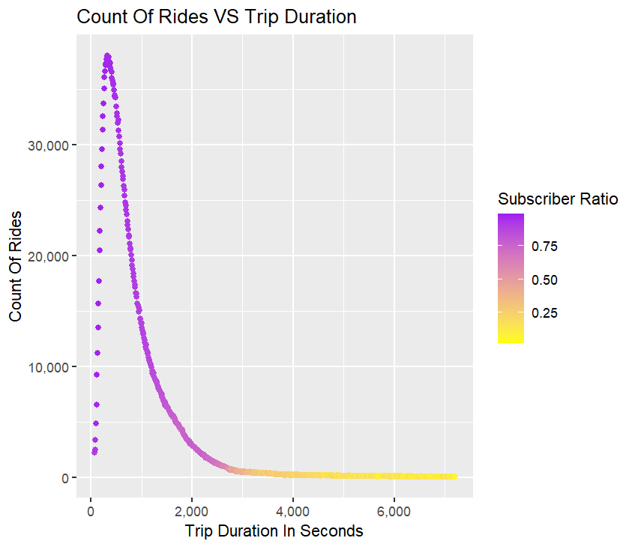
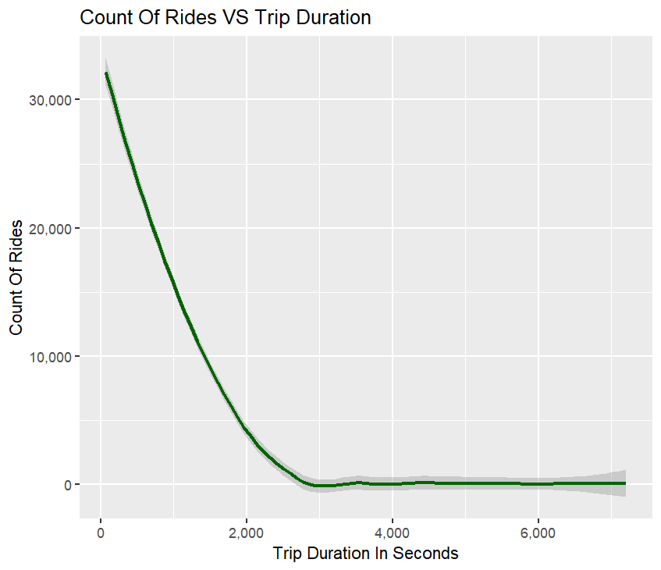
Analysis: Trip Duration Reveals Critical User Segments
In this charts we see that we have much more short rides then longer once, however I noticed that longer ride are much more spaced apart that’s why I added the smooth chart. The smooth chart indicates ballooning at the end and considering their remarkably low subscription rate.

Slide 10
Analysis: Trip Duration Reveals Critical User Segments
For the analysis a day of the ride column was added and the month of the ride, also in temporary table a column of subscribers to customer ratio column were added to show the difference between the subscriber percentages.
Short, Utilitarian Trips: The vast majority of rides are short, lasting under 2,000 seconds. The purple coloring in the scatter plot shows these trips are overwhelmingly taken by subscribers. This confirms their use of the service for predictable, functional journeys like commuting.
Long, Leisure-Focused Rides: As trip duration increases past 3,000 seconds (50 minutes), the subscriber ratio plummets. These longer rides are almost exclusively taken by casual riders (indicated by the yellow data points). The "ballooning" effect noted in the smooth chart confirms this distinct, high-duration usage pattern.
The Core Insight: We have two different products serving two different needs. Subscribers use the bikes as a utility for quick A-to-B trips. Casual riders use the bikes as an experience for leisure and exploration. The current annual membership is designed and priced for the first group, leaving a significant opportunity to better serve the second.

Slide 11
Challenges deep-dive
Challenge 1
Challenge 2
Challenge 3
Lack of direct reviews
This case-study data didn’t include customer surveys, for that reason all the findings are speculative there for to confirm them sample surveys are necessary
Need in future data
In order to confirm the effectiveness future data should be monitored in order of detecting any unnoticed biases that occurred in the analysis
Lack of context
In the project I lacked data about the customer for example work status, for example if the customer is a student, unemployed or a full wage worker.

Slide 12
Recommendations
Weekend Explorer Membership
Focus Marketing on Young, Social, Leisure Riders.
Forge Strategic Leisure Partnerships

Slide 13
Recommendation 1: Weekend Explorer Membership
The Rationale (The "Why"):
Our analysis shows two distinct user profiles.
Subscribers are weekday commuters taking short trips, while Casual Riders are weekend leisure users taking significantly longer rides. The current annual plan is not designed for the casual rider's primary use case: leisure.
The Action (The "What"):
Introduce a new, lower-cost membership tier specifically for weekend use. This could be called the "Weekend Explorer Pass" or something similar.
This pass should feature benefits tailored to leisure riders, such as an extended maximum ride duration (e.g., up to 2 or 3 hours) to accommodate longer exploratory trips.
Focus all advertising for this pass on Fridays through Sundays during the peak leisure season of June to October to maximize relevance and conversion.
The Outcome: This strategy directly targets the observed behavior of casual riders, offering them tangible value and a compelling reason to convert to a membership that fits their lifestyle.

Slide 14
Recommendation 2: Focus Marketing on Young, Social, Leisure Riders
The Rationale (The "Why"):
The data clearly indicates our largest group of casual riders—and thus our biggest conversion opportunity—is with younger adults born between 1988 and 1997. This demographic is highly active on social media, and their use of our bikes for long, leisurely rides suggests a social context.
The Action (The "What"):
Shift the marketing budget towards targeted social media advertisements instead of traditional channels.
Develop and promote new in-app features that enhance the leisure experience, such as GPS route tracking, speed/distance stats, and a points system for distance traveled.
Launch a marketing campaign encouraging users to share their "ride stats" or "bike adventures" online. This turns our users into brand advocates, generating powerful and free word-of-mouth advertising.
Further Research: We must also investigate the dip in popularity among college-aged riders. I recommend conducting targeted surveys to understand their specific barriers to use (e.g., cost, station availability near campus, awareness).

Slide 15
Recommendation 3: Forge Strategic Leisure Partnerships
The Rationale (The "Why"):
Our analysis confirms that casual riders use our bikes for leisure and exploration, not just transportation. Their goal is often the destination itself. By focusing only on the ride, we are missing an opportunity to add value to their entire journey.
The Action (The "What"):
Actively partner with local businesses and institutions that are popular weekend destinations: museums, cafes, breweries, concert venues, and city attractions.
Create a member benefits program. For example, Cyclistic members could get a 10% discount at a partner museum or a free coffee at a partner café when they show their active membership in the app.
Promote these partnerships directly within the app, suggesting routes to "partner destinations" and highlighting the exclusive perks available to members.
The Outcome: This strategy fundamentally increases the value of a Cyclistic membership. It transforms a simple transportation subscription into a city exploration pass, giving casual riders a compelling financial and experiential reason to convert. These partnerships also serve as a new, highly effective marketing channel, increasing brand visibility with our ideal target audience.

Slide 16
Question?

