Slide 1
1
Provedor
AWS, GCP, Azure, etc...
VM
Linux
Firewall
Internet
2
Provedor
AWS, GCP, Azure, etc...
VM
Linux
Firewall
Firewall

Slide 2
Windows 10/11
WSL2 – Ubuntu – Linux
Docker Engine
Linux
Ubuntu
Image

Slide 3
Ambiente
Developer (PC)
Ambiente
Virtualizado (VM)
Ambiente
Docker (Contâiner)
APP/LIBS
APP/LIBS
APP/LIBS
APP/LIBS
APP/LIBS
APP/LIBS
APP/LIBS
APP/LIBS
APP/LIBS
APP/LIBS
APP/LIBS
APP/LIBS
Guest OS
OS
OS
OS
OS
Oracle Virtual Box
Docker Engine
Host OS
Hypervisor
Host SO
Hardware
Hardware
Hardware

Slide 4
Nuvem
Azure • GCP • AWS • Oracle • IBM
VPS
Projeto Local
Pasta
Python + Flask
GitHub
Actions
Yalm
Docker
Serverless
Function

Slide 5




Slide 6
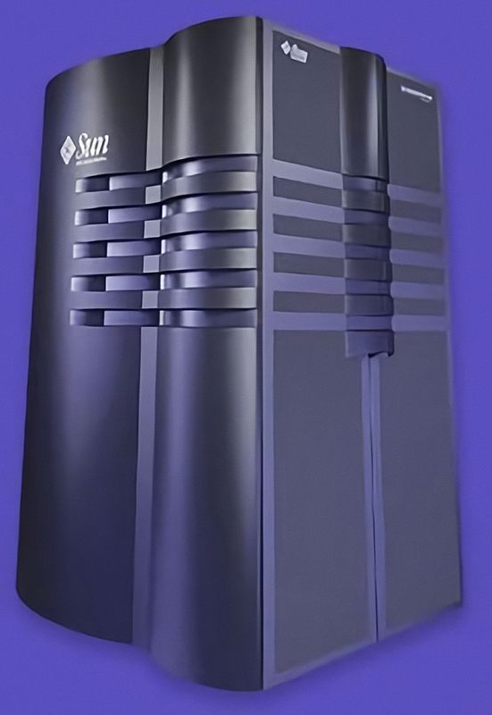
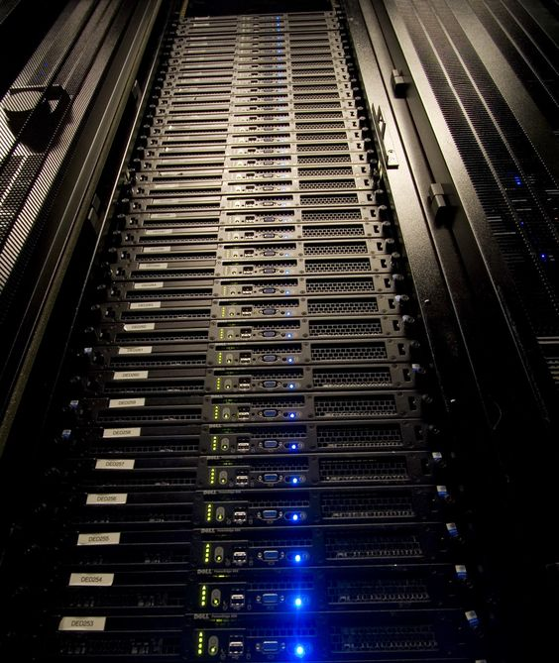
Data Center Rack
42Us
42 Servidores Dell
Linux
Sun E10000
Solaris

Slide 7
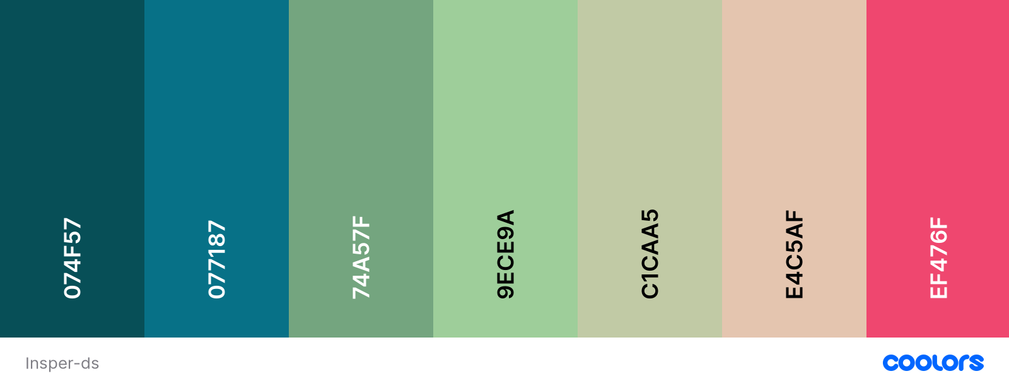
Palheta de Cores
Fonte: Ubuntu

