Slide 1
KPA Group — Meeting 2
29.11.2021 Yuyin Lang, Daniel Schroter, Hannes Schroter

Slide 2
Outline
Short summarization of the essays
Task
Test criteria
Overall result
Basic ideas of the essays (for those who also submitted the essays)
General ideas
Models
Encountered Problems (if applicable)
Possible work in the following weeks (not sure if we report this, we can just listen to Eder’s advice)

Slide 3

Short summarization of the essays -- Task
Topics
Arguments
Key Points
Children can not learn to interact with their peers when taught at home.
It is impossible to ensure that homeschooled children are being taught properly.
Homeschooling a child denies them valuable lifeskills, particularly interaction with their own age group and all experiences stemming from this.
Parents are usually not qualified to provide a suitable curriculum for their children. additionally, children are not exposed to the real world.
Mainstream schools are essential to develop social skills.
Parents are not qualified as teachers.
Homeschools cannot be regulated/standardized.

Slide 4
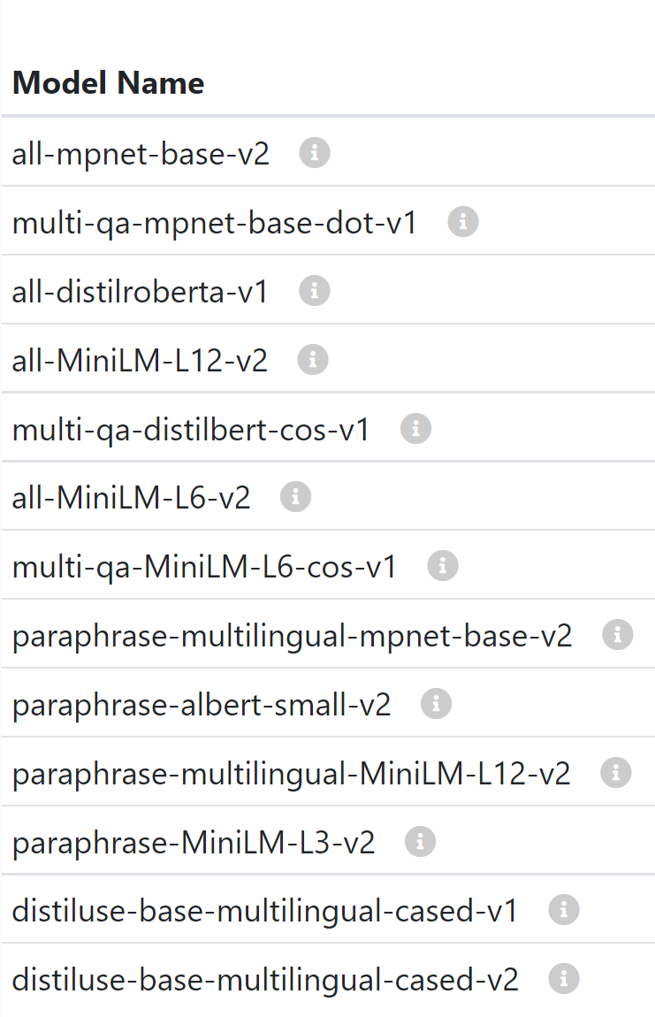
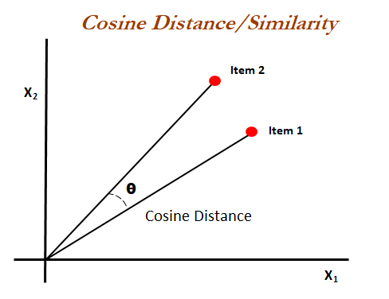
Short summarization of the essays -- Task
Word Embeddings
Similarity
Classification
Multiclass Labeling
Single Labeling
Cosine Similarity
Problem
Arguments are too similar to each other.

Slide 5
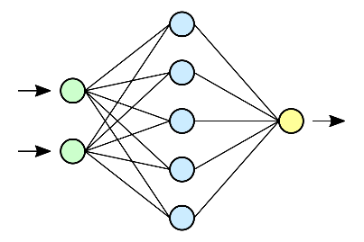
Short summarization of the essays -- Task
Data
Model
Parameters
Arguments
Activation Functions
Neural Network
Key Points
Embedding
Layer Architecture
Topic
Epochs
Problem
Extremly overfitting training data

Slide 6
Short summarization of the essays -- Task
Preprocessing
Architecture
Results
Tokenization
Average Precision
Neural Network
- 79 %
Embedding
Problem
Extremly overfitting training data

Slide 7
Short summarization of the essays
Goal of the shared task
Track 1: map arguments to the KPs
Track 2: given the arguments, generate KPs
Participants
17 groups track 1, 5 for track 2
Test criteria
Create new test data (3 new test sets created for this task)
Match under the same topic and same stance
Use both mAP strict and mAP relaxed (AP = average precision)

Slide 8
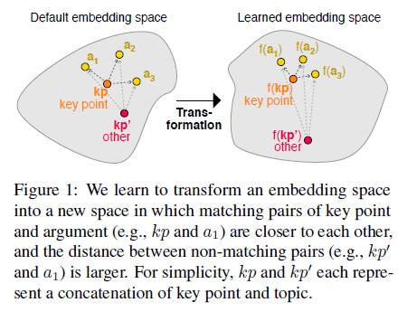
Basic ideas of the essays
1. SMatchToPageRank
learns a semantic embedding space
instances that match are closer to each other while non-matching instances are further away from each other
Model: siamese neural network (suitable for judging if two sentences are similar)
Encoding: RoBERTa-large

Slide 9
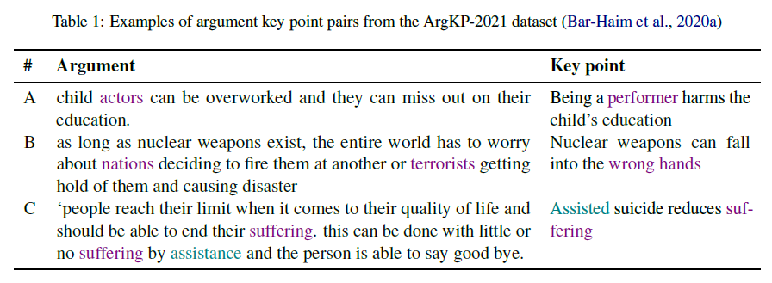
Basic ideas of the essays
3. ModrnTalk
Use rule-based baseline matcher to compute token-overlap, then use BERT as regression classifier
Difficult cases:
3 cases
A: The model has to recognize the difference between actor and performer
B: (More difficult) The model has to understand “wrong hands” stands for nations and terrorists here
C: The argument is far longer than the KP
Final model: measuring token overlap between key points and arguments, then fine-tune with BERT and RoBERTa

Slide 10
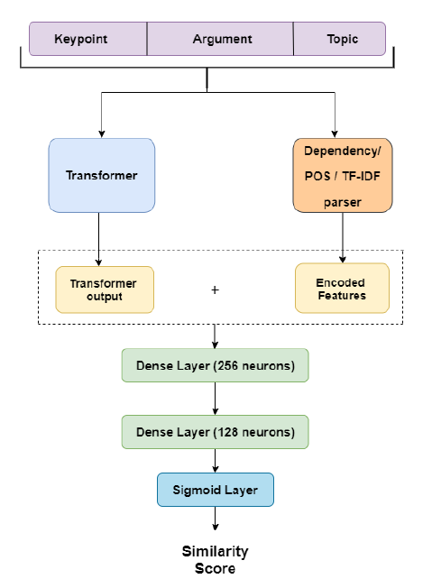
Basic ideas of the essays
4. Enigma
Additional training set: STS(8020 pairs of sentences)，IBM Rank 30k(30497 pairs of arguments and key points)
Model: concatenate KP, arguments and topics. Use transformer on the one side and dependency, POS, TF-IDF on the other (use only one at a time)
Then, feed them into a neural network
Ablation study
Idea: Use simpler model and see if the model performs way
worse
Trials: Exclude topic, average hidden states

Slide 11
Basic ideas of the essays
5. MatchTStm
Use pseudolabels mechanism —— The argument and KP with the same label will become closer (just like in SMatchToPageRank)
Model: Clustering
Every cluster is represented by a KP, the arguments in the same cluster are considered as matched
Intuition: If two different arguments support the same key point, they tend to convey similar meanings

Slide 12
Basic ideas of the essays
8. poledro
Directly use Avg mAP to evaluate the model
Model selection: Aims to choose the best embedding.
First, all models trained and validated with their basic configurations
After choosing the best model, try different configurations on VL
Error analysis: human tends to see all the possible key points to make decision, but the model only sees the single pair of arguments and KPs. (Human can make decision based on the overall judgement)
Example:
Topic: Routine child vaccinations should be mandatory
Argument: Child vaccination should be mandatory to prevent children from spreading the virus
KP 1: Routine child vaccinations are necessary to protect others
KP 2: Routine child vaccinations should be mandatory to prevent virus/disease spreading

Slide 13
Possible work in the following weeks
Take into account the difficult cases and error analysis
Consider more about RoBERTa, which performs the best in most of the models (possible problem: computational too expensive)
More advice?

