Slide 1
Backgammon
Daniel shaked

Slide 2
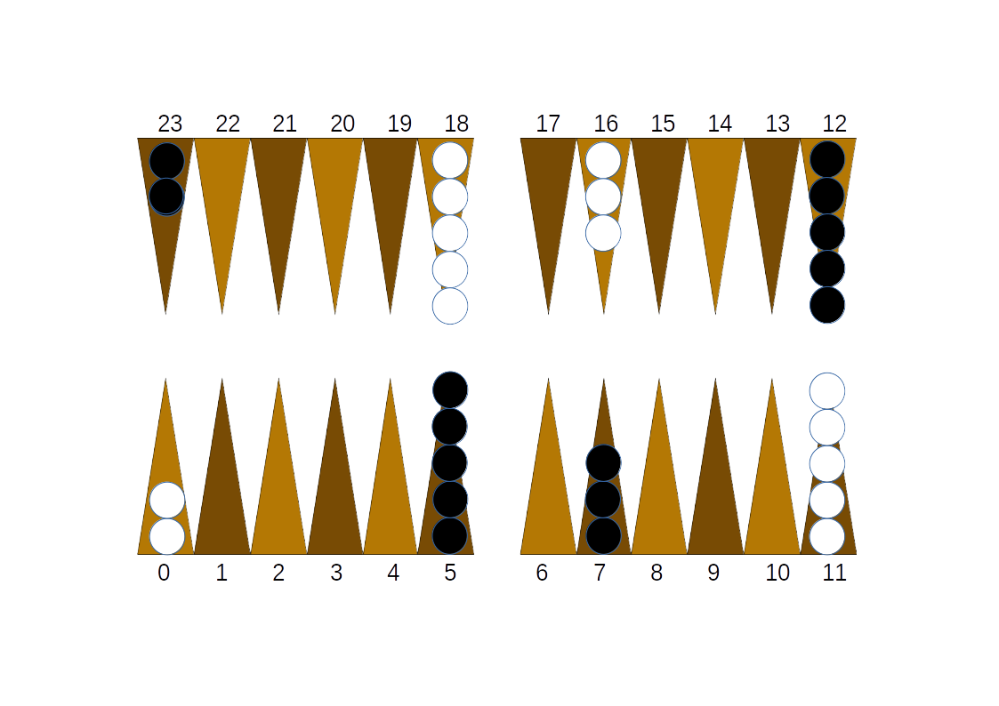
Board Setup
initial_board=[-2,0,0,0,0,5,0,3,0,0,0,-5,5,0,0,0,-3,0,-5,0,0,0,0,2]

Slide 3
is_point_inside_shape()
פונקציה זו מקבלת פוליגון ונקודה על גבי המסך וע"י חישוב של 4 נוסחאות טריגונומטריות קובעת האם נקודה נמצאת בתוך הפוליגון
def is_point_inside_shape(abc, d):
a,b,c=abc[0],abc[1],abc[2]
area = abs(0.5 * (a[0]*(b[1]-c[1]) + b[0]*(c[1]-a[1]) + c[0]*(a[1]-b[1])))
area1 = abs(0.5 * (d[0]*(b[1]-c[1]) + b[0]*(c[1]-d[1]) + c[0]*(d[1]-b[1])))
area2 = abs(0.5 * (a[0]*(d[1]-c[1]) + d[0]*(c[1]-a[1]) + c[0]*(a[1]-d[1])))
area3 = abs(0.5 * (a[0]*(b[1]-d[1]) + b[0]*(d[1]-a[1]) + d[0]*(a[1]-b[1])))
return area == area1 + area2 + area3

Slide 4
roll_dices()
def roll_dices():
global status,dices,screen,dices_sound,angles,decide_begin,angles
pygame.mixer.Sound.play(dices_sound)
sleep(0.3)
die1=np.random.randint(1,7)
die2=np.random.randint(1,7)
if die1==die2: dices=[die1,die1,die1,die1]
else: dices=[die1,die2]
status[3]=len(dices)
angles=[np.random.randint(1,360),np.random.randint(1,360)]

Slide 5
Index to pixels
def convert_idx_to_pixels(idx):
screen_offsets=[40,120,200,280,360,440,600,680,760,840,920,1000]
if idx < 12: pos = screen_offsets[idx]
elif idx ==50: pos=520
else: pos = screen_offsets[23-idx]
return pos

Slide 6
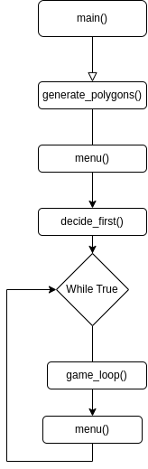
Game flow

Slide 7
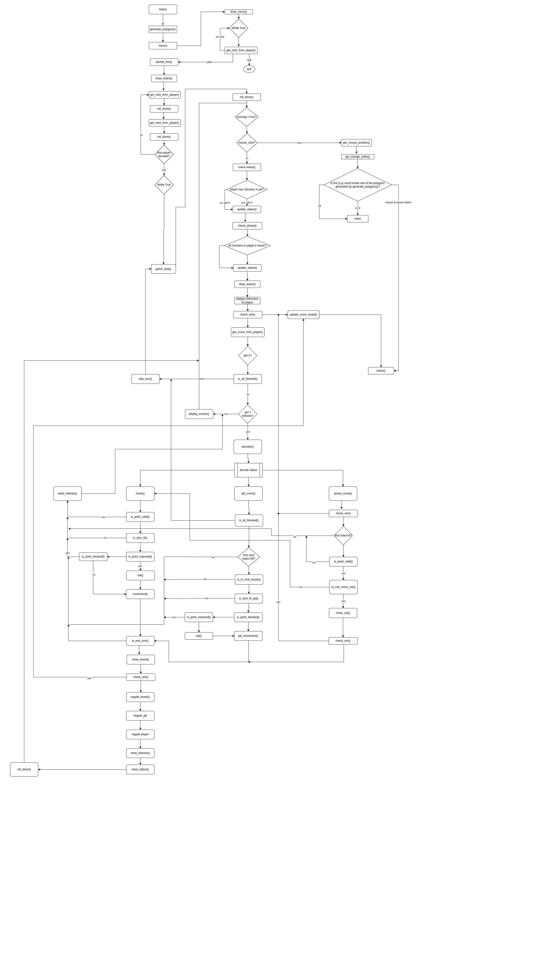
Full game flow

Slide 8
What went wrong?
Redefinition of the game flow multiple times
Defining the game flow to work properly
Keeping the code light
Choosing the right approch

Slide 9
Future work
Peer to peer based online PvP
Bot trained by reinforcement network model

Slide 10
Questions?

