Slide 1

Trivia Application (Android)
By Daniel Shmayoich and Matan Faragian

Slide 2
The Main Goal
Creating application of trivia questions
The questions are divided into different categories:
Sport
Music
Technology
Science
Movies

Slide 3
Activities Flow
Play Activity – Represents the opening screen.
Category Activity – Were the player selects the relevant questions section.
Quiz Activity – The main activity.
Represents the basic question screen. Turns to the question database, and activates all the functionality related to the correctness of the questions and beyond the additional questions.

Slide 4
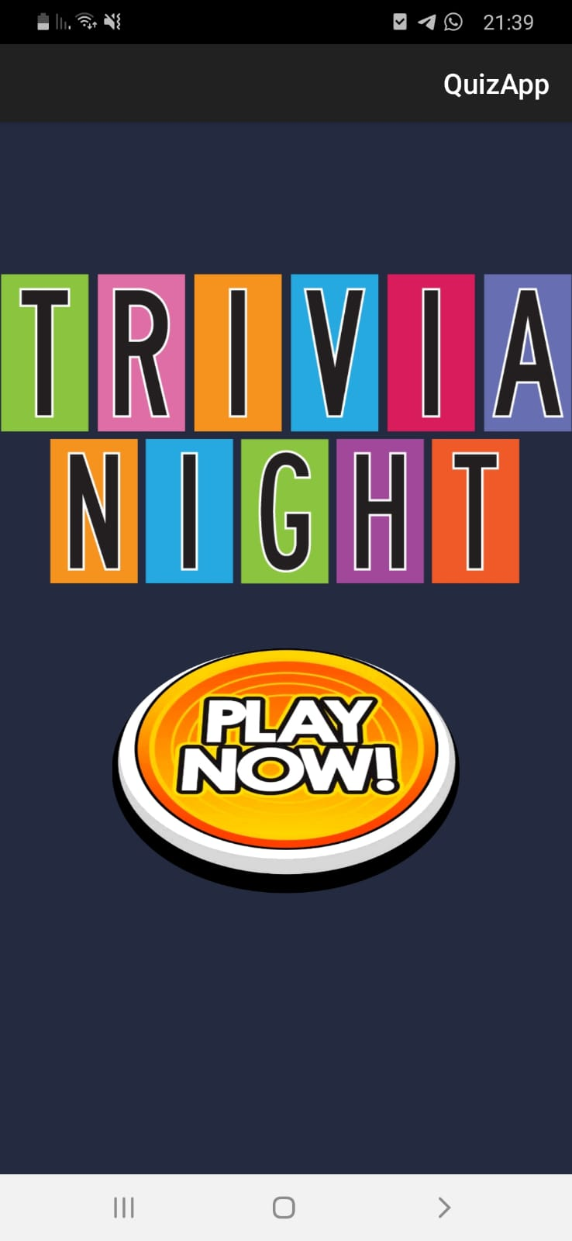
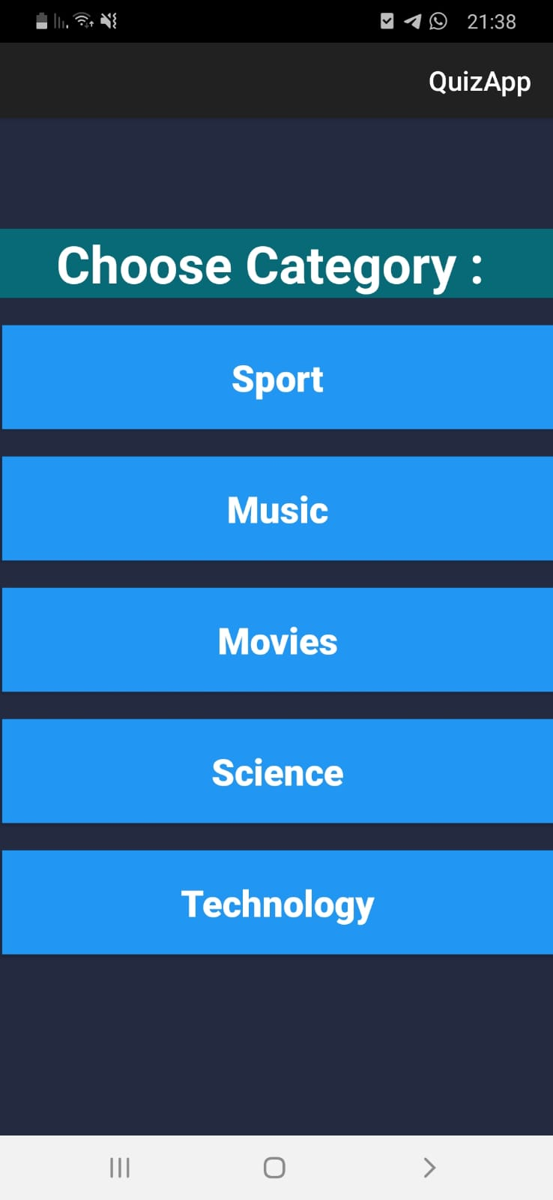
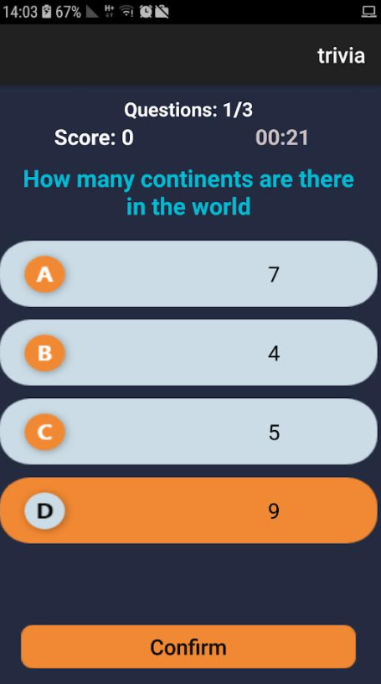

Slide 5
Questions DataBase
We used Java-Room-DB
QuestionsViewModel – Returns the list of the questions by the relevant category
QuestionDao – Keeps the queries of the DB.
QuestionsRoomDatabase – A java class that implements the DB itself (keeps all the questions).
Implemented as a singleton, and using Asynchronous tasks.

Slide 6
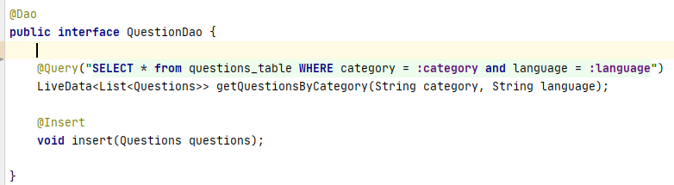
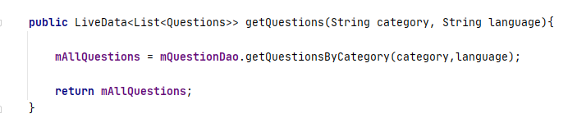

Slide 7
Other Activities and Dialogs
Result Activity – Pops in the end of all the questions series
Correct & Wrong Dialogs – Pops after every question.
Timer Dialog – Pops if the player didn’t answer in time.
PlayAudioForAnswers – Plays the relevant sound after every question

Slide 8
