Slide 1

Computational Reproducibility (Research Reproducibility in Theory and Practice, Day 3, FSCI2021)
Daniel S. Katz
d.katz@ieee.org, @danielskatz
Slides and examples are in https://bit.ly/CompRepro
With thanks to many! See last slides for sources

Slide 2
Exercise
Take a look at this dataset: https://osf.io/z274d/
Download it via: https://osf.io/z274d/download
Contains demographic data: tab-separated with a header row
Using this data, create a graph that shows life expectancy in Canada between 1980 and 2000
Write down how you did it, and give it to someone else, then ask them to reproduce it
year pop lifeexp gdppercap country continent
1952 8425333 28.801 779.4453145 afghanistan asia
1957 9240934 30.332 820.8530296 afghanistan asia
…
Credit: Soderberg, C. K., Smith, J. F., & Katz, D. S. (2017, August 1). Computational Reproducibility Day. Retrieved from http://osf.io/sbnz7

Slide 3
Goals
Reproducibility
Of what?
Papers, results, figures
By whom?
Future you, someone else knowledgeable in your field, anyone else
When?
Tomorrow, six months, 5 years, 50 years
How much?
Close enough (you decide what this means), not necessarily all the bits
Plausible vs. practical

Slide 4
Defining R* - terms
Reproducibility, Replicability, Repeatability, etc.
Confusing terms – see "Replicability vs. reproducibility — or is it the other way around?" (blog) and "Reproducibility vs. Replicability: A Brief History of a Confused Terminology" (paper) for some discussion
Maybe these are getting to be more standardized? But still, define what you mean!
Goodman | Claerbout | ACM (2020+) | AMC (2020-)
 |  | Repeatability | Repeatability
Methods Reproducibility | Reproducibility | Reproducibility | Replicability
Results Reproducibility | Replicability | Replicability | Reproducibility
Inferential Reproducibility
Goodman, S. N., Fanelli, D., and Ioannidis, J. P. A. (2016). What does research reproducibility mean? Sci. Transl. Med.8:341ps12.
Claerbout, J. F., and Karrenbach, M. (1992). Electronic documents give reproducible research a new meaning. SEG Expanded Abstracts 11, 601–604.
Association of Computing Machinery (ACM) (2020). Artifact Review and Badging (Version 1.1).

Slide 5
Context: data science
Organize and analyze large (or small) data sets to learn from them
Steps: capture/acquire, organize, process, analyze, communicate
Examples
How fast are stars moving away from us, and how does this vary with their distance?
Which credit card transactions are fraudulent?
What does this German document say in English? What does this recording of someone speaking Spanish say?
Which patient scans contain tumors?
Who’s going to win the election?
If a patient has these symptoms, what disease do they have?
What treatment is best for this particular patient?
Relevant: statistics, preregistration (declare your hypothesis before doing your analysis), random studies, false positives/negatives, sample size, confidence, power
Typical outputs: data, tools and methods (algorithms, models, software), conclusions (understanding data)

Slide 6
Context: computational science
Modeling or simulating a (physical) process in a predictive way, often using one or more equations
Examples, simulation or analysis of:
Atmospheric or oceanic circulation, coupled together with other physical processes into a climate simulation
The interactions of atoms in one or more molecules (drug design)
The atoms and forces in a material (material design)
Engineering analysis of the stress or deformation of a structure under some load (mechanical engineering)
Electrical signals in a circuit board or a set of synapses (electrical engineering or neuroscience)
Microwaves focused on a breast tumor (patient-specific medicine)
Often called computational science & engineering (CSE)
Relevant: mathematics, error bounds
Typical outputs: algorithm, method, software, conclusions (understanding processes)

Slide 7
Computational reproducibility principles
Provide structure
Control the source & changes
Use notebooks to explain and document
Automate steps
Automate everything
Capture the environment
Provide a license & make citable

Slide 8




First thing – get a terminal
On a Mac
Click the Launchpad icon in the Dock, type Terminal in the search field, then click Terminal.
In the Finder , open the /Applications/Utilities folder, then double-click Terminal.
On Windows
Open your computer's Start menu. Click the Windows icon on the bottom-left corner of your desktop or press the ⊞ Win key on your keyboard
Type cmd or Command Prompt. After opening the Start menu, type this on your keyboard to search the menu items. Command Prompt will show up as the top result.
Click the Command Prompt app on the menu. This will open the Command Prompt terminal in a new window.
Using Binder
Go to https://github.com/danielskatz/repro-fdtd1d, click on
Once binder starts the repo, use “New” -> “Terminal” to get a terminal

Slide 9
Principle 1 – Provide structure
Use directories for different things, all inside a project directory, with a top-level readme and license
E.g., data, docs, models, notebooks, references, reports, src (for Python data science, Cookiecutter Data Science is an example)
Use relative paths, so that you can move and share
(../data/file.dat)
Use names that have meaning (and avoid using “final”)
00-dsk-data_acquisition.py
My_project |--data |--docs |--notebooks |--references |--reports |--src

Slide 10
Principle 2 – Control the source & changes
For data, store the original (raw) data archivally somewhere and build other versions elsewhere using scripts (including accessing the data from the archive)
Note: GitHub is not archival, and isn’t good for large datasets
Two previous versions of this class used data in https://raw.githubusercontent.com/csoderberg/test_study/master/gapminder_copy.txt but this no longer exists
However, it is still in OSF: https://osf.io/z274d/
Get it via
wget https://osf.io/z274d/download -O gapminder_copy.txt
(You may have to install wget – Google it)
My_project |--data | |--raw | |--derived | |--results |--docs |--notebooks |--references |--reports |--src

Slide 11
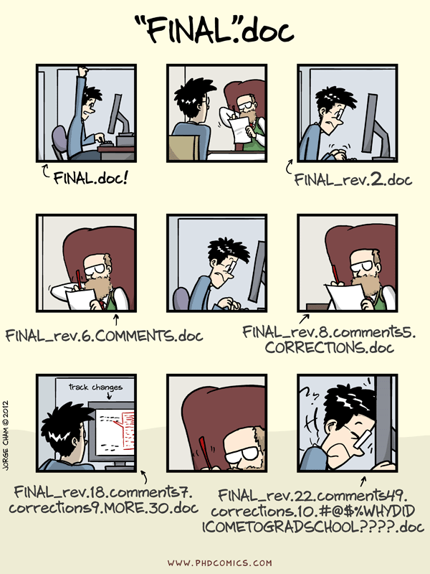
Principle 2 – Control the source & changes
For software, use a version control system to save versions and changes, and explain the reason for the changes
Git is the standard these days
Basics
Software is stored somewhere (e.g., GitHub, GitLab), either privately or publicly
New versions can be added
Author, changes, message about change stored
Multiple people can make changes in different parts of a project or even a file, and these can be merged together, mostly automatically
See Software Carpentry’s “Version Control with Git”
Version numbers
Consider releases, use semantic versioning
A release is a tagged version
major.minor.patch (API-breaking.API-maintaining.bug-fixes)
"Piled Higher and Deeper" by Jorge Cham www.phdcomics.com

Slide 12
Principle 2 – Control the source & changes
For published documents, people, etc. find a permanent identifier (PID, e.g., DOI, PubMed ID, ORCID) and use it to find the details (e.g., for references)
Get data from ORCID for a person (in Python):
import requests
import json
print(requests.get('https://pub.orcid.org/v3.0/0000-0001-5934-7525', headers={'content-type':'application/json'}).json())
Get metadata about a paper from a DOI (in bash):
curl https://api.crossref.org/works/10.1145/3307681.3325400/transform/application/vnd.crossref.unixsd+xml
Get bibtex for a paper from a DOI (in bash):
curl -LH "Accept: application/x-bibtex" https://doi.org/10.1145/3307681.3325400
curl https://data.crosscite.org/application/x-bibtex/10.1145/3307681.3325400

Slide 13
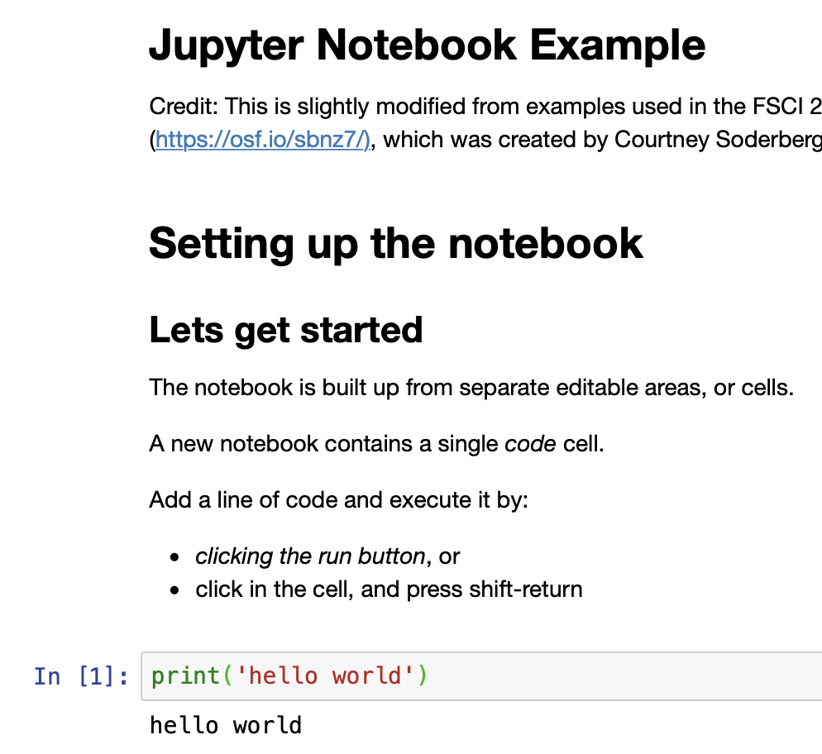
Principle 3 – Use notebooks to explain & document
Notebooks are great for showing what code does
And teaching people how to use it
Intersperse cells with text, equations, runnable code, outputs, images
Demo: go to https://github.com/danielskatz/repro-fdtd1d, click on
Once binder starts the repo, click on Notebook_Demonstration.ipynb
This uses binder (mybinder.org) – you can too
Turn a Git repo into a collection of interactive notebooks, making your code immediately reproducible by anyone, anywhere
Use requirements.txt to tell binder what dependencies to install in the environment
Also take a look at binderhub and jupyterhub if you want to run your own instance
But don't write code to do the same task in multiple notebooks
Pull it out (refactor it) into a (reusable) package, then import that package in the notebooks

Slide 14
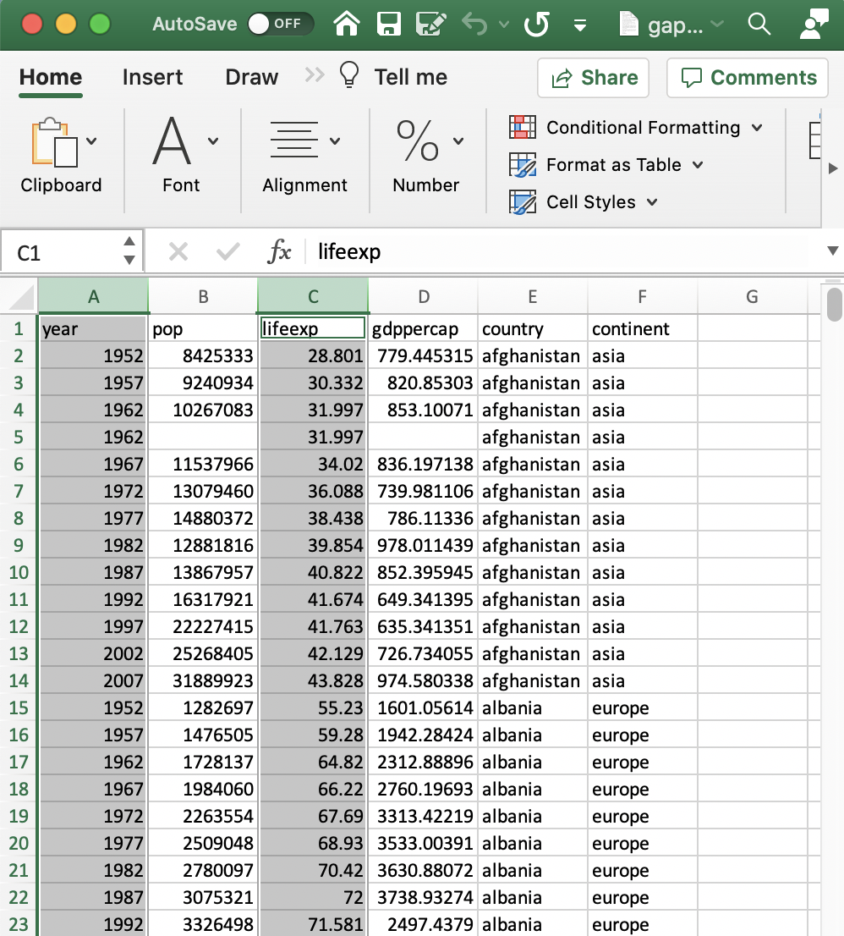
Principle 4 – Automate steps
Anything you do by hand is subject to irreproducible errors
GUIs can be intuitive, but they don’t support scalability or reproducibility well
Imagine having to extract a column of data from 1000 Excel files
Goal: capture what you do in some way so that you can repeat it in one step, such as
Capture a set of commands in a single script
Use pyexcel to read and write data to/from Excel files
Script GUI actions – see AutoHotkey_L for an example of how this can be done for Windows programs

Slide 15
Principle 4 – Automate steps
Scripts for simple things (steps)
Shell scripts
See Software Carpentry lesson “The Unix Shell”
“The Unix shell has been around longer than most of its users have been alive. It has survived so long because it’s a power tool that allows people to do complex things with just a few keystrokes. More importantly, it helps them combine existing programs in new ways and automate repetitive tasks so they aren’t typing the same things over and over again.”
At the simplest, the shell is the process you interact with when you type in a terminal window
Multiple commands can be placed in a script and rerun
And the shell supports variables and control flow (e.g. if-then, loops)

Slide 16
Principle 4 – Automate steps
Go to https://github.com/danielskatz/repro-fdtd1d, click on
Once binder starts the repo, use “New” -> “Terminal” to get a terminal
mkdir raw
mkdir proc
wget https://raw.githubusercontent.com/danielskatz/parsl-example/master/data/0001.jpg -O raw/0001.jpg
wget https://raw.githubusercontent.com/danielskatz/parsl-example/master/data/0002.jpg -O raw/0002.jpg
wget https://raw.githubusercontent.com/danielskatz/parsl-example/master/data/0003.jpg -O raw/0003.jpg
wget https://raw.githubusercontent.com/danielskatz/parsl-example/master/data/0004.jpg -O raw/0004.jpg
python3 bin/sharpen_image.py raw/0001.jpg proc/0001_sharp.jpg
python3 bin/sharpen_image.py raw/0002.jpg proc/0002_sharp.jpg
python3 bin/sharpen_image.py raw/0003.jpg proc/0003_sharp.jpg
python3 bin/sharpen_image.py raw/0004.jpg proc/0004_sharp.jpg
python3 bin/local_build_mosaic.py 2 proc/mosaic.jpg proc/0001_sharp.jpg proc/0002_sharp.jpg proc/0003_sharp.jpg proc/0004_sharp.jpg
Make directories
Get raw input files (into raw directory)
Process raw input files
Further process processed files

Slide 17
Principle 4 – Automate steps
Go to https://github.com/danielskatz/repro-fdtd1d, click on
Once binder starts the repo, use “New” -> “Terminal” to get a terminal
Automate by:
sh script/build_mosaic.sh
Contains all the commands from the previous slide

Slide 18
Principle 4 – Automate steps
Can use notebooks like scripts/programs with tools such as
nbclient, a very lightweight python API for executing notebooks
Papermill, a tool for parameterizing and executing Jupyter Notebooks
Jupytext, a converter between notebooks and code and vice versa
An interesting-looking new project
nbmake-action - A Notebook-First Continuous Integration Framework
A GitHub Action for testing notebooks, runs them from top-to-bottom
Intended to raise the quality of scientific material through better automation
For scientists/developers who have written docs in notebooks and want to CI test them after every commit

Slide 19
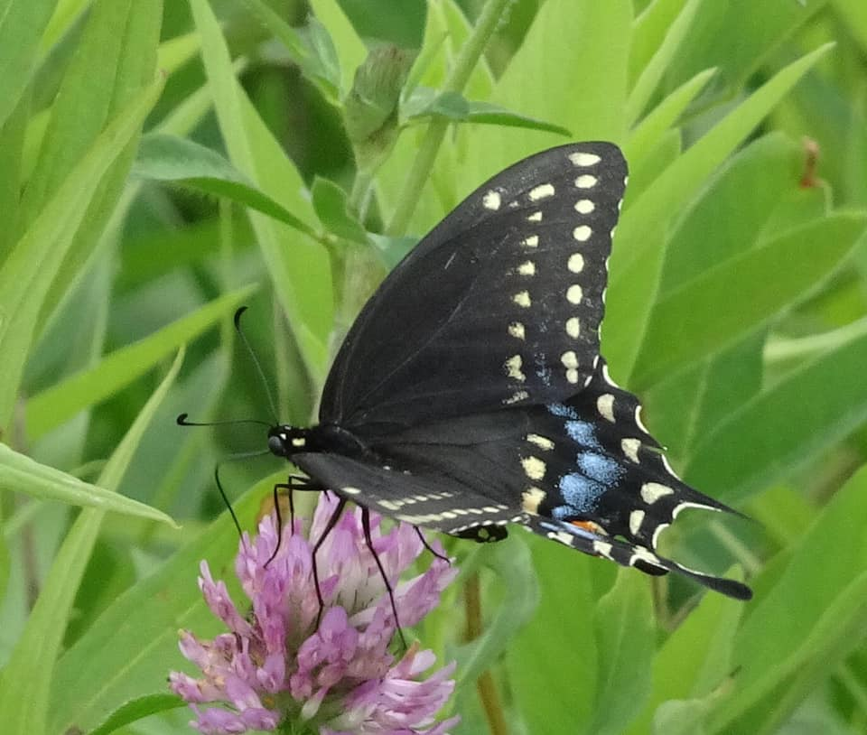
Principle 4 – Automate steps
Make randomness repeatable
Many simulations and data analysis involve random seeds, used to start generating a series of “random” numbers
Capture these seeds as part of your step so that you can repeat the same “randomness”
And get the “same” results
But be aware of tradeoffs
Example
When adding a list of floating point numbers, order can matter due to numerical roundoff
When using parallel computing, order can change with the same or different numbers of processes
Can force order at the cost of performance (extra sync/lock/messages)
Better to know what accuracy counts
Or to have a debug mode and a production mode

Slide 20

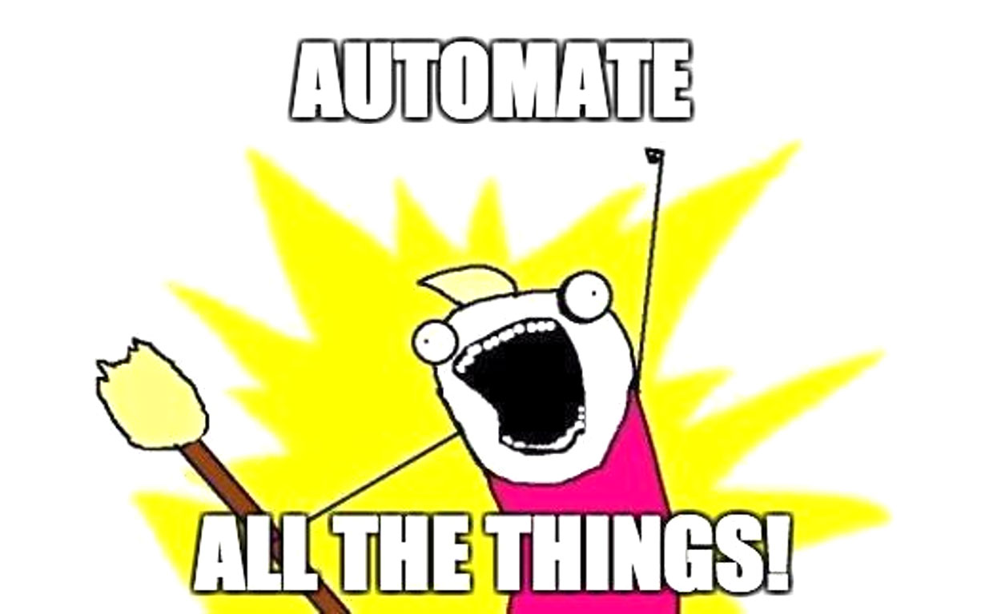
Principle 5 – Automate everything
Make or something make-like to handle multiple steps (dependencies) and not redo what isn’t needed
In the previous example, what happens if we just change the final program?
We don’t really want to have to rerun the whole script
Learn about make (GNU make, gmake) from Software Carpentry’s lesson
Short version
A program that defines rules for how to make one thing from others (dependencies)
Can use variables to make rules general
Make knows how to only make a thing when its dependencies have changes
Other options: workflow (management) systems & languages, e.g., in bioinformatics, snakemake, cwl, wdl, nextflow, … (there’s a CWL wiki page with 298 examples)
Consider continuous integration to automatically rebuild/test when things change
Integrate with GitHub Actions, CircleCI, Travis CI, etc.

Slide 21
Principle 5 – Automate everything
.PHONY: clean all
all: proc/mosaic.jpg
clean:
-rm -rf raw proc
raw:
mkdir raw
proc:
mkdir proc
raw/0001.jpg: | raw
wget https://raw.githubusercontent.com/danielskatz/parsl-example/master/data/0001.jpg -O raw/0001.jpg
[…]
raw/0004.jpg: | raw
wget https://raw.githubusercontent.com/danielskatz/parsl-example/master/data/0004.jpg -O raw/0004.jpg
proc/0001_sharp.jpg: raw/0001.jpg bin/sharpen_image.py | proc
python3 bin/sharpen_image.py raw/0001.jpg proc/0001_sharp.jpg
[…]
proc/0004_sharp.jpg: raw/0004.jpg bin/sharpen_image.py | proc
python3 bin/sharpen_image.py raw/0004.jpg proc/0004_sharp.jpg
proc/mosaic.jpg: bin/local_build_mosaic.py proc/0001_sharp.jpg proc/0002_sharp.jpg proc/0003_sharp.jpg proc/0004_sharp.jpg
python3 bin/local_build_mosaic.py 2 proc/mosaic.jpg proc/0001_sharp.jpg proc/0002_sharp.jpg proc/0003_sharp.jpg proc/0004_sharp.jpg
This is in script/Makefile-explicit
To run it, from the terminal in binderhub, use: make -f script/Makefile-explicit

Slide 22
Principle 5 – Automate everything
LANGUAGE=python3
FILE_NOS=0001 0002 0003 0004
RAW_FILES=$(FILE_NOS:%=raw/%.jpg)
PROC_FILES=$(FILE_NOS:%=proc/%_sharp.jpg)
SHARPEN = bin/sharpen_image.py
MOSAIC = bin/local_build_mosaic.py
RAW_SOURCE_DIR=https://raw.githubusercontent.com/danielskatz/parsl-example/master/data
.PHONY: clean all
all: proc/mosaic.jpg
clean:
-rm -rf raw proc
raw:
mkdir raw
proc:
mkdir proc
$(RAW_FILES): | raw
wget $(@:raw/%.jpg=$(RAW_SOURCE_DIR)/%.jpg) -O $@
proc/%_sharp.jpg: raw/%.jpg $(SHARPEN) | proc
$(LANGUAGE) $(SHARPEN) $(@:proc/%_sharp.jpg=raw/%.jpg) $@
proc/mosaic.jpg: $(MOSAIC) $(PROC_FILES)
$(LANGUAGE) $(MOSAIC) 2 $@ $(PROC_FILES)
And make the automation as general as possible
This is in script/Makefile
To run it, from the terminal in binderhub, use: make -f script/Makefile

Slide 23
Principle 6 – Capture the environment
Containers
Use docker to ensure the exact same software environment everywhere; lightweight & practical
For HPC, will likely need to use singularity or shifter instead
To specify an environment
In Python, use virtualenv (and `pip freeze > requirements.txt`) or pipenv or conda
In R, use add_dependencies_to_description() or use renv package or rocker
VMs (heavier weight than containers, includes OS)
Reproducible builds - a set of software development practices that create an independently-verifiable path from source to binary code
Reliant on package identification and management, e.g., Guix, PyPI, CRAN, …
Lots of tools and systems – see “Publishing computational research - a review of infrastructures for reproducible and transparent scholarly communication” for a 2020 survey of 11

Slide 24
Principle 7 – Provide a license & make citable
Copyright defines ownership, license gives permission to do something
But facts aren’t copyrightable, while works of authorship are (at least in the US)
A particular arrangement of facts might be eligible for copyright protection if that arrangement demonstrates sufficient creativity, but not if the arrangement is something uncreative like chronological or alphabetical order
Even with creative arrangement, underlying facts cannot be copyrighted; it’s perfectly legal for someone else to pull them out, rearrange them, and use them in something new
See “Who ‘owns’ your data?”
If you are employed, your employer may own the copyright to things you create at work, and maybe even outside
Common in the US and in universities, but students own work they develop in their own coursework (though not if they are paid to do it, such as in a research assistantship)
Use a common license, don’t create your own
Common licenses are understood, uncommon one will prevent people from using your work just because they may not understand the license

Slide 25
Principle 7 – Provide a license & make citable
Creative Common licenses for text and data
CC0 – waive copyright, dedicate to the public domain (not really a license)
CC BY (Attribution): material is free to use and adapt, but credit must be given
CC BY-SA (Attribution-ShareAlike): free to use and adapt, but credit must be given and adapted material must also be distributed with this same license
CC BY-ND (Attribution-NoDerivs): free to use, but credit must be given and can’t be adapted
CC BY-NC (Attribution-NonCommercial): free to use and adapt but credit must be given and can’t be used commercially
CC BY-NC-SA (Attribution-NonCommercial-ShareAlike): free to use and adapt, but credit must be given, can’t be used commercially, and adapted material must also be distributed with this same license
CC BY-NC-ND (Attribution-NonCommercial-NoDerivs): free to use, but credit must be given, can’t be used commercially, and can’t be adapted
Creative Commons provides a guide/decision tree
Be aware someone might argue that the data are facts and not subject to copyright, so the license doesn’t hold
Scholarly norms and principles of attribution/credit/provenance/authority might hold more sway
(for more, see “CC BY and data: Not always a good fit”)

Slide 26
Principle 7 – Provide a license & make citable
Open Source Initiative licenses for software
Don’t use a CC license for software
At high level, two types of licenses
Permissive: MIT, Apache, BSD, …
Copyleft (“viral”): GPL, LGPL
Use choosealicense.com to pick one
Pick a very common one if possible
How to apply (MIT):
Create a text file (typically named LICENSE or LICENSE.txt) in the root of your source code and copy the text of the license into the file. Replace [year] with the current year and [fullname] with the name (or names) of the copyright holders.

Slide 27
Principle 7 – Provide a license & make citable
Citeable isn’t required for reproducibility, but it’s a good idea if you want credit
Make your data citable
Deposit it in an archival repository (e.g., Zenodo, OSF, see re3data.org for more) along with metadata, receive a DOI, advertise the DOI and metadata (suggested citation)
Make your software citable
Less well-defined practice
GitHub is not an archival repository
Can follow data practice (can link GitHub repo to Zenodo to automatically deposit new releases - guides.github.com/activities/citable-code)
Record metadata in the repository (using CodeMeta or citation.cff), some repositories will pick up
Also can use Software Heritage (“archive.org for software”) to cite archive of GitHub software
See cite.research-software.org for more

Slide 28
Exercise(s)
Try out one of the project structure tools, or look at them and try to organize a project you have similarly
Python: Cookiecutter Data Science
R: ProjectTemplate
Redo the exercise from the beginning in a more reproducible manner
Automate a paper you have written
Or try to do this for a paper someone else has written (start by finding the data and code, see how far you can get)

Slide 29
Final thoughts
“I was inspired more than 15 years ago by John Claerbout […] He pointed out to me, in a way paraphrased in Buckheit and Donoho (1995): ‘an article about computational result is advertising, not scholarship. The actual scholarship is the full software environment, code and data, that produced the result.’” - David Donoho (in https://doi.org/10.1093/biostatistics/kxq028)
“You shouldn’t try to do these things all at once; start with one, or part of one. Then in your next project, do that plus another thing.” – Karl Broman (in https://kbroman.org/steps2rr/)
It's no secret that good analyses are often the result of very scattershot and serendipitous explorations. […] That being said, once started it is not a process that lends itself to thinking carefully about the structure of your code or project layout, so it's best to start with a clean, logical structure and stick to it throughout. (in https://drivendata.github.io/cookiecutter-data-science/)

Slide 30
Resources (1)
Organizing projects:
Python: Cookiecutter Data Science - https://drivendata.github.io/cookiecutter-data-science
R: ProjectTemplate - http://projecttemplate.net/
Guidelines:
Karl Broman’s initial steps toward reproducible research (R, explains python too) - https://kbroman.org/steps2rr/
Reproducible papers:
PINGA lab’s template (computational science, GitHub, Python, LaTeX) - https://www.leouieda.com/blog/paper-template.html
Manubot (markdown, git, collaboration) - https://manubot.org
Akhaghi (C/C++, LaTeX) - https://gitlab.com/makhlaghi/reproducible-paper
Book:
The Practice of Reproducible Research: Case Studies and Lessons from the Data-Intensive Sciences - http://www.practicereproducibleresearch.org/

Slide 31
Resources (2)
Short courses/MOOCs:
Essential skills for reproducible research computing - https://barbagroup.github.io/essential_skills_RRC/
Reproducible Research using Jupyter Notebooks - https://reproducible-science-curriculum.github.io/workshop-RR-Jupyter/
Duke UPGG Informatics Orientation Bootcamp - https://duke-gcb.github.io/2019-08-12-Duke/
Reproducible Research and Data Analysis (under development) - https://opensciencemooc.eu/modules/reproducible-research-and-data-analysis/
Reproducible research: Methodological principles for a transparent science - https://learninglab.inria.fr/en/mooc-recherche-reproductible-principes-methodologiques-pour-une-science-transparente/
Make (Software Carpentry’s lesson) - http://swcarpentry.github.io/make-novice/

Slide 32
Resources (3)
Tools:
Popper - https://github.com/getpopper/popper
Reana - http://www.reanahub.io
ReproZip - https://www.reprozip.org
Sciunit - https://sciunit.run
Other:
Reproducible PI Manifesto - https://lorenabarba.com/gallery/reproducibility-pi-manifesto/
Container information - https://slurm.schedmd.com/containers.html
Python virtual environments: https://towardsdatascience.com/python-virtual-environments-made-easy-fe0c603fe601 and https://towardsdatascience.com/comparing-python-virtual-environment-tools-9a6543643a44
Computational science example (from FSCI 2018 & 2019): https://github.com/danielskatz/repro-fdtd1d
Make your code ready for publication (sharable and citable) workshop - https://gitlab.com/hifis/hifis-workshops/make-your-code-ready-for-publication/workshop-materials
Software Citation Principles - https://doi.org/10.7717/peerj-cs.86

