Slide 1
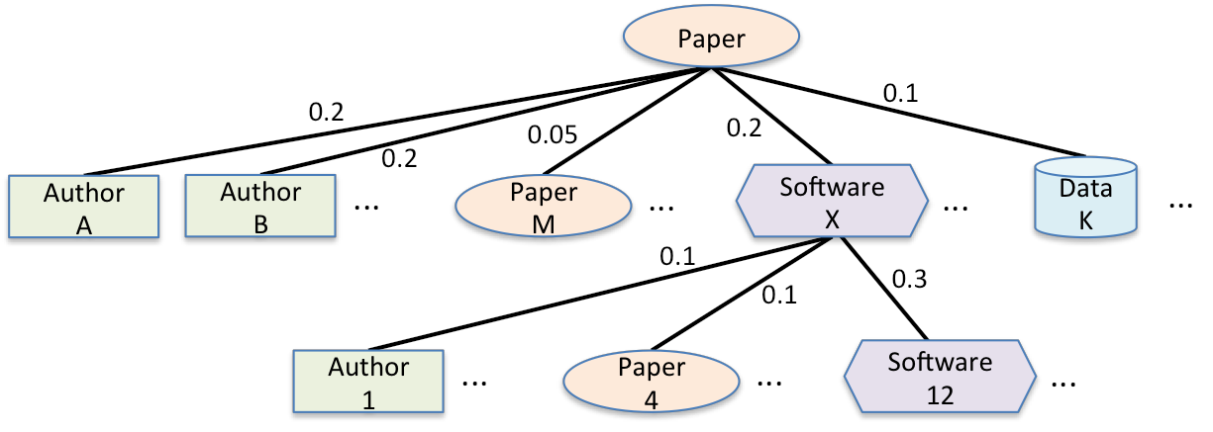
Implementing Transitive Credit with JSON-LD
Daniel S. Katz & Arfon M. Smith
http://arxiv.org/abs/1407.5117
Hypothesis: better measurement of scientific contributions will lead to
rewards (incentives), leading to
better career paths, leading to
more willingness to join communities, leading to
more sustainable software
JSON-LD for Credit Example:
{ "@context": "http://schema.org", "@type": "ScholarlyArticle", "headline": "Implementing Transitive Credit with JSON-LD", "dateCreated": "2014-07-10", "keywords": "transitive credit, json-ld, linked data”, "author": [
{ "@type": "Person", "name": "Daniel S. Katz", "@id": "http://orcid.org/0000-0001-5934-7525”, "email”: "d.katz@ieee.org" "creditWeight": "0.25" }, { "@type": "Person", "name": "Arfon Smith", "@id": "http://orcid.org/0000-0002-7217-4494", "email": "arfon@github.com", "creditWeight": "0.25" }
],
"citation": {
"articles": [
{
"@type": "ScholarlyArticle", "headline": "Transitive credit ...”,
"doi": "10.5334/jors.be", "creditWeight": "0.3"
}
...
],
"software": [
{
"@type": "Code", "name": "Fidgit", "codeRepository": "https://github.com/arfon/fidgit", "license": "http://opensource.org/licenses/MIT",
"creditWeight": "0.04"
}
...
Transitive Credit Concept:
Record “credit map” for products (papers, software, data, etc)
Credit map assigns weighted credit to authors, “contriponents” (items/people acknowledged, credited, etc)
Allows (weighted) credit to flow down (e.g. from paper to cited software application to software library)
JSON-LD
JavaScript Object Notation for Linked Data
http://json-ld.org/
Extension of the key-value based JSON document format
Provides a way of describing machine-readable information with semantic context
Issues:
How to implement with handle/DOI?
Standards (e.g. CASRAI, VIVO)?
Social/cultural acceptance?

