Slide 1

GLOBAL SCREENING · SANCTIONS CONTROLS
Stopping sanctioned banks at the point of payment
How our BIN blocking control works, from designation to declined payment
Blocked here
Merchant
Checkout.com
Card scheme
Sanctioned issuer
Notes:
Opening. We are a payment service provider: we process card payments and card payouts for merchants, in real time and at volume.
The question this talk answers: how do we make sure no card payment involving a sanctioned bank gets through, when we never hold a relationship with that bank?
The line at the bottom is the whole talk: the payment stops at our check, before it ever reaches the scheme.

Slide 2






We block sanctioned banks ourselves, inside our own payment flow
We have no direct relationship with the issuing bank
Merchant
Checkout.com
Card scheme
Issuing bank
Starts a card payment or payout
Processes it and earns the fee
Routes it to the bank
Could be sanctioned
The check runs here
after the issuer BIN is extracted, before anything reaches the scheme
WHAT WE ARE EXPOSED TO
Payments from sanctioned issuers
Payouts to sanctioned issuers
Routing we don't control
Real-time, high-volume card traffic from any bank under sanctions
Card payouts and refunds that would credit a card issued by a sanctioned bank
Acquirers and intermediaries that may sit in sanctioned regions
Source: Blocking framework §3, §6.1, §7.2
Notes:
Our model: we process card payments for merchants, but we do not hold relationships with the issuing banks. Schemes and acquiring partners sit between us and them.
Relying on those partners to enforce sanctions has proven unreliable, and it does not take away our own regulatory liability (framework §6.1).
So the control has to sit inside our own flow. The red marker is where: after we extract the issuer BIN, and before the authorisation request goes to the scheme.
The three cards are the exposures the control exists for: card payments from sanctioned issuers, payouts to cards issued by sanctioned banks, and routing through intermediaries we do not control (framework §3).

Slide 3


The block list is updated weekly, with an emergency route for major designations
1 The list
2 Every payment
3 Who owns it
Output: the Sanctioned BIN List, used in Part 2
1
Identify
2
Map
3
Validate & approve
4
Deploy & verify
A bank is designated under EU, UK (OFSI) or US (OFAC) sanctions
Sanctioned banks found in LexisNexis lists, including by ownership and control
Classified as a global hard stop or a regional / sectoral block
6- and 8-digit BIN ranges generated via BINDB
Manual check so legitimate banks are not blocked
Sanctions Team (2LOD) gives the final approval
Controlled upload to fraud and payout systems
Post-deployment check that the block is live
Every week the full cycle runs again, and the Register is reconciled fortnightly against industry lists
Emergency route for a major designation
2 hours
to update the Register
after a major designation
Expedited approval, and a temporary block goes in before full BIN regeneration. Documentation and validation are completed afterwards.
Source: Blocking framework §6.2, §7.3, §7.4, §8.2, §9.1, §9.3, §10.1, §10.4
Notes:
Part one is the list. When a bank is designated, we identify it, and anything it owns or controls, in our sanctions data.
We classify it: is this a global hard stop, or a regional or sectoral restriction? Then we map the bank to its 6- and 8-digit BIN ranges.
Before anything goes live, the ranges are checked by hand so we do not block legitimate banks, and the Sanctions Team gives the final approval. That is the amber box: a person decides.
Then a controlled upload, and a check after deployment that the block is actually live. This runs every week, and the Register is reconciled against industry lists every two weeks.
For a major designation we do not wait for the week: the Register is updated within two hours and a temporary block goes in ahead of the full BIN rebuild.

Slide 4


Every card payment and payout is checked before it reaches the scheme
1 The list
2 Every payment
3 Who owns it
Issuer BIN extracted
Sanctions check
Authorisation request to scheme
Clearing & settlement
PAYMENT TYPE
WHAT IS CHECKED, AND WHERE
OUTCOME
✕
Declined automatically
Card acquiring
Issuer BIN vs the Sanctioned BIN List
Match?
Processing-In: merchant card payments
Fraud Detection solution, before authorisation
✓
Standard authorisation
✕
Declined automatically
Payout to card
Card BIN vs the Sanctioned BIN List
Match?
Processing-Out: including refunds where the BIN is available
Payout validation layer, before settlement
✓
Standard settlement
On every match a Sanctions_Block_Event is logged and retained, and escalated per Compliance procedures where required
Source: Blocking framework §4, §7.2 (minimum requirements), §7.3.1, §8.1
Notes:
Part two is the payment. The strip at the top is the most important design choice: the check sits after we extract the issuer BIN, and before the authorisation request goes to the scheme. Nothing is routed, cleared or settled first.
Card acquiring: the issuer BIN is matched against the Sanctioned BIN List in our fraud detection layer, in real time, before authorisation. A match is declined automatically.
Payouts to cards, including refunds where we have the BIN: the same match, in the payout validation layer, before settlement.
Every match is logged as a Sanctions_Block_Event, kept, and escalated where required.

Slide 5
Every step has an owner, and people make the decisions
1 The list
2 Every payment
3 Who owns it
1LOD
Fraud Detection: real-time BIN checks for acquiring
FinCrime Engineering: payout validation layer, event logging, no bypass
FinCrime Product: control design, aligned to regulatory requirements
Weekly
Payments & Engineering
The full BIN list update cycle
Build and run the controls
2LOD
Owns the Sanctions Hard Block Register
Sets the global vs regional block taxonomy
Sole approver for adding or whitelisting BINs, and shared-BIN exceptions
2 hours
Sanctions Team
To update the Register after a major designation
Own the list and approve changes
3LOD
Tests the design and operating effectiveness of real-time BIN blocking
1 hour
Internal Audit
To report any payment that did not follow the workflow
Independent assurance
Source: Blocking framework §8.1, §8.2, §8.3, §9.1, §11
Notes:
Who owns it. The first line builds and runs the controls: fraud detection for acquiring, FinCrime Engineering for the payout validation layer and logging, with no way to route around the check, and FinCrime Product for the design.
The second line, the Sanctions Team, owns the Hard Block Register and is the only team that can add or remove a BIN. That is the amber row: a person approves every change.
Internal Audit tests both the design and whether it actually works in operation.
Three numbers to remember: the list updates weekly, the Register is updated within two hours of a major designation, and any payment that gets past the workflow is reported to the Sanctions Team within one hour.

Slide 6




Four things that make BIN blocking harder than it looks
Names don't match across datasets
BINs aren't banks
The same bank is written differently in sanctions lists and BIN databases: abbreviations, transliterations, legal forms. Matching on unique identifiers such as the LEI is the long-term fix.
One bank spans many 6- and 8-digit ranges, and some BINs are shared across territories. Too broad and you block legitimate banks; too narrow and you miss one.
Lists move faster than BIN data
Ownership isn't on the list
There is a lag between a designation and BIN databases or scheme data catching up. The emergency route exists to cover that window.
A bank can be sanctioned through ownership or control without being named. Finding it takes an ownership assessment, not just a list lookup.
Source: Blocking framework §3, §6.3, §7.4, §8.2, §10.4
Notes:
Optional slide: the practical lessons. They are framed as industry problems, not as gaps in our control. Check with the framework owner before using it with an external audience.
Names: sanctions lists and BIN databases spell banks differently, so name matching can miss one. Wildcard searches help today; unique identifiers are the real fix.
BINs: a bank is not one number. Get the ranges too broad and you block good banks; too narrow and you miss one. Some BINs are even shared across territories.
Timing: lists move faster than BIN data, which is why the emergency route exists. Ownership: banks can be sanctioned without being named, so you need ownership and control analysis, not just a lookup.

Slide 7
Three things to take away
01
02
03
We block it ourselves
The list is kept current
People make the decisions
The check sits inside our payment flow, before the scheme sees the payment. Partners don't carry our liability.
Weekly updates, a 2-hour Register update for major designations, and fortnightly reconciliation against industry lists.
The Sanctions Team approves every change to the list, including shared-BIN exceptions.
Source: Blocking framework §6.1, §7.2, §8.2, §9.1, §10.4
Notes:
Close on the three ideas: we do it ourselves, before the scheme; the list is kept current on a weekly cycle with an emergency route; and a person approves every change to what gets blocked.

Slide 8
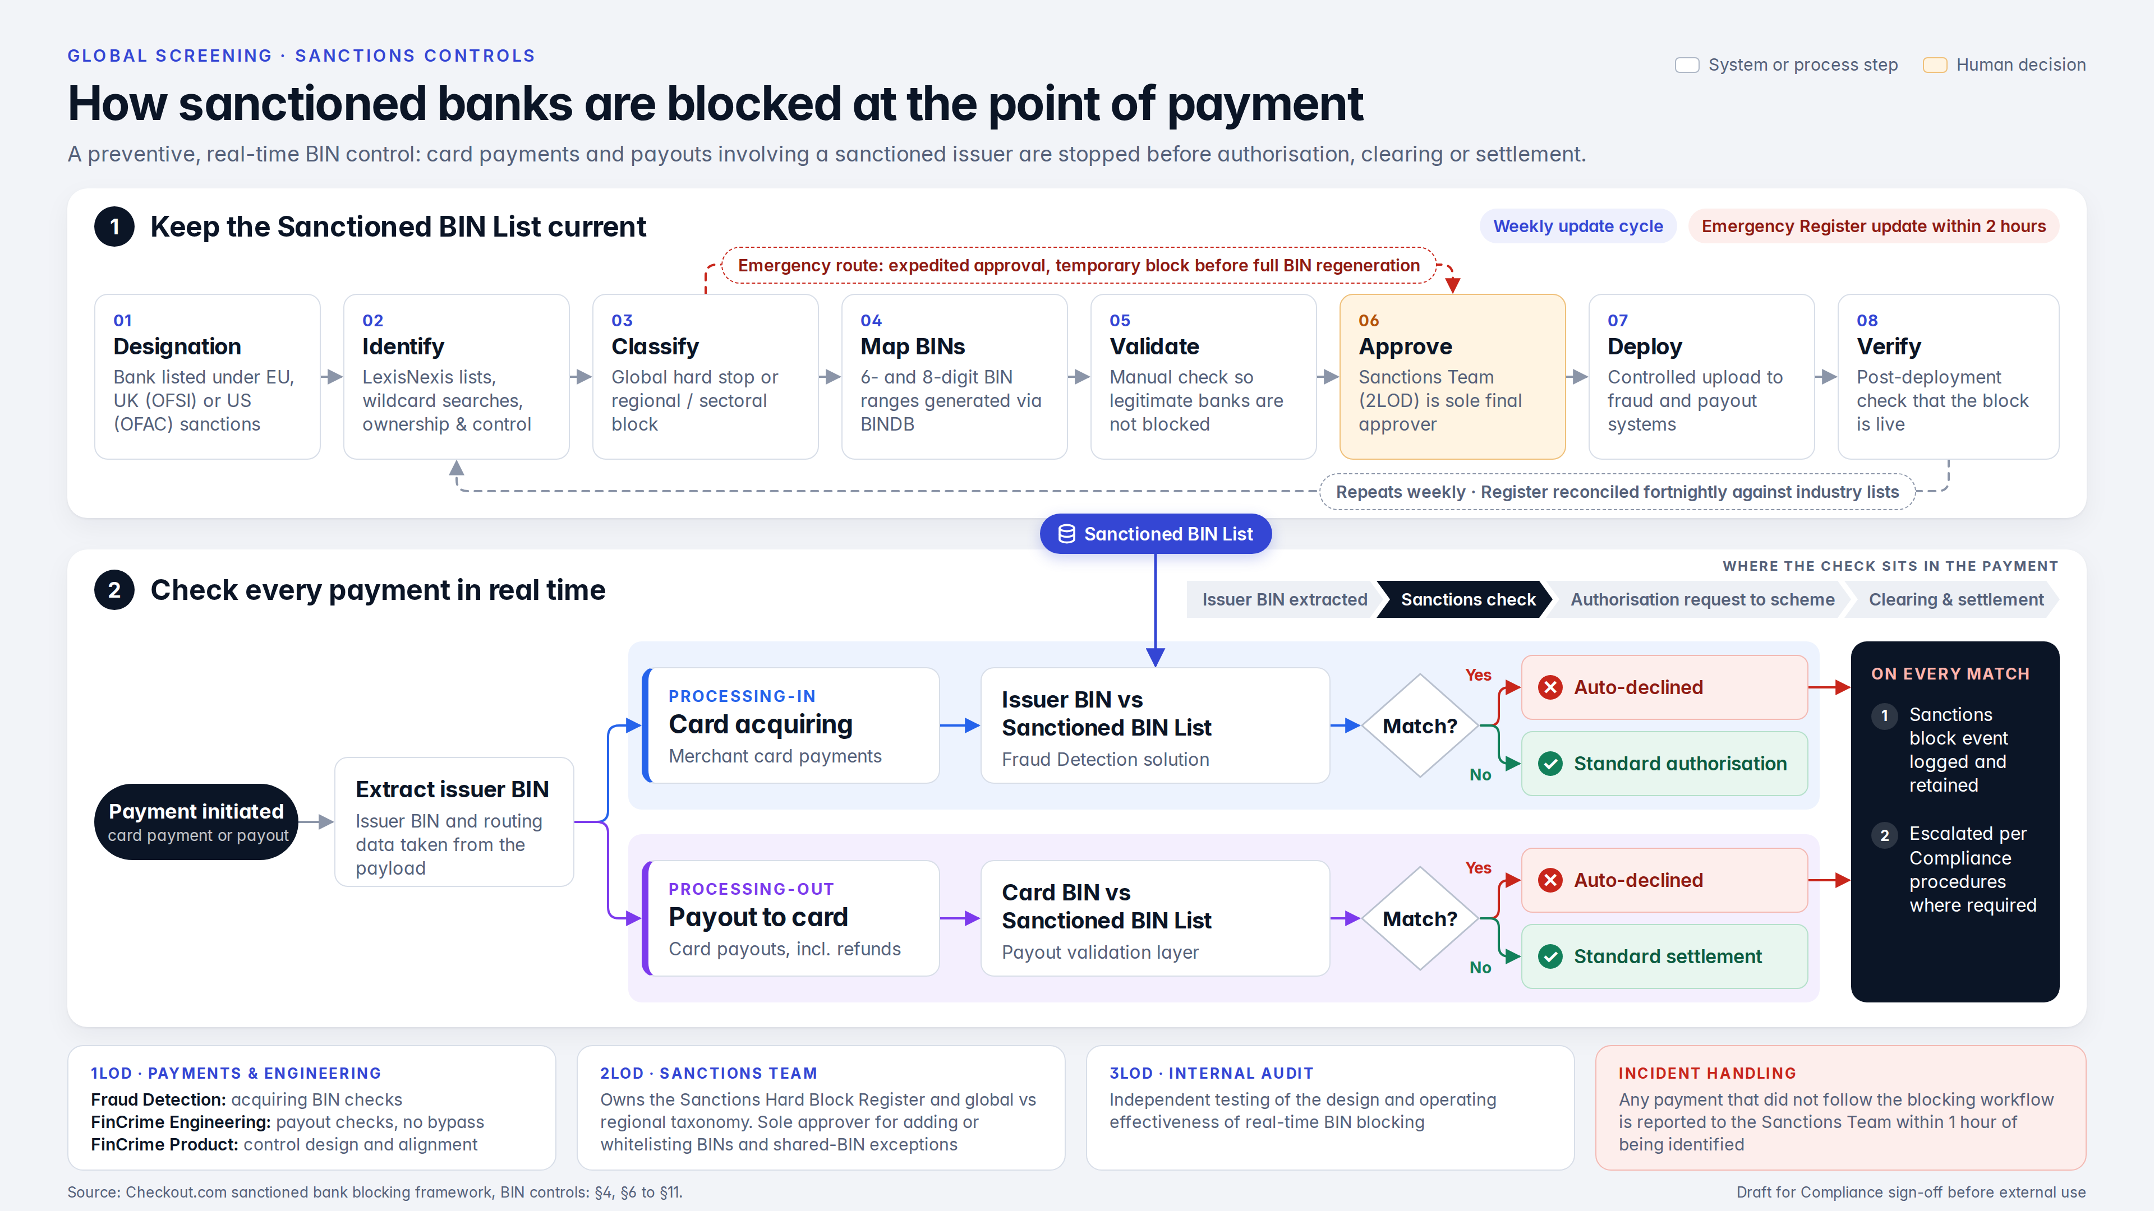
Notes:
Appendix: the whole process on one page. Backup for Q&A, and print the PDF version as a handout; it is too dense to present from.

