Slide 1
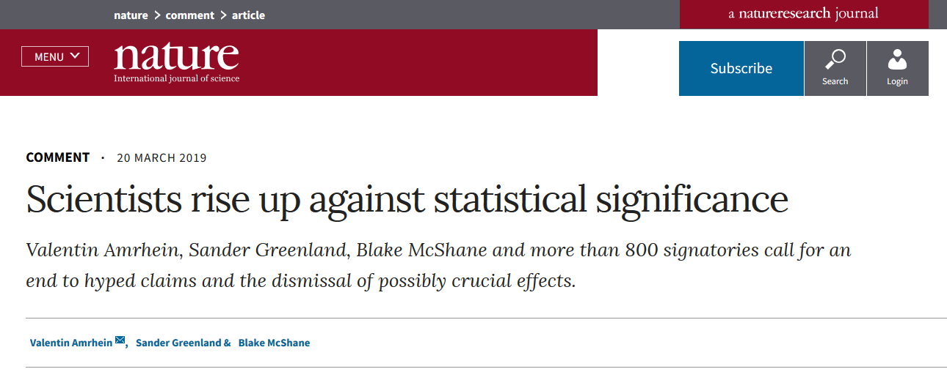

Slide 2


Beyond p <.05: Confidence Intervals in the Evaluation and Reporting of Research Finding
David Schwieder Ph.D.
dschwieder@uflib.ufl.edu
http://arcs.uflib.ufl.edu/

Slide 3
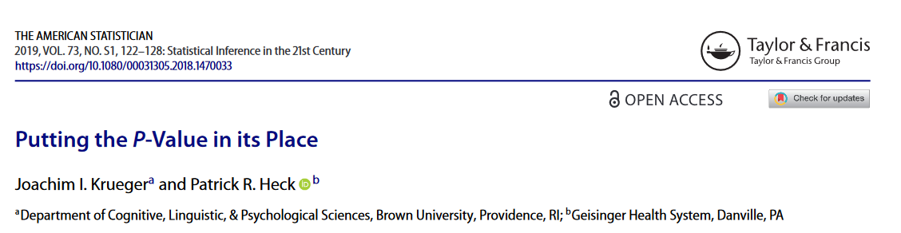

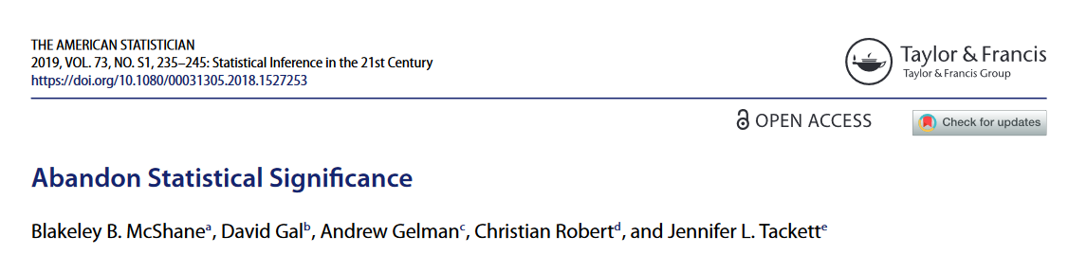


Slide 4
Summary of Some Major Criticisms of NHST (p values/sig. testing)
Reliance on NHST produces misleading results
Sig tests tell us little, by themselves, and discourage consideration of a broader
range of useful information like effect sizes and “substantive
significance”
Sig tests create an artificial dichotomy (Significant/Not significant)
which facilitates a false certainty and obscures the uncertainty
inherent in data analysis and inference
Selective emphasis and publication / ”p-hacking”
Reliance on Sig testing undermines replication of results

Slide 5
Beyond p <.05: Confidence Intervals in the
Evaluation and Reporting of Research Finding

Slide 6
Sig Testing and Confidence Intervals
Sig Testing
Produces a point estimate of a population parameter and an associated
inferential p value
e.g. Mean, Effect Size, etc. p < .05 p = .023***
Confidence Intervals
Produce a point estimate and a surrounding probability interval
e.g. Mean, Effect Size, etc. e95% CI, (3.5 to 7.5) 95% CI [2.47, 2.99]

Slide 7
Definition: Confidence Interval
Common: An interval which has a 95% chance of containing the
population value
More Formally: 95% of all confidence intervals (obtained from
multiple random samples) will contain the true population value
Source: https://rpsychologist.com/d3/CI/
In practice, these mean the same thing: If 95% of the sample
CI’s contain the true Pop. Value, there is a 95% chance that your
sample is one of these – Thus your CI has a 95% chance of
containing the Pop. Value
So we can legitimately use the common interpretation

Slide 8
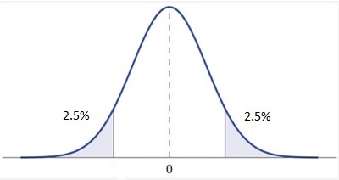
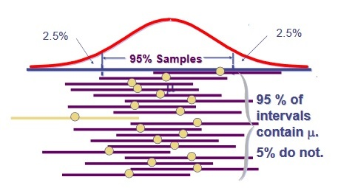
Calculation of p Values/Significance and Confidence Intervals
Sig Test: Posit the Sampling Dist. under the Null Hyp, then reject Null when the prob. of obtaining your Sample Mean or Effect Size under a correct Null is less than .05 / 5%
C.I.: Posit the Sampling Dist. of the Population, Draw CI “Borders” to include 95% of samples, these will be the samples that encompass the true Pop Value.
Source: Prof. Guang-Hwa "Andy" Chang,
http://gchang.people.ysu.edu/class/mph/note/06_5_CI_Ch8_9_CLT_CI.pdf

Slide 9
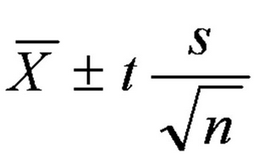
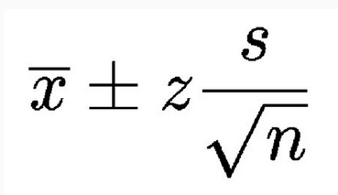
Calculation of Confidence Interval for the Mean

Slide 10
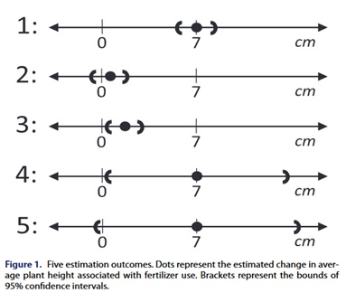
What do Confidence Intervals Tell You?
1) Provides range of plausible pop. values
i.e. the effect sizes most compatible with
the data
2) Shows precision of pop. estimate
3) Supports comparison/Meta analysis
4) Performs significance test
Example: Effect of New Fertilizer on Corn Plant Growth
Five Scenarios

Slide 11
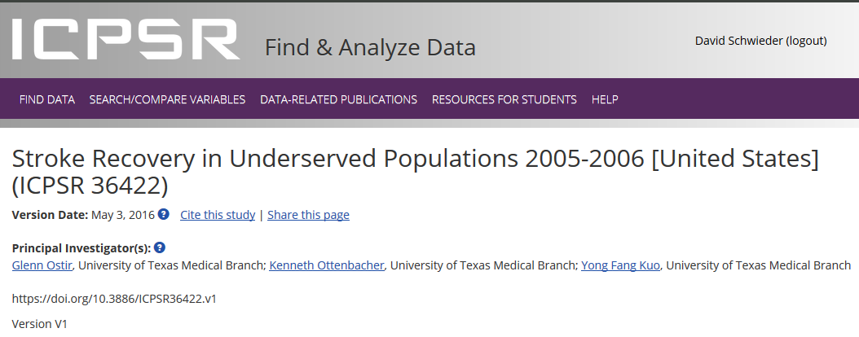
The Stroke Recovery in Underserved Populations 2005-2006 study was created to address the National Institute on Aging (NIA) Request For Application entitled "Research on Mind-Body Interactions and Health" (RFA OD-03-008). It addressed the NIA interest in "the impact of optimism, happiness, or a positive attitude on well-being and health; and social functioning and health." The study examined how positive emotion (e.g., joy, gratitude, love, contentment) and social networks independently and interactively contribute to recovery of functional status after stroke within two underserved groups.

Slide 12
CI: ANOVA/t-test example
Research Question:
Does pain at admission differ for male and female
stroke patients?
Dep Variable Factor
Reported pain Sex
0 -- 10 Female 0, Male 1
Low High

Slide 13
CI: Regression Example
Research Question:
What factors affect post-stroke mobility?
Age →
Sex →
Comorbidity: Heart Disease →
Distance walked
Comorbidity: Obesity →
Complication: Bedsores →
Distance walked at admission →

Slide 14
Dep Variable:
Distance Walked 12 mos. Post-Discharge
0 Did not walk
1 < 50 feet
2 50-149 feet
3 > 150 feet
Ind Variables:
Age
Sex (Female 0, Male 1)
Comorbidity: Heart Disease (No 0, Yes 1)
Comorbidity: Obesity (No 0, Yes 1)
Complication: Bedsores (No 0, Yes 1)
Distance Walked at Discharge 0 Did not walk
1 < 50 feet
2 50-149 feet
3 > 150 feet

Slide 15
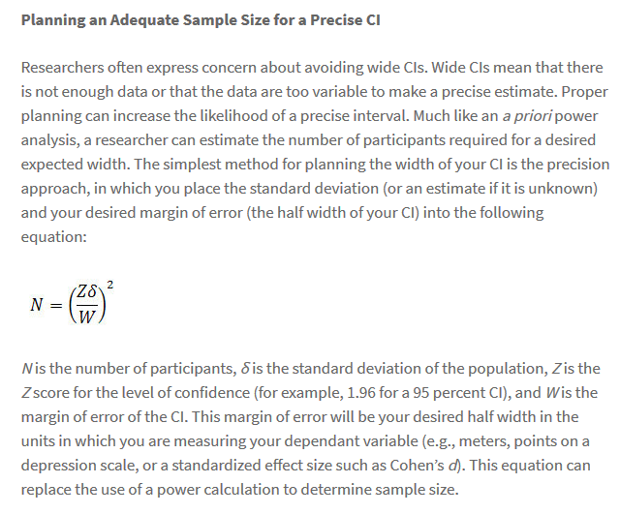
Planning for Confidence Interval Research: CI Precision
Source: https://www.psychologicalscience.org/observer/understanding-confidence-intervals-cis-and-effect-size-estimation

Slide 16
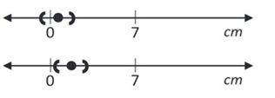
Advanced CI Approaches
1) Leverage the Correspondence between p values and CI
Based on expert judgment and past research, determine a minimal substantively meaningful effect size
Calculate the lower bound of the desired CI that corresponds to the minimum substantively meaningful effect size
Then take advantage of correspondence between p values and CI. Again:
Use sample size, desired CI %, and correspondence between CI and p to calculate largest acceptable p value that accords with that lower CI bound. That is your threshold for rejecting the null.

Slide 17
Advanced CI Approaches
2) Analysis of Credibility
1The study finding is summarized using standard methods as a 95% CI (L, U); this represents
the likelihood, with point estimate M
This likelihood is then used to deduce the range of prior effect sizes which, when combined
with the likelihood, lead to a posterior range that just excludes no effect at the 95% level. The
resulting critical prior interval (CPI) is used to assess the credibility of a finding, according to
whether it is statistically significant or not.
For example, if the effect size is stated as a difference in means or proportions, the CPI
for statistically significant findings is (-SL, +SL), where SL is the skepticism limit
calculated from the likelihood (L,U).
For statistically nonsignificant findings, the CPI is (0, AL), where AL is the advocacy limit
(AL).
To assess the credibility of the finding under AnCred, this CPI is compared with effect sizes
supported by prior evidence, in the form of CIs or plausible ranges
Matthews, R.A.J.(2019). “Moving Towards the Post p < 0.05 Era via the Analysis of Credibility.” The American Statistician, 73, 202-212.

Slide 18
Other Alternative Approaches
Use Lower p value
Use smaller p values: e.g. .005 values between .05 and .005 are “suggestive”
Complement p values with additional criteria
Alternate null hypothesis
“Second Generation p Values”: Compute a composite null hypothesis based on
a range of substantively unimportant effect sizes instead of zero
Multiple p values
Supplement the traditional .05 p value with a p value from a sig test calculated
on a minimal substantively important effect size instead of zero
Supplement p value with a measure of effect size
Require both a small p value and a pre-specified sufficiently large effect size
to assert significance
Consider p values within a wider context
Consider p values within the wider context of your sample size, your effect size,
prior results, novelty of your findings, and your model assumptions and
properties

Slide 19
Other Alternative Approaches (Cont’d)
Treat p values as continuous measures—not dichotomous
Don’t say “significant”
Complement p values with Bayesian Analysis
Abandon p values/NHST entirely
Use Bayesian analysis
Decide based on all information available: sample size, effect size,
prior results, novelty of findings, and model assumptions and
properties

Slide 20
Broader changes
Report all study results in papers —”sig” and non-sig No p-Hacking
Solicit expert knowledge to interpret importance of p and results
Accept uncertainty Treat inferential stats as “highly unstable local descriptions”
Don’t “expect” replication
View research as body of literature, not in terms of an isolated single study
“Remarkable New Study Reveals”
Changes in professional education, institutional and journal practices

Slide 21
The End

Slide 24
Based on judgment and past research, determine a minimal substantively meaningful effect size
Use sample size, desired CI % and the correspondence between p values and CIs to calculate p value that corresponds to the lower endpoint of the CI.
Based on expert judgment and past research, determine a minimal substantively meaningful effect size
Calculate the lower bound of the desired CI that corresponds to the minimal substantively meaningful effect size.
Then take advantage of correspondence between p values and CI. Use sample size, desired CI %, and correspondence between CI and p to calculate largest acceptable p value that accords with that lower CI bound. That is your threshold for rejecting null.

Slide 25
ASA Statement on Statistical Significance and P-Values
Six Principles
P-values can indicate how incompatible the data are with a specified statistical model.
P-values do not measure the probability that the studied hypothesis is true, or the probability that the data were produced by random chance alone.
ED 7 much less than you think
Scientific conclusions and business or policy decisions should not be based only on whether a p-value passes a specific threshold.
Proper inference requires full reporting and transparency.
A p-value, or statistical significance, does not measure the size of an effect or the importance of a result.
By itself, a p-value does not provide a good measure of evidence regarding a model or hypothesis.

Slide 26
Summary Points
p values are overused
Over-reliance on p values produce misleading results
p hacking
divorced from effect size/sub significance
Dichotomoy is brute
Masks uncertainty / ubiquity of uncertainty /
accept unc—researchers must communicate the sampling and modeling uncertainties assoc with their findings. And 121
Suggest “no difference” when difference exists
Produces lack of replicability
overconfidence
Suggests categorical difference
Nexus of openness and modesty

Slide 27
Solutions
dichotomy/point estimates -> continuous
p → CI
Compatibility intervals MCS 2/5 4/5/ Greeland, AM p3
AnCred Mathews
Comp ints bring in effect size in a natural way, me
surrounding/context
model assumptions must consider/be grounded in theory and evidence
Specs of model—Anderson /thoughtful/res design Ed 4
Previous work
effect size /sub sig
Meta analyses ED 3
theory
supplement p values
BFB
Goodman et al, 2 stage, small p and big effect size = sig
Gannon et al—hybrid freq and bayes
Mathews, alloyed, side by side old and new
expert judgment
See ed 6 on mcshane – context and res design
Bet interp p within sample and effect size/also procedure
One study is rarely enough ED 6
Byline status for replicants Ed 6
Modestly in rep expectations Ed 6 80 % power

Slide 28
Inst changes Ed 7
Social change in insts, jnls, funding and regulatory agencies
Trafimow five changes Kmetz agrees, suggests this would let reviwers focus on research designs.
Am—all should be published McShane says this too
Acceptance based on quality of materials and methods rather than results
Send ASA statement to jnl editors
Stat education

Slide 29
Careful attention to modeling assumptions. Validity/plausibility of modeling assumptins—adequacy, not perfection.
Check to see how estimates change across a range of plausible modeling assumtions. Ad hoc, or Bayesian model averaging, robustness checks
Replicablity will be clearer—can see why no rep ED 1

Slide 30
Difficutly of change
Baby steps, Benjamin
Mathews, side by side, alloyed
Some urge band aid flat abandonment

Slide 31
“Regardless of whether it was ever useful, a declaration of statistical significance has today become meaningless.” ED 2
“Bright line rules can lead to erroneous beliefs and poor decision making.”
“As statistical sig is used less, stat thiking will be used more. ED 1
A label of ss adds nothing to what is already conveyed by the value of p ED 2, but dich makes it worse.
Worthy vs unworthy results. ED 2
Stats as a simple model – Ed 6 Am quote
No one true model ED6
Stat inf does not = sci inf
“The ASA statement is intended to steer research into a ‘post p<0.05 era.”
“Having confidence in generalizations from single studies means having overconfidence in most cases. Inference that would be called trustworthy would require merging information from multiple studies and lines of evidence.” Am 264
“The Replication crisis is mainly a crisis of overconfidence in statistical results.” Am 262

Slide 32
The controversy
show headlines/articles
Nature of controversy – p hacing, example
Solutions
CI –rubik’s cube
Anderson Diagram on 119, diagram shows that sig is not proxy for magnitude or precision.

Slide 33

… Yet many researchers persist in working in a way almost guaranteed not to deliver meaningful results. They ride with what I refer to as the four horsemen of the reproducibility apocalypse: publication bias, low statistical power, P-value hacking and HARKing (hypothesizing after results are known). My generation and the one before us have done little to rein these in.

Slide 34
The biomedical and social sciences are facing a widespread crisis with published findings failing to replicate at an alarming rate. Often, such failures to replicate are associated with claims of huge effects from subtle, sometimes even preposterous, interventions. Further, the primary evidence adduced for these
claims is one or more comparisons that are anointed “statistically significant”—typically defined as comparisons with p values less than the conventional 0.05 threshold relative to the sharp point null hypothesis of zero effect and zero systematic error.
Indeed, the status quo is that p < 0.05 is deemed as strong evidence in favor of a scientific theory and is required not only for a result to be published but even for it to be taken seriously.
[T]here is an epidemic of misinterpretation of statistics and what amounts to scientific misconduct, even though it is common practice (such as selectively reporting studies that “worked” or that were “significant.

