Slide 1
Getting Started in R

Slide 2
Presenter
Dan Maxwell
Informatics Consultant
Marston Science Library
danielmaxwell@ufl.edu
Notes:
I started programming some 30 years ago – my first “real” program was a dbase III+ application, written in 1987 or so.

Slide 3
Agenda
Learning Strategies
Architecture
Resources
Introduction to RStudio & R as Calculator
Seeking Help
Notes:
Okay – let’s get started. Here’s what we’re going to cover today. In today’s presentation, I’m going to introduce you to Rstudio – one of the most popular Integrated Development Environments or IDE’s. We’ll then take a look at some basic functions for managing your environment, followed by a short discussion on getting help.

Slide 4
Learning Strategies
Space out your practice sessions
Don’t cut-and-paste code – type it out
Errors and warnings are learning opportunities
Start with what works and build out
Stuck? – Ask for help

Slide 5
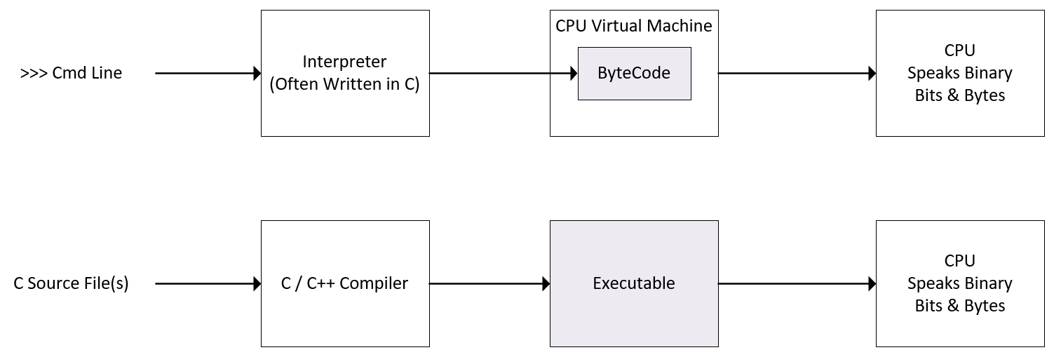
Architecture
Notes:
Interpreted languages are much slower than compiled languages. When performance matters, an interpreted language is not the best solution. I’ve had multiple consults where clients have bumped into R performance issues. Refer to Hadley Wickham’s Advanced R for performance tuning tips.

Slide 6
Resources
Introduction to R https://github.com/mydatastory/r_intro_class/tree/master/_episodes_html
Stack Overflow
https://stackoverflow.com/tags
Kaggle Micro Courses
https://www.kaggle.com/learn/overview
Notes:
Intro to R: Online R learning experience
Stack Overflow: An indispensable resource for R programming questions
Kaggle Micro Courses: Already shared by your instructor – Coursera and EdX also offer free courses

Slide 7

Variables and Memory
Notes:
In statistics, a variable is a measured attribute or trait that varies from case to case. For example, when measuring the running speed of college sophomores, running speed is variable because each student runs at a different speed.
In computer science, a variable still varies from case to case. But it also “names” a specific location of memory. Behind the name you assign to a variable, there’s a hidden address or pointer to its location or compartment in memory.

