Slide 1
Introduction to R for Applied Statistical Methods
Larry Winner
University of Florida

Slide 2
Reading In External Data (Fixed Width)
Data are in external ASCII file with each variable assigned to a “fixed field”, with one line per unit
Variable Names are NOT in first row
You will need to give the following information:
The directory and name of the data file (file=)
The width of the field for each variable (width=)
The name of each variable (col.names=)
2 Important Notes for R:
The Command: c(1,2,3) strings the numbers 1,2,3 into a vector (concatenates them) and c(“A”,”B”,”C”) does same for the characters A,B,C
To assign a function or data to a variable name, the command: <- is used as opposed to =
y <- c(20,60,40) creates a vector y with 3 rows (cases)

Slide 3
Example Data File
File Contains 6 Variables in Fixed Column format
Var1 ≡ Student Name in Columns 1-30
Var2 ≡ College/Year Code in Columns 31-33
Var3 ≡ Exam 1 Score in Columns 34-41
Var4 ≡ Exam 2 Score in Columns 42-49
Var5 ≡ Project 1 Score in Columns 50-57
Var6 ≡ Project 2 Score in Columns 58-65
Note Var1 is of Length 30, Var2 3, All Others 8

Slide 4
*****************************************************************
00000000011111111112222222222333333333334444444444555555555666666
12345678901234567890123456789012345678901234567890123456789012345
*****************************************************************
SMITH ROBERT 7TD 71 83 14 19
WILSON JENNIFER 8RZ 92 89 18 20
NGUYEN QI 9YX 84 79 17 15
Note: The first 4 rows are only there to show the fixed width format, and would not be part of the data file.
Assume the following information:
File Name: sta666.dat
Data File Directory: C:\data
R Program Directory: C:\Rmisc
In the R program sta666.r, we want to read in this data.
We will assign it the name grades666 within the program, and assign names to the variables as well as their field lengths.

Slide 5
R Command to Read in Data File
grades666 <- read.fwf(
file="C:\\data\\sta6166.dat",
width=c(30,3,8,8,8,8),
col.names=c("Student", "Collyear", "Exam1", "Exam2", "Project1", "Project2"))
attach(grades666)
Note that grades666 is now a “data frame” containing 6 variables.
You have “told” R where the dataset is (C:\data\sta6166.dat, but note you had to use 2 back slashes, you could have also used a single forward slash)
You “told” R there were 6 variables in fields of widths 30,3,8,8,8,8, respectively
You have assigned names to the variables
Originally, to R, the exam1 score is: grades666$Exam1
By adding the line: attach(grades666) you can use the shorter label Exam1 instead of grades666$Exam1 in future commands

Slide 6
Handling Categorical (Factor) Variables
In many applications, we have categorical variables that are coded as 1,2,…as opposed to their actual levels (names).
In R, you need to inform the program that these are factor levels, not the corresponding numeric levels (so it can differentiate between a 1-Way ANOVA and Simple Regression, for instance).
You also may wish to give the levels character names to improve interpreting output.

Slide 7
Example Inoculating Amoebae
1 265
1 292
1 268
1 251
1 245
1 192
1 228
1 291
1 185
1 247
2 204
2 234
2 197
2 176
2 240
2 190
2 171
2 190
2 222
2 211
3 191
3 207
3 218
3 201
3 192
3 192
3 214
3 206
3 185
3 163
4 221
4 205
4 178
4 167
4 224
4 225
4 171
4 214
4 283
4 277
5 259
5 206
5 179
5 199
5 180
5 146
5 182
5 147
5 182
5 223
5 Methods of Inoculation (Conditions)
None (Control)
Heat at 70C for 10 minutes (Heat)
Addition of 10% Formalin (Form)
Heat followed by Formalin (HF)
Formalin, followed after 1 hour by heat (FH)
n=10 Replicates per Condition (N=50)
Y=Yield (10⁻⁴)
Method is in Columns 1-8
Yield is in Columns 9-16
Data is in C:\data\amoeba.dat
Program in C:\Rmisc\amoeba.r

Slide 8
Reading in Data and Declaring Factor
amoeba <- read.fwf(
file="http://www.stat.ufl.edu/~winner/data/entozamoeba.dat",
width=c(8,8), col.names=c("method", "yield"))
attach(amoeba)
method <- factor(method, levels=1:5,
labels=c("Control", "Heat", "Form", "HF", "FH"))
method
method was originally to be treated as interval scale (like if it had been a dose)
Within the FACTOR command, we change it to being a categorical variable by giving its levels (1,2,3,4,5) and assigning names to those levels (Control, Heat, Form, HF, FH)
In Place of levels=1:5 we could have used levels=c(1,2,3,4,5)

Slide 9
Obtaining Summary Statistics
Directly obtain summary statistics for variables in R
You can simply have the statistic computed
You can save the value of statistic to variable for future use
Common Statistical Functions (x is the variable):
Average: mean(x)
Standard Deviation: sd(x)
Variance: var(x)
Median: median(x)
Quantile (0<p<1): quantile(x,p)
Correlation (Between vars x and y): cor(x,y)
Coefficient of Variation: 100*sd(x)/mean(x)
Min, LQ, Median, Mean, UQ, Max: summary(x)
Obtained by Group: tapply(x,groupvar,mean) where mean can be replaced by sd, var, …

Slide 10
Program – PGA/LPGA Driving Distance/Accuracy
pdf("pgalpga1.pdf")
pgalpga <- read.fwf(
file="http://www.stat.ufl.edu/~winner/data/pgalpga2008.dat",
width=c(8,8,8),
col.names=c("Distance", "Accuracy", "Gender"))
attach(pgalpga)
Gender <- factor(Gender, levels=1:2, labels=c("Female", "Male"))
mean(Distance); mean(Accuracy)
sd(Distance); sd(Accuracy)
tapply(Distance, Gender, mean); tapply(Accuracy, Gender, mean)
tapply(Distance, Gender, sd); tapply(Accuracy, Gender, sd)
dev.off

Slide 11
Output – PGA/LPGA Driving Distance/Accuracy
> mean(Distance); mean(Accuracy)
[1] 269.5116
[1] 65.23927
> sd(Distance); sd(Accuracy)
[1] 22.19603
[1] 5.973796
>
> tapply(Distance, Gender, mean); tapply(Accuracy, Gender, mean)
Female Male
246.8013 287.6107
Female Male
67.59108 63.36497
> tapply(Distance, Gender, sd); tapply(Accuracy, Gender, sd)
Female Male
9.493797 8.554456
Female Male
5.768708 5.461109

Slide 12
Tables for Categorical Data
For categorical variables, we use frequency (and relative frequency) tabulations to describe data
Frequency Tabulation: table(x)
Relative Frequencies: table(x)/sum(table(x))
For contingency tables (pairs of variables)
Frequency Cross-tabulation: table(x,y)
Row Marginal totals for x: margin.table(table(x,y),1)
Column totals for y: margin.table(table(x,y),2)
Relative Freq Cross-tab: table(x,y)/sum(table(x,y))
Extends to more than 2 Dimensions

Slide 13
Program – UFO Encounters
pdf("ufocase.pdf")
ufo <- read.fwf(file="http://www.stat.ufl.edu/~winner/data/ufocase.dat",
width=c(4,52,16,3,4,4,4),
col.names=c("Year", "Event", "Loc", "Effect", "Photo", "Contact", "Abduct"))
attach(ufo)
Effect <- factor(Effect,levels=0:1,labels=c("No", "Yes"))
Photo <- factor(Photo,levels=0:1,labels=c("No", "Yes"))
Contact <- factor(Contact,levels=0:1,labels=c("No", "Yes"))
Abduct <- factor(Abduct,levels=0:1,labels=c("No", "Yes"))
table(Effect); table(Photo); table(Contact); table(Abduct);
table(Photo,Contact)
margin.table(table(Photo,Contact),1) # Row Totals Computed
margin.table(table(Photo,Contact),2) # Column Totals Computed
table(Photo,Contact)/sum(table(Photo,Contact))
dev.off()

Slide 14
Output – UFO Encounters
> table(Effect); table(Photo); table(Contact); table(Abduct);
Effect
No Yes
74 129
Photo
No Yes
141 62
Contact
No Yes
146 57
Abduct
No Yes
182 21
>
> table(Photo,Contact);
Contact
Photo No Yes
No 100 41
Yes 46 16

Slide 15
Output – UFO Encounters
> margin.table(table(Photo,Contact),1)
# Row Totals Included
Photo
No Yes
141 62
> margin.table(table(Photo,Contact),2)
# Column Totals Included
Contact
No Yes
146 57
>
> table(Photo,Contact)/sum(table(Photo,Contact))
Contact
Photo No Yes
No 0.49261084 0.20197044
Yes 0.22660099 0.07881773

Slide 16
Summarizing a Single Numeric Variable
Index Plot – Plot of Response against its position in dataset
Boxplot – Plot Representing Minimum, Lower Quartile, Median, Upper Quartile, Maximum (and possibly outliers – observations more than 1.5*IQR below (above) the lower (upper) quartile
Histogram – Plot of Frequency across range of values of response (More detail below)
QQ-Plot – Plot of sample quantiles versus corresponding quantiles of a probability distribution
Shapiro-Wilk Test – Used to test for normality

Slide 17
Summarizing LPGA Driving Distances
png("lpga2008plots.png")
lpga2008 <- read.fwf("http://www.stat.ufl.edu/~winner/data/lpga2008.dat",
width=c(30,8,8,8,8,8,8,8,8,8,8),
col.names=c("Name", "Drive", "Accuracy", "Greens", "AvePutts", "SandAttmpts",
"PctSandSv", "PrzRnd", "lnPrzRnd", "Rounds", "GolferID"))
attach(lpga2008)
par(mfrow=c(2,2)) # Put plots in 2 rows/cols on single page
plot(Drive) # Index plot
boxplot(Drive)
hist(Drive)
qqnorm(Drive); qqline(Drive) # Normal QQ-Plot with straight line added
shapiro.test(Drive) # Shapiro-Wilk Stat/P-value H0: Data are Normal
dev.off()

Slide 18
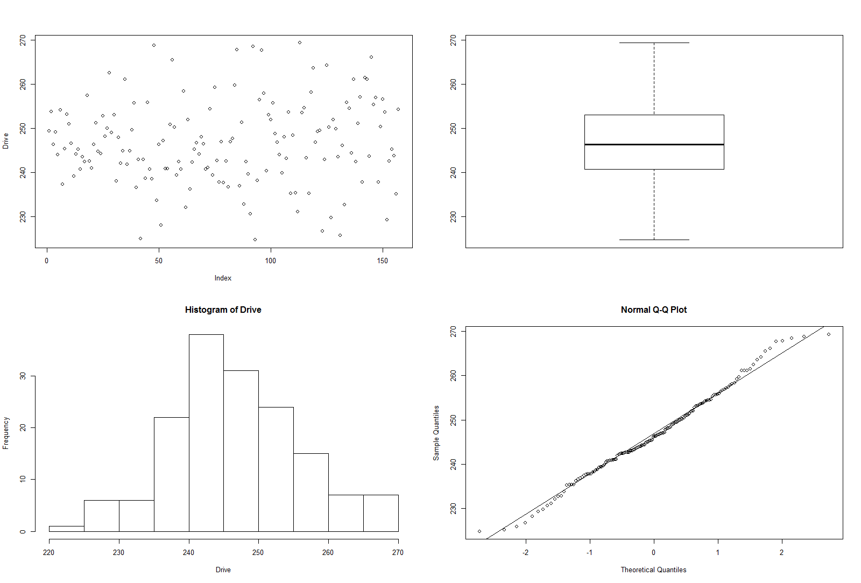
LPGA Driving Distance Output
Shapiro-Wilk normality test
data: Drive
W = 0.99, p-value = 0.3362

Slide 19
Histograms
Histograms for Numeric Data (x is the variable):
Frequency Histogram (Default # of bins): hist(x)
Fixing the number of bins: hist(x, breaks=10)
Fixing the Break Points: hist(x, breaks=c(5,10,15,20))
Relative Freq.: hist(x, probability=T) or hist(x,freq=F)
Density Curves can be superimposed as well (see example on upcoming slide)
Side-by-Side histograms by Group can also be created (see below)

Slide 20
Program – Driving Distance Histogram
pdf("pgalpga1.pdf")
pgalpga <- read.fwf(
file="http://www.stat.ufl.edu/~winner/data/pgalpga2008.dat",
width=c(8,8,8),
col.names=c("Distance", "Accuracy", "Gender"))
attach(pgalpga)
Gender <- factor(Gender, levels=1:2, labels=c("Female", "Male"))
hist(Distance, breaks=seq(220,320,5))
dev.off

Slide 21
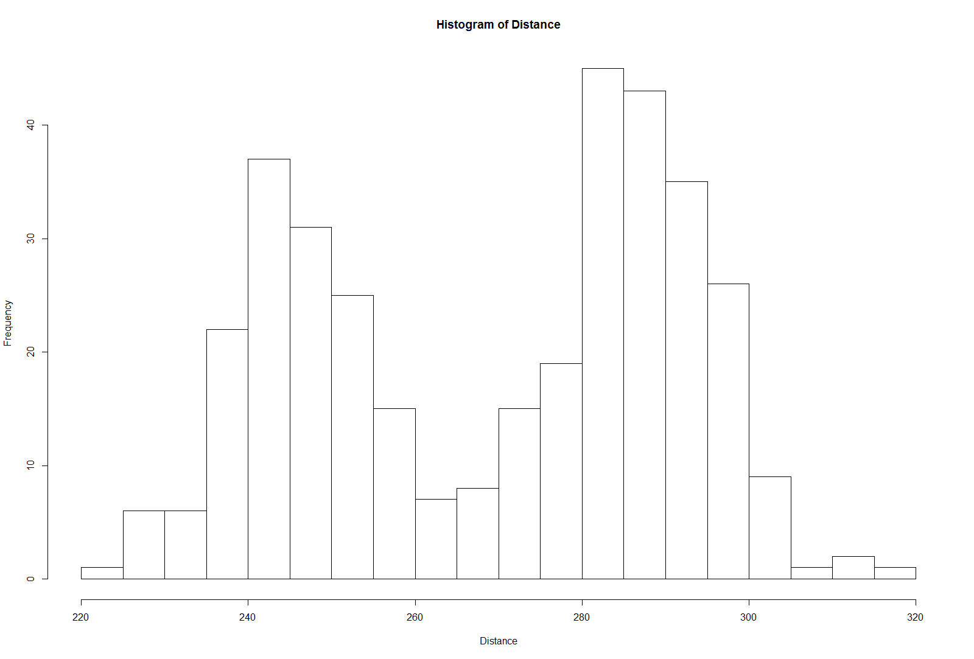

Slide 22
Separate by Gender (Same Range)
pdf("pgalpga2.pdf")
pgalpga <- read.fwf(
file="http://www.stat.ufl.edu/~winner/data/pgalpga2008.dat",
width=c(8,8,8),
col.names=c("Distance", "Accuracy", "Gender"))
attach(pgalpga)
Gender <- factor(Gender, levels=1:2, labels=c("Female", "Male"))
# Create Distance variables seperately by gender
Distance.female <- Distance[Gender=="Female"]
Distance.male <- Distance[Gender=="Male"]
#There will be 2 “rows” and 1 “column” of graphs
# Force each axis to have bins from 220 to 320 by 5 (original scale)
par(mfrow=c(2,1))
hist(Distance.female,breaks=seq(220,320,5))
hist(Distance.male,breaks=seq(220,320,5))
par(mfrow=c(1,1))
dev.off

Slide 23
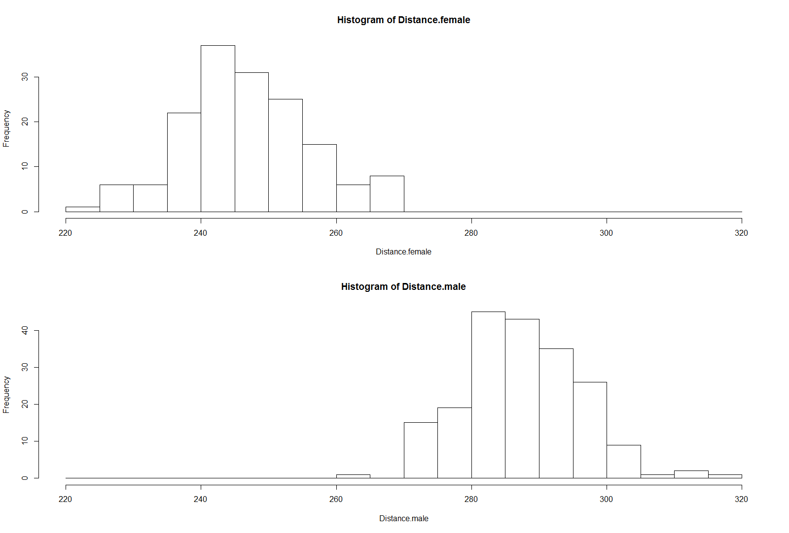

Slide 24
Program – Histogram with Normal Curve
pdf("pgalpga3.pdf")
pgalpga <- read.fwf(
file="http://www.stat.ufl.edu/~winner/data/pgalpga2008.dat",
width=c(8,8,8),
col.names=c("Distance", "Accuracy", "Gender"))
attach(pgalpga)
Gender <- factor(Gender, levels=1:2, labels=c("Female", "Male"))
Distance.female <- Distance[Gender=="Female"]
Distance.male <- Distance[Gender=="Male"]
# Histogram for Male Distances
# ylim command "frames" plot area to avoid “cutting off” curve
# Curve command adds a Normal Density with μ=287.61,σ=8.55
h <- hist(Distance.male,plot=F,breaks=seq(260,320,3))
ylim <- range(0,h$density,dnorm(287.61,287.61,8.55))
hist(Distance.male,freq=F,ylim=ylim)
curve(dnorm(x,287.61,8.55),add=T)
dev.off()

Slide 25
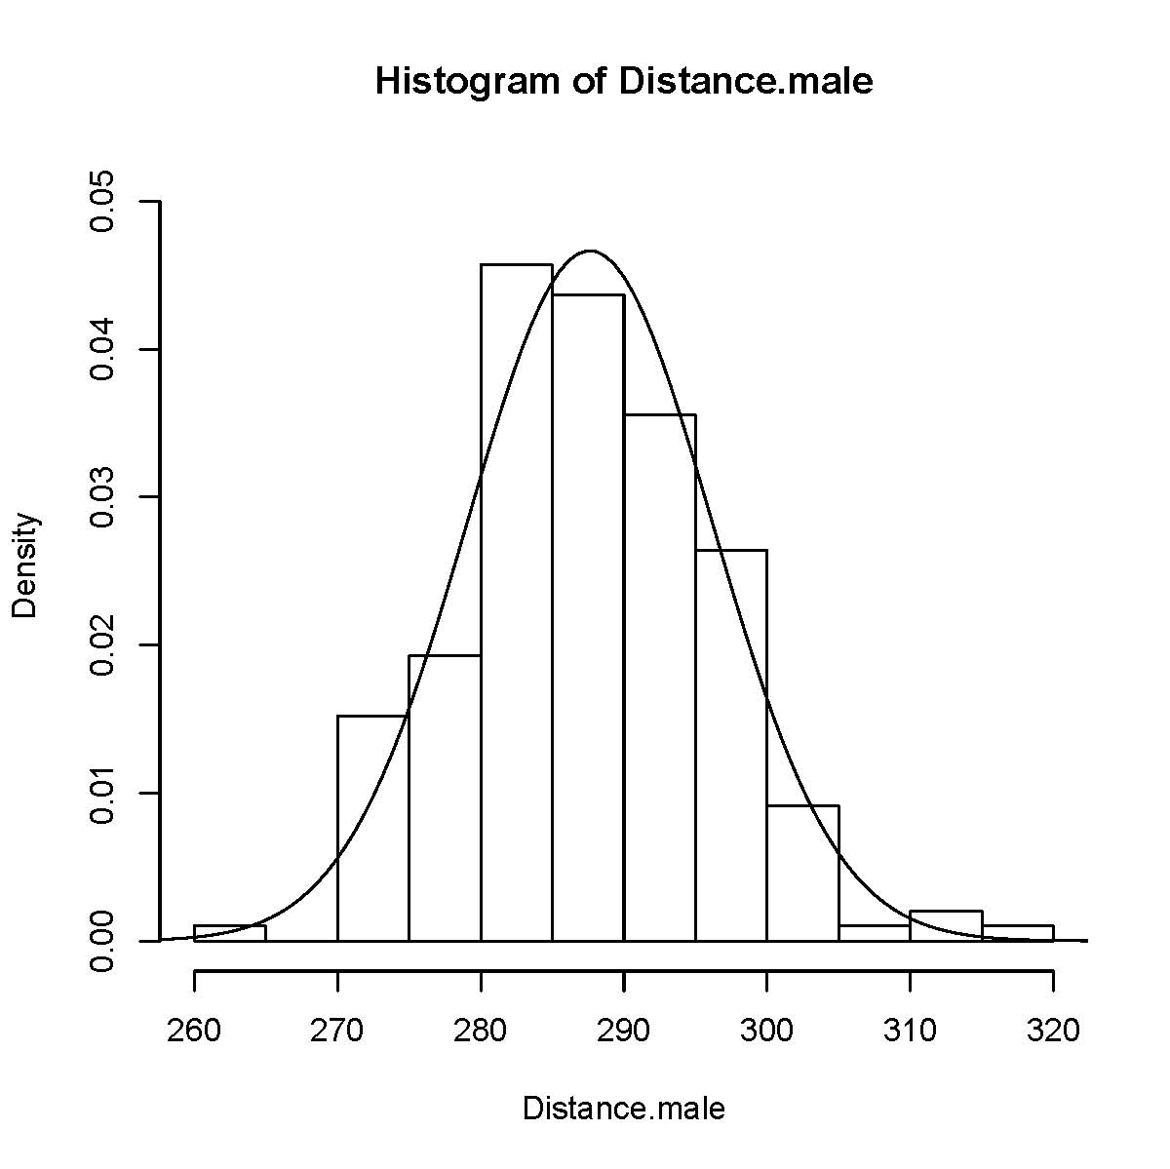

Slide 26
Side-by-Side with Normal Curves
pdf("pgalpga4.pdf")
pgalpga <- read.fwf(
file="http://www.stat.ufl.edu/~winner/data/pgalpga2008.dat",
width=c(8,8,8),
col.names=c("Distance", "Accuracy", "Gender"))
attach(pgalpga)
Gender <- factor(Gender, levels=1:2, labels=c("Female", "Male"))
Distance.female <- Distance[Gender=="Female"]
Distance.male <- Distance[Gender=="Male"]
par(mfrow=c(1,2))
# Histogram for Male Distances
hm <- hist(Distance.male,plot=F,breaks=seq(260,320,3))
ylim <- range(0,hm$density,dnorm(287.61,287.61,8.55))
hist(Distance.male,freq=F,ylim=ylim)
curve(dnorm(x,287.61,8.55),add=T)
# Histogram for Female Distances
hf <- hist(Distance.female,plot=F,breaks=seq(220,270,2.5))
ylim <- range(0,hf$density,dnorm(246.80,246.80,9.49))
hist(Distance.female,freq=F,ylim=ylim)
curve(dnorm(x,246.80,9.49),add=T)
dev.off()

Slide 27
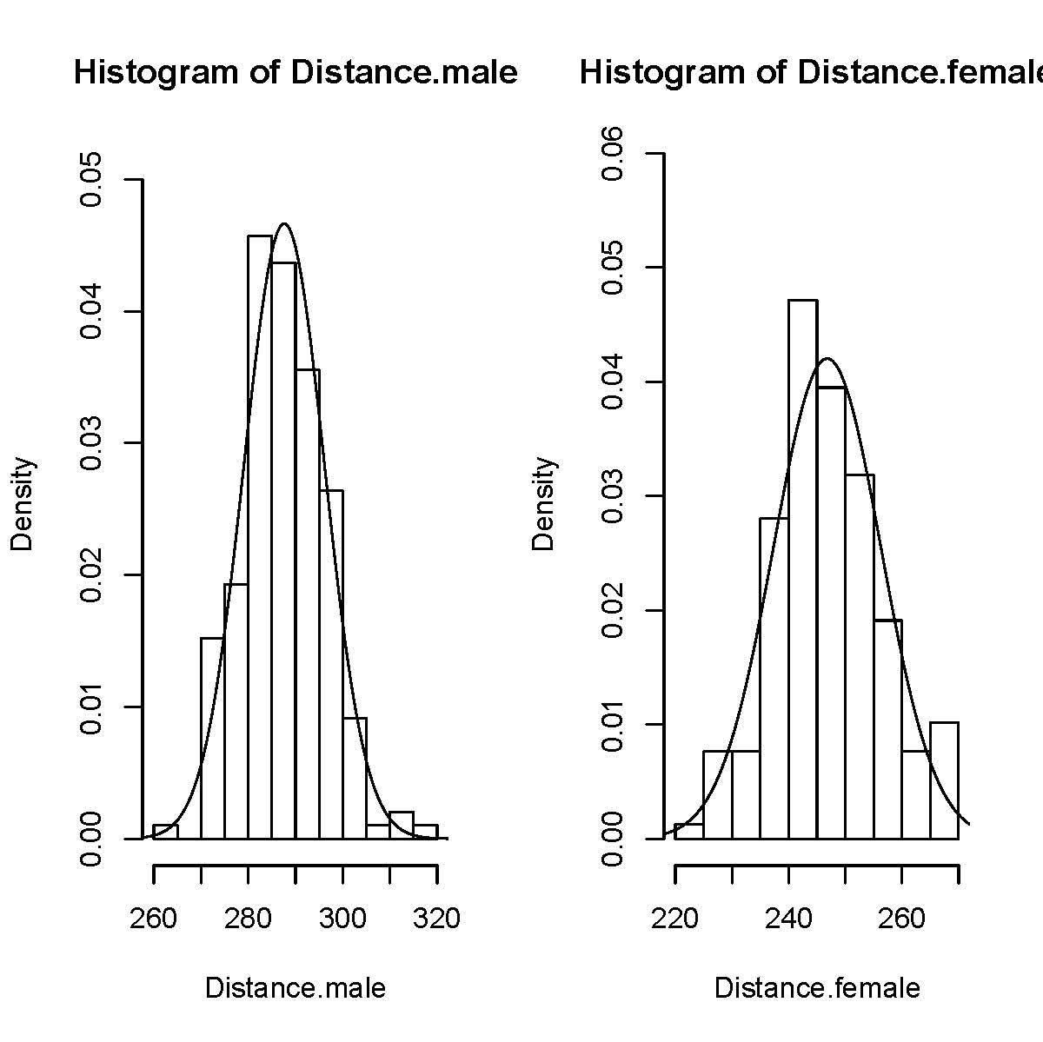

Slide 28
Barplots and Pie Charts
Used to show frequencies for categorical variables
Barplots
Simplest version (single variable): barplot(table(x))
Used to show cross-tabulations: barplot(table(x,y))
Can be structured for side-by-side or stacked (see below)
Pie Charts
Simplest version (single variable): pie(table(x))
Used to show cross-tabulations: pie(table(x,y))
Can be used for Categorical or numeric data

Slide 29
Barplots – UFO Data
pdf("ufocase1.pdf")
ufo <- read.fwf(file="http://www.stat.ufl.edu/~winner/data/ufocase.dat",
width=c(4,52,16,3,4,4,4),
col.names=c("Year", "Event", "Loc", "Effect", "Photo", "Contact", "Abduct"))
attach(ufo)
Effect <- factor(Effect,levels=0:1,labels=c("No", "Yes"))
Photo <- factor(Photo,levels=0:1,labels=c("No", "Yes"))
Contact <- factor(Contact,levels=0:1,labels=c("No", "Yes"))
Abduct <- factor(Abduct,levels=0:1,labels=c("No", "Yes"))
barplot(table(Photo))
dev.off()

Slide 30
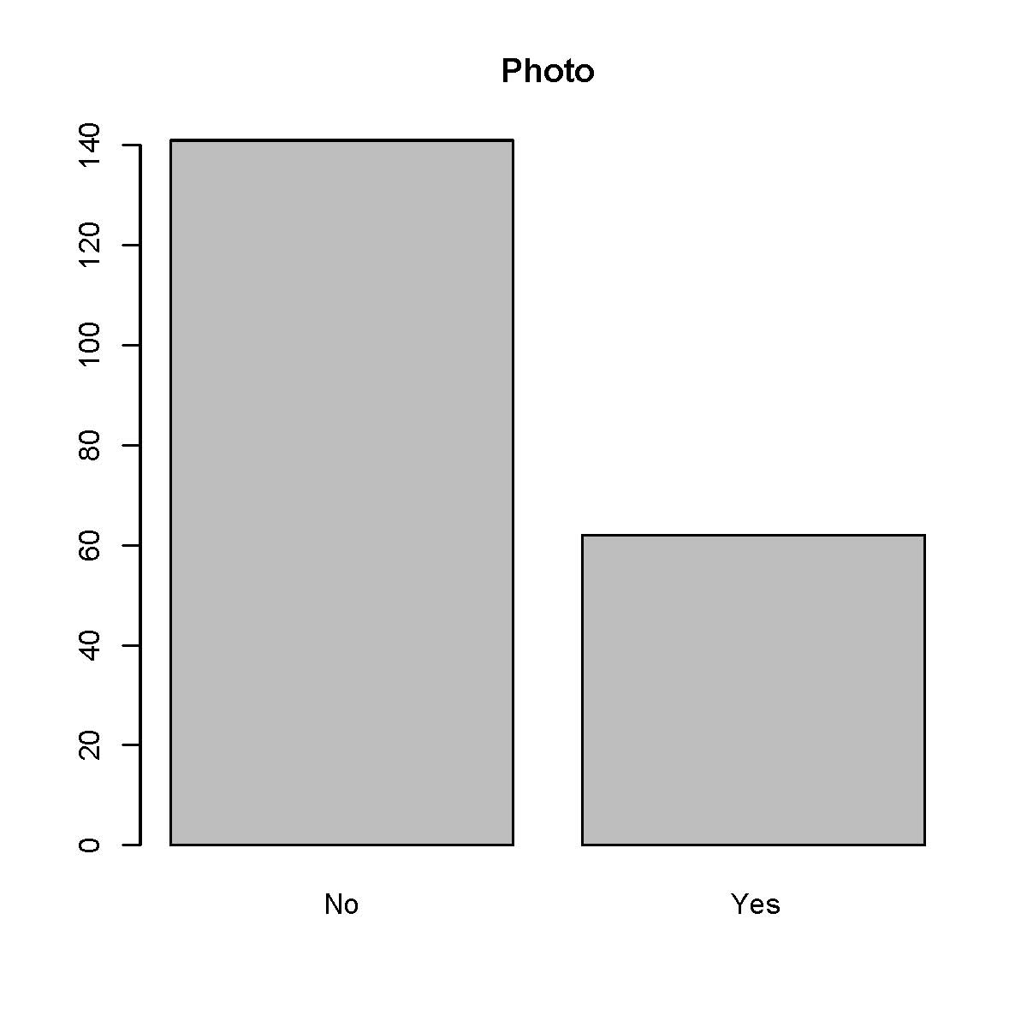

Slide 31
4 Plots of a 2-Way Contingency Table
pdf("ufocase2.pdf")
ufo <- read.fwf(file="http://www.stat.ufl.edu/~winner/data/ufocase.dat",
width=c(4,52,16,3,4,4,4),
col.names=c("Year", "Event", "Loc", "Effect", "Photo", "Contact", "Abduct"))
attach(ufo)
Effect <- factor(Effect,levels=0:1,labels=c("No Effect", "Effect"))
Photo <- factor(Photo,levels=0:1,labels=c("No Photo", "Photo"))
Contact <- factor(Contact,levels=0:1,labels=c("No Contact", "Contact"))
Abduct <- factor(Abduct,levels=0:1,labels=c("No Abduct", "Abduct"))
pht.cntct <- table(Photo,Contact);
# t(x) transposes the table x (interchanges rows/cols)
#prop.table(pht.cntct,2) obtains the proportions separately within columns
par(mfrow=c(2,2))
barplot(pht.cntct)
barplot(t(pht.cntct))
barplot(pht.cntct,beside=T)
barplot(prop.table(pht.cntct,2),beside=T)
par(mfrow=c(1,1))
dev.off()

Slide 32
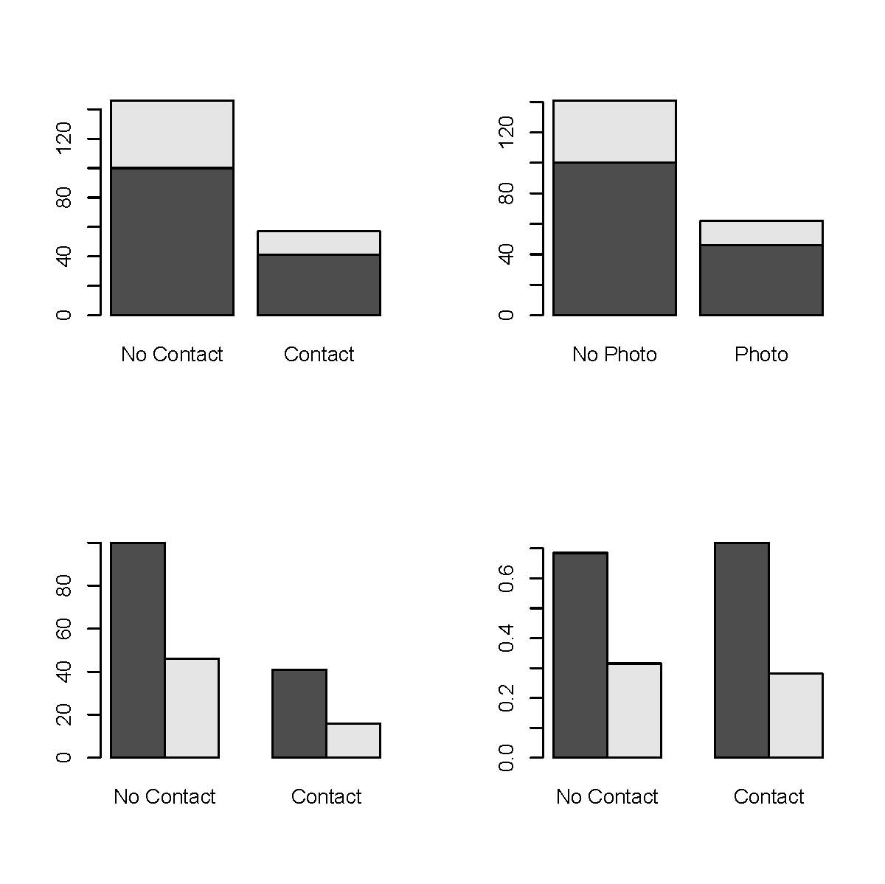

Slide 33
Pie Chart – UFO Data
pdf("ufocase3.pdf")
ufo <- read.fwf(file="http://www.stat.ufl.edu/~winner/data/ufocase.dat",
width=c(4,52,16,3,4,4,4),
col.names=c("Year", "Event", "Loc", "Effect", "Photo", "Contact", "Abduct"))
attach(ufo)
Effect <- factor(Effect,levels=0:1,labels=c("No Effect", "Effect"))
Photo <- factor(Photo,levels=0:1,labels=c("No Photo", "Photo"))
Contact <- factor(Contact,levels=0:1,labels=c("No Contact", "Contact"))
Abduct <- factor(Abduct,levels=0:1,labels=c("No Abduct", "Abduct"))
table(Effect); table(Photo); table(Contact); table(Abduct);
pie(table(Photo),main="Photo Evidence")
dev.off

Slide 34
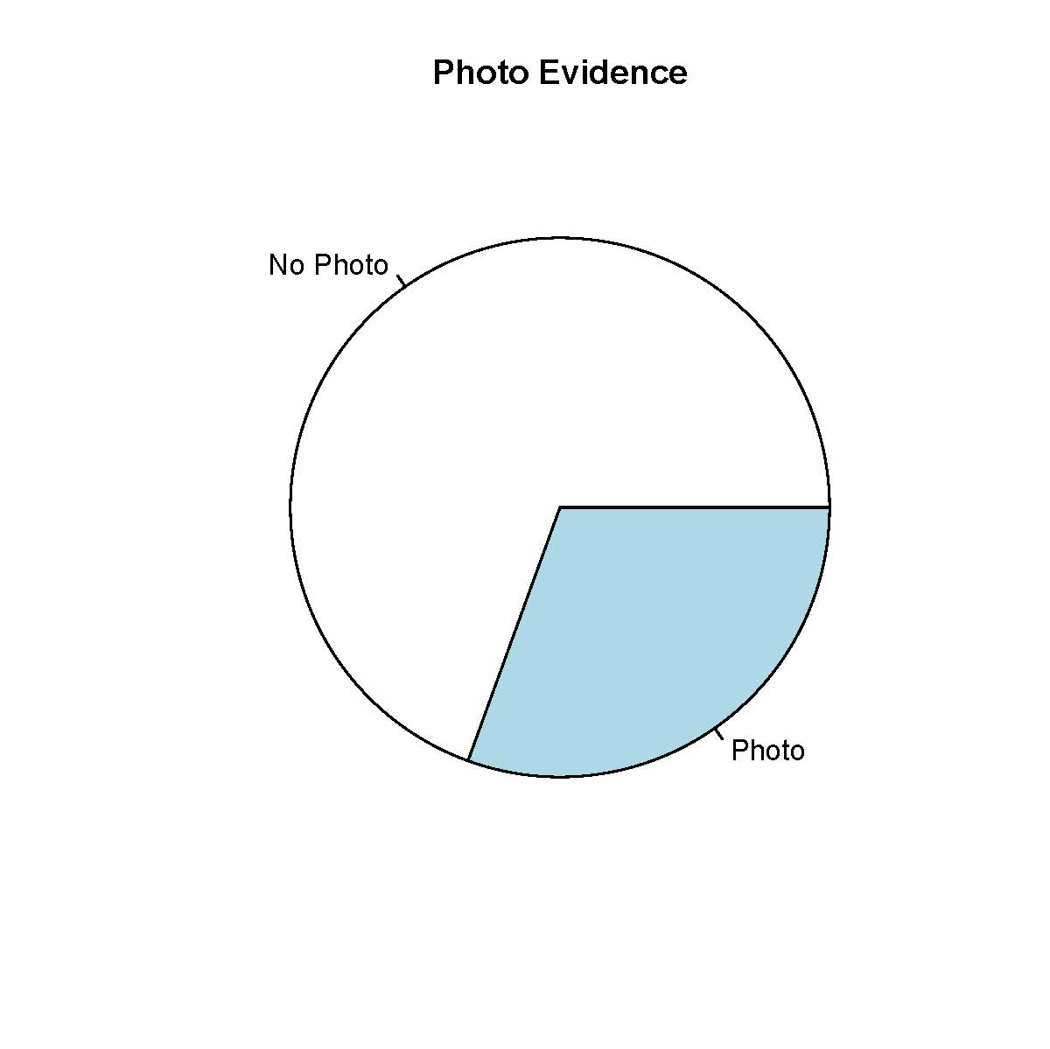

Slide 35
UFO Contact (Column) by Photo (Row) Status
pdf("ufocase4.pdf")
ufo <- read.fwf(file="http://www.stat.ufl.edu/~winner/data/ufocase.dat",
width=c(4,52,16,3,4,4,4),
col.names=c("Year", "Event", "Loc", "Effect", "Photo", "Contact", "Abduct"))
attach(ufo)
Effect <- factor(Effect,levels=0:1,labels=c("No Effect", "Effect"))
Photo <- factor(Photo,levels=0:1,labels=c("No Photo", "Photo"))
Contact <- factor(Contact,levels=0:1,labels=c("No Contact", "Contact"))
Abduct <- factor(Abduct,levels=0:1,labels=c("No Abduct", "Abduct"))
pht.cntct <- table(Photo,Contact);
par(mfrow=c(1,2))
pie(pht.cntct["No Photo",],main="No Photo")
pie(pht.cntct["Photo",],main="Photo")
par(mfrow=c(1,1))
dev.off()

Slide 36
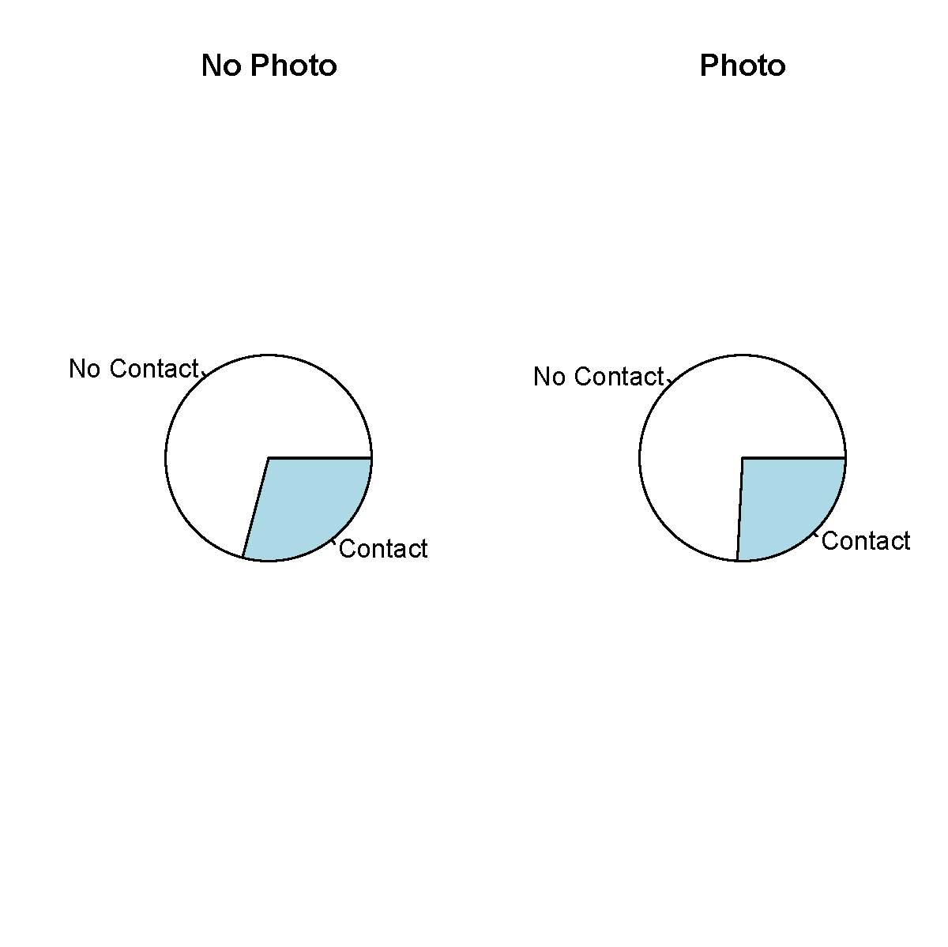

Slide 37
Scatterplots
Plots of 2 (or more) Quantitative Variables
For Basic Plot (default symbol is circle): plot(x,y)
Can change plotting symbol to lines or both lines and points (appropriate if time series data) plot(x,y,type=“l”) for lines or plot(x,y,type=“b”) for both
Can change plotting character to dots: plot(x,y,pch=“.”)
Can add “jitter” when data are discrete and have ties: plot(jitter(x,3),jitter(y,3)) where the number in second position of jitter command reflects amount of jitter
Can add lines to plots: plot(x,y); abline(lm(y~x));
Can do plots by groups of 3rd variable (coplots): coplot(x~y|z)

Slide 38
PGA/LPGA Data
pdf("pgalpga5.pdf")
pgalpga <- read.fwf(
file="http://www.stat.ufl.edu/~winner/data/pgalpga2008.dat",
width=c(8,8,8),
col.names=c("Distance", "Accuracy", "Gender"))
attach(pgalpga)
Gender <- factor(Gender, levels=1:2, labels=c("Female", "Male"))
par(mfrow=c(2,2))
plot(Accuracy,Distance)
plot(jitter(Accuracy,3),jitter(Distance,3),pch=".")
plot(Accuracy,Distance); abline(lm(Distance~Accuracy))
coplot(Accuracy~Distance|Gender)
dev.off()

Slide 39
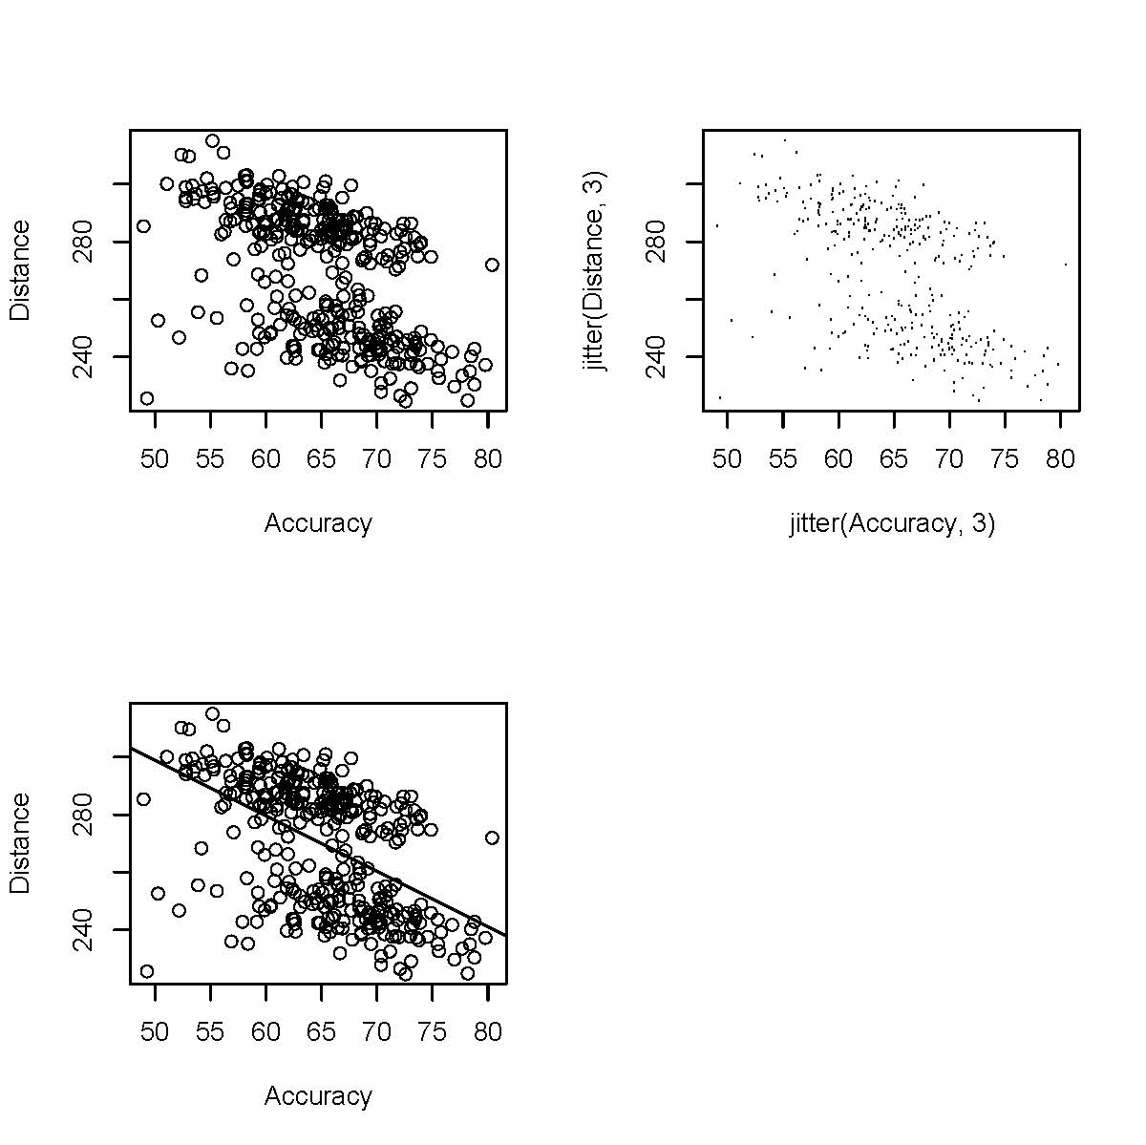

Slide 40
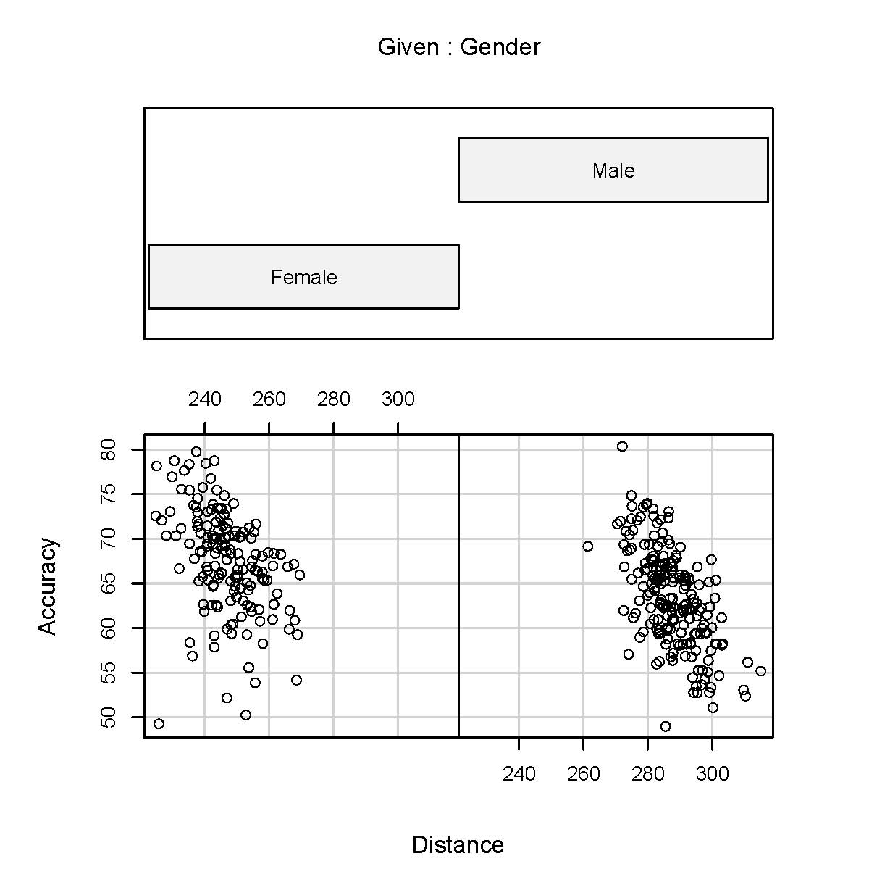

Slide 41
Comparing 2 Populations
Sampling Designs: Independent/Dependent
Distributional Assumptions: Normal/Non-Normal
Means: Independent Samples/Normal Distributions
Student’s t-test (Equal and Unequal Variance cases)
Medians: Independent Samples/Non-Normal Distributions
Wilcoxon Rank-Sum Test
Means: Dependent Samples/Normal Distributions
Paired t-test
Medians: Dependent Samples/Non-Normal Distributions
Wilcoxon Signed-Rank Test
Variances: Independent Samples/Normal Distributions
F-test

Slide 42
Program -Testing for Accuracy by Gender
pdf("pgalpga5.pdf")
pgalpga <- read.fwf(
file="http://www.stat.ufl.edu/~winner/data/pgalpga2008.dat",
width=c(8,8,8),
col.names=c("Distance", "Accuracy", "Gender"))
attach(pgalpga)
Gender <- factor(Gender, levels=1:2, labels=c("Female", "Male"))
Distance.female <- Distance[Gender=="Female"]
Distance.male <- Distance[Gender=="Male"]
Accuracy.female <- Accuracy[Gender=="Female"]
Accuracy.male <- Accuracy[Gender=="Male"]
# 2 ways of getting t-test: As a “Model” and as 2 Groups of Responses
# var.test tests the equal variance assumption
var.test(Accuracy ~ Gender)
t.test(Accuracy ~ Gender,var.equal=T)
t.test(Accuracy.female,Accuracy.male)
wilcox.test(Accuracy ~ Gender)
dev.off()

Slide 43
Output -Testing for Accuracy by Gender
> var.test(Accuracy ~ Gender)
F test to compare two variances
data: Accuracy by Gender
F = 1.1158, num df = 156, denom df = 196, p-value = 0.4664
alternative hypothesis: true ratio of variances is not equal to 1
95 percent confidence interval:
0.8300783 1.5076372
sample estimates:
ratio of variances
1.115823
> t.test(Accuracy ~ Gender, var.equal=T)
Two Sample t-test
data: Accuracy by Gender
t = 7.0546, df = 352, p-value = 9.239e-12
alternative hypothesis: true difference in means is not equal to 0
95 percent confidence interval:
3.047924 5.404292
sample estimates:
mean in group Female mean in group Male
67.59108 63.36497

Slide 44
Output -Testing for Accuracy by Gender
> t.test(Accuracy.female,Accuracy.male)
Welch Two Sample t-test
data: Accuracy.female and Accuracy.male
t = 7.011, df = 326.041, p-value = 1.369e-11
alternative hypothesis: true difference in means is not equal to 0
95 percent confidence interval:
3.040267 5.411949
sample estimates:
mean of x mean of y
67.59108 63.36497
> wilcox.test(Accuracy ~ Gender)
Wilcoxon rank sum test with continuity correction
data: Accuracy by Gender
W = 22016.5, p-value = 7.417e-12
alternative hypothesis: true mu is not equal to 0

Slide 45
Program – Caffeine/Endurance – Paired Data
pdf("caffeine.pdf")
caffeine <- read.fwf("http://www.stat.ufl.edu/~winner/data/caffeine1.dat",
width=c(8,8,8,8,8),
col.names=c("subject", "mg0", "mg5", "mg9", "mg13"))
attach(caffeine)
# Plot of 13mg endurance versus 5mg
# endurance for the 9 cyclists
plot(mg5,mg13)
# Conduct Paired t-test to determine if Dose effect exists
t.test(mg13, mg5, paired=TRUE)
# Conduct Wilcoxon Signed-Rank Test
wilcox.test(mg13, mg5, paired=TRUE)
dev.off()
1 37.55 42.47
2 59.30 85.15
3 79.12 63.20
4 58.33 52.10
5 70.54 66.20
6 69.47 73.25
7 46.48 44.50
8 66.35 57.17
9 36.20 35.05
Data

Slide 46
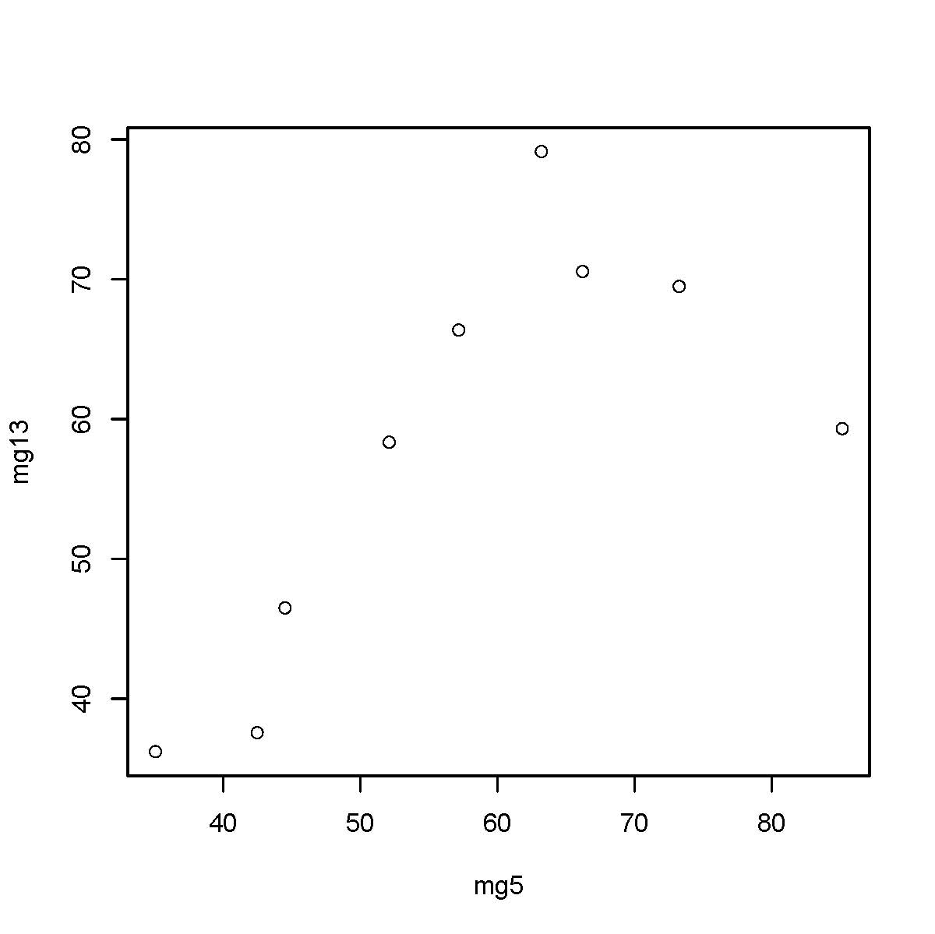

Slide 47
Output – Caffeine/Endurance – Paired Data
Paired t-test
data: mg13 and mg5
t = 0.1205, df = 8, p-value = 0.907
alternative hypothesis: true difference in means is not equal to 0
95 percent confidence interval:
-8.562982 9.507426
sample estimates:
mean of the differences
0.4722222
>
> # Conduct Wilcoxon Signed-Rank Test
> wilcox.test(mg13, mg5, paired=TRUE)
Wilcoxon signed rank test
data: mg13 and mg5
V = 28, p-value = 0.5703
alternative hypothesis: true mu is not equal to 0

Slide 48
Pearson Chi-Square Test
Used to Test for Association Between 2 or More Categorical Variables
Arranges Counts of Outcomes in Contingency Table (Cross-Tab)
Null Hypothesis: Distribution of Column (Row) Proportions is Constant Across Rows (Columns)
Data Can be Entered Directly into Contingency Table or Table Formed From Raw Data at the Individual Level
fisher.test(table) Can be used for small samples (exact for 2x2 tables)

Slide 49
Case 1 – Direct Entry of Contingency Table
pdf("dietcomp.pdf")
# Create Table as string of 8 counts, tell R it's entered by rows
# (as opposed to columns) and tell R there are 4 rows (thus 2 columns)
diet.table <- matrix(c(21,19,26,14,26,14,20,20),byrow=T,nrow=4)
diet.table
# Conduct Pearson's chi-square test
chisq.test(diet.table)
# Conduct Fisher's exact test
fisher.test(diet.table)
dev.off()

Slide 50
Case 1 – Direct Entry of Contingency Table
> # Conduct Pearson's chi-square test
> chisq.test(diet.table)
Pearson's Chi-squared test
data: diet.table
X-squared = 3.1584, df = 3, p-value = 0.3678
>
> # Conduct Fisher's exact test
> fisher.test(diet.table)
Fisher's Exact Test for Count Data
data: diet.table
p-value = 0.3904
alternative hypothesis: two.sided

Slide 51
Case 2 – Raw Data
pdf("rawdiet.pdf")
rawdiet <- read.fwf("http://www.stat.ufl.edu/~winner/data/rawdiet.dat",
width=c(8,8), col.names=c("diet", "comp1yr"))
attach(rawdiet)
diet <- factor(diet,levels=1:4,labels=c("A", "Z", "W", "O"))
comp1yr <- factor(comp1yr,levels=0:1,labels=c("Fail", "Comp"))
dietcomp <- table(diet,comp1yr)
dietcomp
# Conditional Distributions of Outcome by Diet (Rows)
# The “1” gets row distributions, “2” would give columns
prop.table(dietcomp,1)
# Pearson Chi-Square Test
chisq.test(dietcomp)
dev.off()
160Subjects
40 per diet

Slide 52
Case 2 – Raw Data
> dietcomp
comp1yr
diet Fail Comp
A 19 21
Z 14 26
W 14 26
O 20 20
> # Conditional Distributions of Outcome by Diet (Rows)
> prop.table(dietcomp,1)
comp1yr
diet Fail Comp
A 0.475 0.525
Z 0.350 0.650
W 0.350 0.650
O 0.500 0.500
> # Pearson Chi-Square Test
> chisq.test(dietcomp)
Pearson's Chi-squared test
data: dietcomp
X-squared = 3.1584, df = 3, p-value = 0.3678

Slide 53
Comparison of k>2 Means
Sampling Designs:
Independent – Completely Randomized Design
Dependent – Randomized Block Design
Distributional Assumptions: Normal/Non-Normal
Independent Samples/Normal Distributions
ANOVA F-Test for CRD
Independent Samples/Non-Normal Distributions
Kruskal-Wallis Test
Dependent Samples/Normal Distributions
ANOVA F-Test for RBD
Dependent Samples/Non-Normal Distributions
Friedman’s Test
Post-Hoc Comparison’s (Normal Data)
Bonferroni’s Method
Tukey’s Method

Slide 54
Program – Amoebae Innoculi - F-test, Post-Hoc Tests
amoeba <- read.fwf(
file="http://www.stat.ufl.edu/~winner/data/entozamoeba.dat",
width=c(8,8), col.names=c("Trt", "Yield"))
attach(amoeba)
fTrt <- factor(method, levels=1:5,
labels=c("Control", "Heat", "Form", "HF", "FH"))
# Obtain the 1-Way ANOVA using aov, not lm to obtain Tukey’s HSD
amoeba1.aov <- aov(Yield~fTrt)
summary(amoeba1.aov)
# Obtain Tukey's Comparisons among levels of treatment
TukeyHSD(amoeba1.aov, "fTrt")
# Obtain Bonferroni Comparisons among levels of treatment
# Does NOT use pooled Mean Square Error Across all Treatments
pairwise.t.test(Yield, fTrt, p.adj="bonf")
dev.off()

Slide 55
Output – 5 Amoebae Innoculi – F-Test
> amoeba1.aov <- aov(Yield~fTrt)
>
> summary(amoeba1.aov)
Df Sum Sq Mean Sq F value Pr(>F)
fTrt 4 19666 4916 5.0444 0.001911 **
Residuals 45 43858 975
---
Signif. codes: 0 '***' 0.001 '**' 0.01 '*' 0.05 '.' 0.1 ' ' 1
>
>
> # Obtain Tukey's Comparisons among levels of treatment
>
> TukeyHSD(amoeba1.aov, "fTrt")
Tukey multiple comparisons of means
95% family-wise confidence level
Output Continued on next slide

Slide 56
Output – 5 Amoebae Innoculi – Post-Hoc Tests
Fit: aov(Yield ~ fTrt)
$fTrt
diff lwr upr p adj
H-None -42.9 -82.57118 -3.228817 0.0281550
F-None -49.5 -89.17118 -9.828817 0.0078618
HF-None -29.9 -69.57118 9.771183 0.2208842
FH-None -56.1 -95.77118 -16.428817 0.0019658
F-H -6.6 -46.27118 33.071183 0.9894377
HF-H 13.0 -26.67118 52.671183 0.8832844
FH-H -13.2 -52.87118 26.471183 0.8774716
HF-F 19.6 -20.07118 59.271183 0.6284290
FH-F -6.6 -46.27118 33.071183 0.9894377
FH-HF -26.2 -65.87118 13.471183 0.3444453
pairwise.t.test(Yield, fTrt, p.adj="bonf")
Pairwise comparisons using t tests with pooled SD
data: Yield and fTrt
None H F HF
H 0.0360 - - -
F 0.0093 1.0000 - -
HF 0.3768 1.0000 1.0000 -
FH 0.0022 1.0000 1.0000 0.6707
P value adjustment method: bonferroni

Slide 57
Program/Output – Kruskal-Wallis Test
amoeba <- read.fwf(
file="http://www.stat.ufl.edu/~winner/data/entozamoeba.dat",
width=c(8,8), col.names=c("Trt", "Yield"))
attach(amoeba)
fTrt <- factor(method, levels=1:5,
labels=c("Control", "Heat", "Form", "HF", "FH"))
# Conduct the Kruskal-Wallis Test (Rank-Based)
kruskal.test(Yield~fTrt)
> kruskal.test(Yield~fTrt)
Kruskal-Wallis rank sum test
data: Yield by fTrt
Kruskal-Wallis chi-squared = 12.6894,
df = 4, p-value = 0.01290

Slide 58
RBD Program – Caffeine and Endurance
pdf("caffrbd.pdf")
caffrbd <- read.fwf("http://www.stat.ufl.edu/~winner/data/caffeine.dat",
width=c(1,5,8), col.names=c("subject", "dose", "enduretime"))
attach(caffrbd)
# Create Factors from subject and dose
subject <- factor(subject, levels=1:9,
labels=c("S1", "S2", "S3", "S4", "S5", "S6", "S7", "S8", "S9"))
dose <- factor(dose, levels=c(0,5,9,13),
labels=c("0mg", "5mg", "9mg", "13mg"))
# Plot of endurance versus dose separately for the 9 cyclists
# The order of vars is: X-Variable, Separate Line Factor, Y-Variable
interaction.plot(dose, subject, enduretime)
# Obtain Analysis of Variance for RBD
caffeine.aov <- aov(enduretime ~ dose + subject)
summary(caffeine.aov)
# Conduct Tukey's HSD for Doses
TukeyHSD(caffeine.aov, "dose")

Slide 59
Output – Caffeine and Endurance
> caffeine.aov <- aov(enduretime ~ dose + subject)
> summary(caffeine.aov)
Df Sum Sq Mean Sq F value Pr(>F)
dose 3 933.1 311.0 5.9168 0.003591 **
subject 8 5558.0 694.7 13.2159 4.174e-07 ***
Residuals 24 1261.7 52.6
---
Signif. codes: 0 '***' 0.001 '**' 0.01 '*' 0.05 '.' 0.1 ' ' 1
>
> # Conduct Tukey's HSD for Doses
> TukeyHSD(caffeine.aov, "dose")
Tukey multiple comparisons of means
95% family-wise confidence level
Fit: aov(formula = enduretime ~ dose + subject)
$dose
diff lwr upr p adj
5mg-0mg 11.2366667 1.808030 20.665303 0.0153292
9mg-0mg 12.2411111 2.812474 21.669748 0.0076616
13mg-0mg 11.7088889 2.280252 21.137526 0.0110929
9mg-5mg 1.0044444 -8.424192 10.433081 0.9909369
13mg-5mg 0.4722222 -8.956414 9.900859 0.9990313
13mg-9mg -0.5322222 -9.960859 8.896414 0.9986162

Slide 60
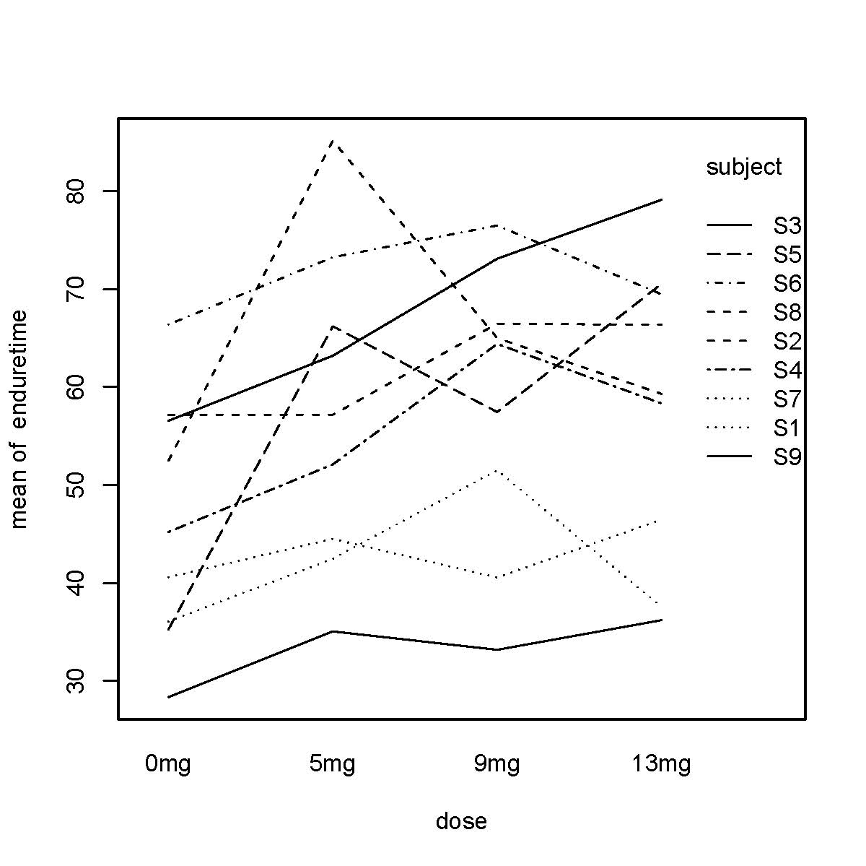

Slide 61
Program/Output for Friedman’s Test
pdf("caffrbd.pdf")
caffrbd <- read.fwf(" http://www.stat.ufl.edu/~winner/data/caffeine.dat ",
width=c(1,5,8), col.names=c("subject","dose","enduretime"))
attach(caffrbd)
subject <- factor(subject, levels=1:9,
labels=c("S1","S2","S3","S4","S5","S6","S7","S8","S9"))
dose <- factor(dose, levels=c(0,5,9,13),
labels=c("0mg", "5mg", "9mg", "13mg"))
# Conduct Friedman's Test (DepVar ~ Trt | Block)
friedman.test(enduretime ~ dose | subject)
> friedman.test(enduretime ~ dose | subject)
Friedman rank sum test
data: enduretime and dose and subject
Friedman chi-squared = 14.2, df = 3, p-value = 0.002645

Slide 62
Multi-Factor ANOVA
Used to Measure Main Effects and Interactions among Several Factors Simultaneously
Can be Conducted Within CRD or RBD frameworks
Can Make Post-Hoc Comparisons among Main Effects of Factor Levels (Assuming Interaction is Not Present
Factors can be Crossed or Nested
Crossed → Levels of One Factor Observed at all levels of other factor(s)
Nested → Levels of One Factor Are Different Within Various levels of other factor(s)

Slide 63
2-Way ANOVA (CRD) – Lacrosse Helmets
pdf("lacrosse.pdf")
lacrosse1 <- read.fwf("http://www.stat.ufl.edu/~winner/data/lacrosse.dat",
width=c(8,8,14), col.names=c("brand", "side", "gadd"))
attach(lacrosse1)
brand <- factor(brand, levels=1:4,
labels=c("SHC", "SCHAF", "SCHUL", "BUL"))
side <- factor(side, levels=1:2,
labels=c("Front", "Back"))
# Descriptive Statistics
tapply(gadd, brand, mean) # marginal mean for brand
tapply(gadd, side, mean) # marginal mean for side
tapply(gadd, list(brand,side), mean) # cell means
tapply(gadd, list(brand,side), sd) # cell SDs
# Fit Model with Interaction (A*B says to include main effects and interactions)
lacrosse1.aov <- anova(lm(gadd ~ brand*side))
lacrosse1.aov
# Plot Means of Front and Back versus Brand
interaction.plot(brand,side,gadd)

Slide 64
Output – Part 1
> tapply(gadd, brand, mean) # marginal mean for brand
SHC SCHAF SCHUL BUL
1070.300 1069.850 1116.650 1359.650
>
> tapply(gadd, side, mean) # marginal mean for side
Front Back
1090.875 1217.350
>
> tapply(gadd, list(brand,side), mean) # cell means
Front Back
SHC 1166.0999 974.4998
SCHAF 1117.5999 1022.1000
SCHUL 857.0001 1376.3000
BUL 1222.8001 1496.5001
>
> tapply(gadd, list(brand,side), sd) # cell SDs
Front Back
SHC 152.3998 72.99994
SCHAF 216.2000 105.09994
SCHUL 151.4998 211.40010
BUL 123.1000 183.99987

Slide 65
Output – Part 2
> # Fit Model with Interaction
> # (A*B says to include main effects and interactions)
>
> lacrosse1.aov <- anova(lm(gadd ~ brand*side))
>
> lacrosse1.aov
Analysis of Variance Table
Response: gadd
Df Sum Sq Mean Sq F value Pr(>F)
brand 3 1155478 385159 15.179 9.459e-08 ***
side 1 319918 319918 12.608 0.0006816 ***
brand:side 3 1632156 544052 21.441 4.988e-10 ***
Residuals 72 1826954 25374
---
Signif. codes: 0 '***' 0.001 '**' 0.01 '*' 0.05 '.' 0.1 ' ' 1

Slide 66
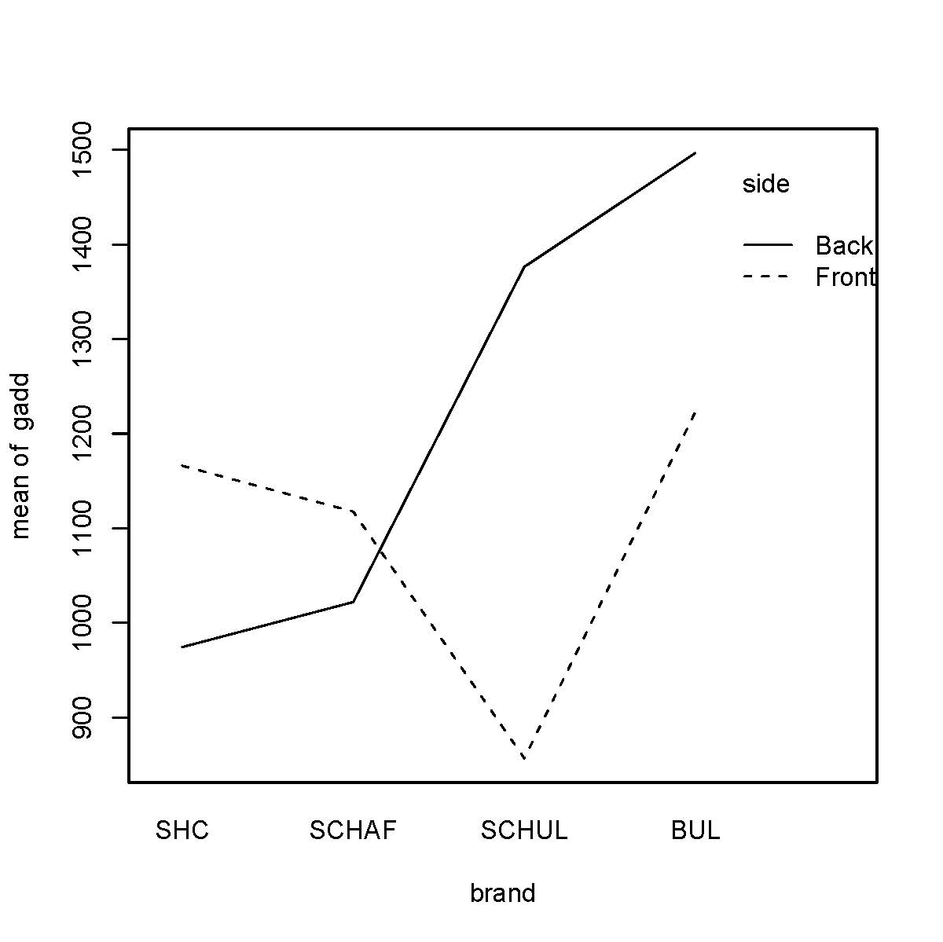

Slide 67
2-Way ANOVA (RBD) Fabric Hairiness
pdf("hairiness.pdf")
hair1 <- read.fwf("http://www.stat.ufl.edu/~winner/data/hairyarn.dat", width=c(8,8,8,8), col.names=c("twstlvl", "tstspd", "bobbin", "hairiness"))
attach(hair1)
twstlvl <- factor(twstlvl, levels=1:3,labels=c("373tpm", "563tpm", "665tpm"))
tstspd <- factor(tstspd, levels=1:3,labels=c("25mpm", "100mpm", "400mpm"))
bobbin <- factor(bobbin, levels=1:6)
tapply(hairiness, bobbin, mean) # marginal mean for bobbin
tapply(hairiness, list(twstlvl,tstspd), mean) # Trt cell means
interaction.plot(tstspd,twstlvl,hairiness) # Interaction Plot
# Fit Model with Interaction and bobbin effect
hair1.aov <- anova(lm(hairiness ~ twstlvl*tstspd + bobbin)); hair1.aov
# Fit Additive Model with bobbin effect (Use aov to get TukeyHSD)
hair2.aov <- aov(hairiness ~ twstlvl + tstspd + bobbin); summary(hair2.aov)
# Tukey's HSD For Main Effects
TukeyHSD(hair2.aov, "twstlvl")
TukeyHSD(hair2.aov, "tstspd")

Slide 68
Output – Part 1
> tapply(hairiness, bobbin, mean) # marginal mean for bobbin
1 2 3 4 5 6
632.5556 607.5556 608.5556 605.3333 614.4444 614.1111
> tapply(hairiness, list(twstlvl,tstspd), mean) #Trt cell means
25mpm 100mpm 400mpm
373tpm 744.6667 744.5000 775.8333
563tpm 582.3333 584.8333 597.5000
665tpm 492.3333 494.6667 507.1667
>
> # Fit Model with Interaction and bobbin effect
> hair1.aov <- anova(lm(hairiness ~ twstlvl*tstspd + bobbin))
> hair1.aov
Analysis of Variance Table
Response: hairiness
Df Sum Sq Mean Sq F value Pr(>F)
twstlvl 2 611792 305896 1324.6920 < 2.2e-16 ***
tstspd 2 4637 2318 10.0402 0.0002928 ***
bobbin 5 4414 883 3.8231 0.0063403 **
twstlvl:tstspd 4 826 207 0.8946 0.4761743
Residuals 40 9237 231
---
Signif. codes: 0 '***' 0.001 '**' 0.01 '*' 0.05 '.' 0.1 ' ' 1

Slide 69
Output – Part 2
> # Fit Additive Model with bobbin effect
> hair2.aov <- aov(hairiness ~ twstlvl + tstspd + bobbin)
> summary(hair2.aov)
Df Sum Sq Mean Sq F value Pr(>F)
twstlvl 2 611792 305896 1337.5107 < 2.2e-16 ***
tstspd 2 4637 2318 10.1373 0.0002394 ***
bobbin 5 4414 883 3.8601 0.0054948 **
Residuals 44 10063 229
---
Signif. codes: 0 '***' 0.001 '**' 0.01 '*' 0.05 '.' 0.1 ' ' 1
>
> # Tukey's HSD For Main Effects
>
> TukeyHSD(hair2.aov, "twstlvl")
Tukey multiple comparisons of means
95% family-wise confidence level
Fit: aov(formula = hairiness ~ twstlvl + tstspd + bobbin)

Slide 70
Output – Part 3
Fit: aov(formula = hairiness ~ twstlvl + tstspd + bobbin)
$twstlvl
diff lwr upr p adj
563tpm-373tpm -166.77778 -179.0046 -154.5509 0
665tpm-373tpm -256.94444 -269.1713 -244.7176 0
665tpm-563tpm -90.16667 -102.3935 -77.9398 0
> TukeyHSD(hair2.aov, "tstspd")
Tukey multiple comparisons of means
95% family-wise confidence level
Fit: aov(formula = hairiness ~ twstlvl + tstspd + bobbin)
$tstspd
diff lwr upr p adj
100mpm-25mpm 1.555556 -10.671306 13.78242 0.9489254
400mpm-25mpm 20.388889 8.162027 32.61575 0.0005994
400mpm-100mpm 18.833333 6.606472 31.06020 0.0015237

Slide 71
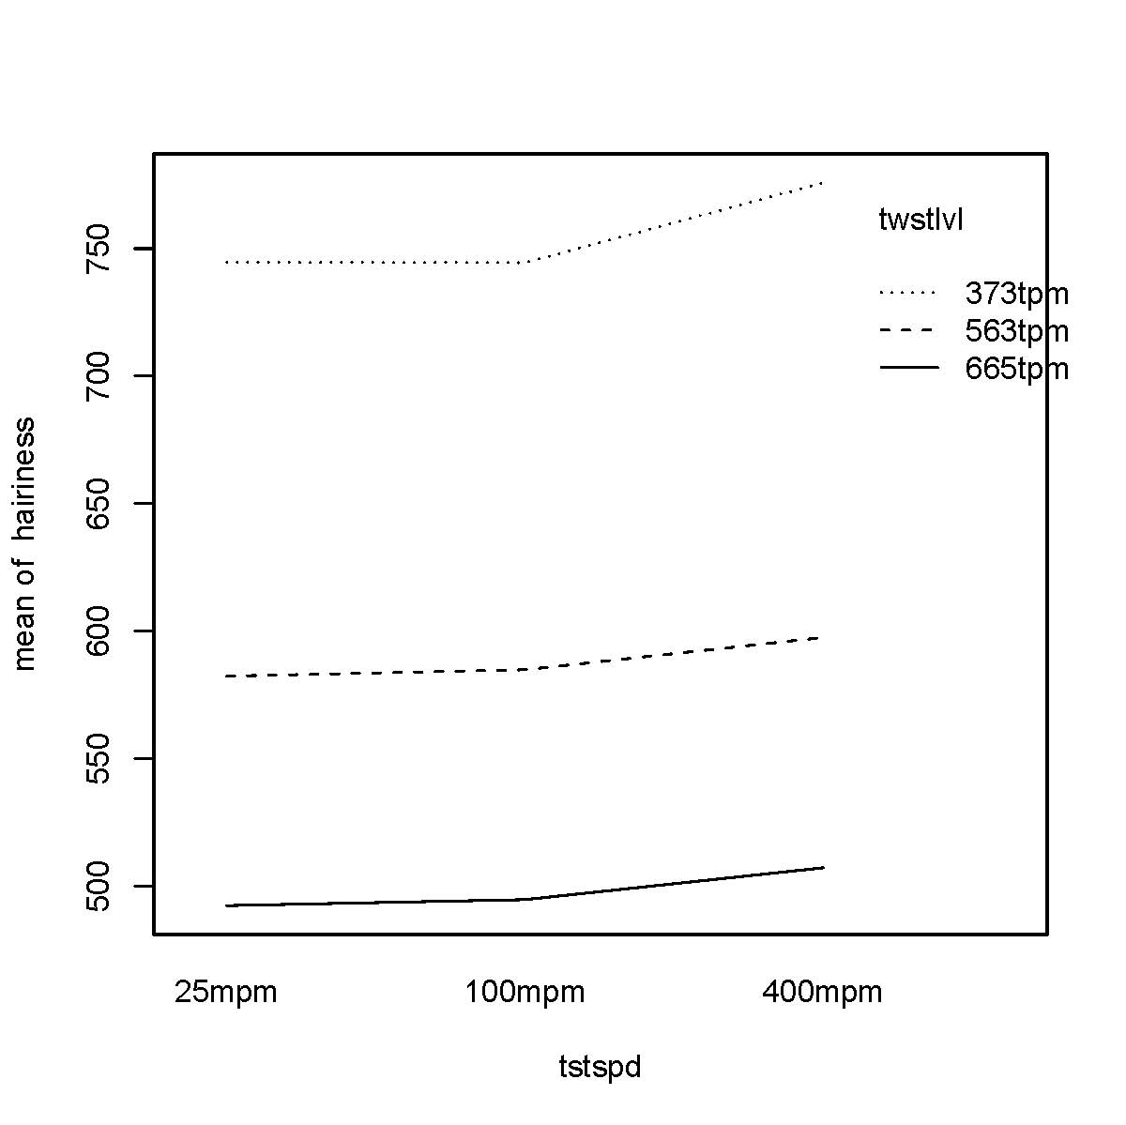

Slide 72
Nested Design – Florida Swamp Depths
Response=Watlev Nesting Factor=size Nested Factor = swampid
pdf("swamp.pdf")
swamp <- read.fwf("http://www.stat.ufl.edu/~winner/data/swamp1.dat", width=c(8,8,8), col.names=c("size", "swampid", "watlev"))
attach(swamp)
size <- factor(size, levels=1:3, labels=c("small", "medium", "large"))
swampid <- factor(swampid, levels=1:9)
tapply(watlev, size, mean)
# Fit the ANOVA with size and swamp nested within size
swamp.aov1 <- aov(watlev ~ size/swampid)
# This provides ANOVA, not appropriate F-test for size
summary(swamp.aov1)
swamp.aov2 <- aov(watlev ~ size + Error(swampid))
# This provides appropriate F-test for size
summary(swamp.aov2)

Slide 73
Output – Swamp Depths
> tapply(watlev, size, mean)
small medium large
52.16667 106.43444 152.76654
>
>
> # Fit the ANOVA with size and swamp nested within size
>
> swamp.aov1 <- aov(watlev ~ size/swampid)
>
> # This provides ANOVA, not appropriate F-test for size
>
> summary(swamp.aov1)
Df Sum Sq Mean Sq F value Pr(>F)
size 2 410724 205362 888.385 < 2.2e-16 ***
size:swampid 6 83058 13843 59.884 < 2.2e-16 ***
Residuals 234 54092 231
---
Signif. codes: 0 '***' 0.001 '**' 0.01 '*' 0.05 '.' 0.1 ' ' 1

Slide 74
Output – Swamp Depths
> swamp.aov2 <- aov(watlev ~ size + Error(swampid))
>
> # This provides appropriate F-test for size
>
> summary(swamp.aov2)
Error: swampid
Df Sum Sq Mean Sq F value Pr(>F)
size 2 410724 205362 14.835 0.004759 **
Residuals 6 83058 13843
---
Signif. codes: 0 '***' 0.001 '**' 0.01 '*' 0.05 '.' 0.1 ' ' 1
Error: Within
Df Sum Sq Mean Sq F value Pr(>F)
Residuals 234 54092 231

Slide 75
Split-Plot Design – Wool Shrinkage
Response = shrink
Whole Plot Factor = trt
Subplot Factor = revs
Block = runnum
pdf("woolfrict.pdf")
wf1 <- read.fwf("http://www.stat.ufl.edu/~winner/data/woolfrict1.dat",
width=c(8,8,8,8),
col.names=c("runnum", "trt", "revs", "shrink"))
attach(wf1)
trt <- factor(trt, levels=1:4,
labels=c("Untreated", "AC15sec", "AC4min", "AC15min"))
runnum <- factor(runnum, levels=1:4)
revs <- factor(revs,levels=seq(200,1400,200),ordered=TRUE)

Slide 76
Split-Plot Design – Wool Shrinkage
# Fit full ANOVA with all terms, F-test for trt is inappropriate
woolfrict.sp1 <- aov(shrink ~ trt + runnum + trt:runnum + revs + revs:trt)
summary(woolfrict.sp1)
# This model uses correct error terms for trt and revs and interaction
woolfrict.sp2 <- aov(shrink ~ trt*revs + Error(runnum/trt))
summary(woolfrict.sp2)
# Partitions the Revs SS into orthogonal polynomials
summary(woolfrict.sp2,split=list(revs=list(linear=1, quadratic=2,
cubic=3, quartic=4, quintic=5, sextic=6)))

Slide 77
Output – Wool Shrinkage
> > # Fit full ANOVA with all terms, F-test for trt is inappropriate
> woolfrict.sp1 <- aov(shrink ~ trt + runnum + trt:runnum + revs + revs:trt)
> summary(woolfrict.sp1)
Df Sum Sq Mean Sq F value Pr(>F)
trt 3 3012.5 1004.2 729.1367 < 2.2e-16 ***
runnum 3 124.3 41.4 30.0815 1.024e-12 ***
revs 6 11051.8 1842.0 1337.4577 < 2.2e-16 ***
trt:runnum 9 114.6 12.7 9.2487 3.546e-09 ***
trt:revs 18 269.5 15.0 10.8718 4.620e-14 ***
Residuals 72 99.2 1.4
---
Signif. codes: 0 '***' 0.001 '**' 0.01 '*' 0.05 '.' 0.1 ' ' 1
>

Slide 78
Output – Wool Shrinkage
> # This model uses correct error terms for trt and revs and interaction
> woolfrict.sp2 <- aov(shrink ~ trt*revs + Error(runnum/trt))
> summary(woolfrict.sp2)
Error: runnum
Df Sum Sq Mean Sq F value Pr(>F)
Residuals 3 124.286 41.429
Error: runnum:trt
Df Sum Sq Mean Sq F value Pr(>F)
trt 3 3012.53 1004.18 78.836 8.81e-07 ***
Residuals 9 114.64 12.74
---
Signif. codes: 0 '***' 0.001 '**' 0.01 '*' 0.05 '.' 0.1 ' ' 1
Error: Within
Df Sum Sq Mean Sq F value Pr(>F)
revs 6 11051.8 1842.0 1337.458 < 2.2e-16 ***
trt:revs 18 269.5 15.0 10.872 4.62e-14 ***
Residuals 72 99.2 1.4

Slide 79
Output – Wool Shrinkage
> # Partitions the Revs SS into orthogonal polynomials
> summary(woolfrict.sp2,split=list(revs=list(linear=1, quadratic=2,
+ cubic=3, quartic=4, quintic=5, sextic=6)))
Error: runnum
Df Sum Sq Mean Sq F value Pr(>F)
Residuals 3 124.286 41.429
Error: runnum:trt
Df Sum Sq Mean Sq F value Pr(>F)
trt 3 3012.53 1004.18 78.836 8.81e-07 ***
Residuals 9 114.64 12.74
Error: Within
Df Sum Sq Mean Sq F value Pr(>F)
revs 6 11051.8 1842.0 1337.4577 < 2.2e-16 ***
revs: linear 1 10846.8 10846.8 7875.9309 < 2.2e-16 ***
revs: quadratic 1 198.9 198.9 144.4046 < 2.2e-16 ***
revs: cubic 1 2.9 2.9 2.0842 0.1532
revs: quartic 1 1.4 1.4 1.0398 0.3113
revs: quintic 1 0.1 0.1 0.0885 0.7669
revs: sextic 1 1.7 1.7 1.1983 0.2773
trt:revs 18 269.5 15.0 10.8718 4.620e-14 ***
trt:revs: linear 3 154.4 51.5 37.3624 1.133e-14 ***
trt:revs: quadratic 3 104.8 34.9 25.3581 2.646e-11 ***
trt:revs: cubic 3 7.4 2.5 1.7944 0.1559
trt:revs: quartic 3 0.8 0.3 0.1861 0.9055
trt:revs: quintic 3 0.9 0.3 0.2099 0.8892
trt:revs: sextic 3 1.3 0.4 0.3199 0.8110
Residuals 72 99.2 1.4

Slide 80
Repeated Measures Design – Hair Growth
Response = hair
Treatment Factor = trt
Subject within Treatment Factor = subj
Time Factor = time
pdf("rogaine.pdf")
rogaine <- read.fwf("http://www.stat.ufl.edu/~winner/data/rogaine.dat",
width=c(8,8,8,8), col.names=c("trt", "subj", "time", "hair"))
# Only use values where time>0
rogaine2 <- subset(rogaine,rogaine$time>0)
rogaine1 <- data.frame(trt=factor(rogaine2$trt), subj=factor(rogaine2$subj),
time=factor(rogaine2$time), hair=rogaine2$hair)
attach(rogaine1)

Slide 81
Repeated Measures Design – Hair Growth
# Give ANOVA with all factors and interactions (inappropriate error for trt)
rogaine1.mod1 <- aov(hair ~ trt + trt/subj + time + time:trt)
summary(rogaine1.mod1)
# Give ANOVA with proper error term for trt
rogaine1.mod2 <- aov(hair ~ trt*time + Error(subj))
summary(rogaine1.mod2)

Slide 82
Output – Hair Growth
> # Give ANOVA with all factors and interactions (inappropriate error for trt)
> rogaine1.mod1 <- aov(hair ~ trt + trt/subj + time + time:trt)
>
> summary(rogaine1.mod1)
Df Sum Sq Mean Sq F value Pr(>F)
trt 1 8064 8064 27.7389 5.231e-05 ***
time 3 2268 756 2.5999 0.08391 .
trt:subj 6 55476 9246 31.8027 1.230e-08 ***
trt:time 3 2005 668 2.2985 0.11201
Residuals 18 5233 291
---
Signif. codes: 0 '***' 0.001 '**' 0.01 '*' 0.05 '.' 0.1 ' ' 1

Slide 83
Output – Hair Growth
> # Give ANOVA with proper error term for trt
> rogaine1.mod2 <- aov(hair ~ trt*time + Error(subj))
>
> summary(rogaine1.mod2)
Error: subj
Df Sum Sq Mean Sq F value Pr(>F)
trt 1 8064 8064 0.8722 0.3864
Residuals 6 55476 9246
Error: Within
Df Sum Sq Mean Sq F value Pr(>F)
time 3 2267.6 755.9 2.5999 0.08391 .
trt:time 3 2004.8 668.3 2.2985 0.11201
Residuals 18 5233.1 290.7
---
Signif. codes: 0 '***' 0.001 '**' 0.01 '*' 0.05 '.' 0.1 ' ' 1

Slide 84
Linear Regression
Response/Dependent Variable – Y
Explanatory/Predictor/Independent Variable(s) – X₁,…,X_{p}
Predictors can me numeric, qualitative (using dummy variables), polynomials, or cross-products
Methods based on independent and normally distributed errors with constant variance

Slide 85
Simple Linear Regression – Math Scores / LSD Levels
mathlsddat <- read.fwf("http://www.stat.ufl.edu/~winner/data/lsd.dat",
width=c(4,8), col.names=c("lsd","math"))
mathlsd <- data.frame(mathlsddat)
attach(mathlsd)
# Fit the simple linear regression model with Y = math (score) and X = lsd (concentration)
mathlsd.reg <- lm(math ~ lsd)
# Plot the data and regression line (Note you enter X first, then Y in plot statement)
plot(lsd,math)
abline(mathlsd.reg)
# Print out the estimates, standard errors and t-tests, R-Square, and F-test
summary(mathlsd.reg)

Slide 86
Simple Linear Regression – Math Scores / LSD Levels
# Print out the ANOVA table (Sums of Squares and degrees of freedom)
anova(mathlsd.reg)
# Compute the correlation coefficient (r) and test if rho=0
cor(math,lsd)
cor.test(math,lsd)
# Plot Residuals versus Fitted Values
png("mathlsd2.png")
plot(predict(mathlsd.reg),residuals(mathlsd.reg))
abline(h=0)
dev.off()
# Print out standardized, studentized Residuals and Influence Measures
round(rstandard(mathlsd.reg),3)
round(rstudent(mathlsd.reg),3)
influence.measures(mathlsd.reg)

Slide 87
Output – Math/LSD
> summary(mathlsd.reg)
Call: lm(formula = math ~ lsd)
Residuals:
1 2 3 4 5 6 7
0.3472 -4.1658 7.7170 -9.3995 9.0513 -2.1471 -1.4032
Coefficients:
Estimate Std. Error t value Pr(>|t|)
(Intercept) 89.124 7.048 12.646 5.49e-05 ***
lsd -9.009 1.503 -5.994 0.00185 **
Residual standard error: 7.126 on 5 degrees of freedom
Multiple R-squared: 0.8778, Adjusted R-squared: 0.8534
F-statistic: 35.93 on 1 and 5 DF, p-value: 0.001854
> anova(mathlsd.reg)
Analysis of Variance Table
Response: math
Df Sum Sq Mean Sq F value Pr(>F)
lsd 1 1824.30 1824.30 35.928 0.001854 **
Residuals 5 253.88 50.78

Slide 88
Output – Math/LSD
> cor(math,lsd)
[1] -0.9369285
> cor.test(math,lsd)
Pearson's product-moment correlation
data: math and lsd
t = -5.994, df = 5, p-value = 0.001854
alternative hypothesis: true correlation is not equal to 0
95 percent confidence interval:
-0.9908681 -0.6244782
sample estimates:
cor
-0.9369285
> round(rstandard(mathlsd.reg),3)
1 2 3 4 5 6 7
0.076 -0.664 1.206 -1.430 1.460 -0.352 -0.241
> round(rstudent(mathlsd.reg),3)
1 2 3 4 5 6 7
0.068 -0.622 1.281 -1.663 1.723 -0.319 -0.217

Slide 89
Output – Math/LSD
> influence.measures(mathlsd.reg)
Influence measures of
lm(formula = math ~ lsd) :
dfb.1_ dfb.lsd dffit cov.r cook.d hat inf
1 0.0805 -0.0706 0.0811 3.783 0.00411 0.588 *
2 -0.2900 0.2033 -0.3358 1.677 0.06424 0.225
3 0.5047 -0.3230 0.6288 0.974 0.17521 0.194
4 -0.1348 -0.1358 -0.6945 0.642 0.17824 0.149
5 -0.2918 0.6253 0.9752 0.680 0.34114 0.243
6 0.0672 -0.1308 -0.1921 2.026 0.02249 0.267
7 0.0694 -0.1167 -0.1541 2.295 0.01467 0.335 *

Slide 90
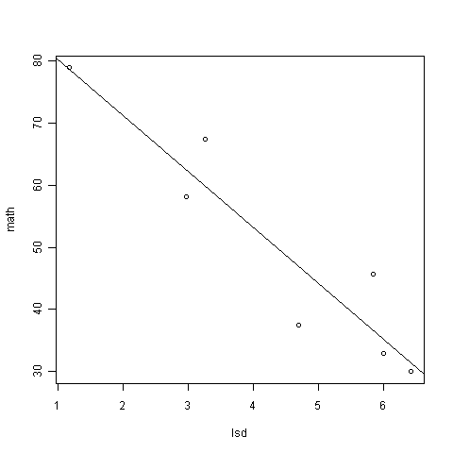

Slide 91
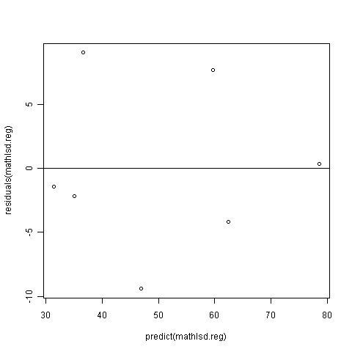

Slide 92
Multiple Regression – PGA/LPGA
Y = Accuracy (pctfrway=Percent Fairways) X₁ = Average Distance X₂ = Male
png("C:\\Rmisc\\pgalpga.png")
pgalpga <- read.fwf("http://www.stat.ufl.edu/~winner/data/pgalpga2008.dat",
width=c(8,8,8), col.names=c("avedist","pctfrwy","gender"))
attach(pgalpga)
# Gender has levels 1=Female, 2=Male. Create Male “Dummy” variable
male <- gender-1
# Fit additive Model (Common slopes)
add.model <- lm(pctfrwy ~ avedist + male)
# Fit interaction model (Different slopes by gender)
int.model <- lm(pctfrwy ~ avedist*male)
summary(add.model)
summary(int.model)
dev.off()

Slide 93
PGA/LPGA Output - I
> summary(add.model)
Call:
lm(formula = pctfrwy ~ avedist + male)
Residuals:
Min 1Q Median 3Q Max
-25.0712 -2.8263 0.4867 3.3494 12.0275
Coefficients:
Estimate Std. Error t value Pr(>|t|)
(Intercept) 147.26894 7.03492 20.934 < 2e-16 ***
avedist -0.32284 0.02846 -11.343 < 2e-16 ***
male 8.94888 1.26984 7.047 9.72e-12 ***
---
Signif. codes: 0 ‘***’ 0.001 ‘**’ 0.01 ‘*’ 0.05 ‘.’ 0.1 ‘ ’ 1
Residual standard error: 4.797 on 351 degrees of freedom
Multiple R-squared: 0.3589, Adjusted R-squared: 0.3552
F-statistic: 98.24 on 2 and 351 DF, p-value: < 2.2e-16

Slide 94
PGA/LPGA Output - II
> summary(int.model)
Call:
lm(formula = pctfrwy ~ avedist * male)
Residuals:
Min 1Q Median 3Q Max
-23.6777 -2.7462 0.3365 3.3635 11.0186
Coefficients:
Estimate Std. Error t value Pr(>|t|)
(Intercept) 130.89331 9.92928 13.183 < 2e-16 ***
avedist -0.25649 0.04020 -6.380 5.61e-10 ***
male 44.03215 15.15809 2.905 0.00391 **
avedist:male -0.13140 0.05657 -2.323 0.02078 *
---
Signif. codes: 0 ‘***’ 0.001 ‘**’ 0.01 ‘*’ 0.05 ‘.’ 0.1 ‘ ’ 1
Residual standard error: 4.767 on 350 degrees of freedom
Multiple R-squared: 0.3686, Adjusted R-squared: 0.3632
F-statistic: 68.11 on 3 and 350 DF, p-value: < 2.2e-16

Slide 95
Obtaining Plot by Gender with Regression Lines
png("C:\\Rmisc\\pgalpga.png")
pgalpga <- read.fwf("http://www.stat.ufl.edu/~winner/data/pgalpga2008.dat ",
width=c(8,8,8), col.names=c("avedist","pctfrwy","gender"))
attach(pgalpga)
male <- gender-1
# Create measures specifcally by gender
ad.female <- avedist[gender == 1]; ad.male <- avedist[gender == 2]
pf.female <- pctfrwy[gender == 1]; pf.male <- pctfrwy[gender == 2]
# First “set up” variables to plot but leave blank (type=“n”). Then add points,
# lines, and legend
plot(c(ad.female,ad.male),c(pf.female,pf.male),
xlab="Average Distance", ylab="Percent Fairways",
main="Accuracy vs Distance by Gender", type="n")
points(ad.female,pf.female,col="red"); points(ad.male,pf.male,col="blue")
abline(lm(pf.female~ad.female),col="red"); abline(lm(pf.male~ad.male),col="blue")
legend("topright",c("females","males"),pch=c(1,1),col=c(2,4))
dev.off()

Slide 96
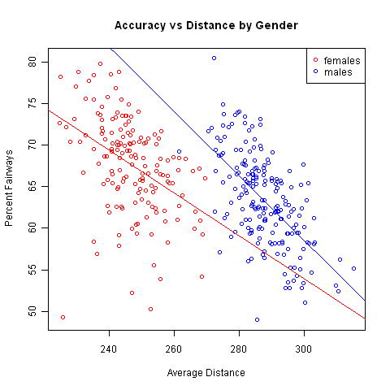

Slide 97
Generalized Linear Models
General class of linear models that are made up of 3 components: Random, Systematic, and Link Function
Random component: Identifies dependent variable (Y) and its probability distribution
Binary Responses ⇒ Binomial Distribution
Count Responses ⇒ Poisson Distribution (or Negative Binomial)
Positive and Skewed Responses ⇒ Gamma Distribution
Systematic Component: Identifies the set of explanatory variables (X₁,...,X_{k})
Link Function: Identifies a function of the mean that is a linear function of the explanatory variables

Slide 98
Common Link Functions
Identity link (form used in normal and gamma regression models):
Log link (used when μ cannot be negative as when data are Poisson counts):
Logit link (used when μ is bounded between 0 and 1 as when data are binary):

Slide 99
Logistic Regression – NFL Field Goals
png("fieldgoal.png")
fieldgoal <- read.fwf("http://www.stat.ufl.edu/~winner/data/fieldgoal.dat",
width=c(8,8,8), col.names=c("distance","success","week"))
attach(fieldgoal)
# Create a contingency Table, Conditional (Row) Distributions
# and variables for observed proportion of Success (prop.dist)
# and observed distances (obs.dist) for plot
dstable <- table(distance,success)
prop.dstable <- prop.table(dstable,1)
prop.dist <- prop.dstable[,2]
obs.dist <- as.numeric(rownames(dstable))
# Fit the logistic regression model and print results
fg.reg1 <- glm(success~distance,binomial)
summary(fg.reg1)

Slide 100
Logistic Regression – NFL Field Goals
# Give a range of Distance values for the smooth fitted/predicted curve
raw.dist <- seq(min(distance),max(distance),0.1)
# Plot the raw data and add line with predicted curve evaluated at raw.dist
# type="response" backtransforms model to S-shaped response
# scale (not linear scale)
plot(obs.dist,prop.dist,xlab="distance",ylab="Probability(Success)")
lines(raw.dist,predict(fg.reg1,list(distance=raw.dist),type="response"))
dev.off()

Slide 101
Text Output – Field Goal Data
> # Fit the logistic regression model and print results
> fg.reg1 <- glm(success~distance,binomial)
> summary(fg.reg1)
Call:
glm(formula = success ~ distance, family = binomial)
Deviance Residuals:
Min 1Q Median 3Q Max
-2.6569 0.2718 0.4166 0.6938 1.4750
Coefficients:
Estimate Std. Error z value Pr(>|z|)
(Intercept) 5.69788 0.45110 12.63 <2e-16 ***
distance -0.10991 0.01058 -10.38 <2e-16 ***
---
Signif. codes: 0 '***' 0.001 '**' 0.01 '*' 0.05 '.' 0.1 ' ' 1
(Dispersion parameter for binomial family taken to be 1)
Null deviance: 955.38 on 947 degrees of freedom
Residual deviance: 817.20 on 946 degrees of freedom
AIC: 821.2
Number of Fisher Scoring iterations: 5

Slide 102
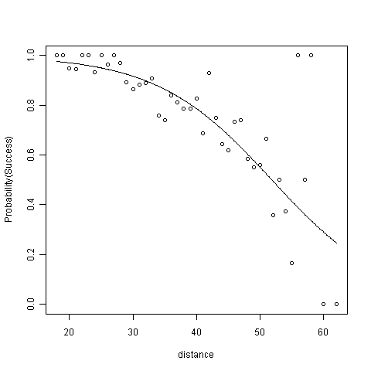

Slide 103
Poisson Regression – NASCAR Crashes
race1 <- read.fwf("http://www.stat.ufl.edu/~winner/data/race7579.dat",
width=c(rep(8,9),12,40), col.names=c("srace", "year", "yrace", "drivers",
"trklen", "laps", "roadtrk", "cautions", "leadchng", "trkid", "track"))
attach(race1)
## Fit Poisson Regression, Relating Cautions to Drivers, Track Length, and Laps
race.mod <- glm(cautions ~ drivers + trklen + laps, poisson)
summary(race.mod)
anova(race.mod, test=“Chisq”) # Gives sequential tests

Slide 104
Output - NASCAR Crashes
> summary(race.mod)
Coefficients:
Estimate Std. Error z value Pr(>|z|)
(Intercept) -0.7962699 0.4116942 -1.934 0.05310 .
drivers 0.0365253 0.0124932 2.924 0.00346 **
trklen 0.1144986 0.1684236 0.680 0.49662
laps 0.0025963 0.0007893 3.289 0.00100 **
(Dispersion parameter for poisson family taken to be 1)
Null deviance: 215.49 on 150 degrees of freedom
Residual deviance: 171.22 on 147 degrees of freedom
AIC: 671.11
> anova(race.mod, test="Chisq") # Gives sequential tests
Analysis of Deviance Table
Model: poisson, link: log
Response: cautions
Terms added sequentially (first to last)
Df Deviance Resid. Df Resid. Dev Pr(>Chi)
NULL 150 215.49
drivers 1 5.1673 149 210.32 0.023016 *
trklen 1 28.1912 148 182.13 1.099e-07 ***
laps 1 10.9167 147 171.22 0.000953 ***
---

