Slide 1
Today’s course is about …

Slide 2
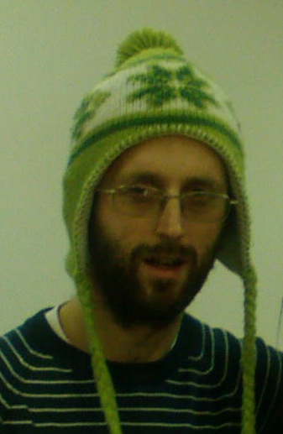
… me

Slide 3
Famous bearded people in the history of Computer Science

Slide 4
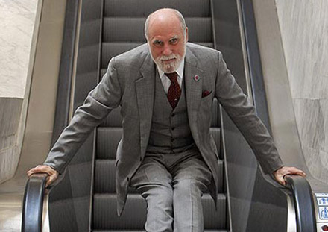
Vinton Cerf

Slide 5
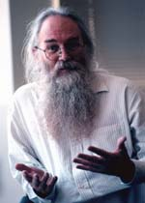
Jonathan Postel

Slide 6
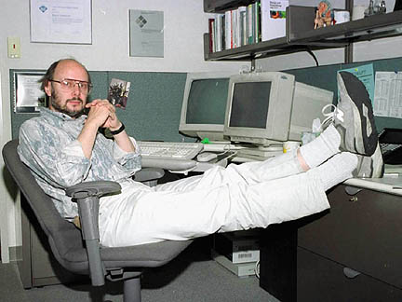
Bjarne Strostrup

Slide 7
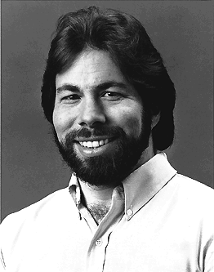
Steve Wozniak - woz

Slide 8
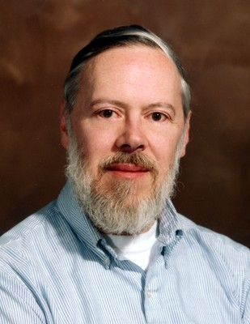
Dennis Ritchie

Slide 9
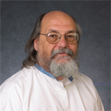
Ken Thompson

Slide 10
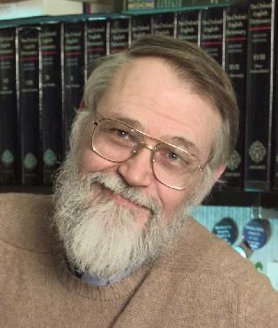
Brian Kernighan

Slide 11
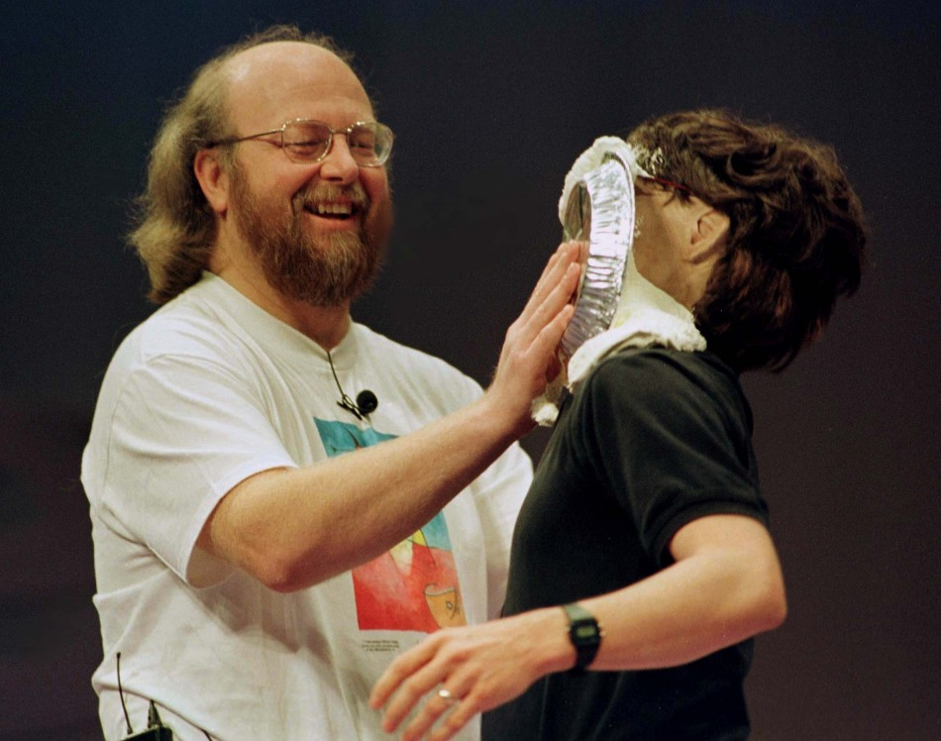
James Gosling

Slide 12
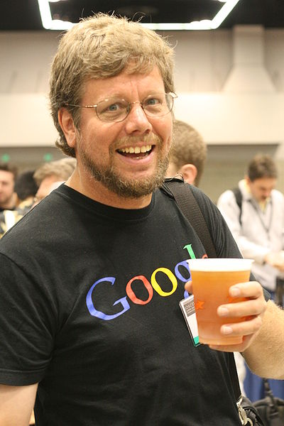
Guido van Rossum

Slide 13
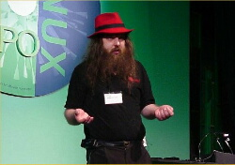
Alan Cox

Slide 14
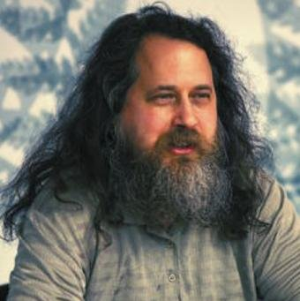
Richard M Stallman - rms

Slide 15
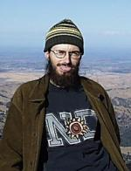
David Miller - davem

Slide 16
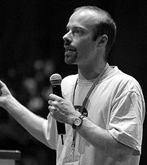
Paul ‘Rusty’Russell

Slide 17
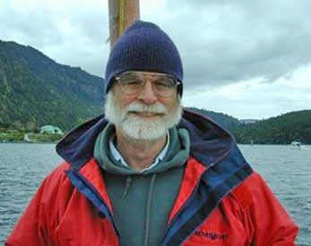
Jim Gray

Slide 18
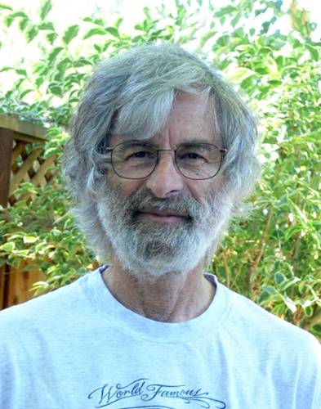
Leslie Lamport

Slide 19
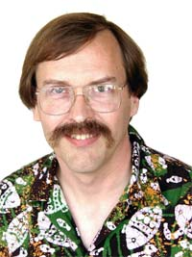
Larry Wall

Slide 20
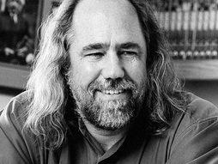
Grady Booch

Slide 21
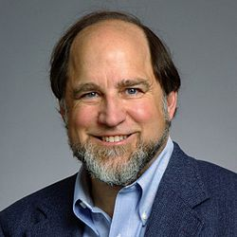
Ron Rivest

Slide 22
And finally, this is not a bearded person, but still famous among male scientists …

Slide 23
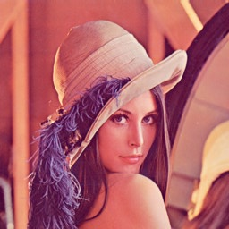
Lenna

