Slide 1
Embedded Software Development with Python and the Raspberry Pi
Class 1: Introduction to Python
August 18, 2014
Jacob Beningo, CSDP
© All Images and content in this presentation may not be used or copied without express written permission of the owner.

Slide 2
Course Overview
  Introduction to Python
  Python Fundamentals
  An Overview of the Raspberry Pi
  Controlling Raspberry Pi Peripherals with Python
  An Internet of Things Weather Station Example

Slide 3

Session Overview
Introduction to Python
  Overview of Python
  Installing Python
  Python Data Types
  Python Operators
  Python Flow Control
  Built-in functions
  String Manipulations
  Examples

Slide 4
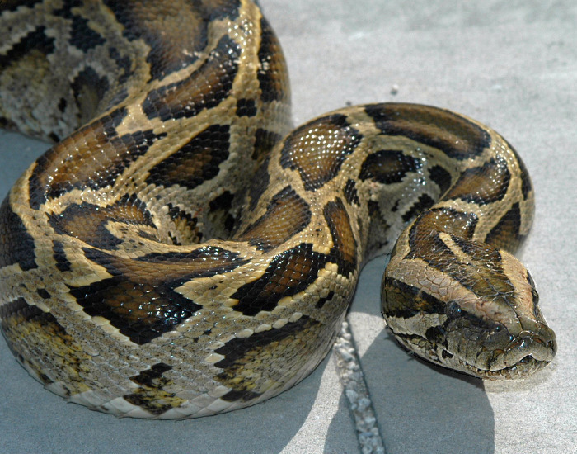
Overview of Python
What is Python?
  Interpreted language
  Interactive
  Object Oriented
Why use Python?
  Entry level language that is easy to learn
  Is portable
  Supports a large set of libraries
Notes:
Interpreted – doesn’t require compilation before execution
Interactive – means that you can issue a command and see the result immediately

Slide 5
Overview of Python
Characteristics of Python Code
  Readable
  Object Oriented
  Typically 20 – 25% size of compiled C++ / Java code
  Can call C/C++/Java/.Net and other language extensions
  Speed of development is extremely fast
  May not be as fast as low level compiled code

Slide 6
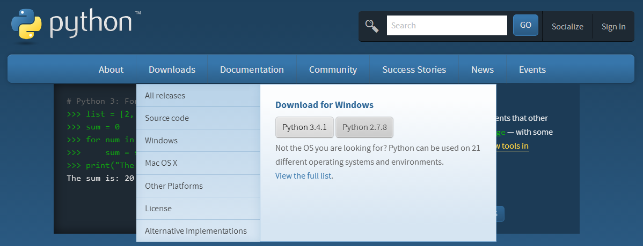
Installing Python
www.python.org
Download this Version!!!

Slide 7
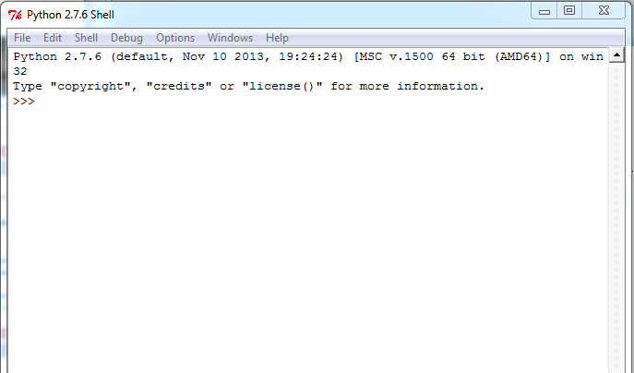
Installing Python

Slide 8
Python Reserved Words
Python Reserved Words | C Reserved Words
and - as - assert - break - | Auto –break - case - char - const-
class - continue - def - del - | Continue - default– do - double-
elif - else - except - exect - | Else – enum – extern - float - for
finally - for - from - global - | Goto - if - int – long - register-
if - import - in - is - lambda - | Return– short- signed- sizeof-
Not - or - pass - print -raise- | Static– switch- typedef- union-
return - try while - with –yield | unsigned –void-volatile-while
Notes:
Rewrite both areas to list the reserved words

Slide 9
Python Data Types
Numeric
  Int (14)
  Long (134563)
  Float (14.34)
  Complex numbers (14.3 + 0.35j)
String
  Myname = ‘Jacob Beningo’
  S = Myname[0] # s = ‘J’
  S = Myname[0:4] # s = ‘Jacob’

Slide 10
Python Data Types
List Variables
  Mylist = [‘Jacob’, ‘Beningo’, 14, ‘November’]
  S = Mylist[0] # s = ‘Jacob’
  S = Mylist[1:2] # s = ‘Beningo’, 14
  Mylist[0] = ‘Jake’
Tuple Variables
  Read only!
  Mytuple = (‘Jacob’, ‘Beningo’, 14, ‘November’)
  Mytuple[0] = ‘Jake’

Slide 11
Python Data Types
Dictionary Variables
  Similar to hash table with keys and values
  Mydictionary = {‘Name’: ‘Jacob’, ‘Surname’: ‘Beningo’}
  S = mydictionary[‘Name’] # s= ‘Jacob’
  S = mydictionary[‘Surname’] # s = ‘Beningo’
  S = mydictionary.keys() # s = ‘Surname’, ‘Name’
  S = mydictionary.values() # s = ‘Beningo’, ‘Jacob’

Slide 12
Python Operators
Arithmetic Operators
Arithmetic Operations | Python | C
Addition | + | +
Subtraction | - | –
Multiplication | * | *
Division | / | /
Modulus | % | %
Exponent | ** | NA
Notes:
Rework

Slide 13
Python Operators
Comparison Operators
Comparison Operators | Python | C
Checks if 2 operands are equal | == | ==
Checks if 2 operands are not equal | != | !=
Checks if the left operand is greater than the right operand | > | >
Checks if the left operand is less than the right operand | < | <
Checks if the left operand is greater than or equal to the right operand | >= | >=
Checks if the left operand is less than or equal to the right operand | <= | <=
Notes:
rework

Slide 14
Python Operators
Logical Operators
Logical Operators | Python | C
Logical AND of the two operands (True if both operands are true) | And | &&
Logical OR of the two operands (True if any operand is true) | Or | ||
Logical inverse of the operand | Not | !
Notes:
rework

Slide 15
Python Operators
Logical Operators
Bitwise Operators | Python | C
Bitwise AND. Corresponding elements of both operators are AND ed | & | &
Bitwise OR. Corresponding elements of both operators are OR ed | | | |
Bitwise EXOR. Corresponding elements are EXCLUSIVE OR ed | ^ | ^
Bitwise complement. All elements of an operand are complemented | ~ | ~
Binary left shift operator | << | <<
Binary right shift operator | >> | >>
Notes:
rework

Slide 16
Python Operators
Assignment Operators
Assignment | Python | Assignment | C | Operation
Assignment Operator | = | Addition | += | a= a + b
Add AND Operator | += | Subtraction | -= | a = a – b
Subtract AND Operator | -= | Multiplication | *= | a = a * b
Multiply AND Operator | *= | Division | /= | a = a / b
Divide AND Operator | /= | Modulo | %= | a = a % b
 |  | Bitwise AND | &= | a = a & b
 |  | Bitwise OR | [- | a = a { b
 |  | Bitwise XOR | ^= | a = a ^ b
 |  | Bitwise left shift | <<= | a = << b
 |  | Bitwise right shift | >>= | a = >> b
Notes:
rework

Slide 17
Python Flow Control
Overview
Python | C
If…else | If…Else
Elif | N/A
For | For
While | While
Break | Break
Continue | Continue
N/A | Switch
N/A | Do…while
Pass | N/A
Notes:
rework

Slide 18
Python Flow Control
If statement
Python
If expression:
statements
Else:
statements
If x == 14:
Delta = 3
Elif x > 15:
Delta = 2
Else:
Delta = 1
C
If (expression)
{
statements;
}
Else
{
statements;
}
Notes:
rework

Slide 19
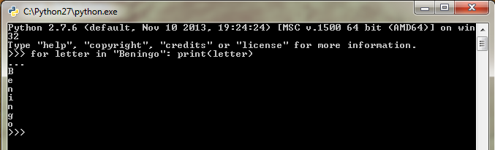
Python Flow Control
for statement
Python
For variable in sequence:
statements
Example:
For letter in “Beningo”:
print(letter)
C
For(start value; end condition; increase value)
{
statements;
}
Notes:
rework

Slide 20
Python Flow Control
while statement
Python
while expression:
statements
Count = 0
while Count < 14:
print Count
Count = Count + 1
C
while(expression)
{
statements;
}
Notes:
rework

Slide 21
Built-in Functions
abs(x)
bin(x)
hex(x)
log(x)
log10(x)
pow(x,y)
round(x,n)
sqrt(x)
sin(x)
cos(x)
tan(x)
asin(x)
acos(x)
atan(x,y)
degrees(x,n)
radians(x)

Slide 22
String Manipulations
print
print formatting characters
Formatting Characters
Character | %c
String | %s
Integer (Signed) | %d
Integer (Unsigned) | %u
Lower case hexadecimal | %x
Upper case hexadecimal | %X
Floating point | %f
Exponential notation | %E
Notes:
rework

Slide 23
String Manipulations
capitalize()
count(str, beg, end)
find(str, beg, end)
len(string)
isdigit()
islower()
lower()
upper()
isalpha()
isalnum()
lstrip()
rstrip()
swapcase()

Slide 24
Going Further
Download Template Materials for
  Python Doxygen Script Template
  Personal Weather Station Python Script
  Raspberry Pi Example Python Scripts
  From www.beningo.com under
  Blog and Articles > Software Techniques > Embedded Software with Python

Slide 25





Contact Information
P.O. Box 400
Linden, Michigan 48451
: jacob@beningo.com
: 810-844-1522
: Jacob_Beningo
: Beningo Engineering
: JacobBeningo
: Embedded Basics
Jacob Beningo
Principal Consultant
© All Images and content in this presentation may not be used or copied without express written permission of the owner.

