Slide 1
Embedded Software Development with Python and the Raspberry Pi
Class 2: Python Fundamentals
August 19, 2014
Jacob Beningo, CSDP
© All Images and content in this presentation may not be used or copied without express written permission of the owner.

Slide 2
Course Overview
  Introduction to Python
  Python Fundamentals
  An Overview of the Raspberry Pi
  Controlling Raspberry Pi Peripherals with Python
  An Internet of Things Weather Station Example

Slide 3

Session Overview
Python Fundamentals
  User Defined Functions
  Lists
  Dictionaries
  File System Manipulation
  Exception Handling
  Object Oriented Programming

Slide 4
User Defined Functions
Begin with def
Input arguments are placed inside of brackets
Statements of function MUST be indented
A function MUST be terminated with return
Python
def Divide(dividend, devisor):
return divident / devisor
C
float Divide(dividend, devisor)
{
return divident / devisor;
}

Slide 5
Lists
List Variable Review
  Mylist = [‘Jacob’, ‘Beningo’, 14, ‘November’]
  S = Mylist[0] # s = ‘Jacob’
  S = Mylist[1:2] # s = ‘Beningo’, 14
  Mylist[0] = ‘Jake’

Slide 6
Lists
list.append(x)
  Appends an element to the end of a list
MyList = []
MyList.append(10)
print MyList
>> [10]
MyList.append(14)
print MyList
>> [10, 14]

Slide 7
Lists
Del(i:j])
  Deletes element from I to j-1
List.remove(x)
  Removes the specified value from the list
MyList = [10,14]
print MyList
>> [10, 14]
del MyList[0]
print MyList
>> [14]

Slide 8
Lists
list.count(x)
  Returns how many times x occurs in the list
List.index(x)
  Returns index of first occurrence of x
List.insert(I,x)
  Inserts x at position I in the list
List.sort()
  Sorts a list

Slide 9
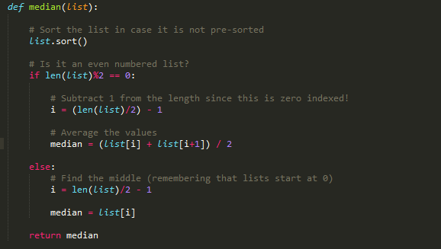
Lists
Example

Slide 10
Dictionaries
Dictionary Variables
  Collection of key-value pairs
  All keys must be unique
  Mydictionary = {‘Name’: ‘Jacob’, ‘Surname’: ‘Beningo’}
  S = mydictionary[‘Name’] # s= ‘Jacob’
  S = mydictionary[‘Surname’] # s = ‘Beningo’
  S = mydictionary.keys() # s = ‘Surname’, ‘Name’
  S = mydictionary.values() # s = ‘Beningo’, ‘Jacob’

Slide 11
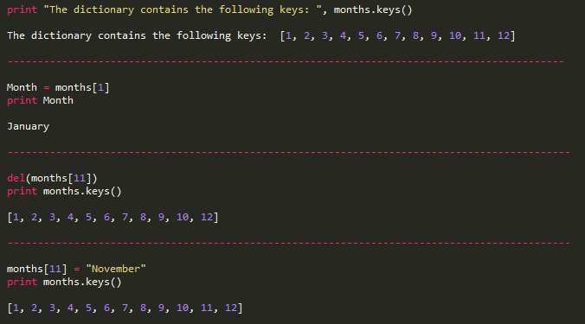
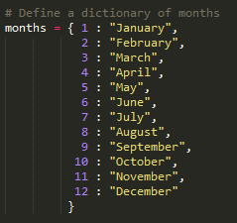
Dictionaries
Examples

Slide 12
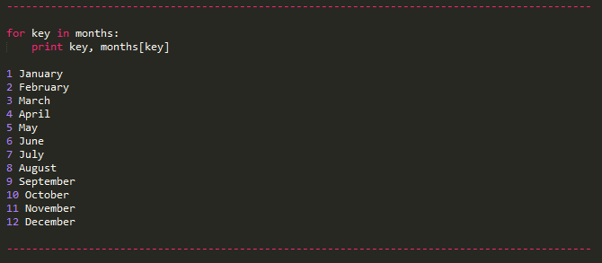
Dictionaries
Examples

Slide 13
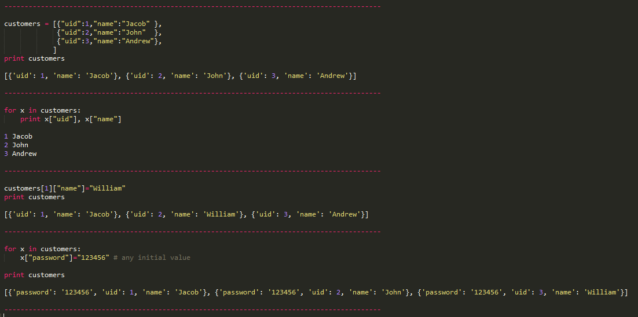
Dictionaries
Examples

Slide 14
File System Manipulation
file object = open(filename, access mode)
Access Mode | Behavior
r | Opens a file for reading only. The file pointer is placed at the beginning of the file. This is the default mode.
r+ | Opens a file for both reading and writing. The file pointer will be at the beginning of the file.
w | Opens a file for writing only. Overwrites the file if the file exists. If the file does not exist, creates a new file for writing.
w+ | Opens a file for both writing and reading. Overwrites the existing file if the file exists. If the file does not exist, creates a new file for reading and writing.
a | Opens a file for appending. The file pointer is at the end of the file if the file exists. That is, the file is in the append mode. If the file does not exist, it creates a new file for writing.
a+ | Opens a file for both appending and reading. The file pointer is at the end of the file if the file exists. The file opens in the append mode. If the file does not exist, it creates a new file for reading and writing.

Slide 15
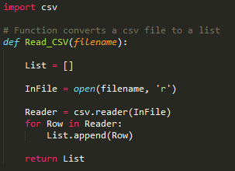
File System Manipulation
Example – Reading a CSV File

Slide 16
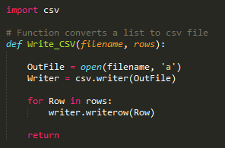
File System Manipulation
Example – Writing a CSV File

Slide 17
Exception Handling
try and except
try:
normal program statements
except condition 1:
if condition 1 type error, then execute this block of code
except condition 2:
if condition 2 type error, then execute this block of code
else:
if no errors then execute this block of code

Slide 18
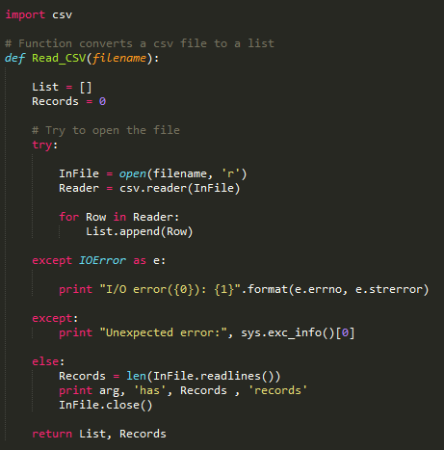
Exception Handling
Example

Slide 19
Object Oriented Programming
Why OOP?
  Organize programs around “objects” that are manipulated not around program “actions”
  Data hiding
  Reusable
  Modular
  Ability to create classes and use inheritance and polymorphism

Slide 20
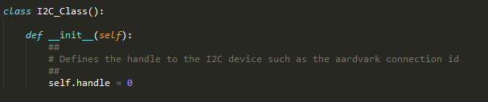

Object Oriented Programming
Defining a class in Python
Add methods to the class

Slide 21
Going Further
Download Template Materials for
  Python Doxygen Script Template
  Personal Weather Station Python Script
  Raspberry Pi Example Python Scripts
Web Tutorials
YouTube
  From www.beningo.com under
  Blog and Articles > Software Techniques > Embedded Software with Python

Slide 22





Contact Information
P.O. Box 400
Linden, Michigan 48451
: jacob@beningo.com
: 810-844-1522
: Jacob_Beningo
: Beningo Engineering
: JacobBeningo
: Embedded Basics
Jacob Beningo
Principal Consultant
© All Images and content in this presentation may not be used or copied without express written permission of the owner.

