Slide 1
Integration into the SDLC
(Software Development Life Cycle)
With Eoin Keary
Eoin.keary@owasp.org

Slide 2

Bespoke Applications Vs. Commercial Applications
Application Development internal use:
  Bespoke, customized, one-off application
    Audience is not so great: (Users, developers, test)
      Vulnerabilities are not discovered too quickly by users.
      Vulnerabilities are discovered by hackers, they actively look for them.
Bespoke application = Small audience = Less chance of vulnerabilities being discovered
This is unlike, Say Microsoft XP 210 Million copies sold (http://www.forbes.com/ May2004)
First Line of Defense:
The Developer:
  Writes the code.
  Understands the problem better than anyone!
  Has the skill set.
  More effective and efficient in providing a solution

Slide 3

Complexity Vs Security
As Functionality and
hence complexity
increase security
decreases.
Functionality
Integrating security into
functionality at design time
Is easier and cheaper.
“100 Times More Expensive to Fix Security Bug at Production Than Design”
– IBM Systems Sciences Institute
Security
It also costs less in the long-term.
-maintenance cost

Slide 4
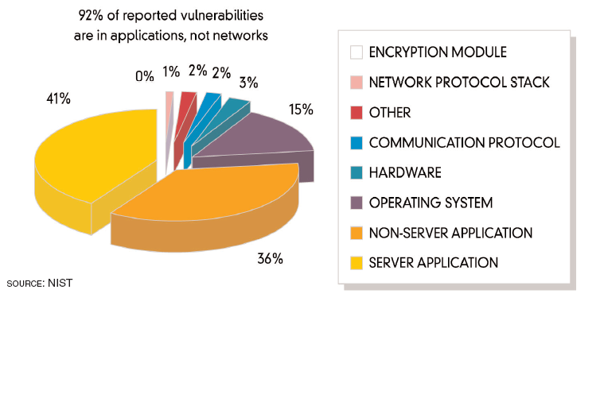
A Few Facts and figures:
How Many Vulnerabilities Are Application Security Related?

Slide 5
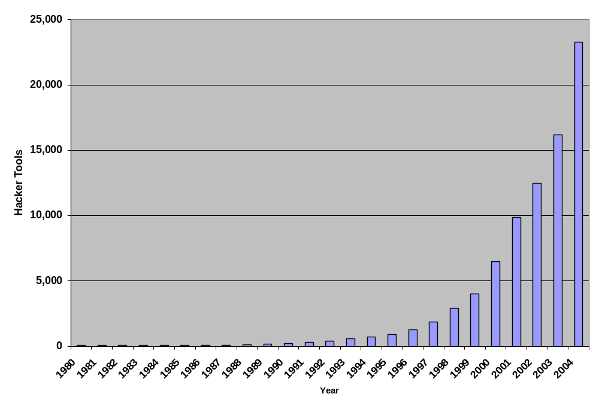
Growth of Threat: Growth in the tools available.
Categories:
Binder
Carding
Cracking Tool
Flooder
Key Generator
Mail Bomber
Mailer
Misc Tool
Nuker
Packer
Password Cracker
Password Cracking Word List
Phreaking Tool
Port Scanner
Probe Tool
Sniffer
Spoofer
Trojan
Trojan Creation Tool
Virus Creation Tool
Virus Source
Virus Tutorial
War Dialer
Source: PestPatrol.com

Slide 6
A Few Facts and figures (contd)
Interesting Statistics – Employing code review
  IBM Reduces 82% of Defects Before Testing Starts
  HP Found 80% of Defects Found Were Not Likely To Be Caught in Testing
  100 Times More Expensive to Fix Security Bug at Production Than Design”
  – IBM Systems Sciences Institute
Promoting People Looking at Code
  Improvement Earlier in SDLC
  Fix at Right Place; the Source
  Takes 20% extra time – payoff is order of magnitude more.
Ref: http://ganssle.com/Inspections.pdf

Slide 7
If cars Were Built Like Applications….
70% of all cars would be built without following the original designs and blueprints. The other 30% would not have designs.
Car design would assume that safety is a function of road design and that all drivers were considerate, sober and expert drivers.
Cars would have no airbags, mirrors, seat belts, doors, roll-bars, side-impact bars, or locks, because no-one had asked for them. But they would all have at least six cup holders.
Not all the components would be bolted together securely and many of them would not be built to tolerate even the slightest abuse.
Safety tests would assume frontal impact only. Cars would not be roll tested, or tested for stability in emergency maneuvers, brake effectiveness, side impact and resistance to theft.
Many safety features originally included might be removed before the car was completed, because they might adversely impact performance.
70% of all cars would be subject to monthly recalls to add major components left out of the initial production. The other 30% wouldn’t be recalled, because no-one would sue anyway.
The after-market for safety devices would include such useful products as training wheels, screen doors, elastic seatbelts and devices that would restrict the car’s top speed to 3mph, if found to be unsafe (which would be always).
Useful safety could be found, but could only be custom retro-fitted, would take six months to fit and would cost more than the car itself.
A NCT/MOT inspection would consist of counting the wheels and making recommendations on wheel quantity.
Your only warning indicator would be large quantities of smoke and flame in the cab.
You could only get insurance from one provider, it would be extremely expensive, require a duplicate NCT/MOT inspection, and you might still never be able to claim against the policy.
- Denis Verdon

Slide 8
How do we do it?
Security Analyst:
  Get involved early in SDLC. Security is a function of the asset we want to secure, what's it worth?
  Understanding the information held in the application and the types of users is half the battle.
  Involve an analyst in the design phase and thereafter.
Developer:
  Embrace secure application development. (Educate)
  Quality is not just “Does it work” Security is a measure of quality also.

Slide 9
How do we do it? (contd)
QA:
  Security vulnerabilities are to be considered bugs, the same way as a functional bug, and tracked in the same manner.
Managers:
  Factor some time into the project plan for security.
  Consider security as added value in an application.
    – $1 spent up front saves $10 during development and $100 after release

Slide 10
Software security tollgates in the SDLC
Risk = Threat x Vulnerability x Cost
What do we need to test,
And how
Code review tools
Iterative approach
Security
requirements
Design
Review
Static
analysis
(tools)
Penetration
testing
Risk
analysis
Risk-based
security tests
Requirements
and use cases
Design
Test plans
Code
Test
results
Field
feedback
Code
Review

Slide 11
Application Security Risk Categorization
Goal
  More security for riskier applications
  Ensures that you work the most critical issues first
  Scales to hundreds or thousands of applications
Tools and Methodology
  Security profiling tools can gather facts
    Size, complexity, security mechanisms, dangerous calls
  Questionnaire to gather risk information
    Asset value, available functions, users, environment, threats
  Risk-based approach
    Evaluates likelihood and consequences of successful attack
Notes:
Scheme to measure lots of apps across an organization.
prioritize based on most risky.
Cat 1 – 5: Based on hurricane scale.
1) Internal app, no sensitive assets
5) Internet app with personal info.
Use this scale to drive the plan for building new apps.

Slide 12
Application Security Project Plan
Define the plan to ensure security at the end
  Ideally done at start of project
  Can also be started before or after development is complete
Based on the risk category
  Identify activities at each phase
  Necessary people and expertise required
  Who has responsibility for risks
  Ensure time and budget for security activities
  Establish framework for establishing the “line of sight”
Notes:
Activities:
Design review, pen test, …
Who has responsibility: Ask the class who has app security responsibility in their org?

Slide 13
Application Security Requirements Tailoring
Get the security requirements and policy right
Start with a generic set of security requirements
  Must include all security mechanisms
  Must address all common vulnerabilities
  Can be use (or misuse) cases
  Should address all driving requirements (regulation, standards, best practices, etc.)
Tailoring examples…
  Specify how authentication will work
  Detail the access control matrix (roles, assets, functions, permissions)
  Define the input validation rules
  Choose an error handling and logging approach
Notes:
Take LMCO standard and tailor it
Refine: “You will do access control”
Into: This is the access control matrix & this is how it will be enforced.
- we will use netegrity to implement this policy

Slide 14
Design Reviews
Better to find flaws early
Security design reviews
  Check to ensure design meets requirements
  Also check to make sure you didn’t miss a requirement
Assemble a team
  Experts in the technology
  Security-minded team members
  Do a high-level penetration test against the design
  Be sure to do root cause analysis on any flaws identified
Notes:
Not trying to reinvent the whole SDLC, just trying to insert a few key activities that will help generate more secure code.

Slide 15
Software Vulnerability Analysis
Find flaws in the code early
Many different techniques
  Static (against source or compiled code)
    Security focused static analysis tools
    Peer review process
    Formal security code review
  Dynamic (against running code)
    Scanning
    Penetration testing
Goal
  Ensure completeness (across all vulnerability areas)
  Ensure accuracy (minimize false alarms)
Notes:
Goal is to find flaws…
- put up next slide

Slide 16
Application Security Testing
Identify security flaws during testing
Develop security test cases
  Based on requirements
  Be sure to include “negative” tests
  Test all security mechanisms and common vulnerabilities
Flaws feed into defect tracking and root cause analysis
Notes:
If the requirements (Security) are written down the normal testing process should work.

Slide 17
Application Security Defect Tracking and Metrics
“Every security flaw is a process problem”
Tracking security defects
  Find the source of the problem
    Bad or missed requirement, design flaw, poor implementation, etc…
  ISSUE: can you track security defects the same way as other defects
Metrics
  What lifecycle stage are most flaws originating in?
  What security mechanisms are we having trouble implementing?
  What security vulnerabilities are we having trouble avoiding?
Notes:
Discussion? Security flaws are often sensitive. Should they be treated differently

Slide 18
Configuration Management and Deployment
Ensure the application configuration is secure
Security is increasingly “data-driven”
  XML files, property files, scripts, databases, directories
How do you control and audit this data?
  Design configuration data for audit
  Put all configuration data in CM
  Audit configuration data regularly
  Don’t allow configuration changes in the field

Slide 19
What now?
"So now, when we face a choice between adding features and resolving security issues, we need to choose security."
-Bill Gates
The user's going to pick dancing pigs over security every time.
-Bruce Schneier
If you think technology can solve your security
problems, then you don't understand the problems
and you don't understand the technology.
-Bruce Schneier
Using encryption on the Internet is the equivalent of arranging
an armored car to deliver credit-card information from someone
living in a cardboard box to someone living on a park bench.
        -Gene Spafford

