Slide 1
Airport Flight Delays (2010-2018)
Presented By Robert Danielson, Sruthi Rajeswari, Sean Evans, Adrian Jackson

Slide 2
Libraries Used
Pandas
Matplotlib
Numpy
Seaborn
Calendar

Slide 3
Airports
Atlanta Hartsfield Jackson Airport
Chicago O’Hare International Airport
John F. Kennedy International Airport
Los Angeles International Airport

Slide 4
How are delay categories split up?
Air Carrier: The cause of the cancellation or delay was due to circumstances within the airline's control (e.g. maintenance or crew problems, aircraft cleaning, baggage loading, fueling, etc.).
Extreme Weather: Significant meteorological conditions (actual or forecasted) that, in the judgment of the carrier, delays or prevents the operation of a flight such as tornado, blizzard or hurricane.
National Aviation System (NAS): Delays and cancellations attributable to the national aviation system that refer to a broad set of conditions, such as non-extreme weather conditions, airport operations, heavy traffic volume, and air traffic control.
Late-arriving aircraft: A previous flight with same aircraft arrived late, causing the present flight to depart late.
Security: Delays or cancellations caused by evacuation of a terminal or concourse, re-boarding of aircraft because of security breach, inoperative screening equipment and/or long lines in excess of 29 minutes at screening areas.
https://www.bts.dot.gov/explore-topics-and-geography/topics/airline-time-performance-and-causes-flight-delays

Slide 5
Five Basic Questions
What is the major cause of flight delays?
Over the last decade, have airline issues improved?
Which airline carrier arrives on time the most often?
Which airport has the most delays?
What month of the year has the most delays?

Slide 6
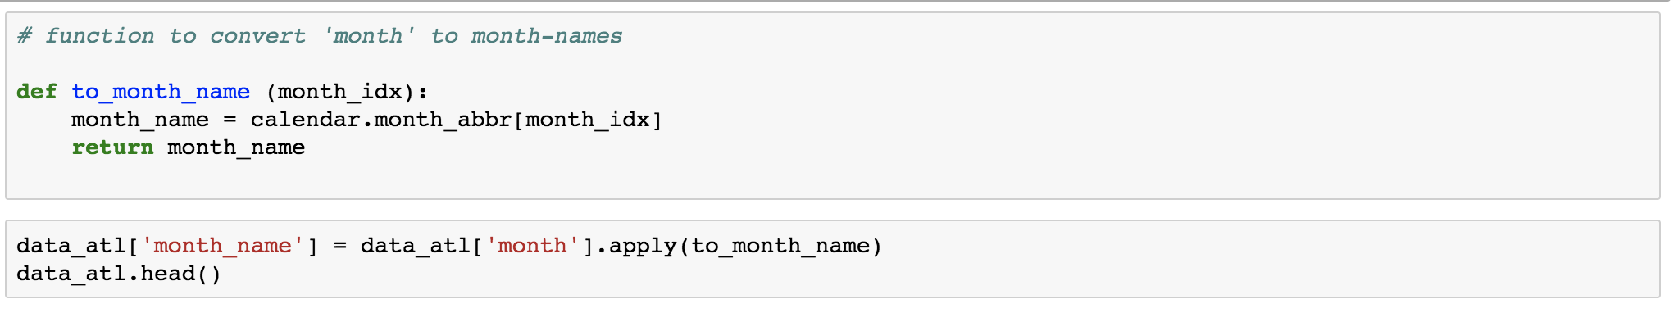
Data Cleaning

Slide 7
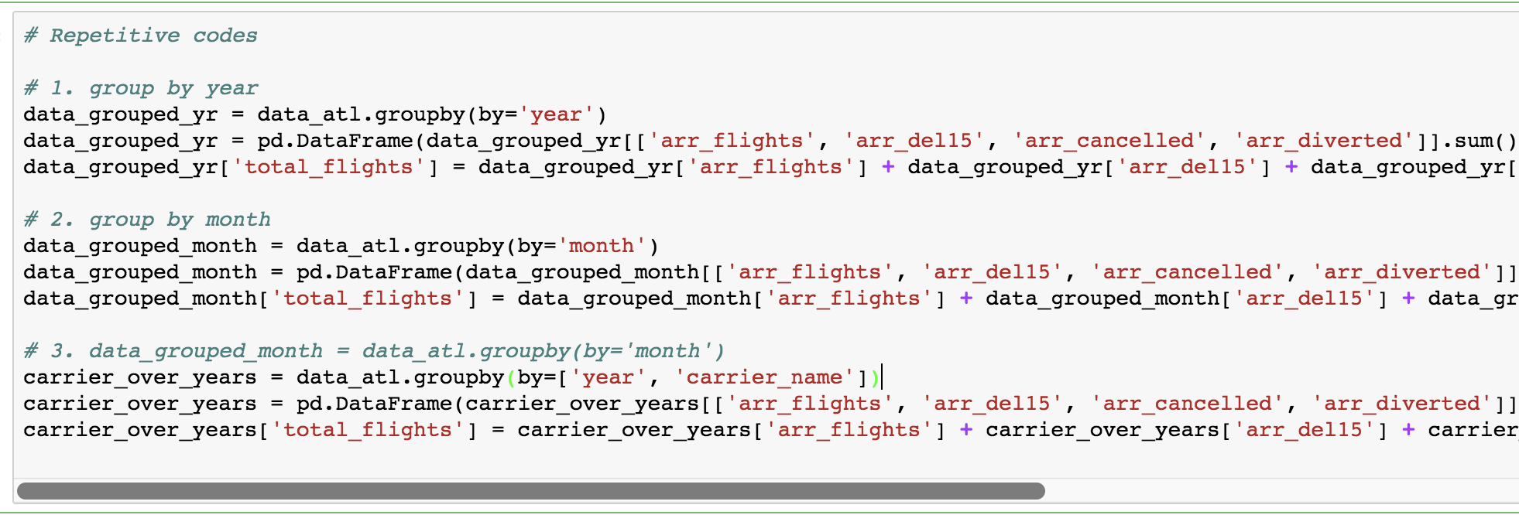
Code Refactoring

Slide 8
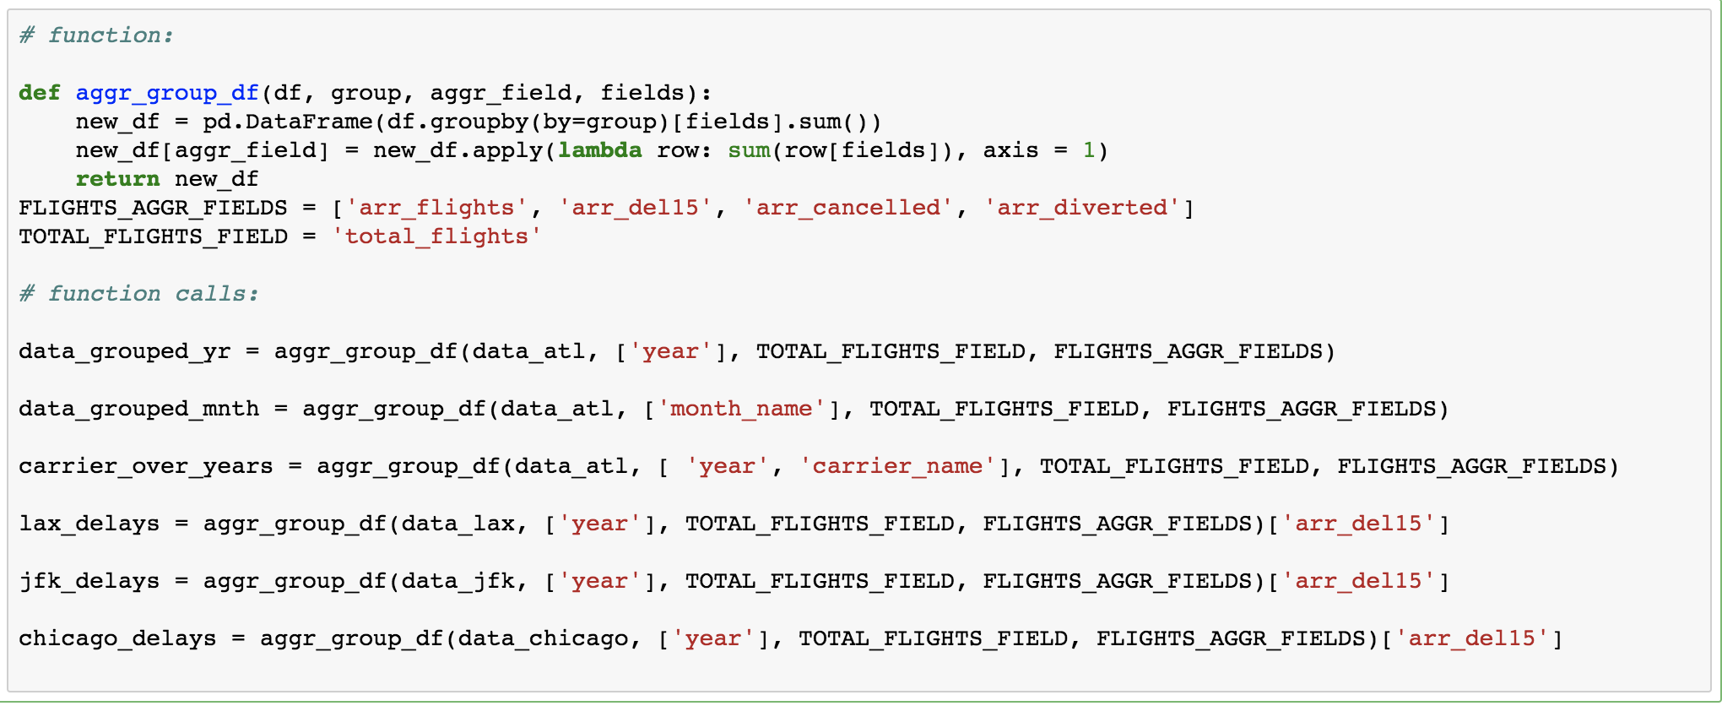
Code Refactoring

Slide 9
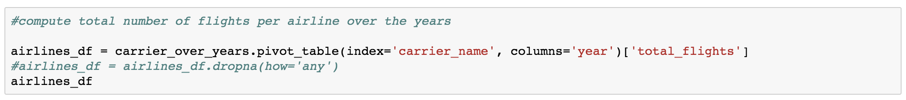
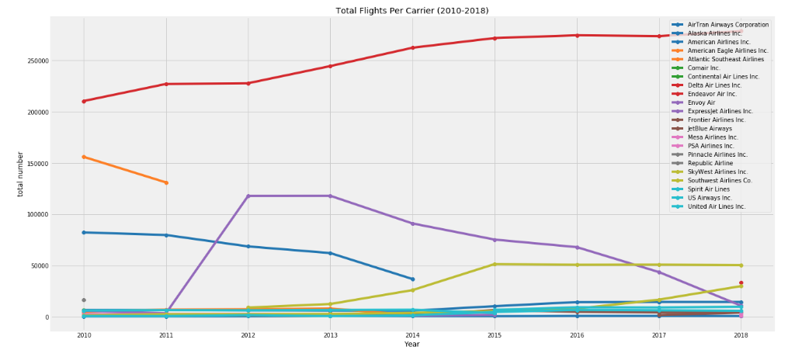
Potential Problems?

Slide 10
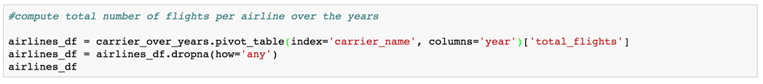
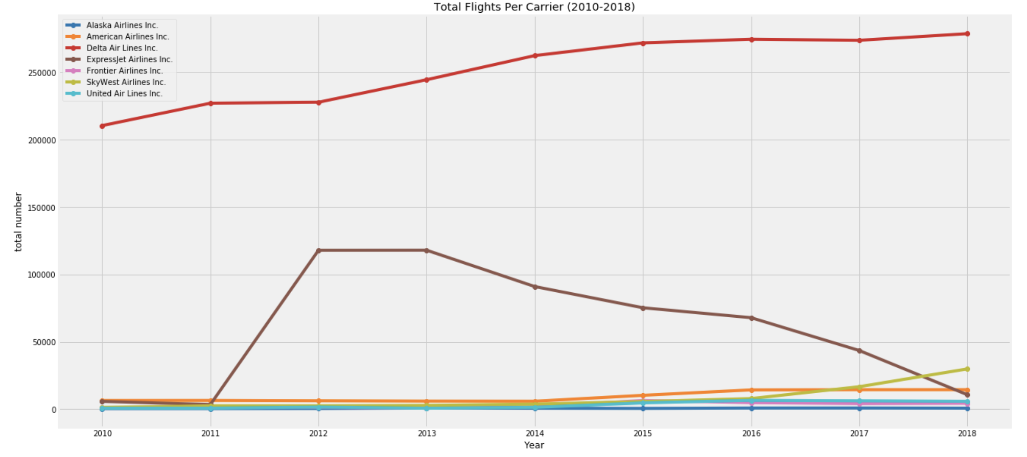

Slide 11
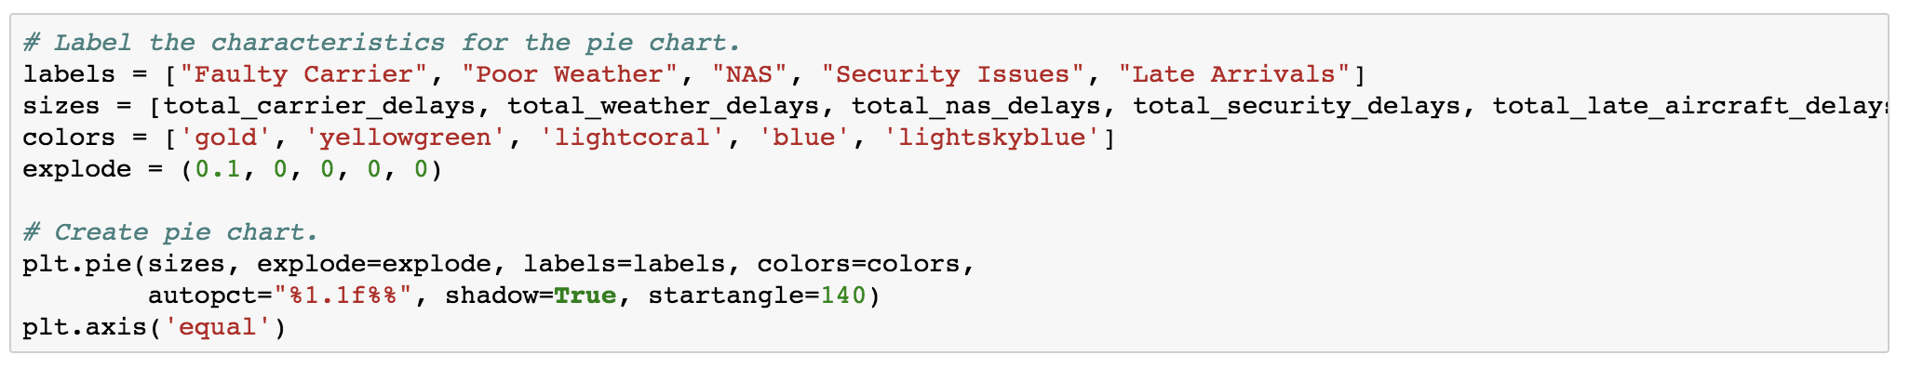
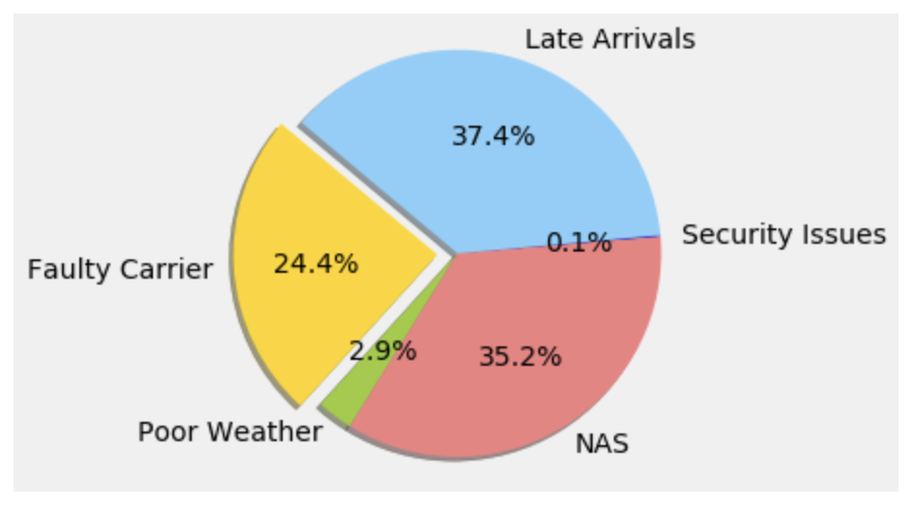
What are the major flight delay causes?

Slide 12
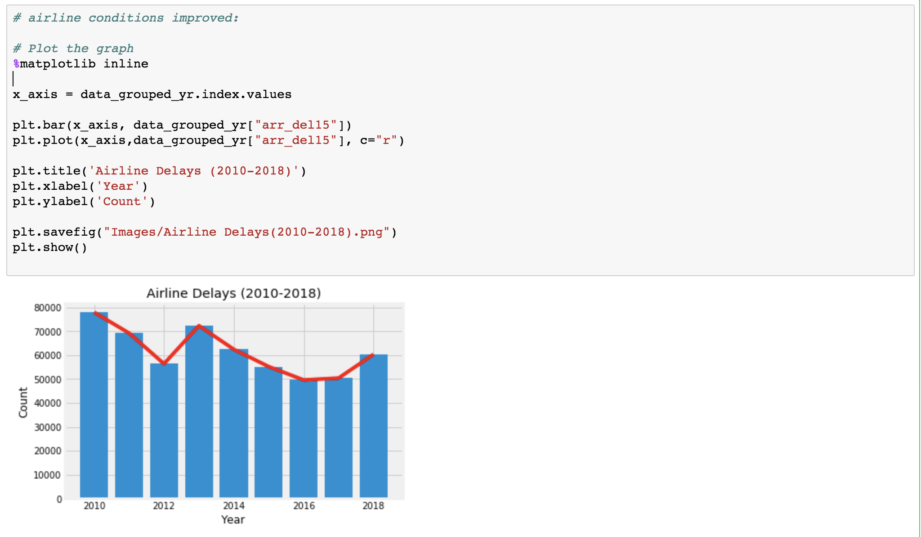
Have airline conditions improved?

Slide 13
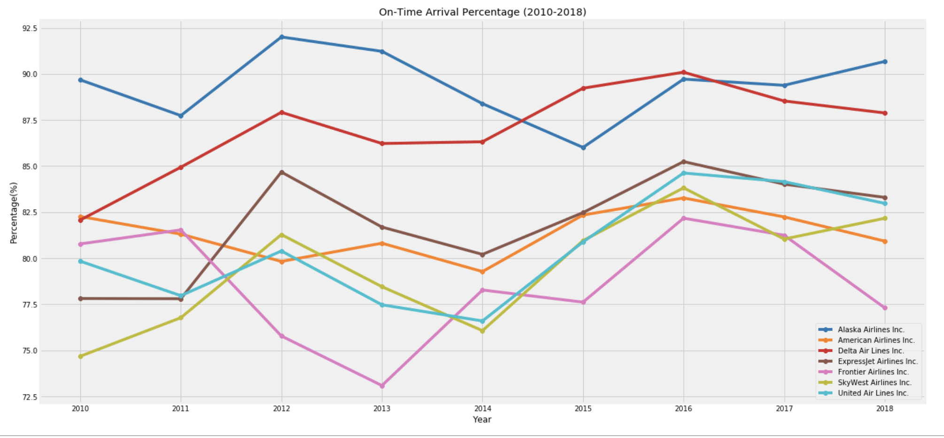
What air carrier arrives on time the most often?

Slide 14
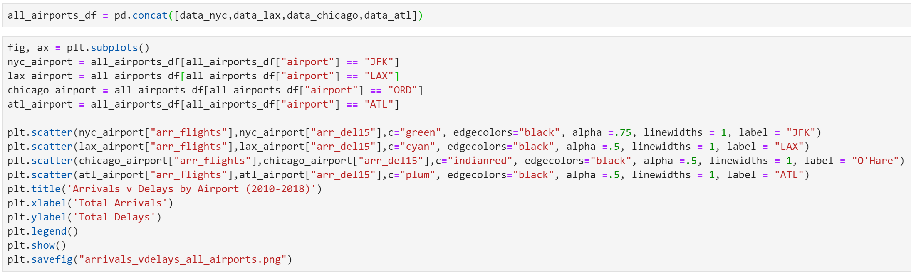
Which airport has the most delays?

Slide 15
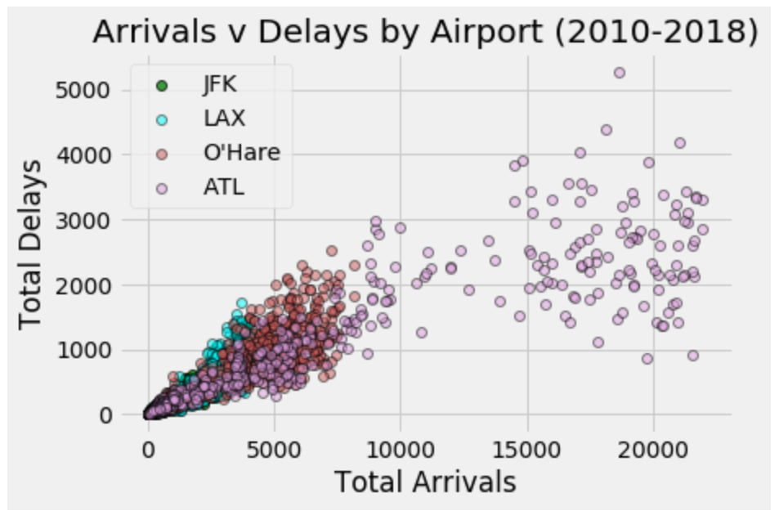
Which airport has the most delays?

Slide 16
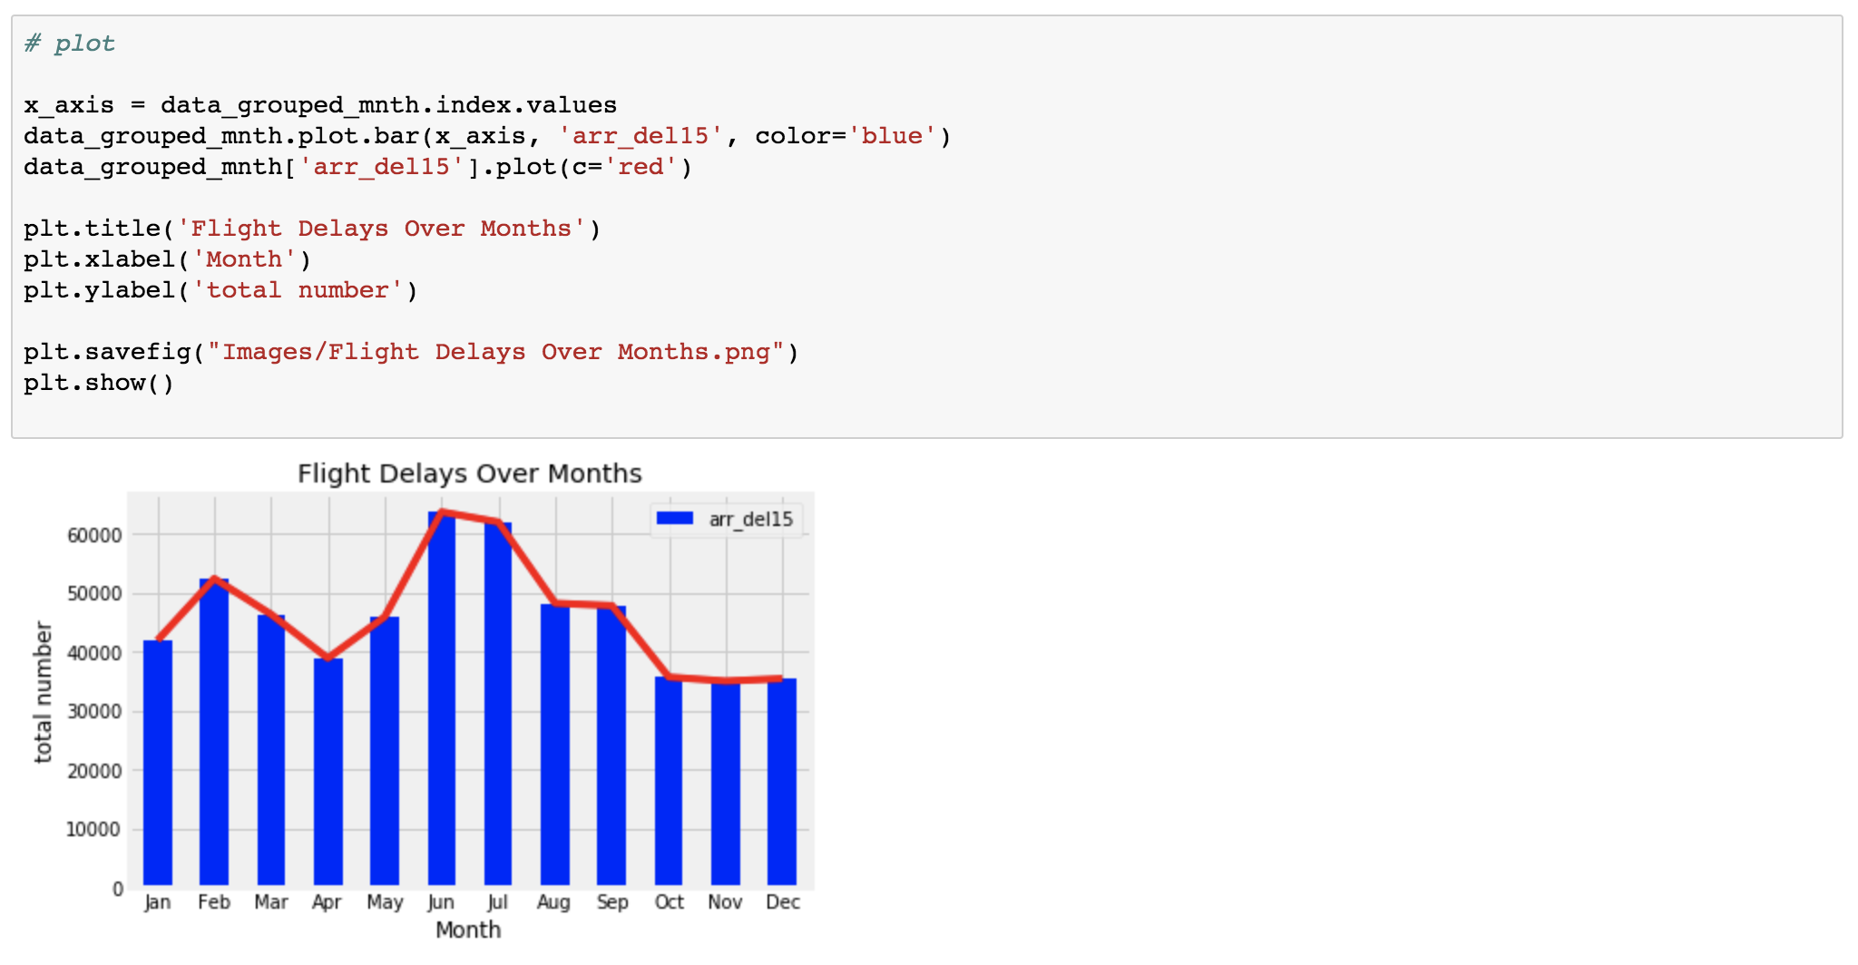
What month of the year has the most delays?

Slide 17
What could be done to improve this presentation?
Obtain data that specifies NAS breakdown
Record busiest hours of the day
More advanced graphs
Graph flight courses from ATL airport to other airports
Look into variables that make ATL the busiest airport
Obtain labor statistics on air traffic controllers

Slide 18
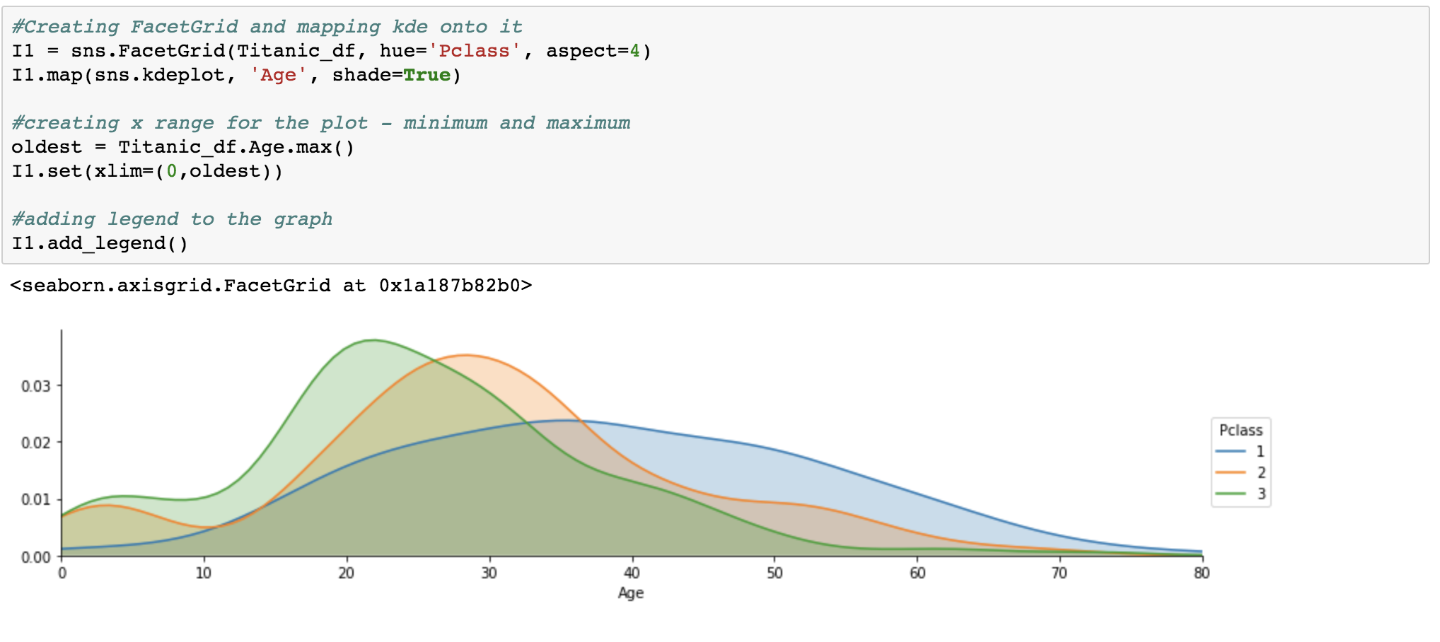
Advanced Graph

Slide 19
Conclusions
Most Delays = National Aviation System Delays & General Late Arrivals
Maximum Delays Year = 2010 Minimum Delay Year = 2016
June & July = Most Delays Oct, Nov, Dec = Least Delays
Most Reliable Carrier = Alaska, Delta
Scatterplot Outlines How Busy ATL Airport Is

Slide 20
Questions?

