Slide 1

Daniel Stoller – Project 3
3D Color Match

Slide 2
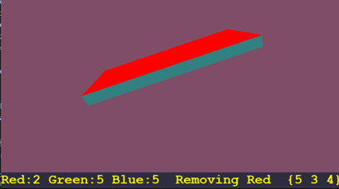
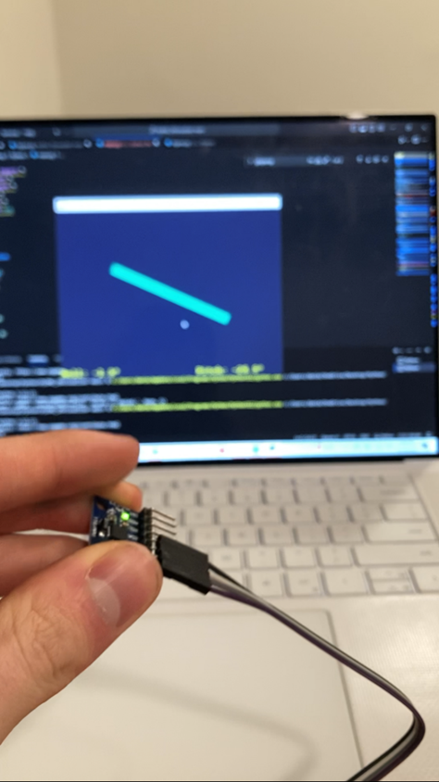
3D Color Match
Match the board color to the background color
IMU sends Roll and Pitch to serial monitor and the game reads the data
Board is a 3d modeled IMU that rotates based on the orientation of the IMU in real time
Board and background are random RGB values between 0 and 9. RGB value of the board can be incremented by the IMU and the background changes once the board matches it
IMU orientation is split into 9 zones, with each zone changing the color of the board differently (left corners is red, right corners is blue, forward and backwards is green, left and right are black and white aka 1 of all)

Slide 3
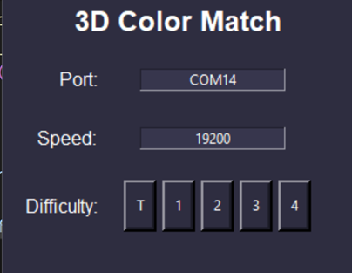
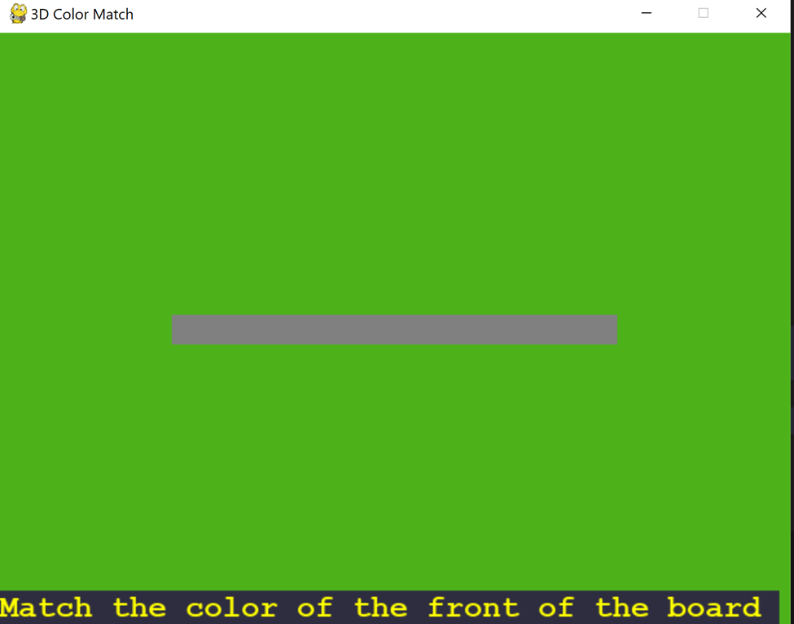
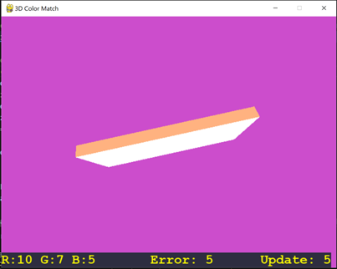
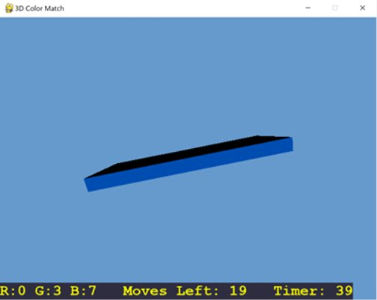
5 Difficulty Levels
Tutorial: Instruction given, Board changes color to zone color, Verbal description of each zone, Answers given
Closeness: Gives the number of moves away from the answer, Updates every 10 seconds
Normal: Shows elapsed time, can't lose
Timer: 60 second timer per round, extra time is rolled over to the next round
Moves + Timer: Only given 30 moves to win, 60 second timer per round

