Slide 1
Lecture 10 Image Feature Detection
ECE 1390/2390

Slide 2
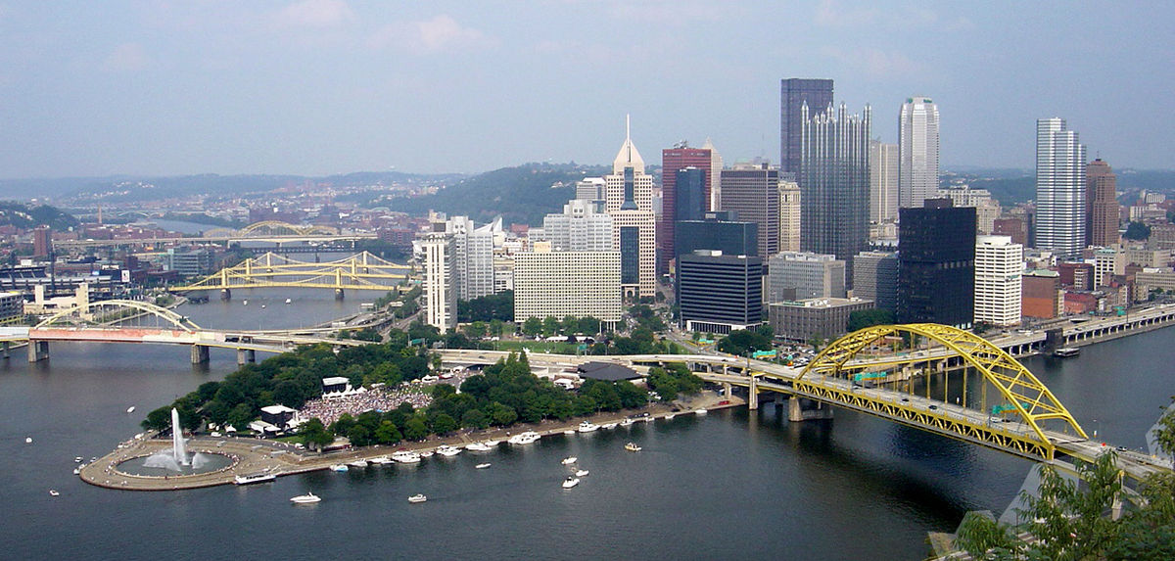
What is an image feature?

Slide 3
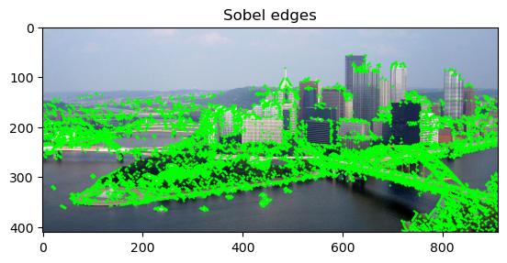
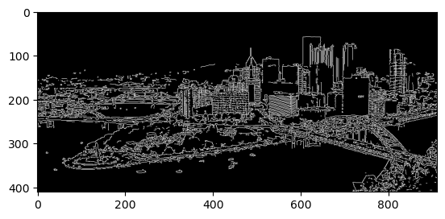
What is an image feature?
Edges

Slide 4
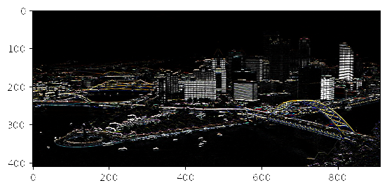
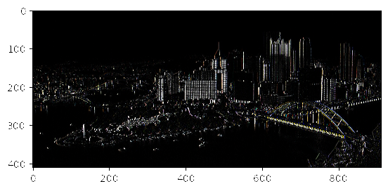


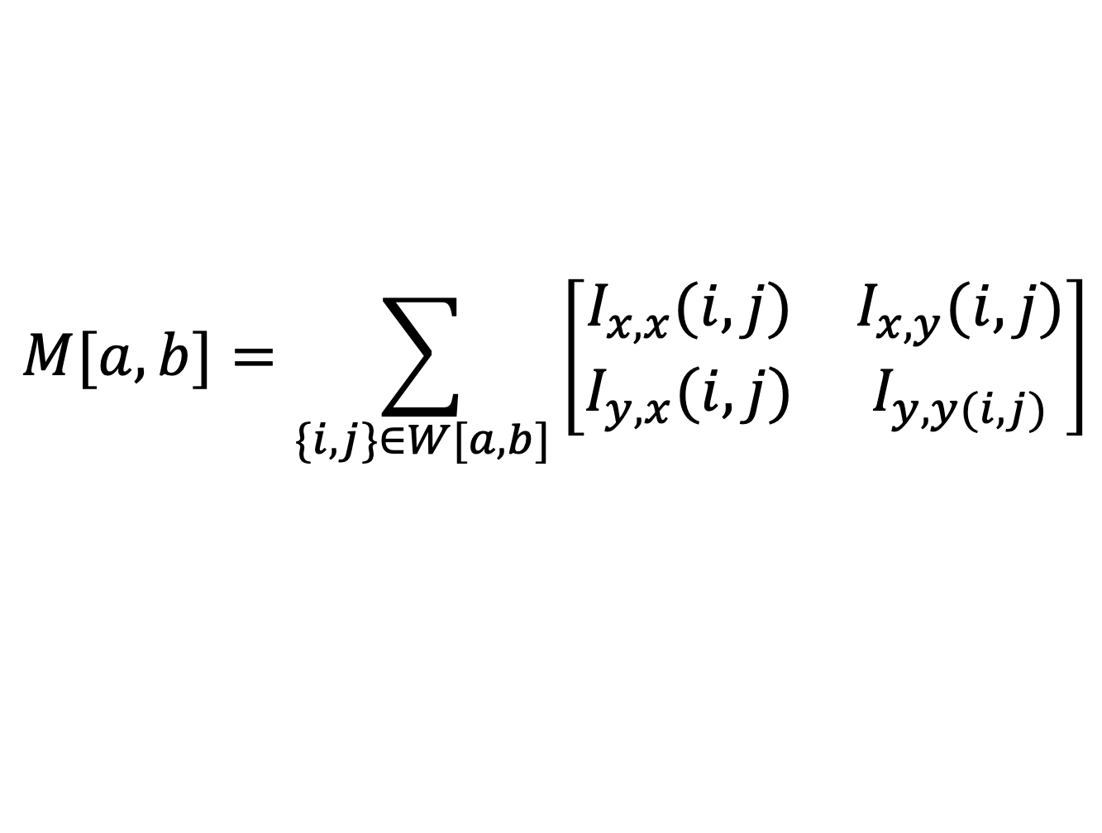
What is an image feature?
Harris Corners
$$Kernel=\left[\begin{matrix}−1 & 1\end{matrix}\right]$$
$$Kernel=\left[\begin{matrix}−1 \\ 1\end{matrix}\right]$$
$$M[a,b]=\sum_{\{i,j\}∈W[a,b]}{\left[\begin{matrix}I_{x,x}(i,j) & I_{x,y}(i,j) \\ I_{y,x}(i,j) & I_{y,y(i,j)}\end{matrix}\right]}$$
Structure matrix

Slide 5
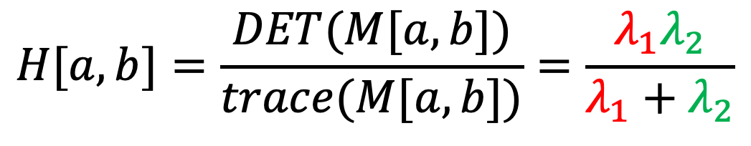
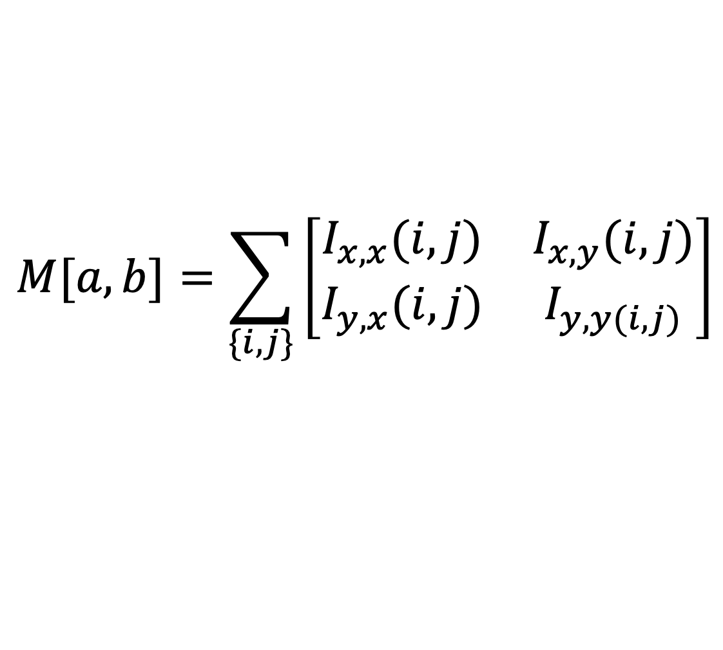
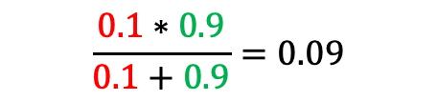
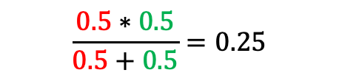
What is an image feature?
Harris Corners
$$M[a,b]=\sum_{\{i,j\}}{\left[\begin{matrix}I_{x,x}(i,j) & I_{x,y}(i,j) \\ I_{y,x}(i,j) & I_{y,y(i,j)}\end{matrix}\right]}$$
$$H[a,b]=\frac{DET(M[a,b])}{trace(M[a,b])}=\frac{λ_{1}λ_{2}}{λ_{1}+λ_{2}}$$
$$\frac{0.5∗0.5}{0.5+0.5}=0.25$$
$$\frac{0.1∗0.9}{0.1+0.9}=0.09$$

Slide 6
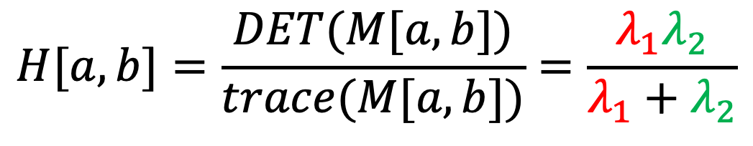
What is an image feature?
Harris Corners
$$H[a,b]=\frac{DET(M[a,b])}{trace(M[a,b])}=\frac{λ_{1}λ_{2}}{λ_{1}+λ_{2}}$$
Non-maximum suppression
$$HNMS\left[a,b\right]=Morph Max Filter(H\left[a,b\right], <3x3>)$$

Slide 7

What is an image feature?
Harris Corners
$$H[a,b]=\frac{DET(M[a,b])}{trace(M[a,b])}=\frac{λ_{1}λ_{2}}{λ_{1}+λ_{2}}$$
$$\frac{0.5∗0.5}{0.5+0.5}=0.25$$
$$\frac{0.1∗0.9}{0.1+0.9}=0.09$$
$${Both λ}_{1} and λ_{2} are large →Corner$$
$${Only λ}_{1} is large →edge$$
$${Both λ}_{1} and λ_{2} are small →no interest$$

Slide 8

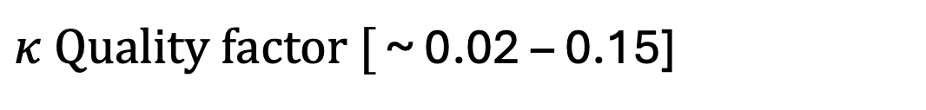

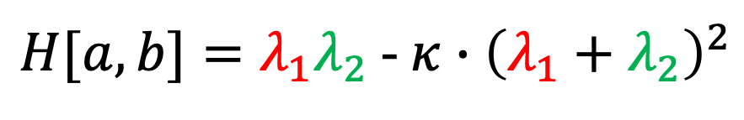
What is an image feature?
Harris Corners
$$H[a,b]=\frac{DET(M[a,b])}{trace(M[a,b])}=\frac{λ_{1}λ_{2}}{λ_{1}+λ_{2}}$$
$H[a,b]=λ_{1}λ_{2}$ - $κ∙{\left(λ_{1}+λ_{2}\right)}^{2}$
$$\frac{0.5∗0.5}{0.5+0.5}=0.25$$
$κ Quality factor [$ ~ 0.02 – 0.15]
$$\frac{0.1∗0.9}{0.1+0.9}=0.09$$
$${Both λ}_{1} and λ_{2} are large →Corner$$
$${Only λ}_{1} is large →edge$$
$${Both λ}_{1} and λ_{2} are small →no interest$$

Slide 9
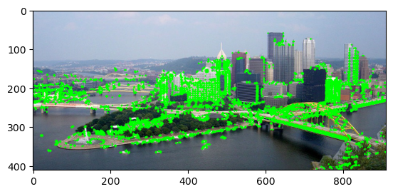
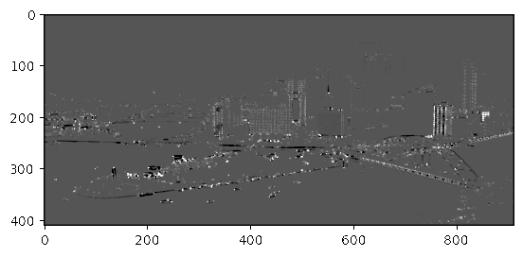
What is an image feature?
Corners

Slide 10
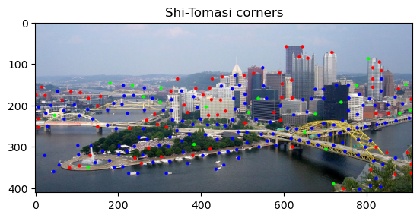
What is an image feature?
Harris Corners
$$H[a,b]=\frac{DET(M[a,b])}{trace(M[a,b])}=\frac{λ_{1}λ_{2}}{λ_{1}+λ_{2}}$$
$H[a,b]=λ_{1}λ_{2}$ - $κ∙{\left(λ_{1}+λ_{2}\right)}^{2}$
$κ Quality factor [$ ~ 0.02 – 0.15]
$${Both λ}_{1} and λ_{2} are large →Corner$$
$${Only λ}_{1} is large →edge$$
$${Both λ}_{1} and λ_{2} are small →no interest$$

Slide 11
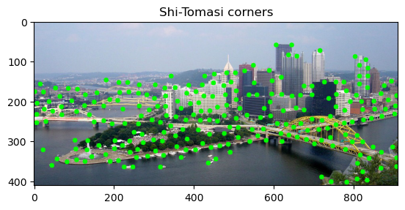
What is an image feature?
Corners
Harris Corners

Slide 12
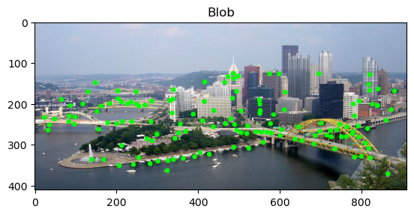
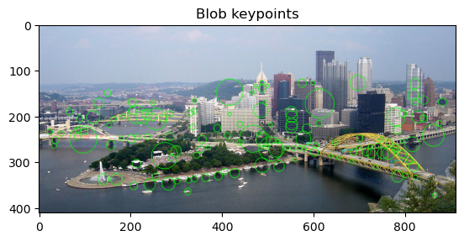
What is an image feature?
Blobs

Slide 13
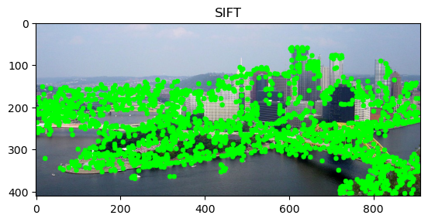
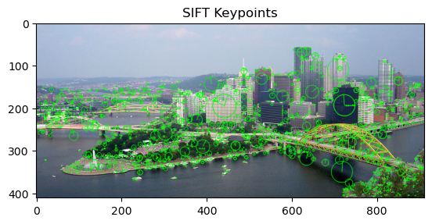
What is an image feature?
SIFT

Slide 14
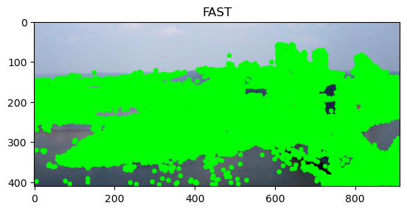
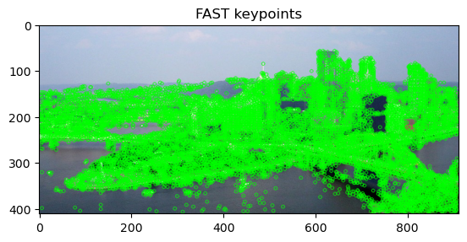
What is an image feature?
FAST

Slide 15
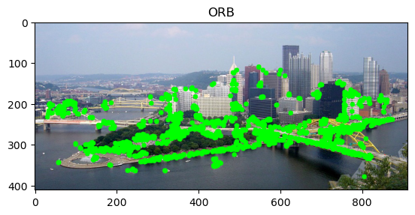
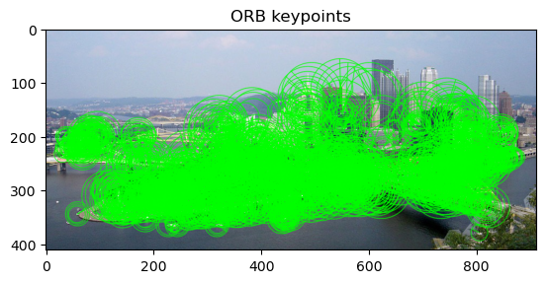
What is an image feature?
ORB

Slide 16
What is an image feature?
Edges
https://learnopencv.com/blob-detection-using-opencv-python-c/

