Slide 1





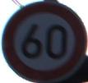














RGB Image
Relative-0.05
Relative-0.20
Absolute-0.01
Absolute-0.04

