Slide 1
Database conversion TOUGHREACT TO MIN3P
Danyang Su
2012-11-27

Slide 2
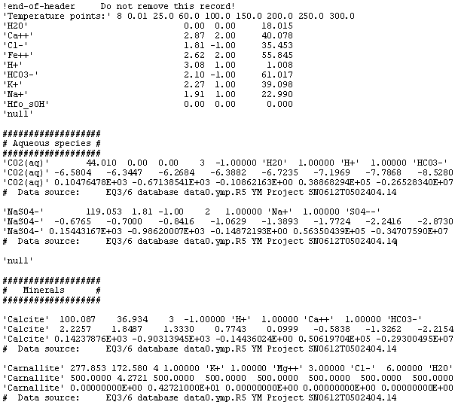
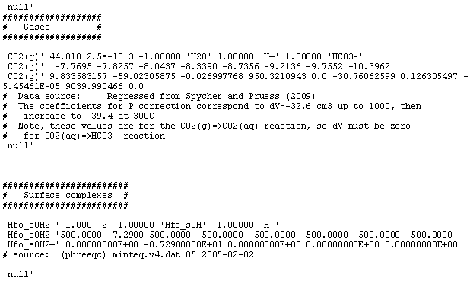
Database of TOUGHREACT

Slide 3
Basic species/ components
Records in TOUGHREACT
Name, Ion radius, charge, mol weight
'Ba+2' 5.50 2.00 137.340
Records in MIN3P, comp.dbs
ba+2 2.0 5.00 .00 137.34000 0.0
Debye-Huckel constants (a, b) and Alkalinity factor
Ion radius is used to compute Debye-Huckel a0 parameter P217 in TOUGHREAC_V2_Users_Guide
The alkalinity factor is used to determine the alkalinity value of the water. It is defined as the proton uptake capacity of the species when titrated to the carbonate alkalinity end point. By definition, the alkalinity factor of CO3 2- equals two (2).

Slide 4
Secondary Species/Complexation Reactions
Records in TOUGHREACT
'FeCl+' 91.299 4.1 1.00 2 1.0000 'Cl-' 1.0000 'Fe+2'
'FeCl+' 0.1349 0.1600 0.0599 -0.1612 -0.5429 -1.0223 -1.6141 -2.3848
'FeCl+' 0E+0 -1.50966195E-1 0E+0 9.27145711E+1 0E+0
Records in MIN3P, complex.dbs
fecl+ .0000 .1400 1.00 5.00 .00 91.3000 .00
2 fe+2 1.000 cl-1 1.000
Enthalpy change, Debye-Huckel constants and Alkalinity factor

Slide 5
Gas Exchange Reaction
Records in TOUGHREACT
'CO2' 44.010 3.4 0.00 3 1.0000 'HCO3-' 1.0000 'H+' -1.0000 'H2O'
'CO2' -6.5721 -6.3543 -6.2796 -6.3935 -6.7235 -7.1998 -7.8073 -8.5960
'CO2' 0E+0 -4.74956912E+0 0E+0 -4.7845942E+2 0E+0
Records in MIN3P, gases.dbs
co2(g) -.5300 18.1600 41.0100
3 co3-2 1.000 h+1 2.000 h2o -1.000
Second line for TOUGHREACT: equilibrium constants (log(K) in base 10) for the reaction at various temperatures (0.0 25.0 60.0 100.0 150.0 200.0 250.0 300.0).
Lack enthalpy change in TOUGHREACT
Values of equilibrium constant do not match (logK₂₅)

Slide 6
Ion Exchange and Sorption Reactions
Records in TOUGHREACT (Not found)
Records in MIN3P, sorption.dbs
'ca-x(na)gp' 0.0000 0.3979 1.00 40.08000
2 'ca+2' 0.500 'na+1' -1.000

Slide 7
Equilibrium Redox Reactions
Records in TOUGHREACT
'Fe+3' 55.85 8.1 3.00 4 0.2500 'O2(aq)' 1.0000 'Fe+2' 1.0000 'H+' -0.5000 'H2O'
'Fe+3' -10.0610 -8.4899 -6.6525 -4.9404 -3.2070 -1.7819 -0.5617 0.5249
'Fe+3' 0E+0 8.83350491E+0 0E+0 -5.164959E+3 0E+0
Records in MIN3P, redox.dbs
'fe+3'
4 'fe+2' 1.000 'o2(aq)' 0.250 'h+1' 1.000 'h2o' -0.500
'equilibrium' -8.4725 23.4570
Lack enthalpy change in TOUGHREACT

Slide 8
Kinetically-controlled reactions
Records in TOUGHREACT (Not found)
Records in MIN3P, redox.dbs
'ch2o-no3-ct'
6 'ch2o' -2.500 'no3-1' -2.000 'co3-2' 2.500 'n2(aq)' 1.000 'h+1' 3.000 'h2o' 1.000
'irreversible'
'hyperbolic T^a' 4
'no3-1' 2.51d-5 1.0d0
'ch2o' 1.0d-5 1.0d0
'no3-1' 1.d-10 2.0d0
'ch2o' 1.d-10 2.0d0
'inhibition T^a' 1
'o2(aq)' 5.0d-8 1.0d0

Slide 9
Mineral Reactions
Records in TOUGHREACT
'UO3(gamma)' 286.027 39.24 3 -2.0000 'H+' 1.0000 'UO2+2' 1.0000 'H2O'
'UO3(gamma)' 9.0219 7.7120 6.2280 4.8825 3.5501 2.4688 1.5401 0.6894
'UO3(gamma)' 0E+0 -6.50116043E+0 0E+0 4.23765659E+3 0E+0
Records in MIN3P, mineral.dbs
'uo3(c)'
'surface'
286.0272 8.0435
3 'h+1' -2.000 'uo2+2' 1.000 'h2o' 1.000
'reversible' -7.7190 19.3150
Lack enthalpy change in TOUGHREACT
The density can be calculated from molecular weight (286.027) divided by molar volume (39.24)
Values of equilibrium constant do not match (logK₂₅)

