Slide 1
Vessel Schedule Tracking Application
G1T4
Yash
Haziq
Daniel

Slide 2
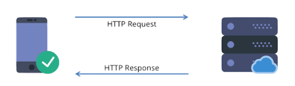
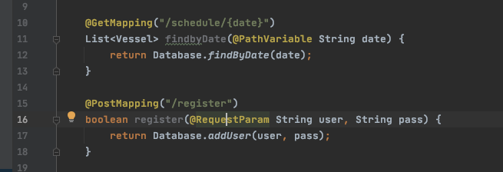
Client-Server Architecture - HTTP(S)
Setup various endpoints in API.java
(+) Client does not share any resources, but it simply requests content/service. authenticated via body of messages
(+) Abstraction of resources, separation of concerns

Slide 3
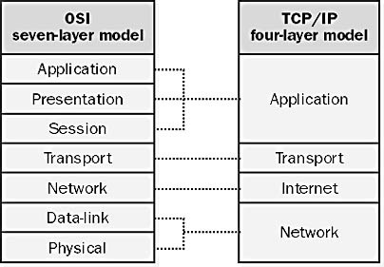
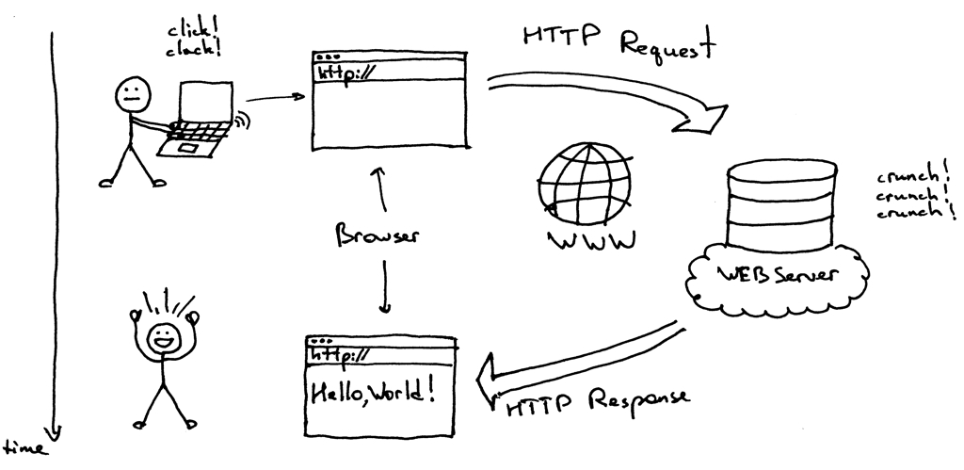
How client communicates with server - TCP/IP
TCP/IP is basically a set of rules for 2 computers to communicate with one another
How our app communicates with server
Frontend makes a GET/POST request to endpoint, request response cycle occurs
Each endpoint specifies CRUD actions
API sets routes

Slide 4
OpenSourceLibraries / Tech Stack used
Frontend ------------- Vanilla HTML/CSS/JS
Backend -------------- Spring Boot (Maven / GSON)
DB -------------- MySQL
Hosting -------------- Docker (nginx)

Slide 5
Design and Laying of app
Design Principles implemented:
Balance and Alignment
Repetition
Proportion
Other principles:
Single responsibility principle
Notes:
Standardized design and proportion implemented across the pages to allow for improved readability and is reinforced with repetitive design to reduce learning curve for first time users. Focuses on minimalist design.

Slide 6
Demo
Our app is live, and dockerized for convenience in deploying :)
We need to deploy frontend, backend, db separately, but with docker we can do everything in 1 command as it is containerized
Let’s check it out -
Notes:
https://portnet.smu.blue/

