Slide 1
Parallel Algorithms Analysis
Daniel Tebor
Merrick McPherson

Slide 2
Topic Overview
In this project, we investigate the potential performance enhancements gained through parallelizing search algorithms by dividing the search process in comparison to enhancing a search algorithm with addition of heuristics.

Slide 3
Motivation
Previous Work and Interest: Prior study and a shared interest in parallel programming and pathfinding have guided our choice of this topic
Goal: Our aim is to assess the performance enhancement achieved by parallelizing the search solution to solving the 8-puzzle problem. Specifically, we aim to:
Compare the results of different algorithms, including A*, BFS, and multithreaded BFS.
Gain a deeper understanding of the potential benefits of parallelization.

Slide 4

Previous Work and Literary Review
Daniel's Experience: In a prior AI class, Daniel contributed by developing a code base for algorithm analysis, which has formed the basis for this project.
Merrick's Experience: Merrick has a background in parallel programming, gained from a different class, providing valuable knowledge to this project.
To further inform the project, the team has referenced:
"Distributed Computing: Principles and Applications" by M. L. Liu: This textbook has served as a foundational resource, offering insights and principles in distributed and parallel computing that guide the project.

Slide 5
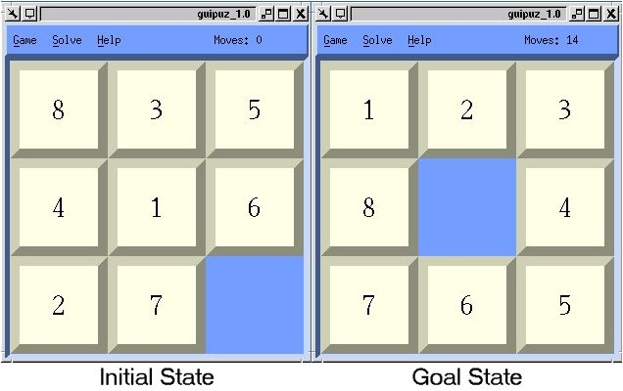
Search Problem
The 8 Puzzle Problem:
The 8-puzzle problem is a classic puzzle that involves a 3x3 grid with eight numbered tiles and one empty tile.
The objective is to rearrange the tiles by sliding them into the empty space to reach a goal state where the numbers are in the correct order.

Slide 6
Solution Approaches
To tackle the 8-puzzle problem, we will employ three primary solution approaches:
Breadth-First Search (BFS): A systematic and reliable search algorithm that explores all possible paths for obtaining the shortest solution.
Multithreaded BFS: A parallelized version of BFS, which leverages the capabilities of multiple CPU cores for faster computation.
A* (A star) Algorithm: A popular and efficient pathfinding algorithm that uses heuristics to guide its search.

Slide 7
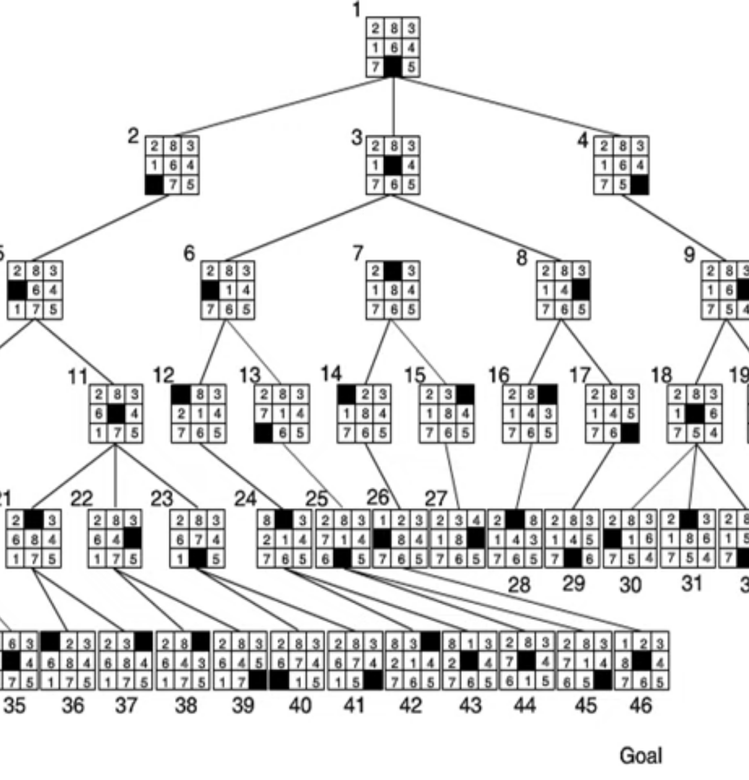
BFS Solution
BFS finds the shortest sequence of moves from the initial state to the goal state.
Initialization:
Start with the initial puzzle state and a queue to store nodes to be explored.
Exploration:
While the queue is not empty:
Dequeue a node and store it in a list of visited nodes.
Check if it's the goal state; if yes, you've found the solution.
Generate child nodes by making valid moves from the current state.
Reject any child nodes that have identical states to a previously visited node
Enqueue child nodes for future exploration.
BFS guarantees an optimal solution, as it explores all possible moves level by level.

Slide 8
BFS Analysis
Time Complexity: O(b^d)
Space Complexity: O(b^d)
O(b^d) know as order of b raise to power d.
"b" is the branching factor, which represents the number of possible moves (states) from any given state. (in this case 0-4, avg. 2.67)
"d" is the depth of the shallowest goal state.
Exploring All Possibilities:
BFS explores all possible solutions on each level.
It exhaustively searches one level before moving to the next.
Optimal Path:
BFS guarantees finding the shortest path to the goal state.
It finds the optimal solution by systematically exploring all possible states.

Slide 9
Multi-Threaded BFS
Step 1: Initial Search:
Start a single-threaded BFS search.
Explore nodes in a breadth-first manner.
If goal is found, terminate search.
If the number of nodes in the queue >= the number of CPU threads, break and proceed.
Step 2: Parallel Distribution:
Distribute nodes into multiple queues for parallel processing. The number of queues equals the number of CPU threads.
Create multiple threads for asynchronous processing. Each thread handles a distinct queue.
Each thread operates independently on its assigned queue.
Step 3: Parallel Exploration:
Threads visit and extend nodes asynchronously
Nodes are added to the list of nodes visited concurrently
Mutex locks access to shared data (list of nodes visited).
If goal found in any thread, terminate search.

Slide 10
Multi-Threaded BFS analysis
Time Complexity: O(b^d)
Space Complexity: O(b^d)
Parallel Processing:
Multi-threaded Breadth-First Search (BFS) optimizes the search process.
Leverages the power of parallel computing to speed up the search.
Locking the nodes visited list creates a contention bottleneck, limiting speed benefits.

Slide 11
A* Implementation
Implementation Steps
Initialization:
Start with the initial puzzle state and a priority queue to store nodes to be explored. The heuristic of the initial node is the largest possible integer value.
Nodes are ordered by the sum of depth and heuristic value with lower having a higher priority.
Exploration:
While the priority queue is not empty:
Dequeue a node and store it in a list of visited nodes.
Check if it's the goal state; if yes, you've found the solution.
Generate child nodes by making valid moves from the current state. Heuristic values are calculated for each node.
Reject any child nodes that have identical states to a previously visited node.
Enqueue child nodes for future exploration.
A* search uses the cost of a node and an estimation function called a "heuristic" to decide the next move. These two values are added together, thus choosing the next node most likely to be closer to the goal and have a minimal distance to the start.
Heuristics Implemented
Manhattan Distance Heuristic:
The Manhattan distance heuristic calculates the sum of the distances (in terms of moves) between each tile in the current puzzle state and its corresponding goal position by adding the x difference and the y difference of the tile.
Nilsson Sequence Score Heuristic:
This heuristic considers not only the individual tile distances but also the sequences of tiles around the blank space in both the current state and goal state. It assigns scores based on the arrangements of tiles.

Slide 12
A* Analysis
Time Complexity: O(b^d)
Space Complexity: O(b^d)
"b" represents the branching factor, i.e., the number of possible moves at each state.
"d" is the depth of the shallowest goal node, indicating the optimal path length.
Why the same complexity?
The difference in behavior arises when A* uses a heuristic that overestimates the true cost (non-admissible heuristic), in which case it can potentially explore more nodes than BFS.
However, given a heuristic that converges, it is unlikely for A* to exhibit a quantity of nodes explored like BFS.

Slide 13
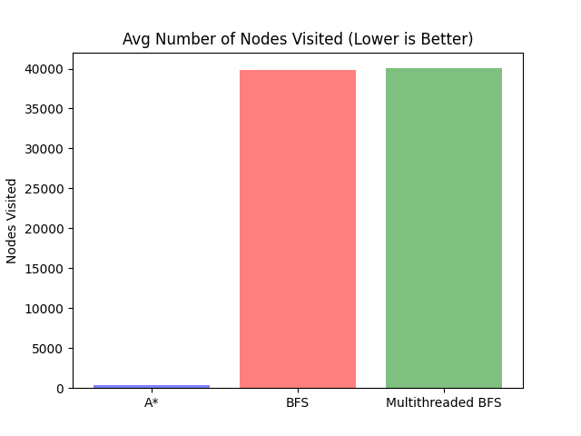
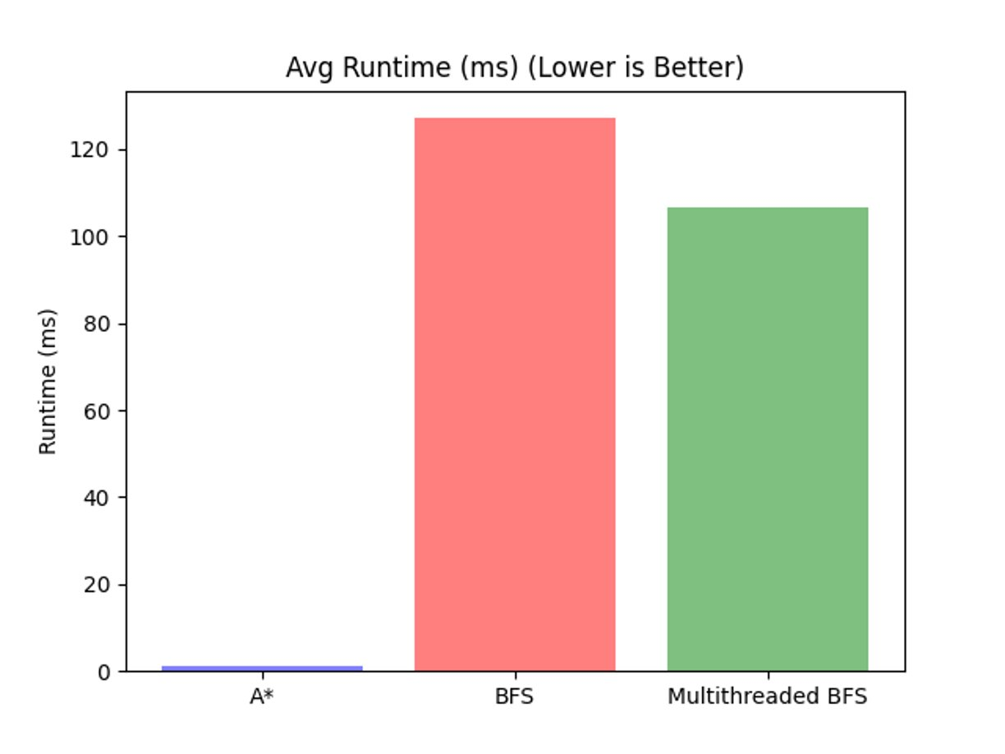
Runtime Analysis
Multi-threaded BFS Efficiency:
Multi-threaded BFS reduces runtime.
It evenly distributes the workload across multiple processors.
Achieves the same number of nodes visited as BFS, maintaining accuracy.
A* outperforms BFS and Multithreaded BFS in Runtime and Nodes visited.

Slide 14
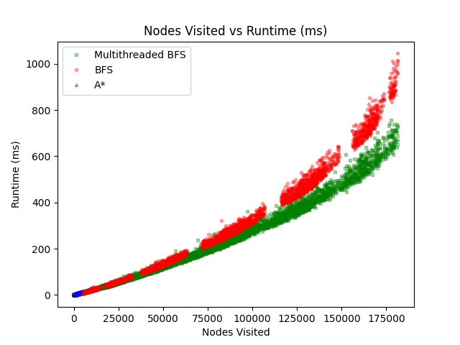
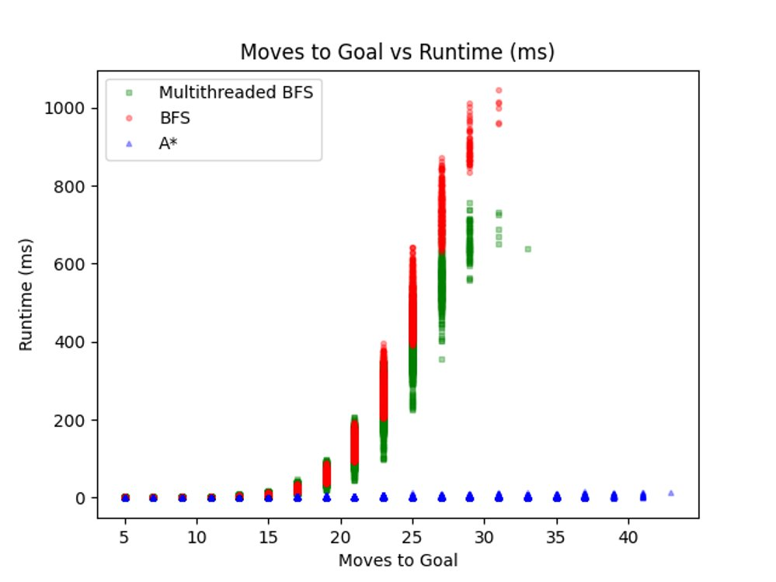
Runtime Analysis Cont.
BFS and Multithreaded BFS visit the same number of nodes while A*'s use of a heuristics requires far less nodes to be visited.
A* outperforms these other algorithms through its significantly faster runtime as the heuristic allows A* to skip the majority of nodes.
We can see that as the depth increases (moves to goal), the runtime increases exponentially for BFS but not A* since A* skips most nodes at each depth. This demonstrates the O(b^d) time complexity of BFS.

Slide 15
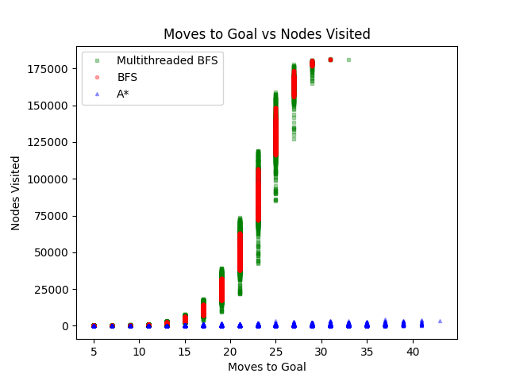
Space Analysis
The X-axis can be thought of as the depth of the tree required to reach the goal state. Y-axis is the number of states explored during the search.
The graph visually demonstrate the space complexity of O(b^d), with A* showcasing a more efficient search process compared to BFS and multi-thread BFS, especially for deeper levels (higher "moves to the goal").
While A* has an identical space complexity to BFS, in practice it uses less space since the heuristic converges on the goal.

Slide 16
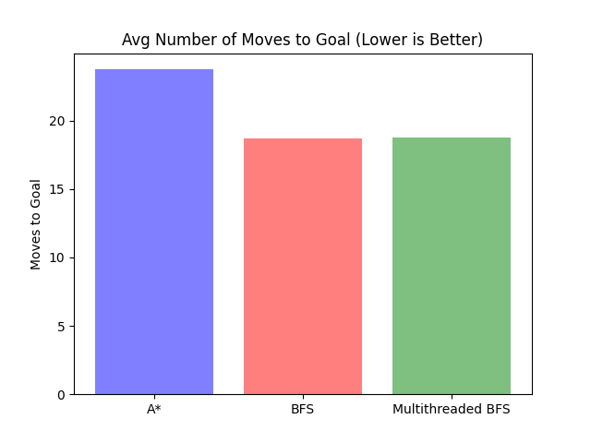
Moves to Goal Performance
Why BFS and Multi-Threaded BFS Finds Fewer Moves
BFS explores all nodes at a given depth level before moving to the next level.
It guarantees finding the optimal solution in terms of moves to goal.
Why A* Makes More Moves?
A* makes the move that is likely to lead towards a goal state.
This means that goals at a particular depth may be skipped, especially when there are many nodes at that depth.

Slide 17
Conclusion
A* for Speed: A* excels when your priority is finding a quick solution to the 8-puzzle problem.
BFS for Optimal Moves: If minimizing the number of moves is your goal, BFS is superior to A*.
Multi-Threaded BFS: For both optimal moves and beating BFS in runtime, multi-threaded BFS is the optimal choice. The runtime benefits seen compared to BFS could potentially be improved upon to a substantial degree.
One option is to use a data structure for the nodes visited that does not need to be locked.
Another option is to have separate nodes visited lists for each thread, but this could cause overlap and increase memory usage.
A third option is to use the path back to the goal to find duplicate states as this circumnavigates the nodes visited list. However, this introduces an O(d) time complexity for each node visited compared to the O(1) average time complexity.

