Slide 1
Effect of Blinking on AI Trained Iris Recognition
By Daniel Tebor

Slide 2
Goals
Training a convolutional neural network such as Resnet50 or Alexnet has been shown to have promising results for subject recognition using the subject’s iris
The focus of this research is to determine what effects blinking has on iris recognition, and if the results can be improved.

Slide 3
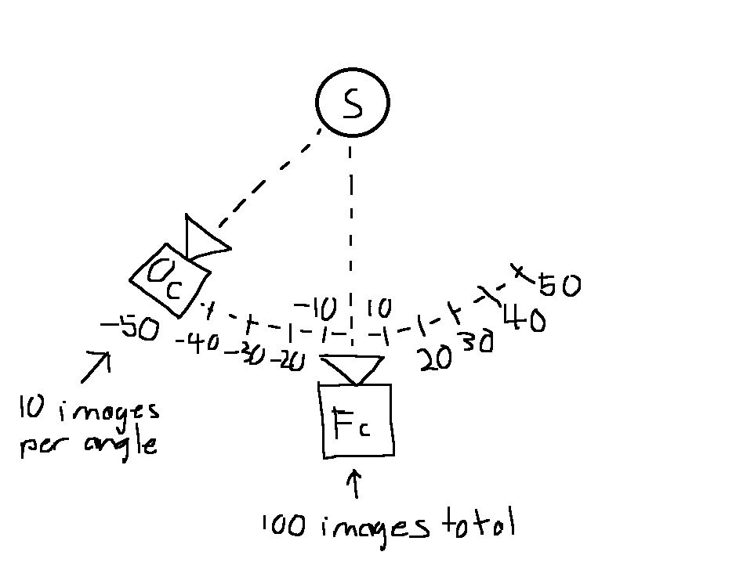
Dataset Creation
101 Valid Subjects
10 Images captured for each angle using orbital camera
Angles ranged from -50 to 50 with a step size of 10
100 Images captured at angle 0 using frontal camera
Images were taken in sync with orbital camera
Images were skipped when orbital camera at angle 0, as orbital camera obscured frontal camera

Slide 4
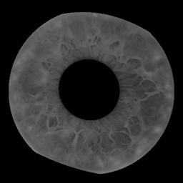
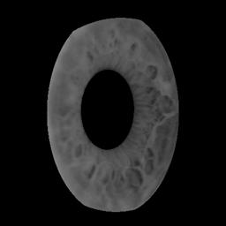
Example Image
The shown images were taken by the orbital camera and frontal camera at the same time
The subject shown is subject 1
The angle of the orbital camera was 50
Frontal Camera
Orbital Camera

Slide 5
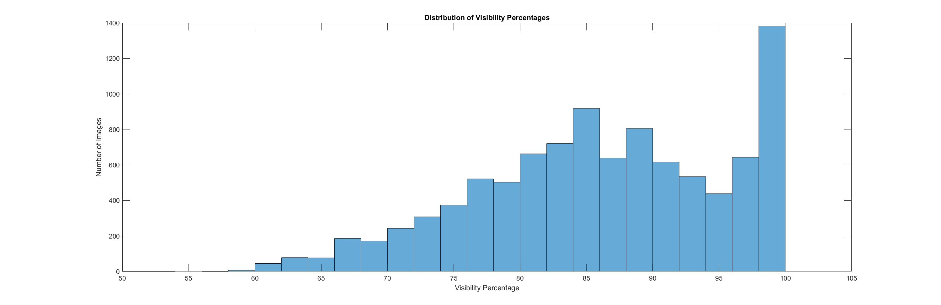
Synthetic Blinking
To test the effects of blinking, the dataset needed to have new images generated with synthetic blinking
Original dataset mostly composed of eyes > 80% open

Slide 6
Synthetic Blinking
To simulate blinking, images were artificially masked using a traditional algorithm
The openness of each eye image was calculated and used to sort into a respective directory ranging from 0% occlusion to 90% occlusion, with a step size of 10%
The 0% occlusion directory contains images ranging from 0-2% occlusion, or else
Once sorted, images were then occluded with a step size of 10 and sorted into their corresponding directory for each occlusion level

Slide 7
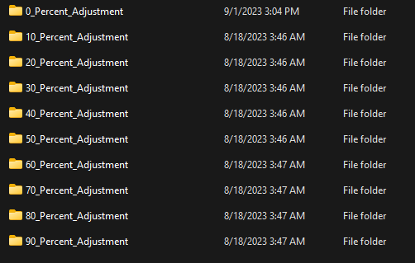
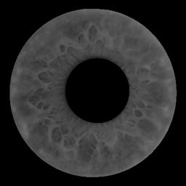
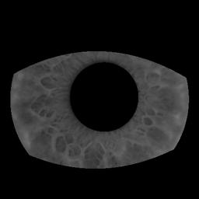
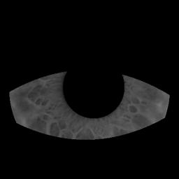
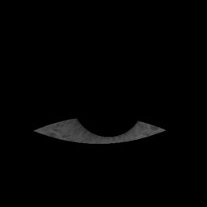
Dataset Layout and Example Images
Images correspond with 0%, 30%, 60%, and 90% occlusion respectively

Slide 8
Deep Learning Model
The model chosen for all experiments is Resnet50 as it has been shown to be effective in previous iris recognition experiments
Alexnet was also considered, but proved to be around 10% worse than Resnet50
Resnet101 was also briefly tested, but showed to have extremely diminishing returns on performance, and was not worth the extra training time and VRAM

Slide 9
Model Setup
The library used was PyTorch, using the IMAGENET1K_V2 pretrained weights as a starting point for training
The output layer of Resnet50 was replaced to match the amount of iris subjects (101)
The criterion chosen was cross entropy loss and the optimizer chosen was stochastic gradient descent (SGD)
Learning rate: 0.001
Momentum: 0.9
Weight decay: 0.00002
Other optimizers such as Adam were tested, and while they trained faster, the resulting performance was worse

Slide 10
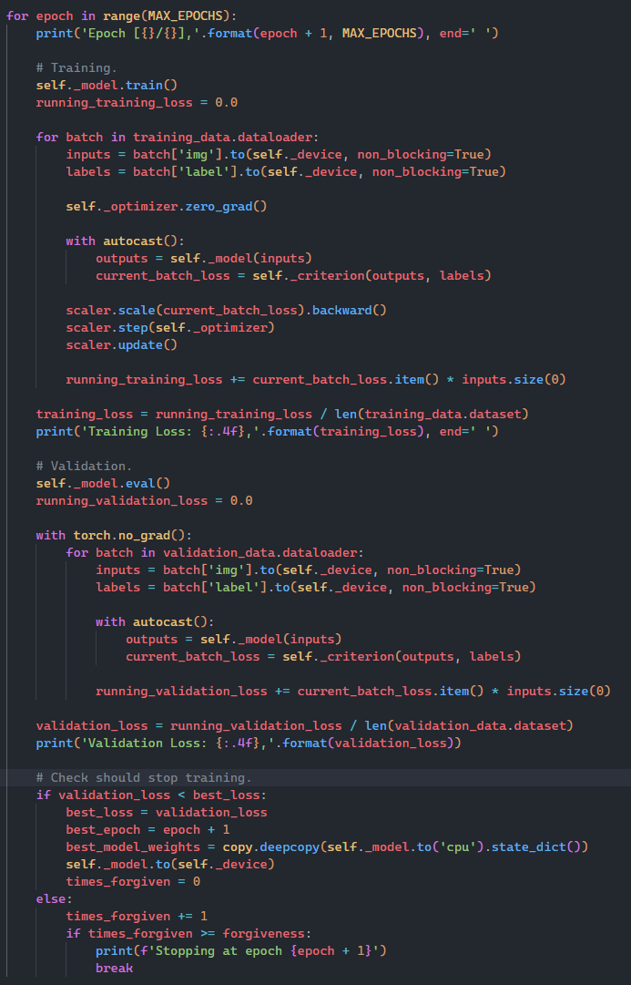
Training Algorithm
An algorithm was set up to automatically stop training
For each epoch, the model was fed with the training dataset, and weights were adjusted
Next, the validation dataset was fed into the model and the loss was calculated
Once the validation loss had not improved for 6 epochs in a row, the training was stopped and the weights from the best epoch were saved as the final weights.

Slide 11
Dataset Augmentation
The testing and validation dataset consisted of only left eye images
For all models trained, images were normalized to the ImageNet standard of:
Mean = [0.485, 0.456, 0.406]
Std = [0.229, 0.224, 0.225]
Images were also randomly translated by 10% and randomly rotated by 20% with bicubic interpolation

Slide 12
Training and Validation Datasets
The training dataset consisted of only images from the frontal camera for each subject.
The validation dataset consisted of the angle 0 images taken from the orbital camera for each subject.
The frontal camera is obscured by the orbital camera when the orbital camera is at angle 0, which allows for a somewhat real-world result
This is because the model was never trained on any angle 0 images, meaning the eye dilation and other effects are likely to be different

Slide 13
Experiment Design
4 Experiments were designed to test the effects of blinking on iris detection with each experiment following the previously outlined dataset and model parameters:
1st Experiment trains a baseline model on original dataset with no synthetic occlusion, meaning the occlusion amount for each subject follows the distribution shown previously. Validation will show how blinking affects a model that has not been exposed to blinked images during training
2nd-4th Experiments trains 3 new models. Each model is trained with the original dataset plus synthetically cropped images as a form of image augmentation. Validation will show how the model performance is affected when exposed to occluded images during training
The 1st model is trained with original + 0-30% synthetically occluded images
The 2nd model is trained with original + 0-60% synthetically occluded images
The 3rd model is trained with original + 0-90% synthetically occluded images

Slide 14
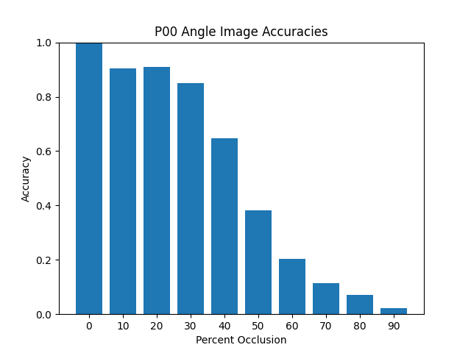
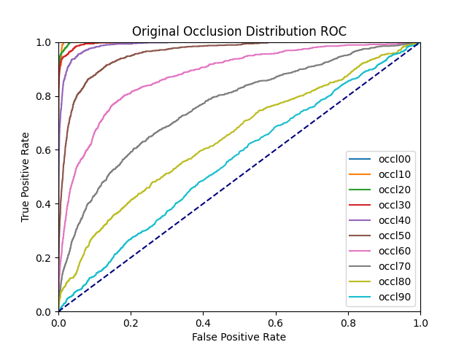
Experiment 1 Results

Slide 15
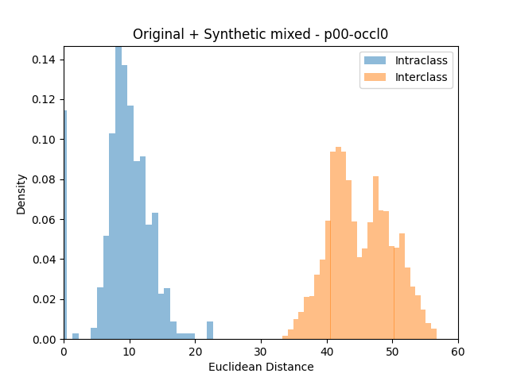
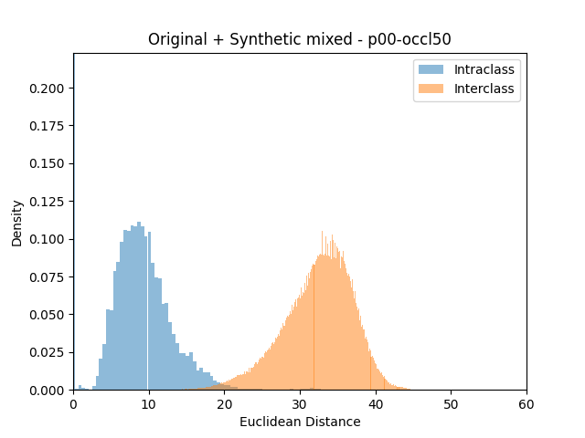
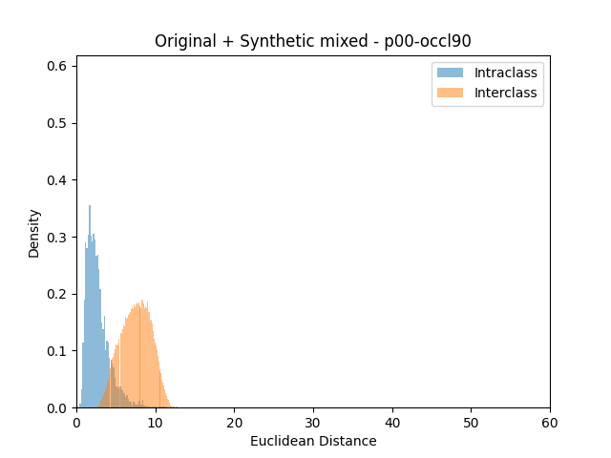
Experiment 1 Results Cont.

Slide 16
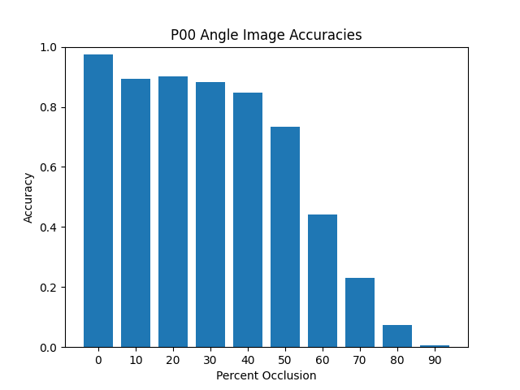
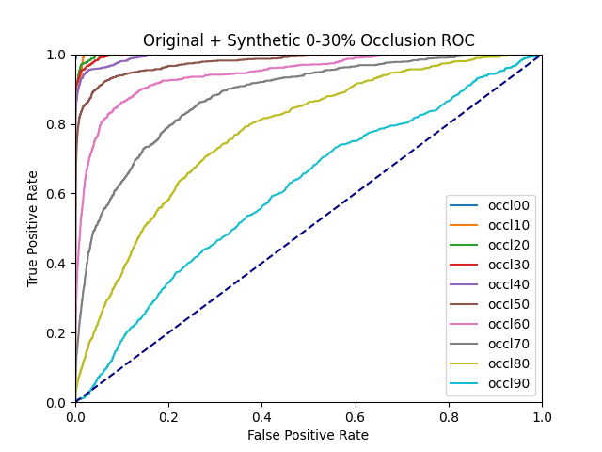
Experiment 2 Results

Slide 17
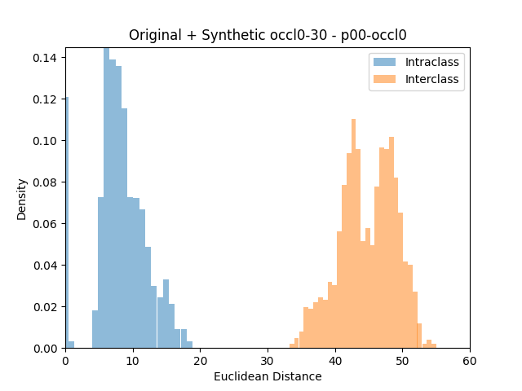
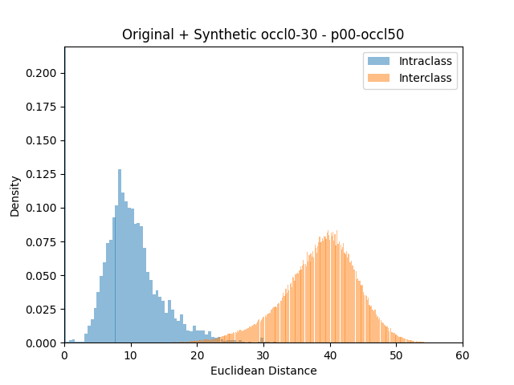
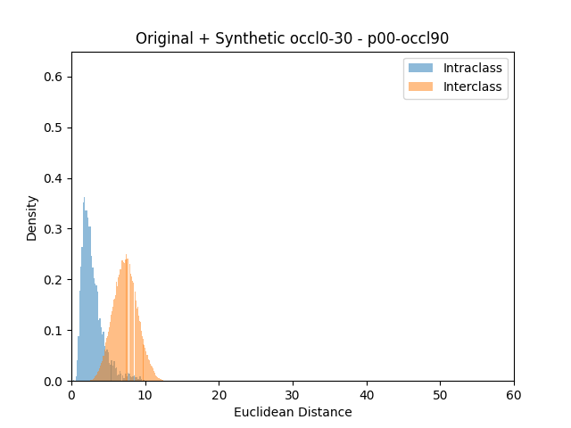
Experiment 2 Results Cont.

Slide 18
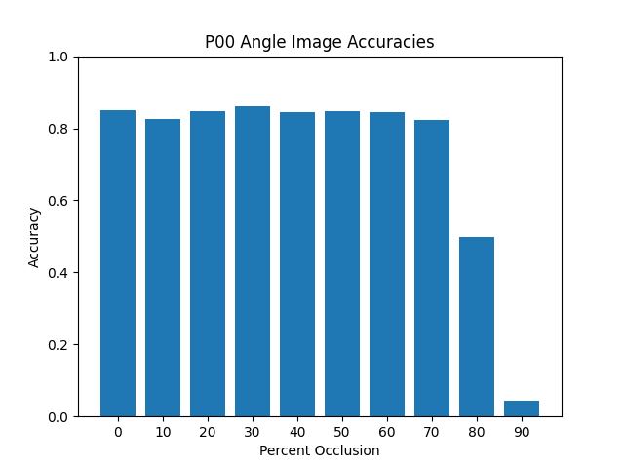
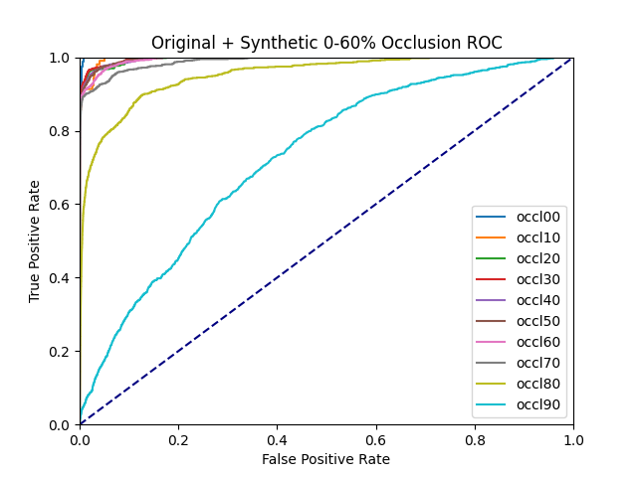
Experiment 3 Results

Slide 19
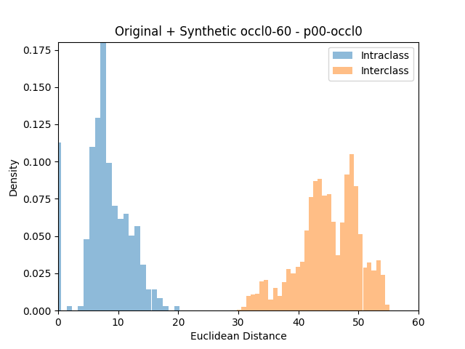
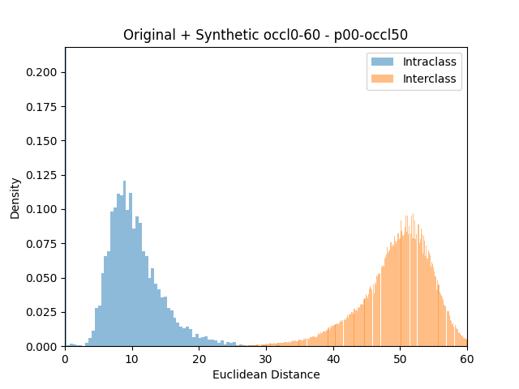
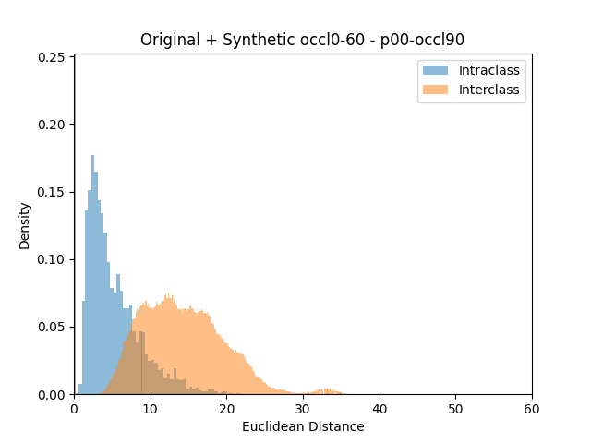
Experiment 3 Results Cont.

Slide 20
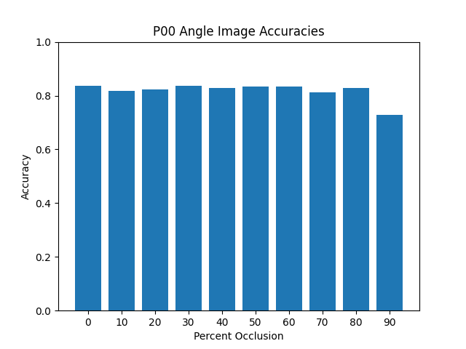
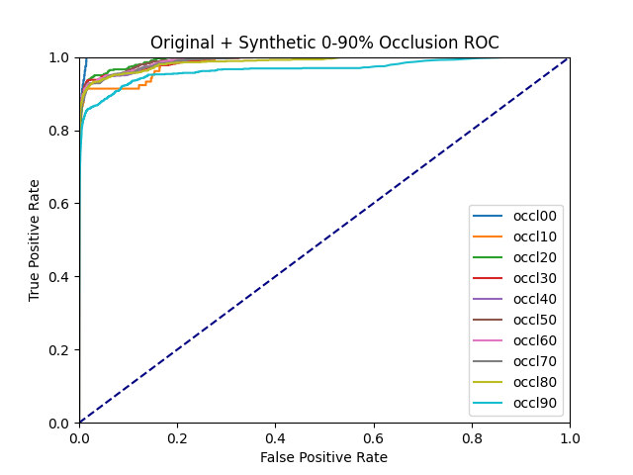
Experiment 4 Results

Slide 21
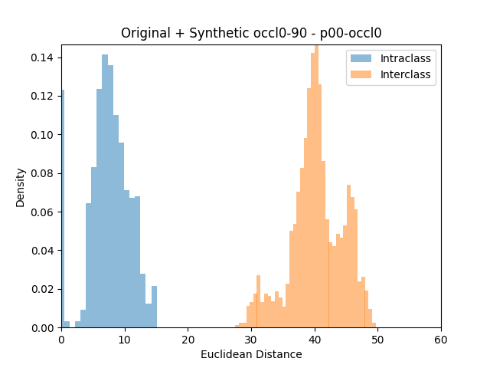
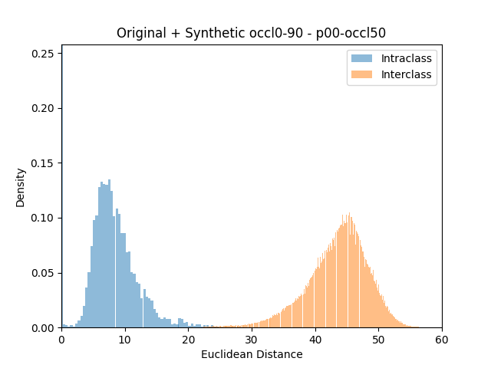
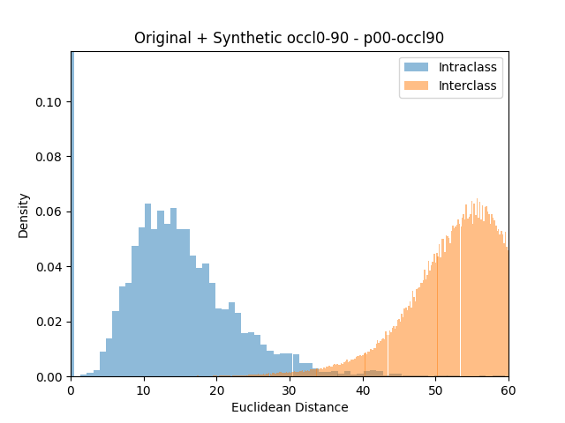
Experiment 4 Results Cont.

Slide 22
Conclusion
When a model is only trained on eyes that are mostly open, performance falls proportionally to the amount that the eye is occluded
When a model is trained on synthetically occluded images, the performance curve becomes flatter as the training occlusion increases
The drawback is that the performance of fully open eye image recognition drops

Slide 23
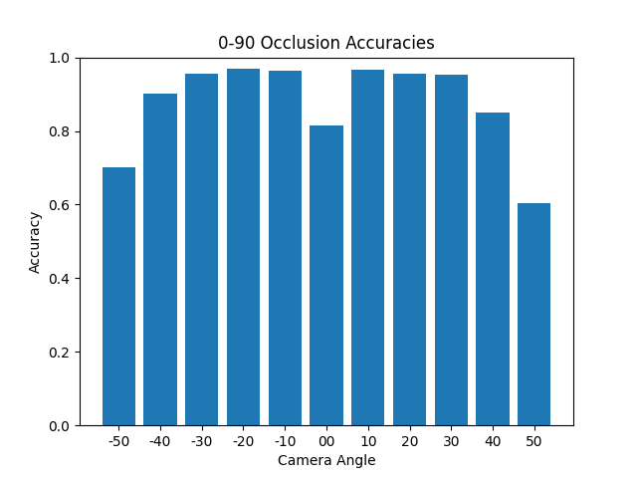
Additional Findings
During validation, the angle 0 orbital camera images were not the only images validated. Validation was split into each angle
It was found that the performance for angles -50 to 50, excluding angle 0 was better than the angle 0 images
This is despite the validation images being angled while the training images were always taken from the frontal camera
The running hypothesis is that training on different eye dilations can help model performance when validating on a range of angles
All occlusion levels validated at each angle

