Slide 1
Results for Triplet Loss Networks
By Daniel Tebor

Slide 2
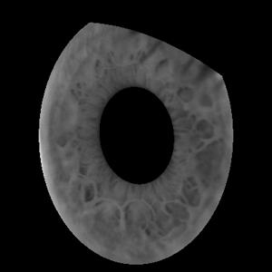
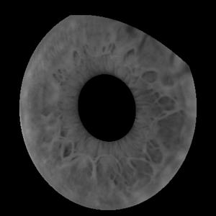
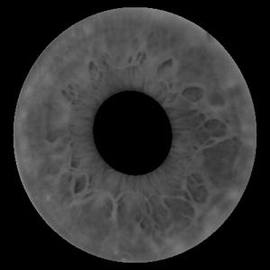
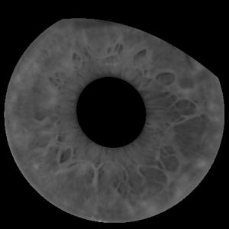
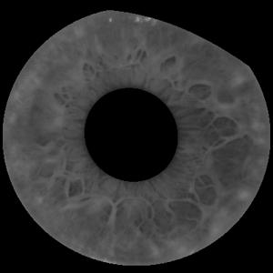
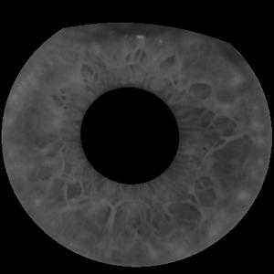
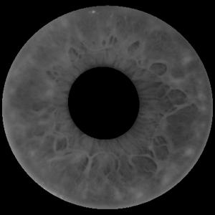
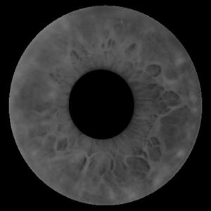
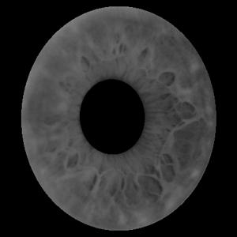
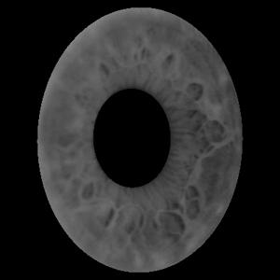
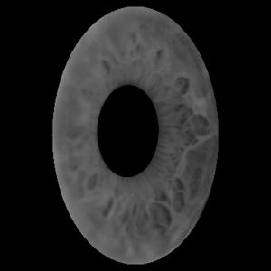
Dataset
80/20 train-test split using orbital camera image
Angles -50 thru 50, step size of 10 degrees
Anchor dataset has one image at each angle for each subject
Anchor image angle and positive image angle always within 10 degrees

Slide 3
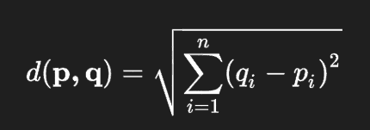
Euclidean Distance
p and q are feature vectors of different images
Euclidean distance is the sqrt of the sum of the squared differences between each value in the feature vectors

Slide 4
Accuracy Calculation
Extract feature vectors for anchor dataset and pair each vector with its label
For each sample in validation dataset:
Extract feature vector
Build list of distances by comparing the sample feature vector to each feature vector from the anchor dataset. Comparison is done using Euclidean distance
Select label for the comparison with smallest distance. This is the predicted label
Update accuracy based on whether predicted label matches the actual label of the sample

Slide 5
Accuracy ROC Calculation
Extract feature vectors for anchor dataset and pair each vector with its label
Create a list to store probabilities and predicted labels
For each sample in validation dataset:
Extract feature vector
Build list of distances by comparing the sample feature vector to each feature vector from the anchor dataset. Comparison is done using Euclidean distance
Normalize the distances to values between 0 and 1
Invert the distances to make a list of probabilities
Extend list of probabilities and add label to list of predicted labels
Binarize labels list
Calculate FPR and TPR

Slide 6
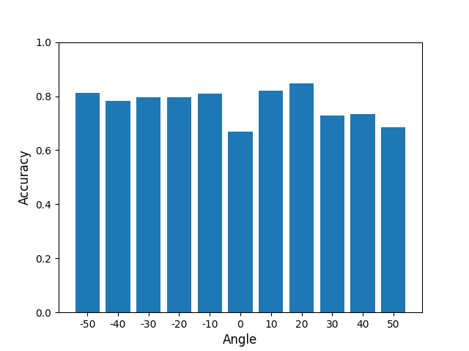
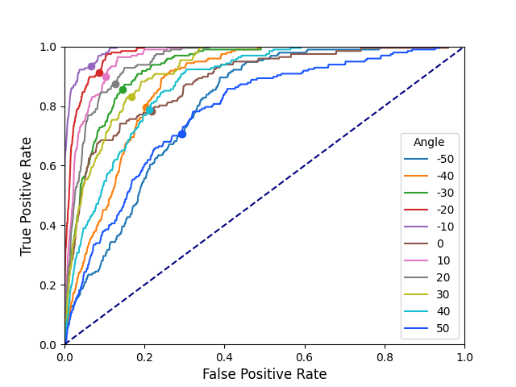
Left Eye Triplet Loss Network

Slide 7
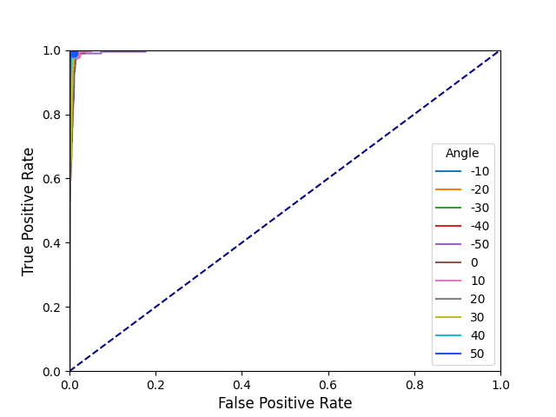
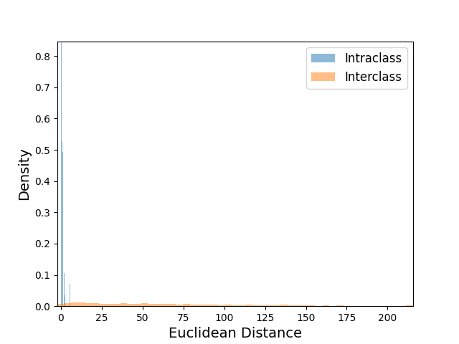
Left Eye Triplet Loss Network Cont.

Slide 8
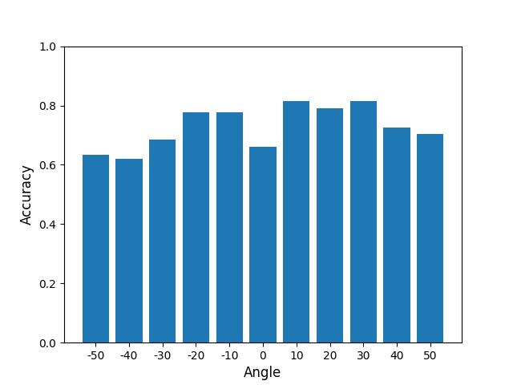
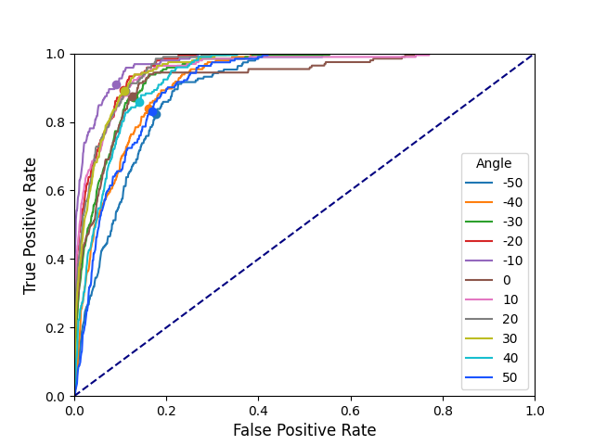
Right Eye Triplet Loss Network

Slide 9
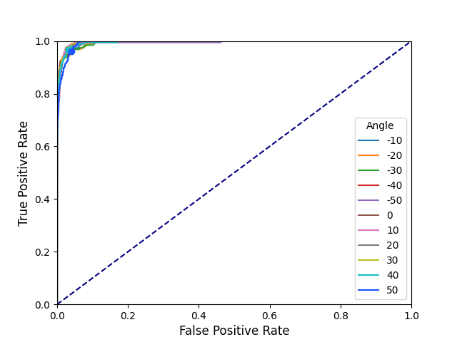
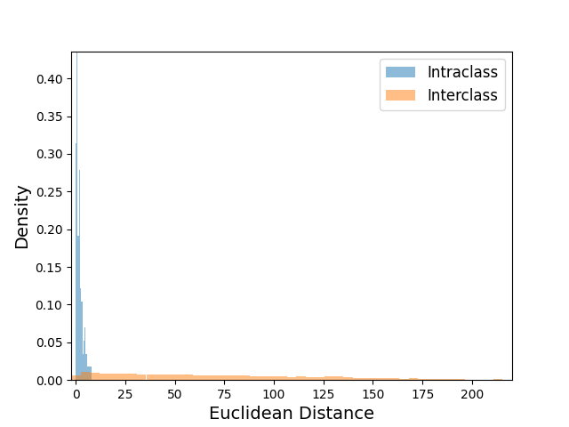
Right Eye Triplet Loss Network Cont.

Slide 10
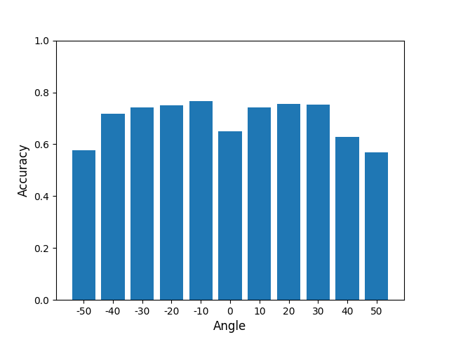
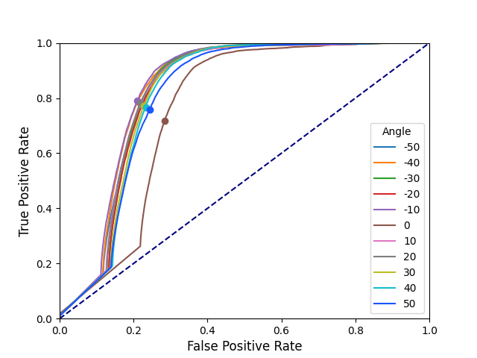
Left & Right Eye Triplet Loss Network

Slide 11
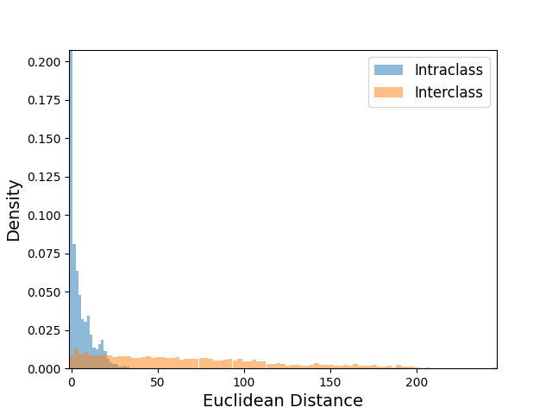
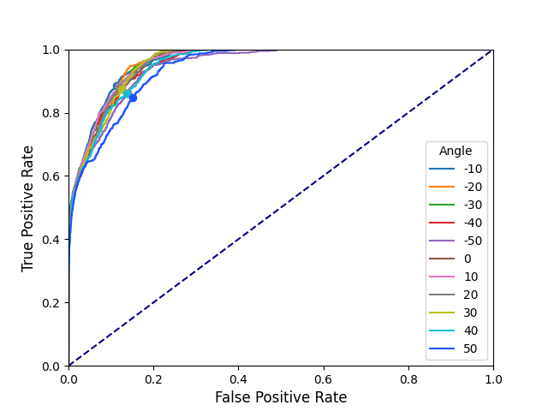
Left & Right Eye Triplet Loss Network Cont.

Slide 12
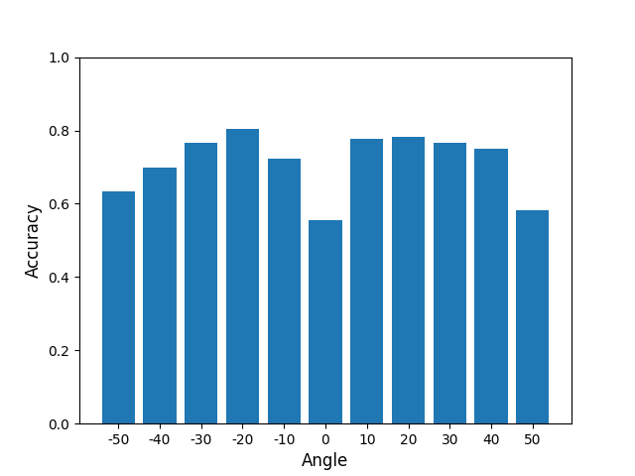
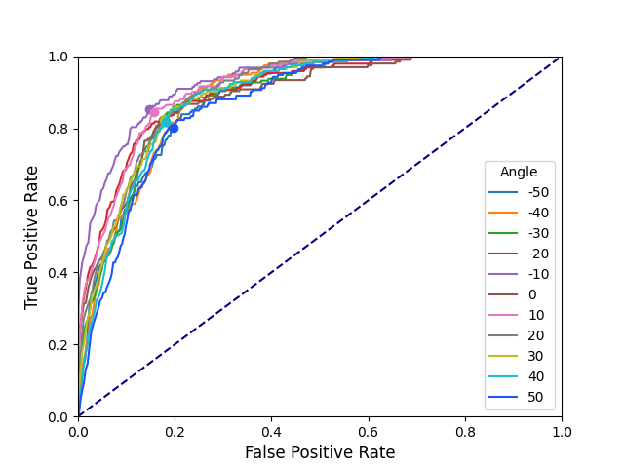
Wide Input Triplet Loss Network

Slide 13
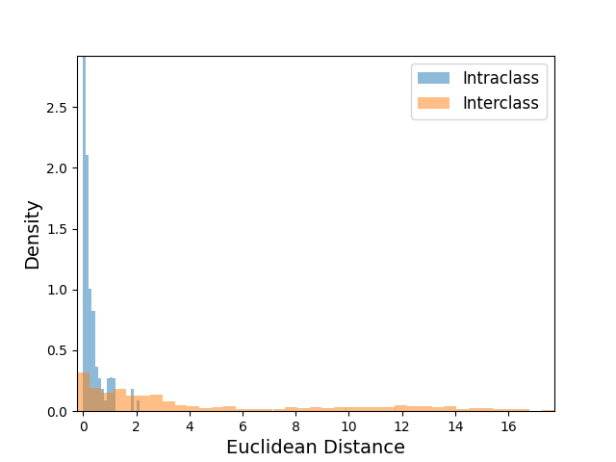
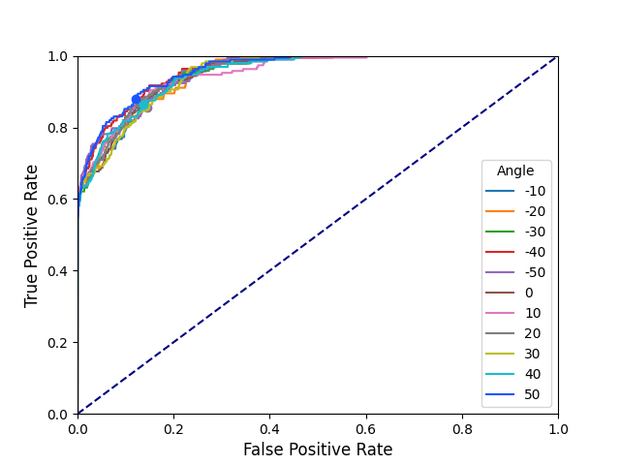
Wide Input Triplet Loss Network Cont.

Slide 14
Results for Open-World Triplet Loss Networks

Slide 15
Dataset
80 subjects used during training
19 subjects used for testing and validation
Angles -50 thru 50, step size of 10 degrees
Anchor dataset has one image at each angle for each subject
Anchor image angle and positive image angle always within 10 degrees

Slide 16
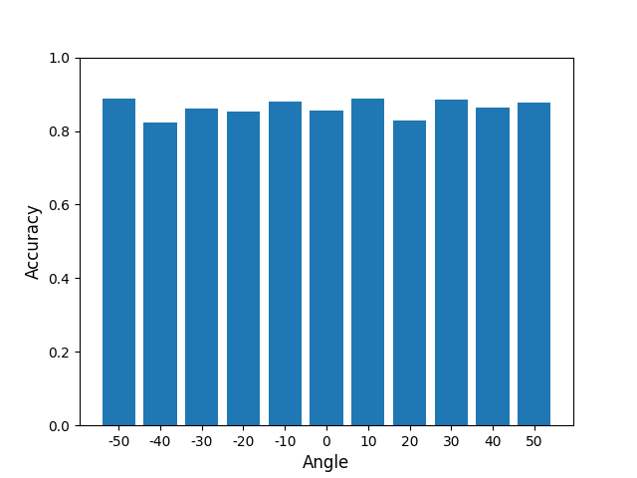
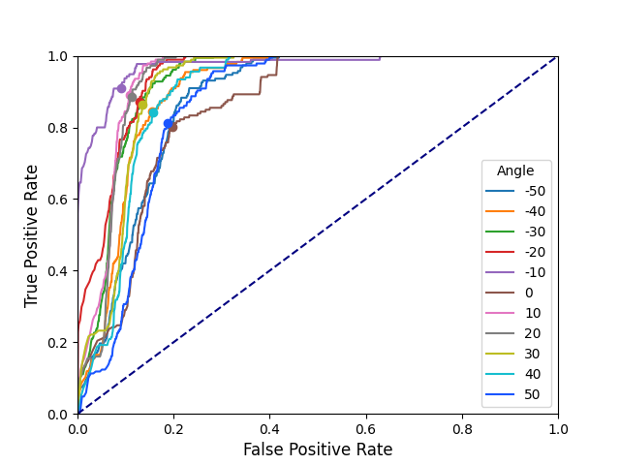
Left Eye Triplet Loss Network

Slide 17
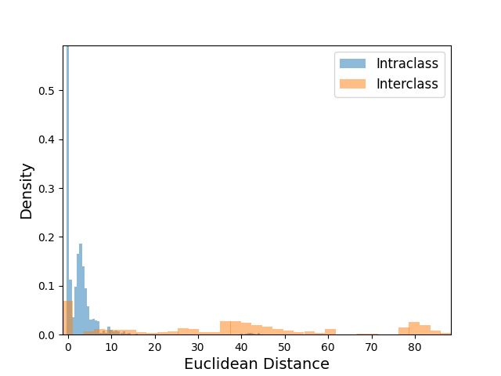
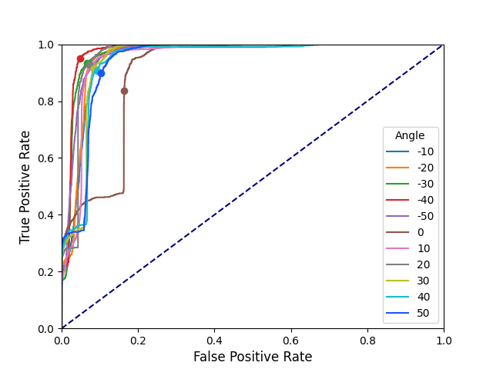
Left Eye Triplet Loss Network Cont.

Slide 18
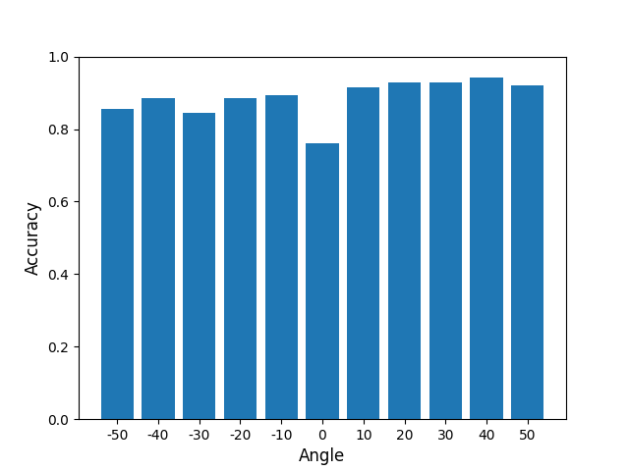
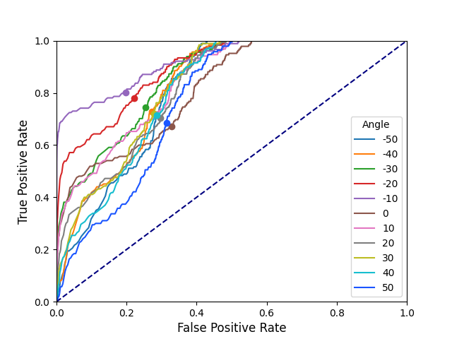
Right Eye Triplet Loss Network

Slide 19
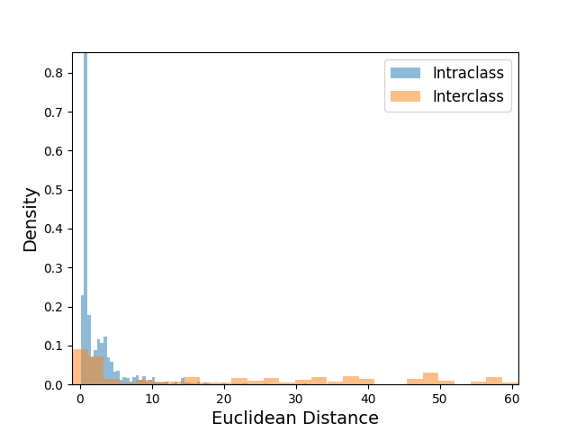
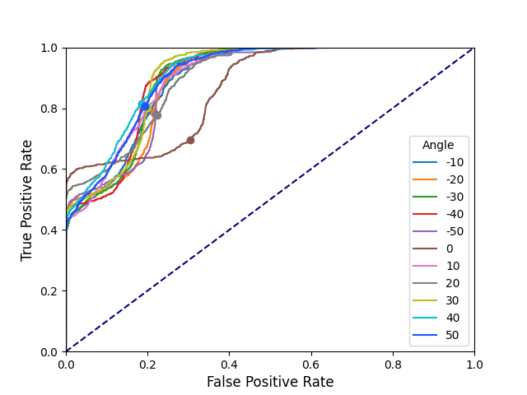
Right Eye Triplet Loss Network Cont.

Slide 20
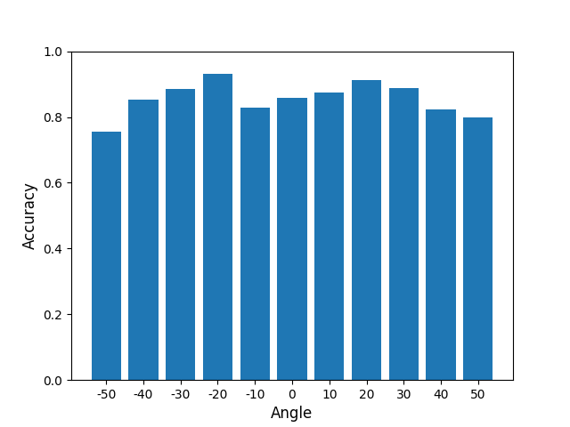
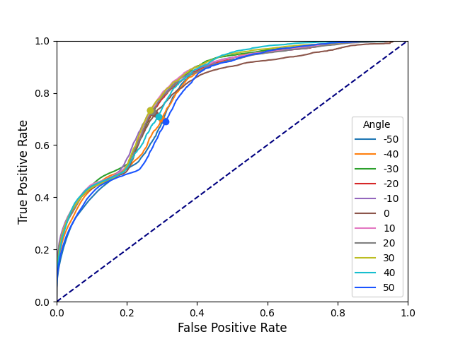
Left and Right Eye Triplet Loss Network

Slide 21
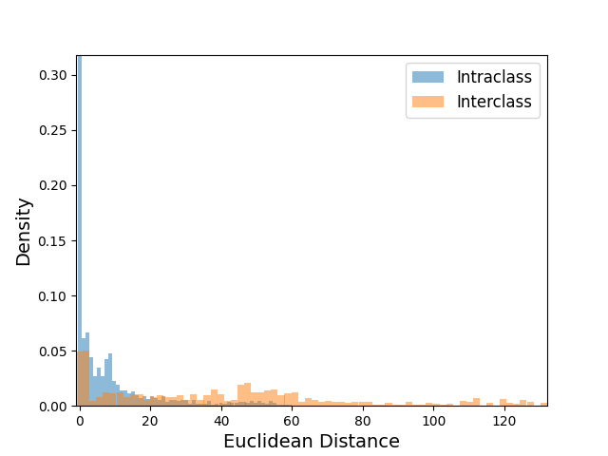
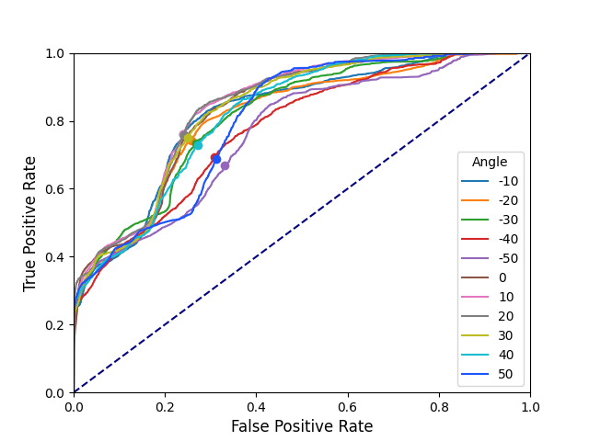
Left and Right Eye Triplet Loss Network Cont.

Slide 22
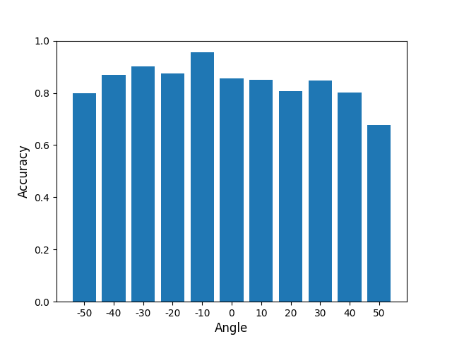
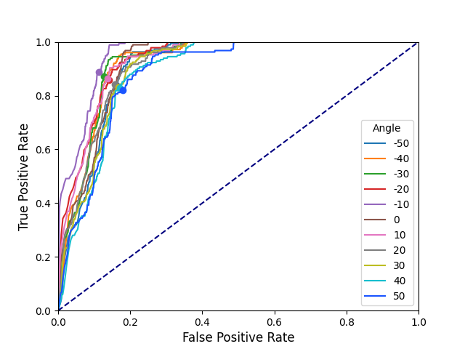
Left Eye Triplet Loss Network

Slide 23
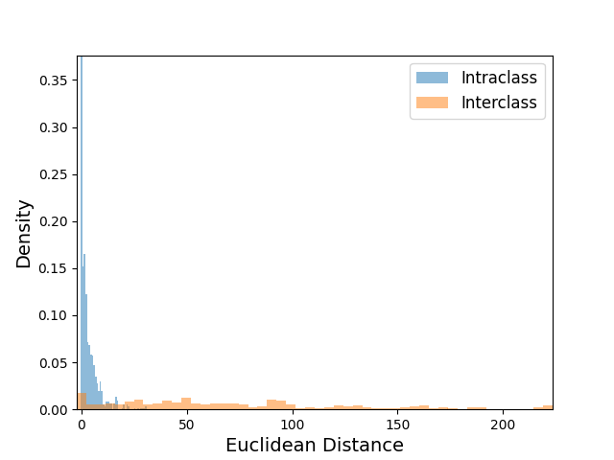
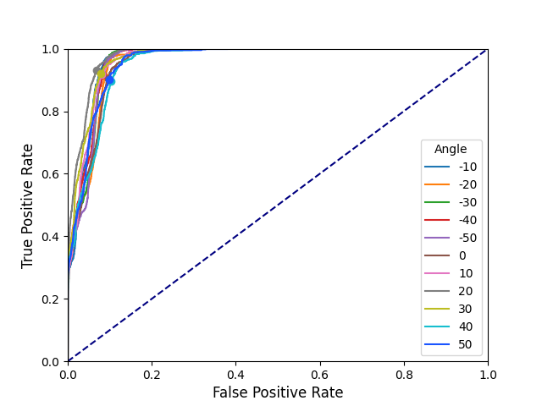
Left Eye Triplet Loss Network Cont.

Slide 24
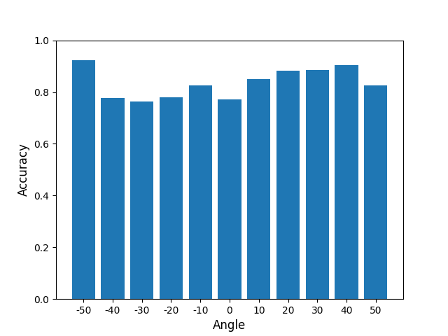
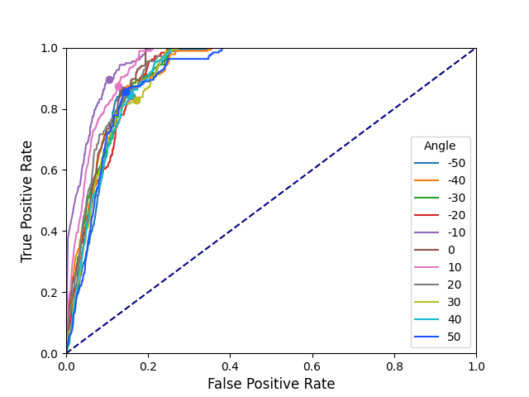
Right Eye Triplet Loss Network

Slide 25
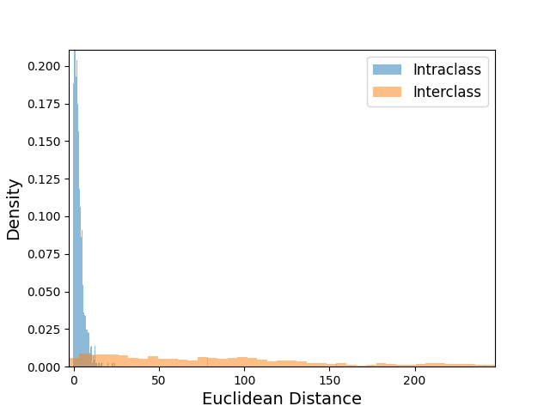
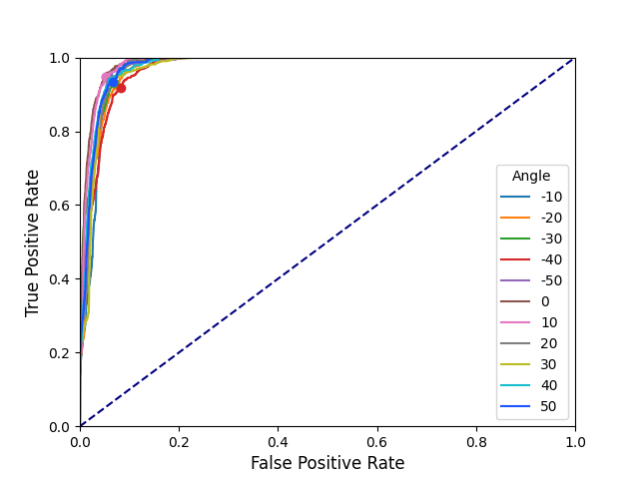
Right Eye Triplet Loss Network Cont.

Slide 26
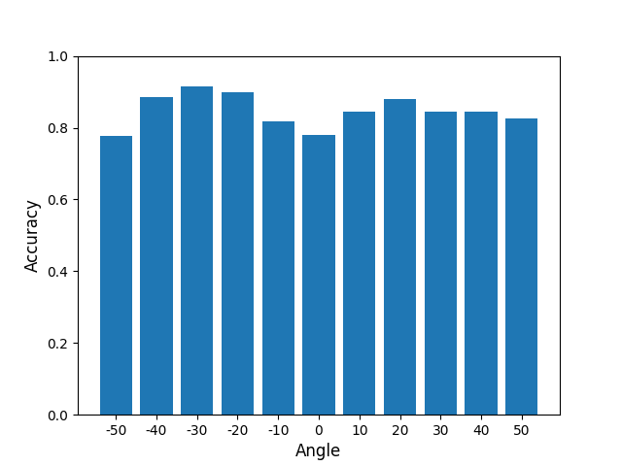
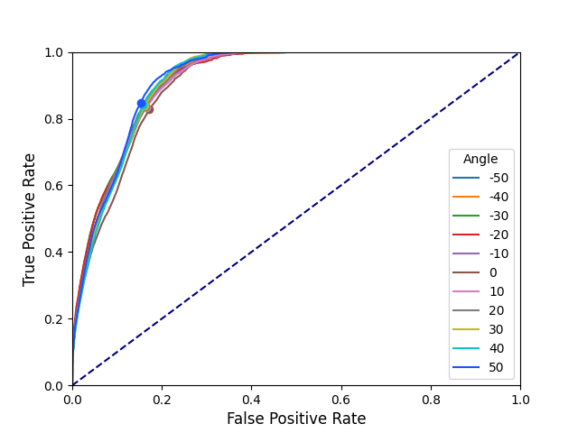
Left and Right Eye Triplet Loss Network

Slide 27


Left and Right Eye Triplet Loss Network Cont.

