Slide 1
STN + ConvNeXt
By Daniel Tebor

Slide 2
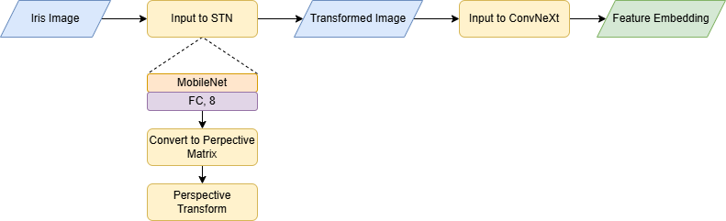
STN + ConvNeXt Architecture
End-to-end training of composite model
STN applies learned transformations
Transformed image fed into ConvNeXt for feature extraction

Slide 3
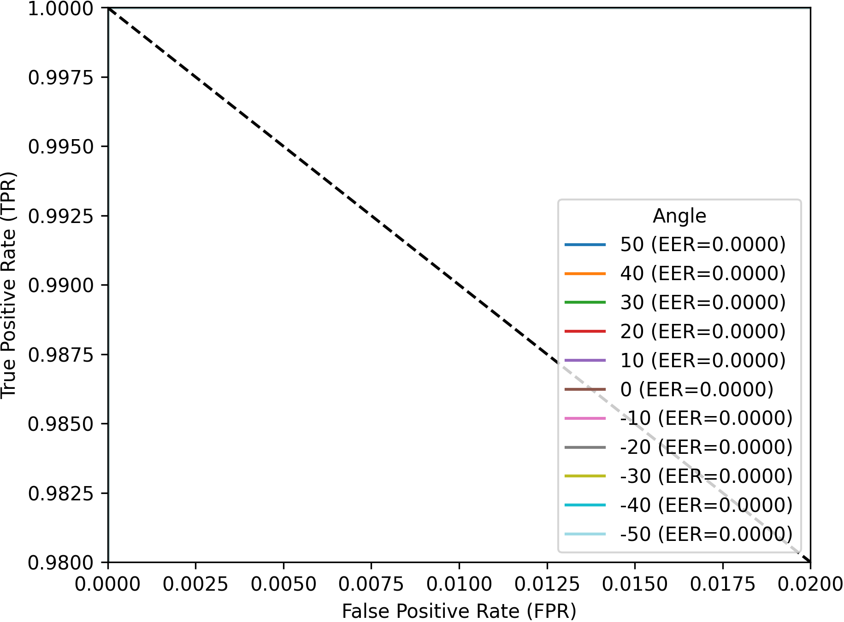
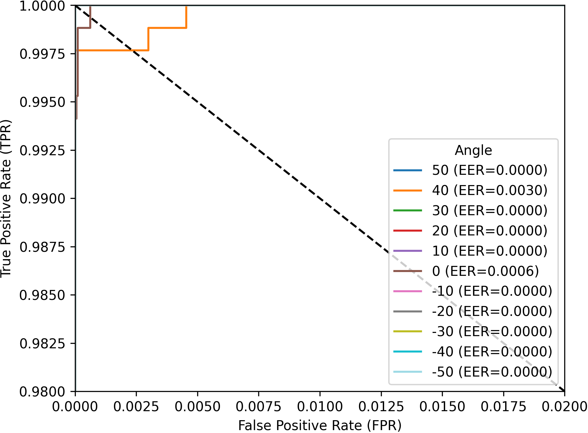
Angle vs Angle Results
ConvNeXt
STN + ConvNeXt

Slide 4
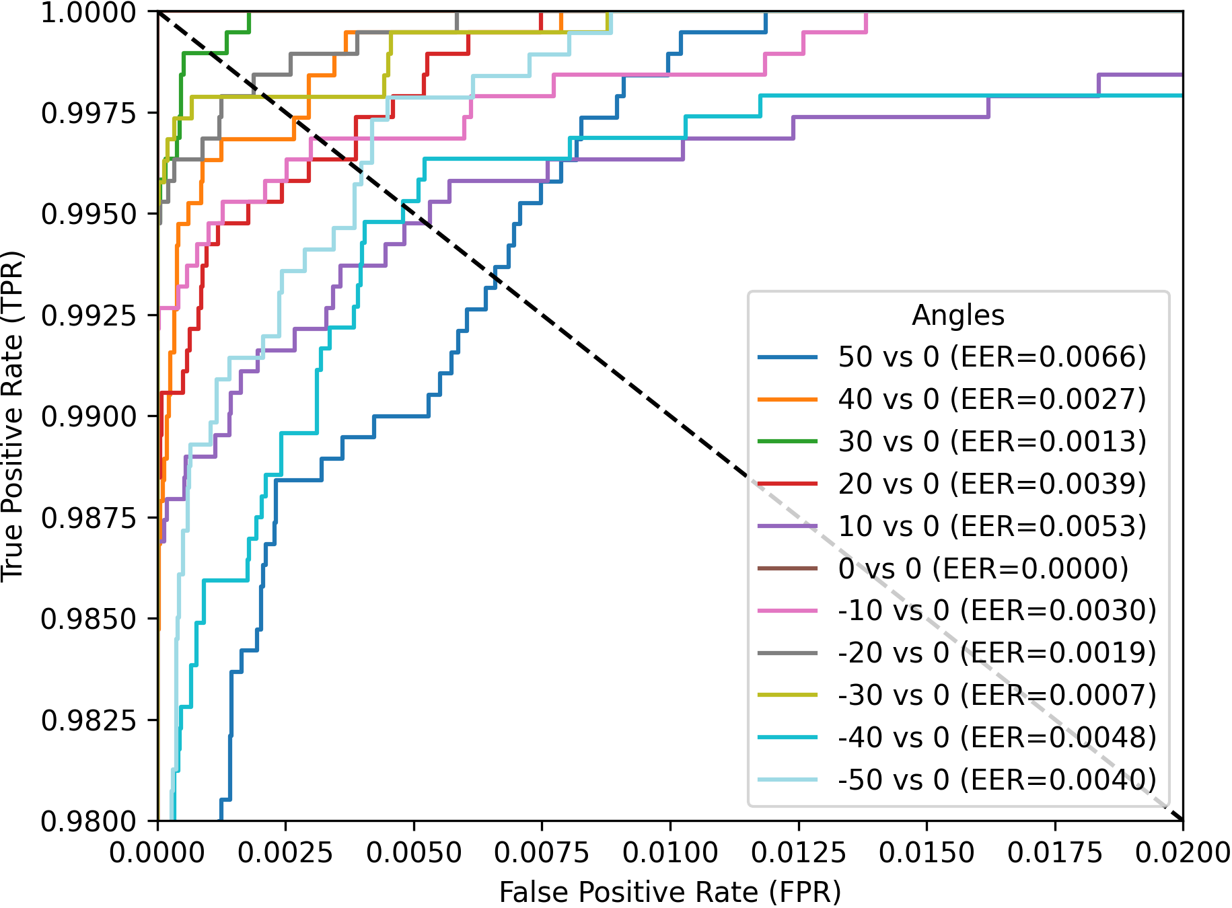
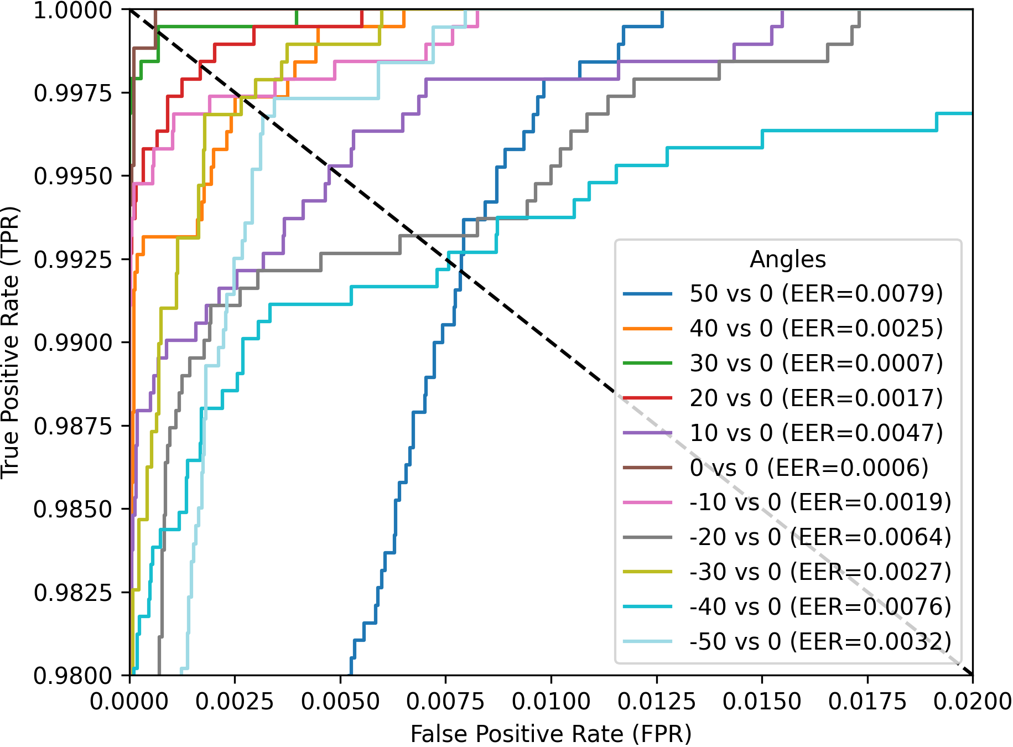
Angle vs Frontal Results
ConvNeXt
STN + ConvNeXt

Slide 5
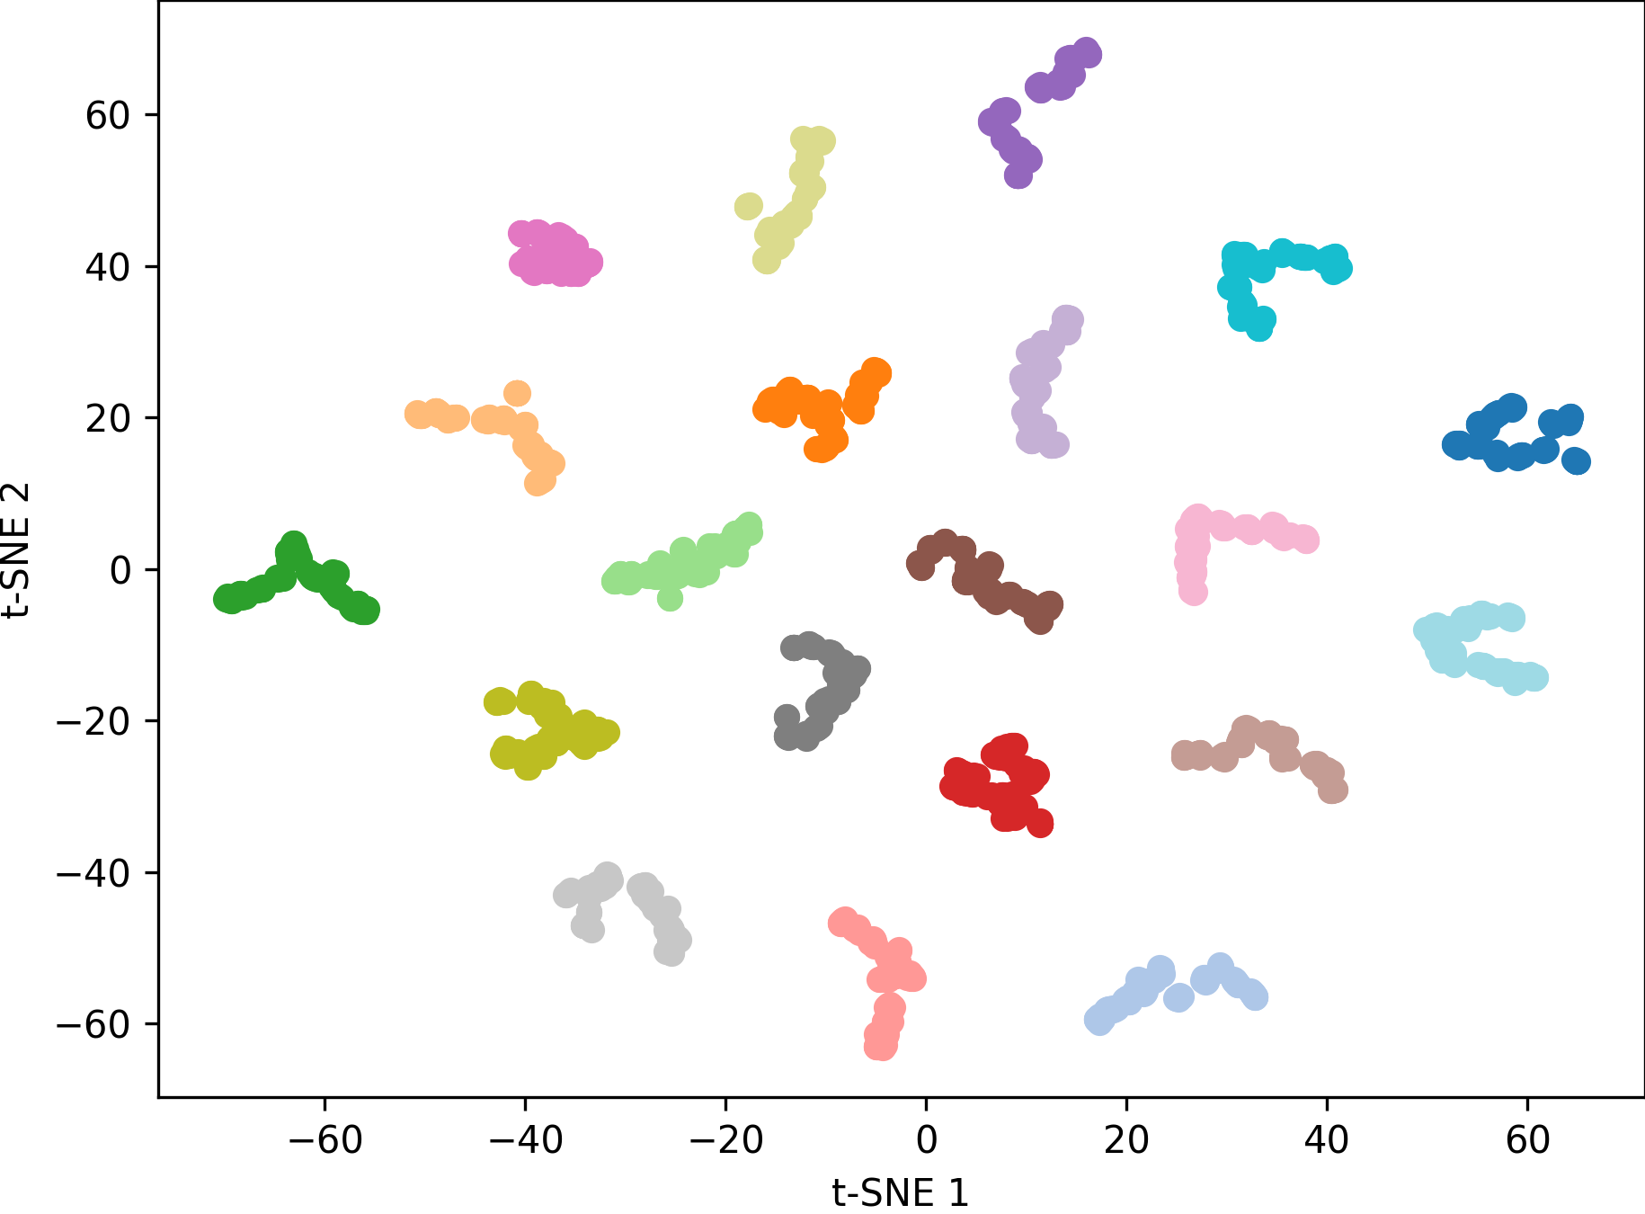
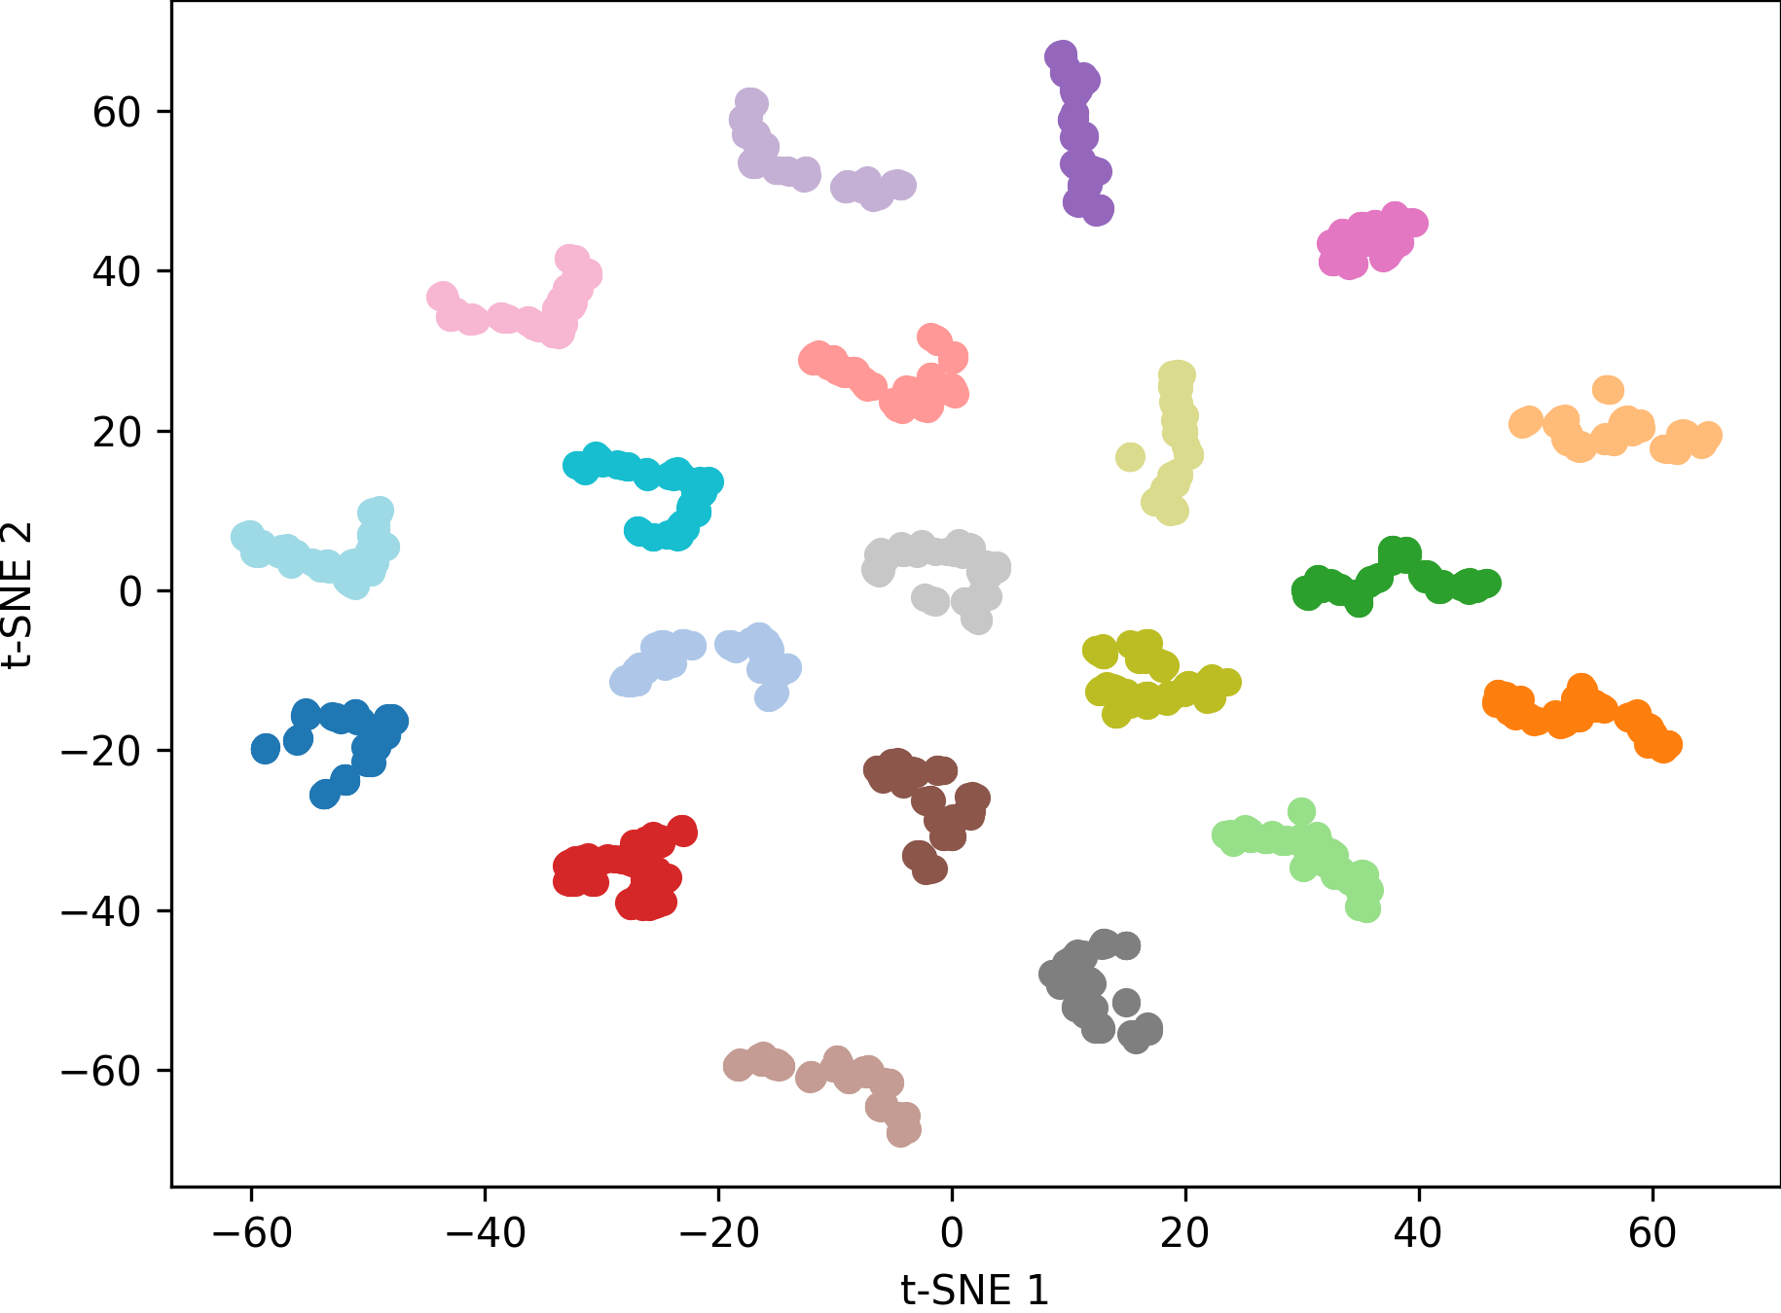
t-SNE Results
ConvNeXt
STN + ConvNeXt

Slide 6
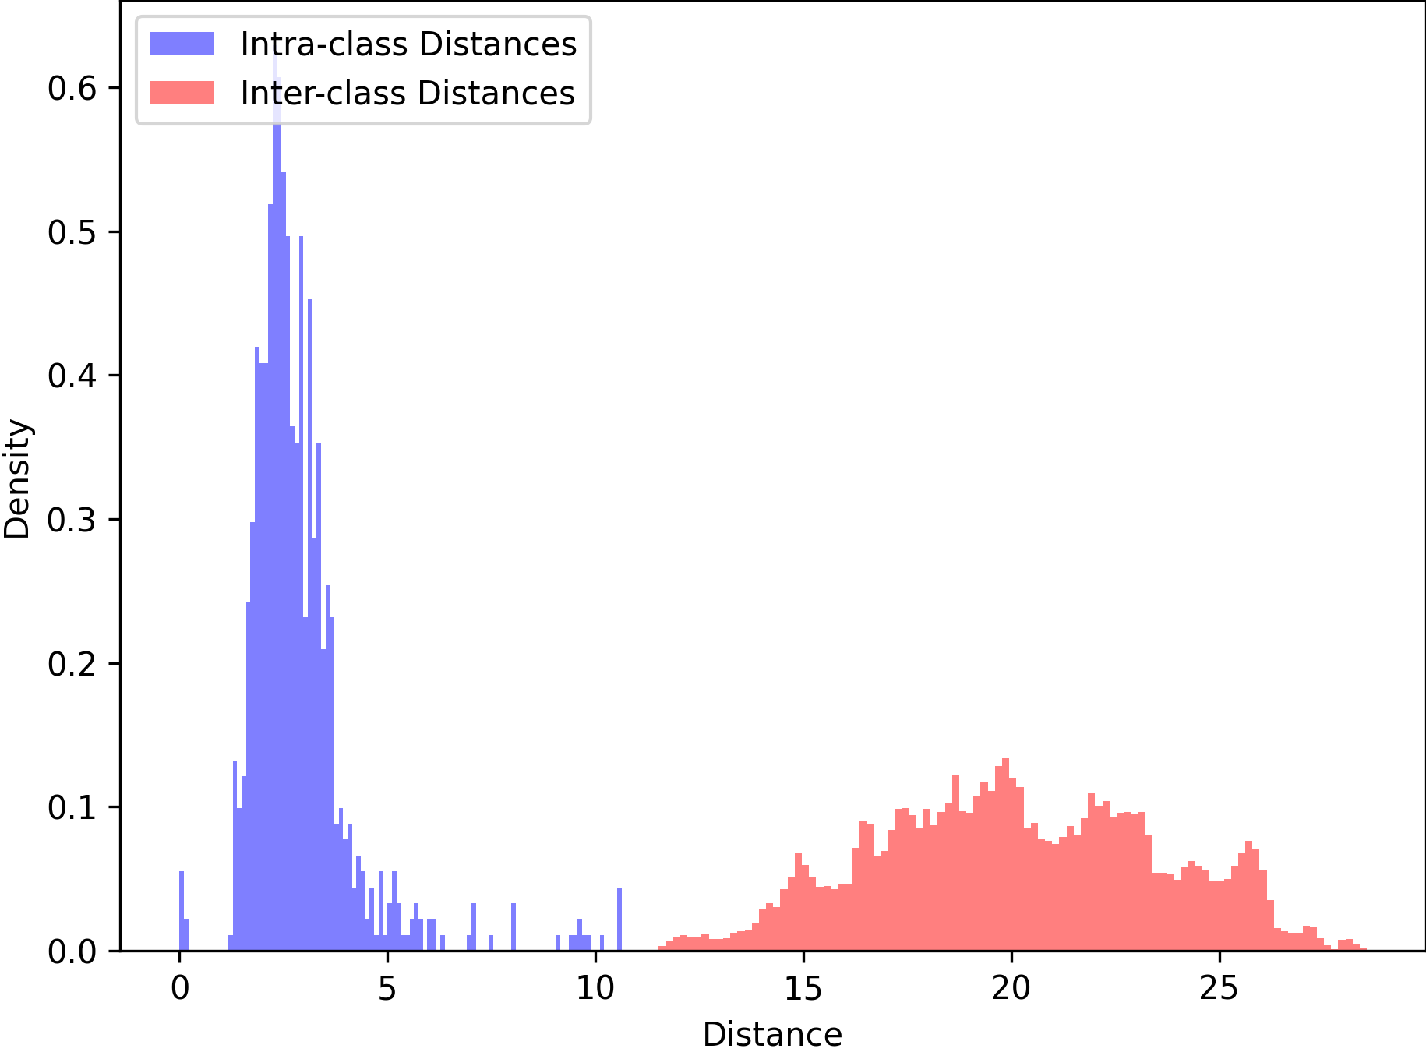
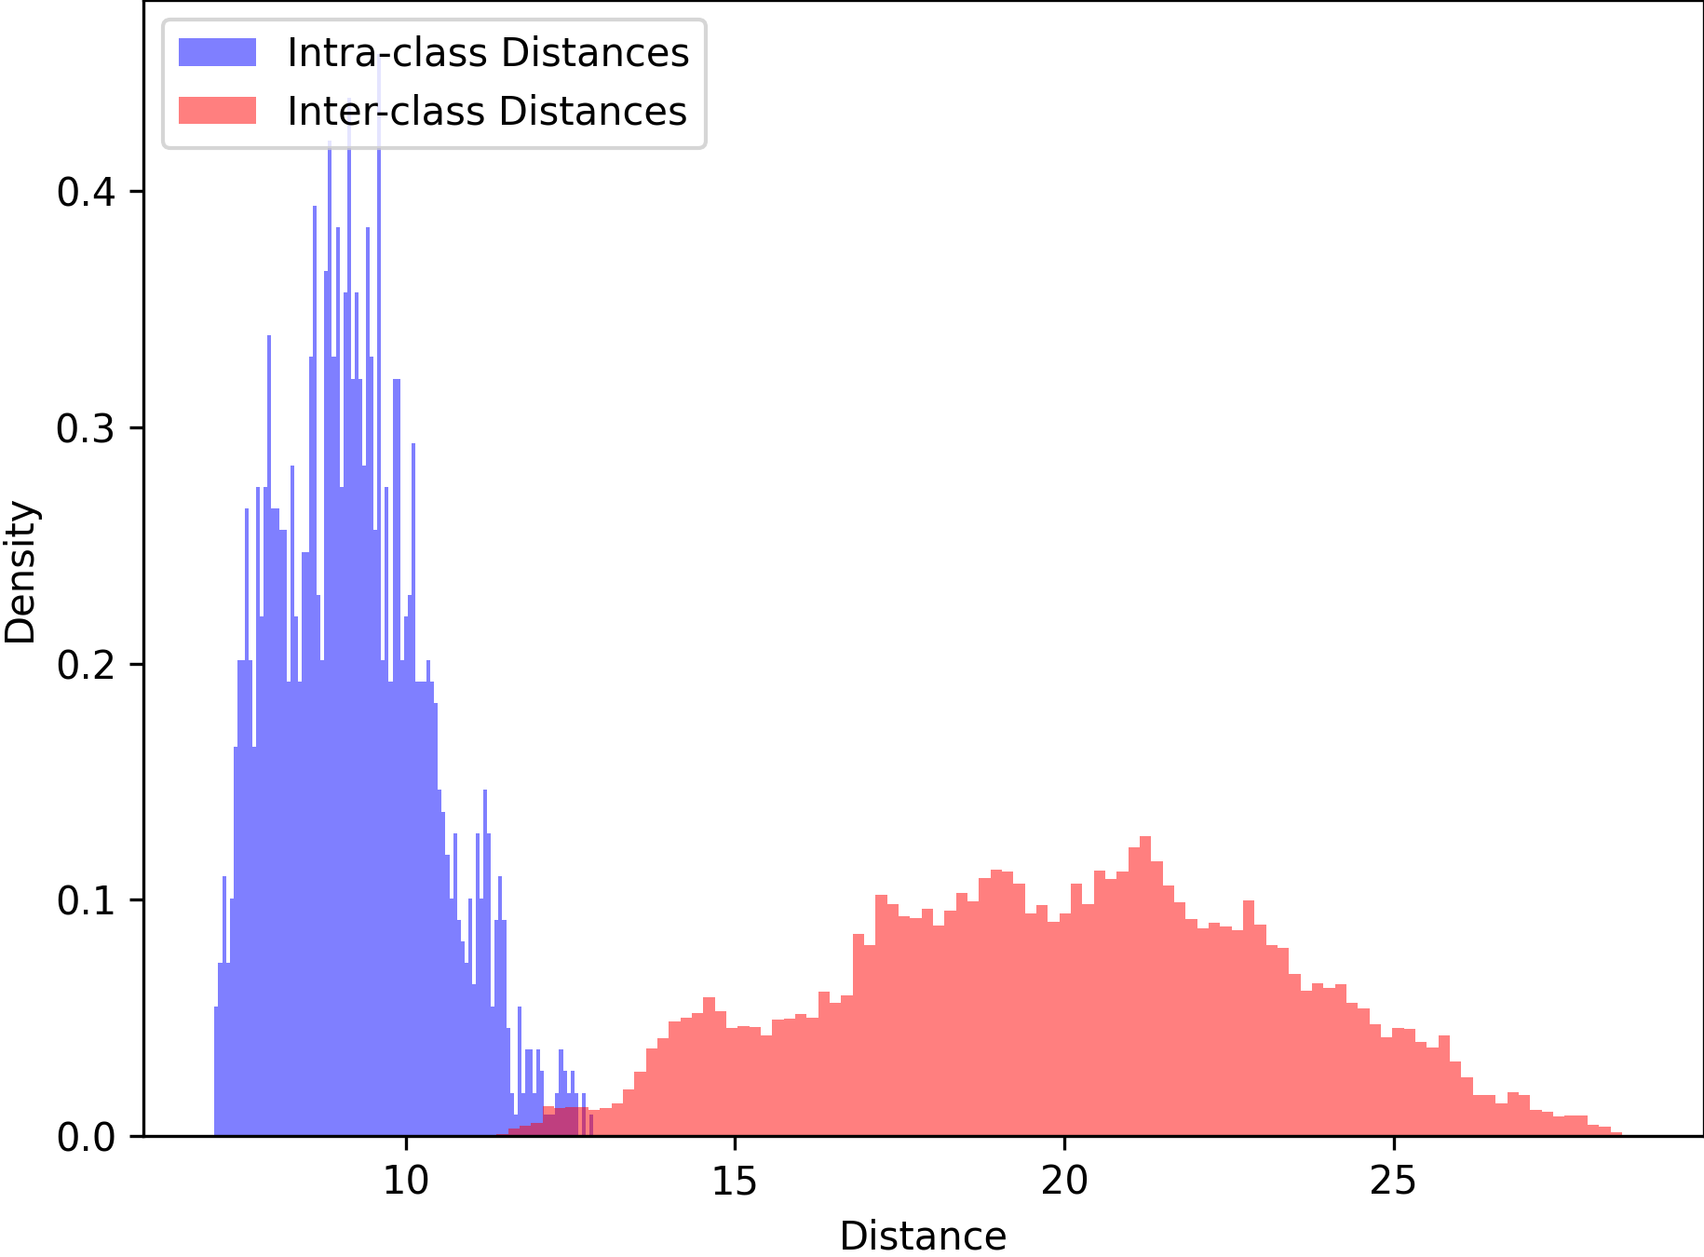
ConvNeXt Histograms
0 vs 0
50 vs 0

Slide 7
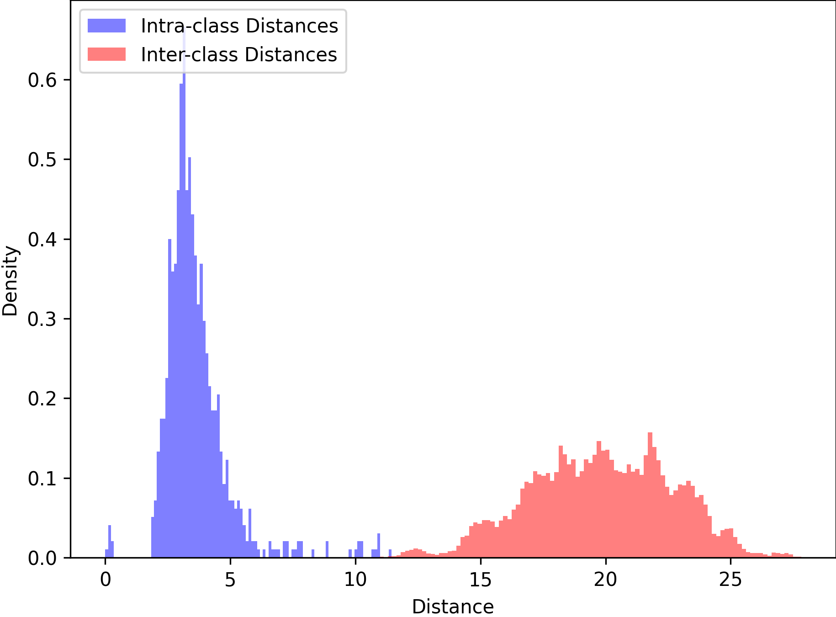
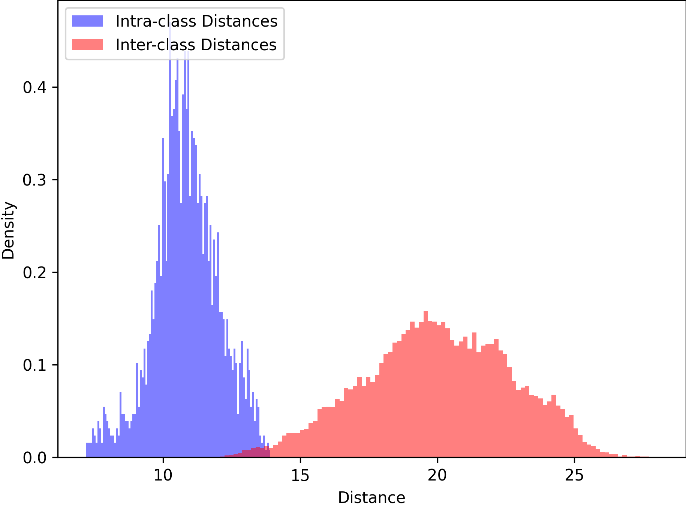
STN + ConvNeXt Histograms
0 vs 0
50 vs 0

