Slide 1
STN + ConvNeXt
By Daniel Tebor

Slide 2
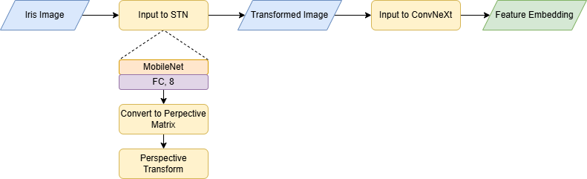
STN + ConvNeXt Architecture
End-to-end training of composite model
STN applies learned transformations
Transformed image fed into ConvNeXt for feature extraction

Slide 3
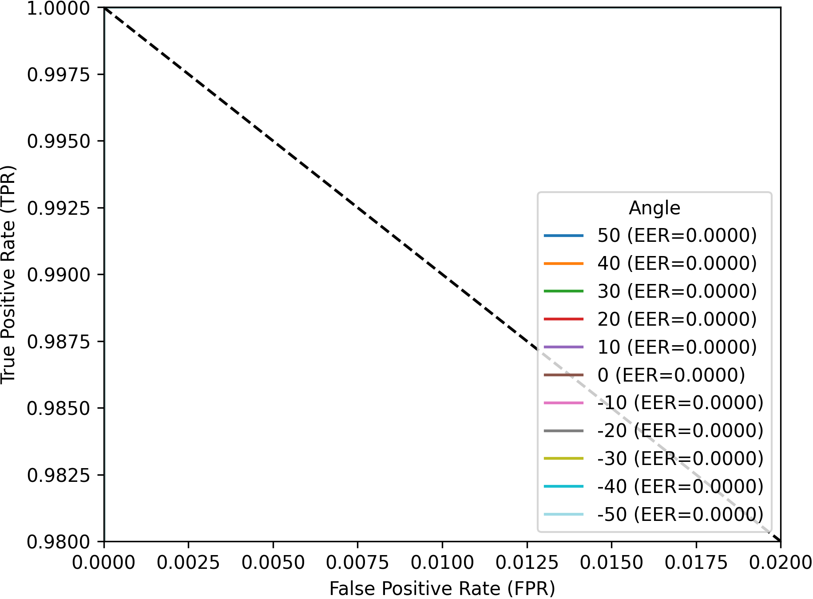
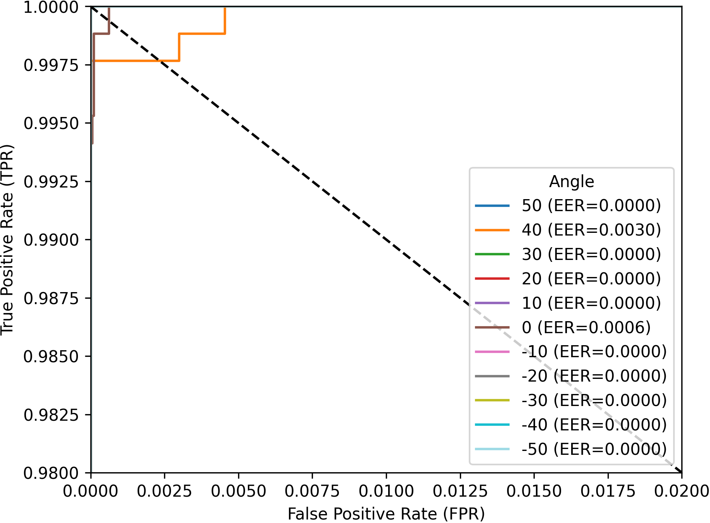
Angle vs Angle Results
ConvNeXt
STN + ConvNeXt

Slide 4
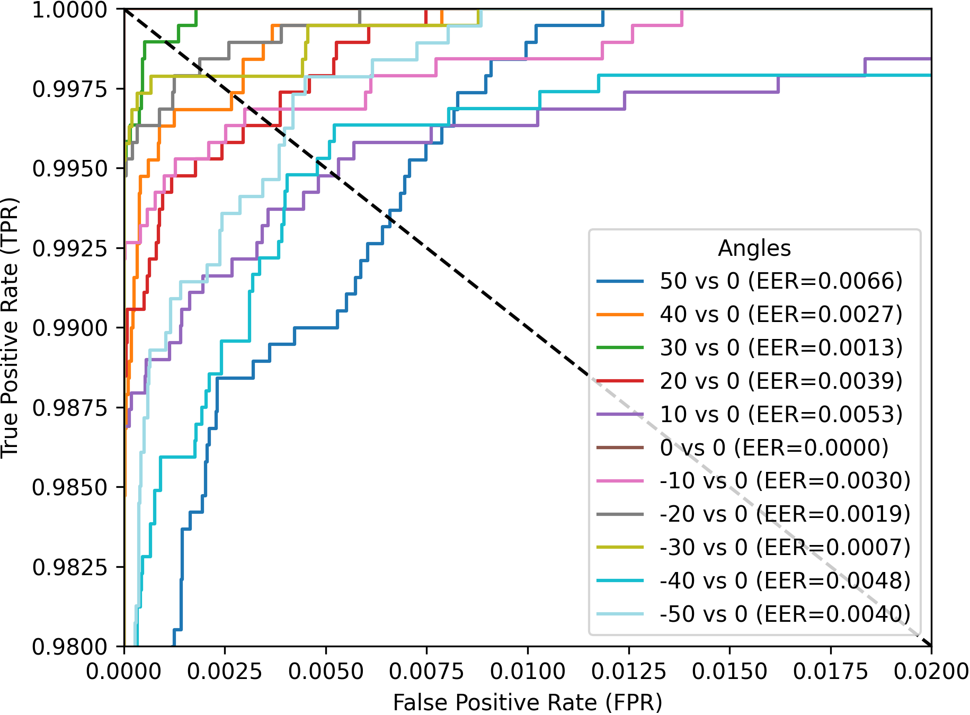
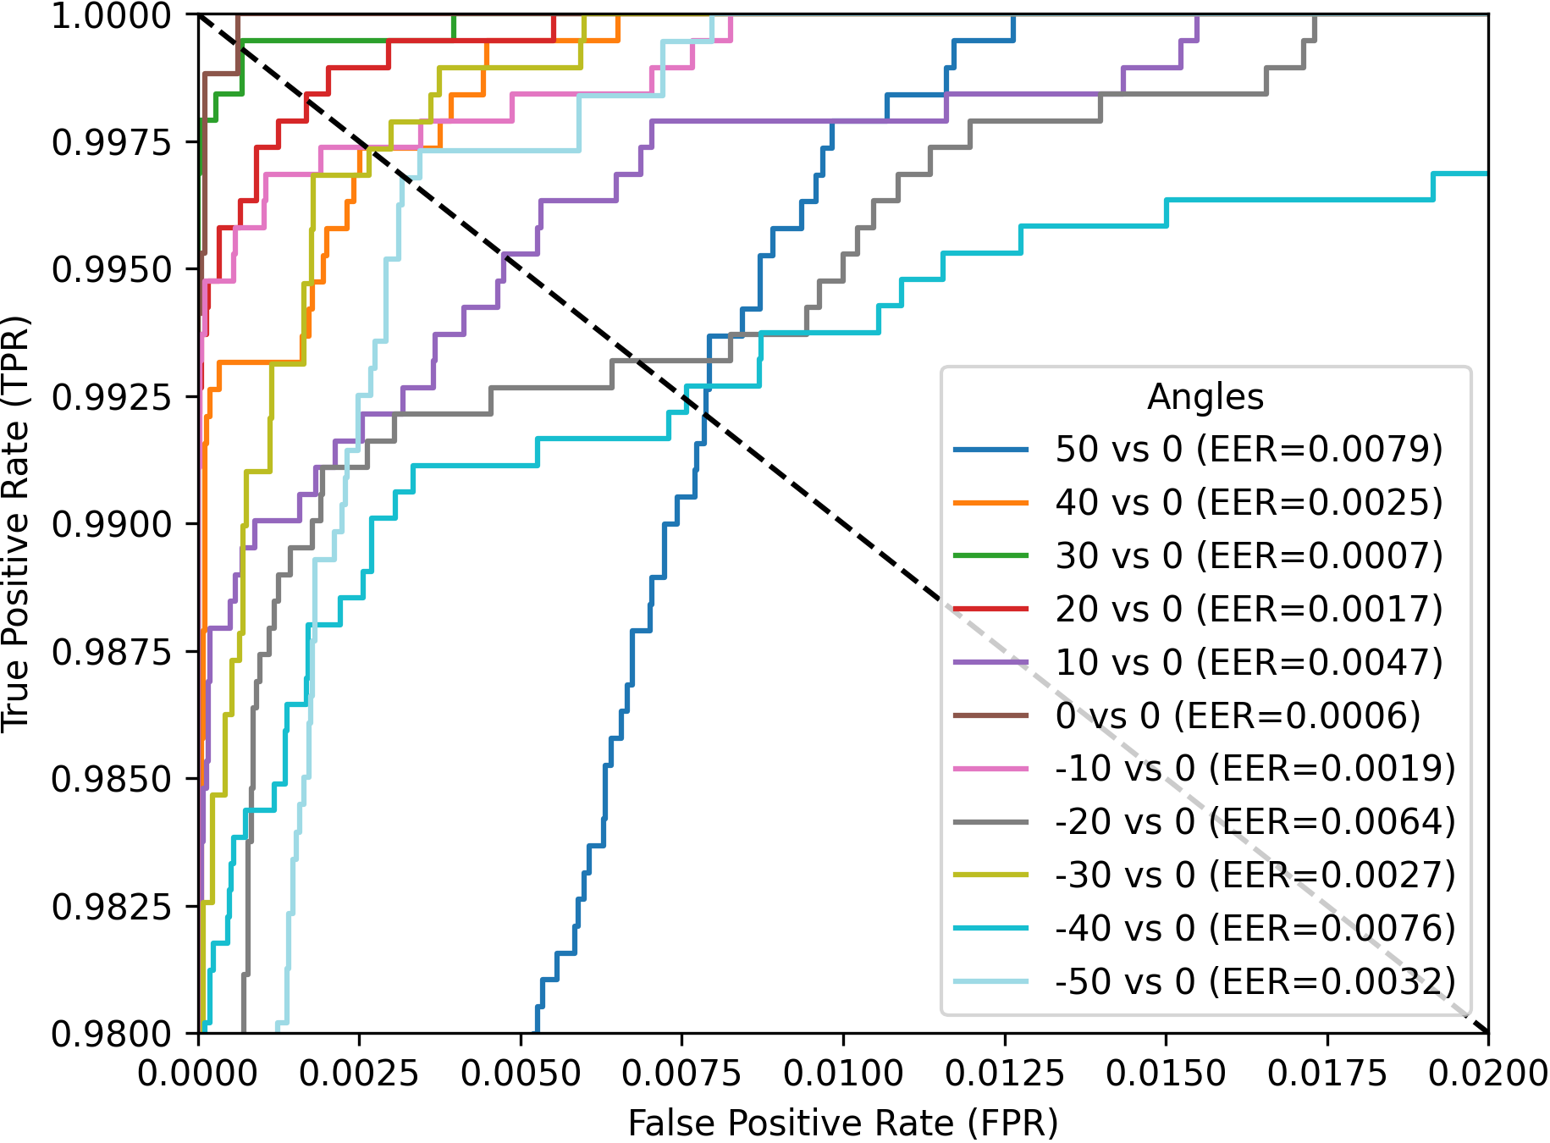
Angle vs Frontal Results
ConvNeXt
STN + ConvNeXt

Slide 5
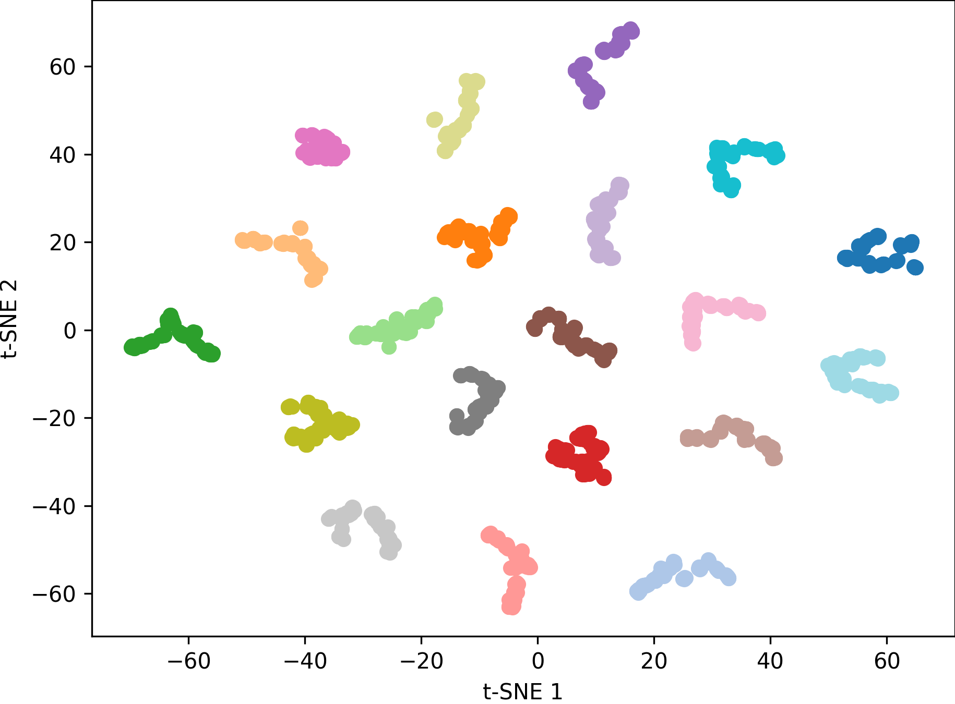
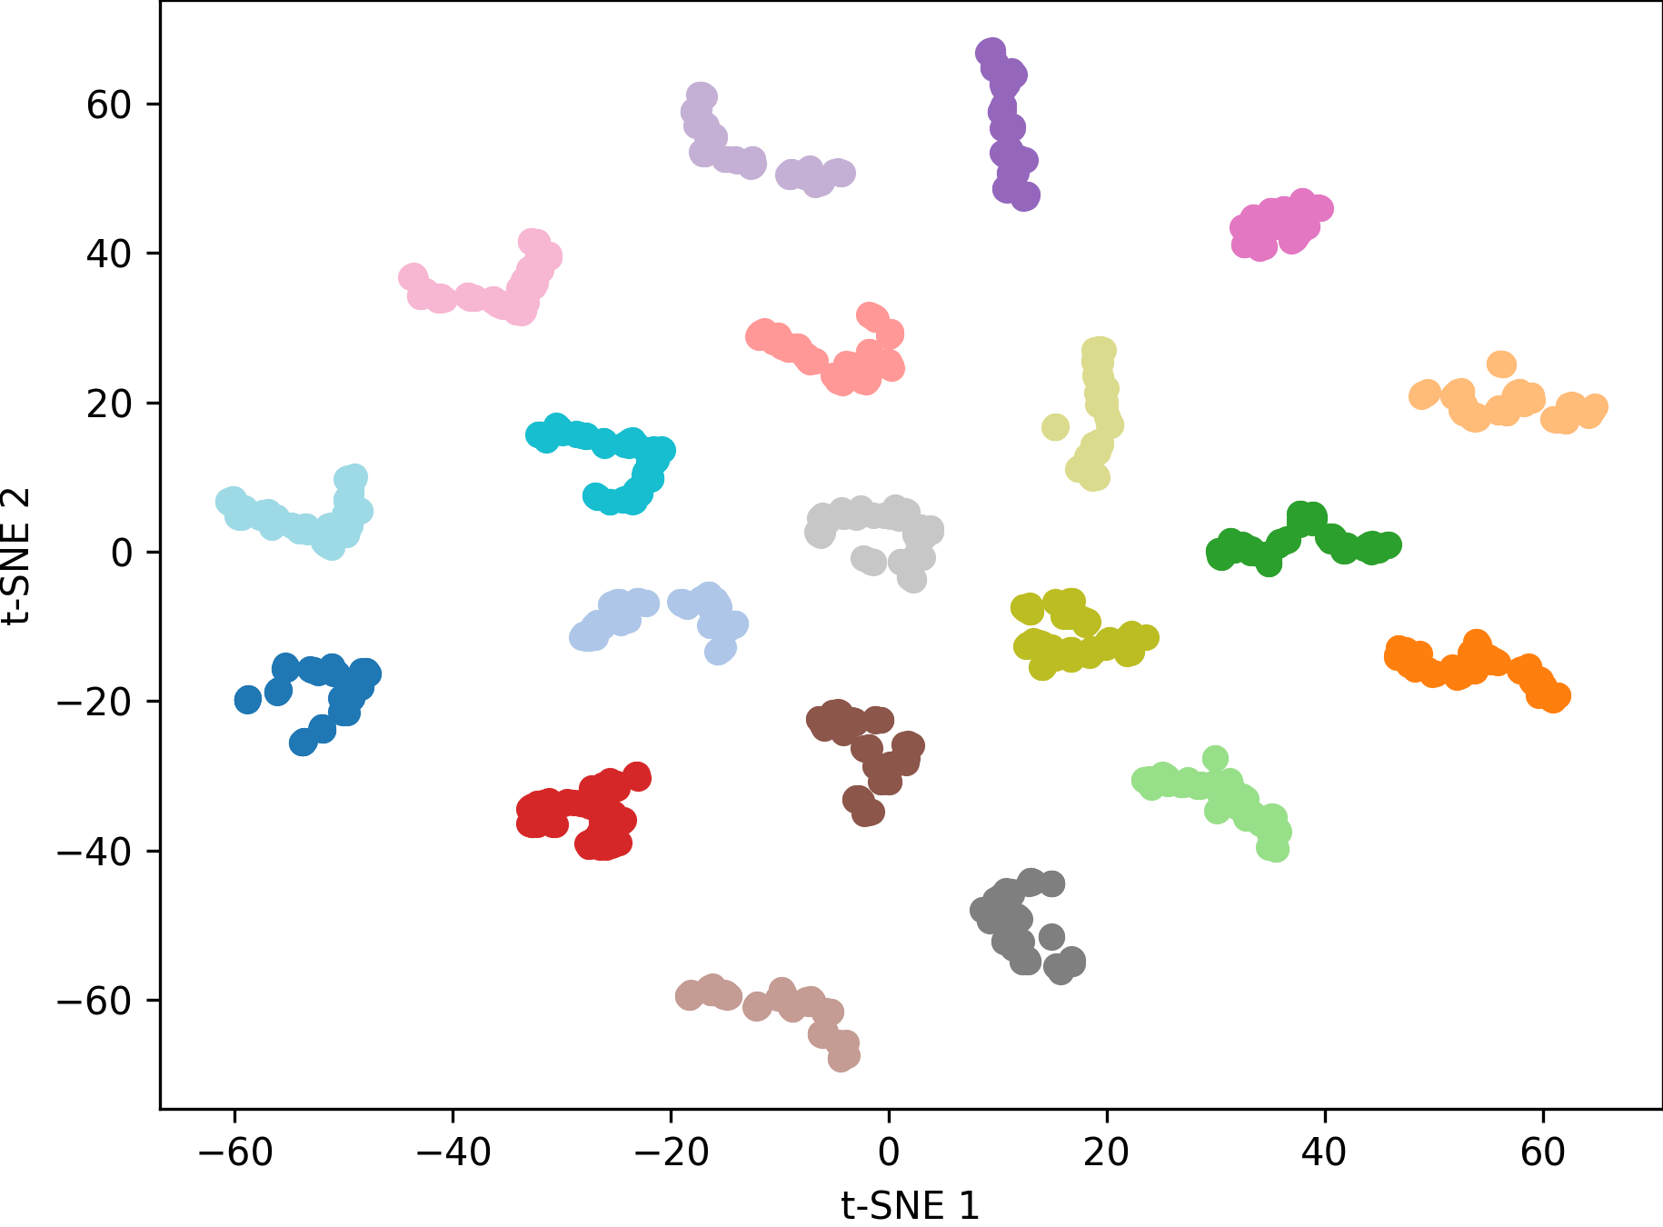
t-SNE Results
ConvNeXt
STN + ConvNeXt

Slide 6
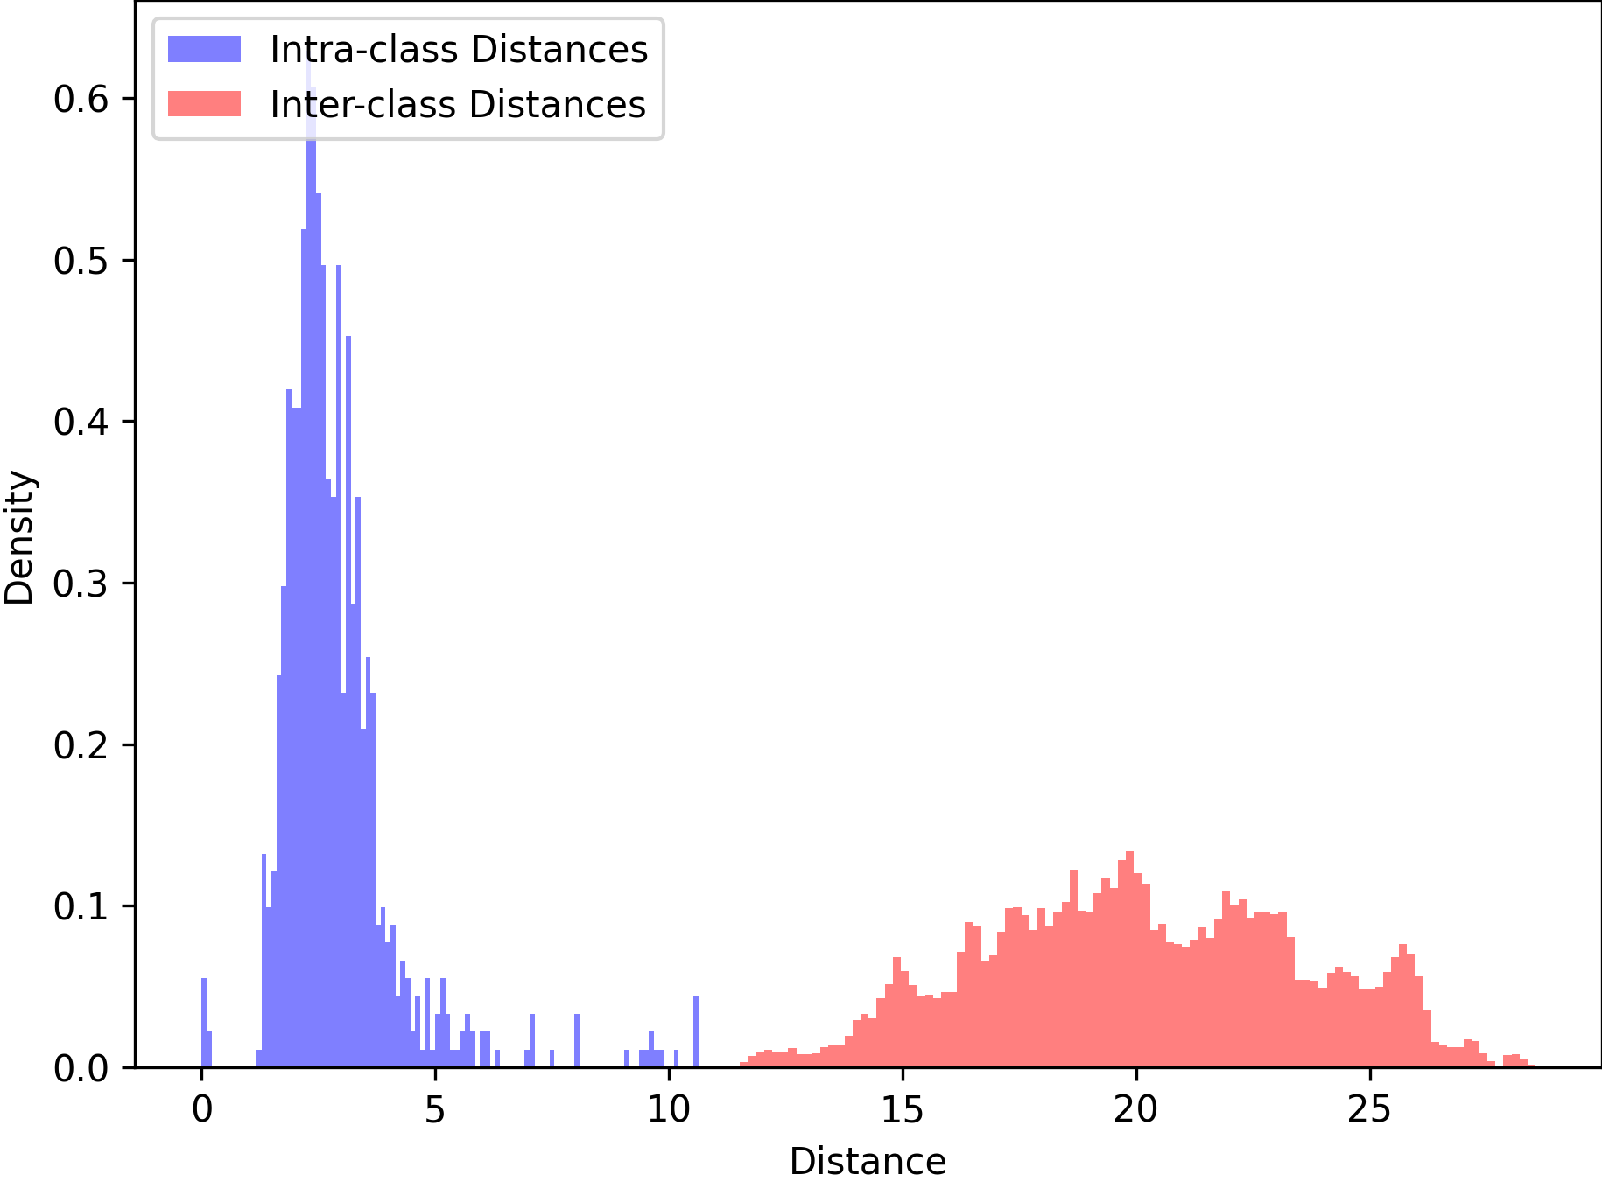
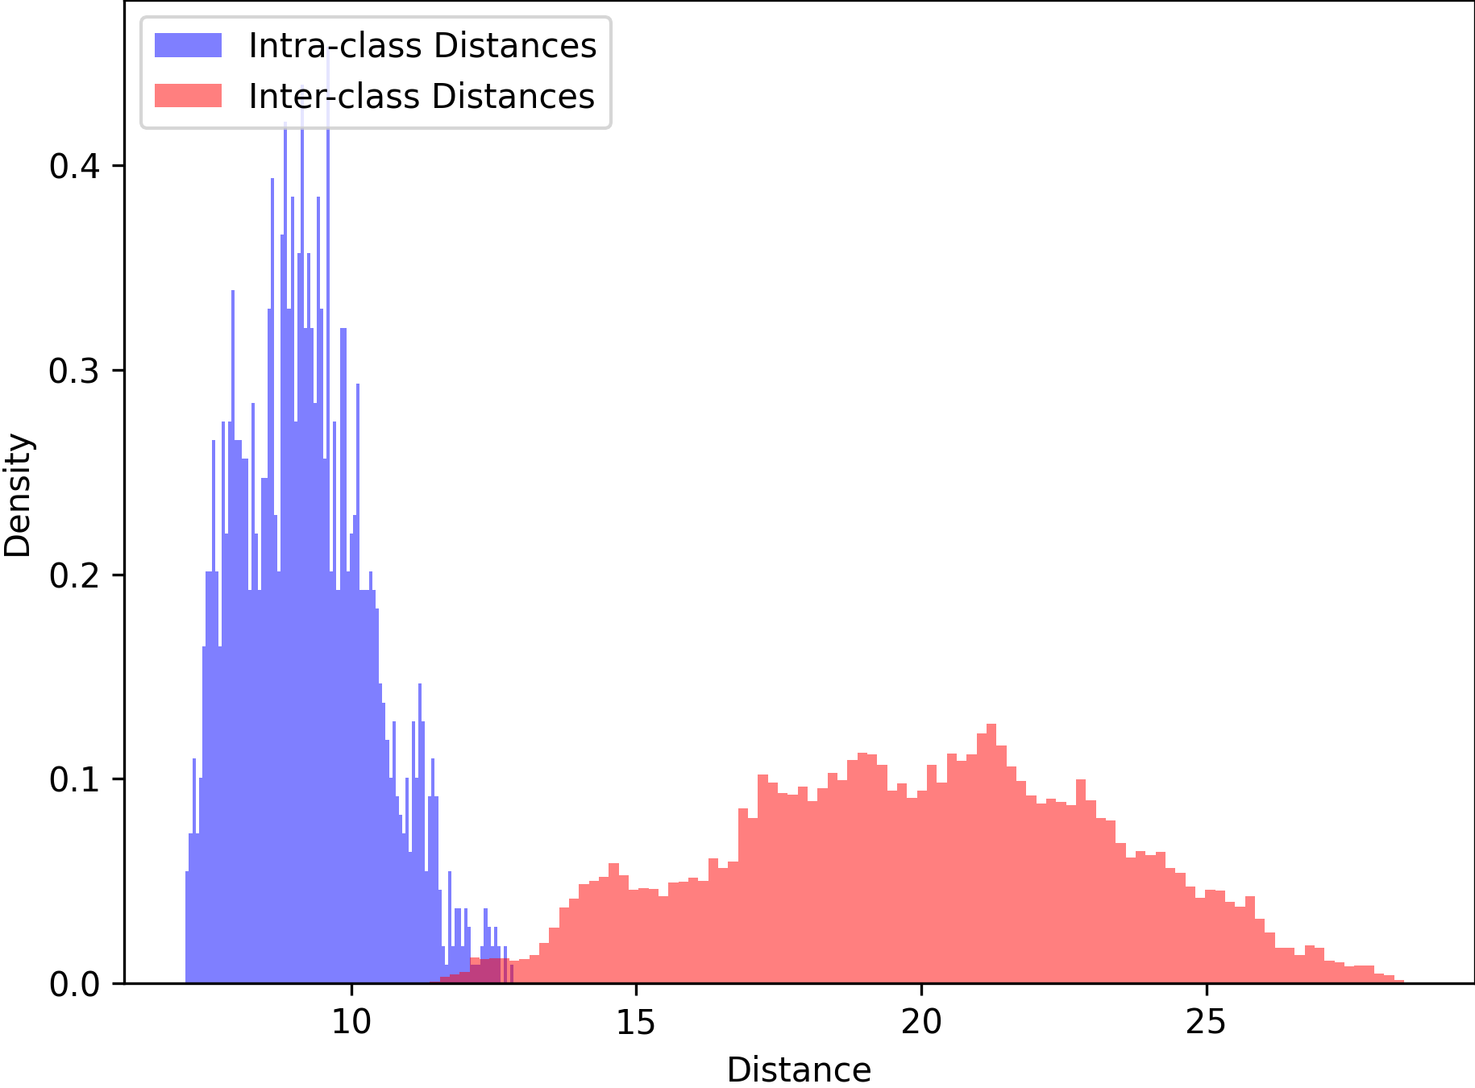
ConvNeXt Histograms
0 vs 0
50 vs 0

Slide 7
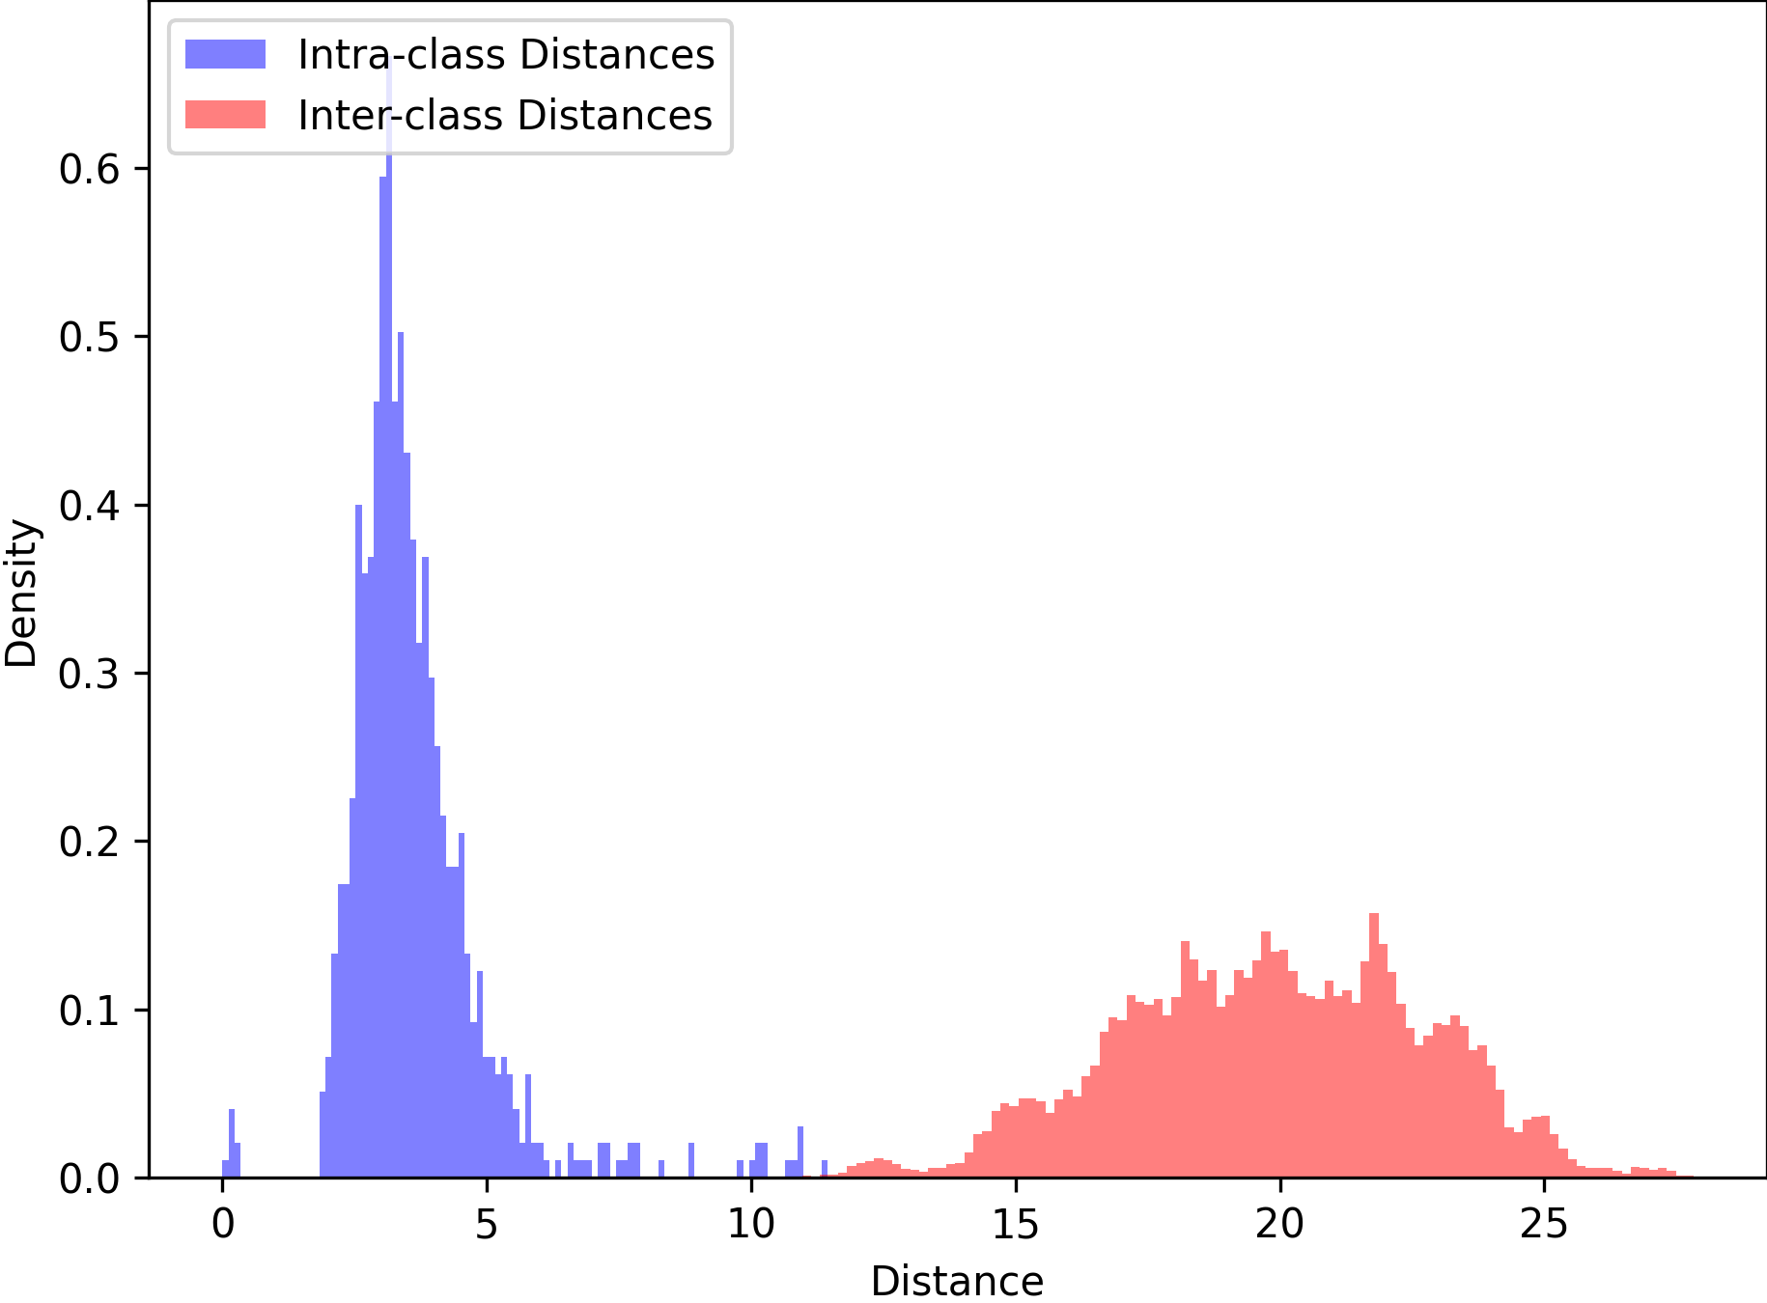
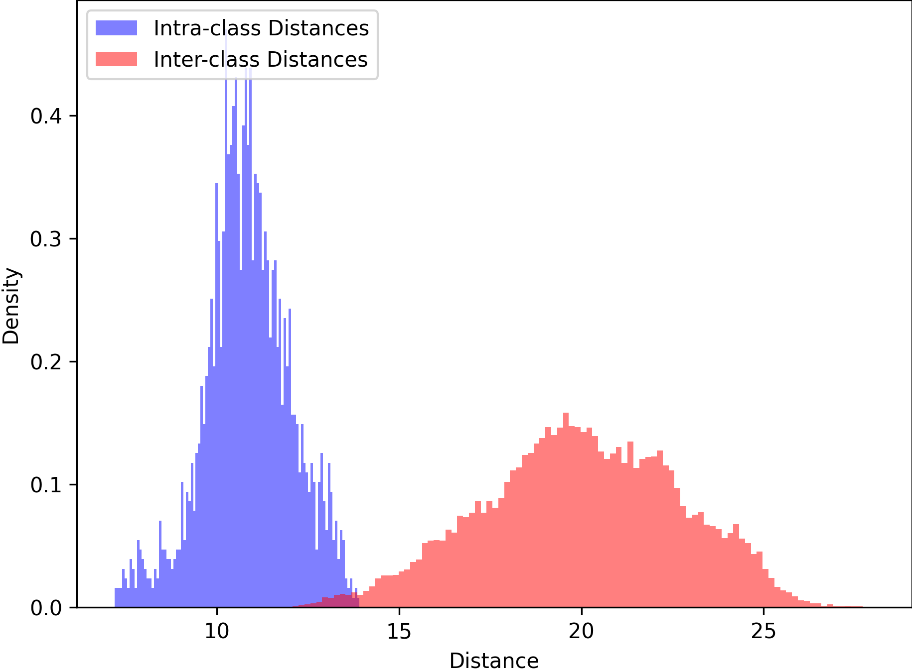
STN + ConvNeXt Histograms
0 vs 0
50 vs 0

Slide 8
Discussion
STN Worse than base ConvNeXt
Inconsistent transformations -> ConvNeXt instability
Transformations not useful to ConvNeXt
Transformations fundamentally cannot add information to image

Slide 9
Angle Correction + ConvNeXt

Slide 10
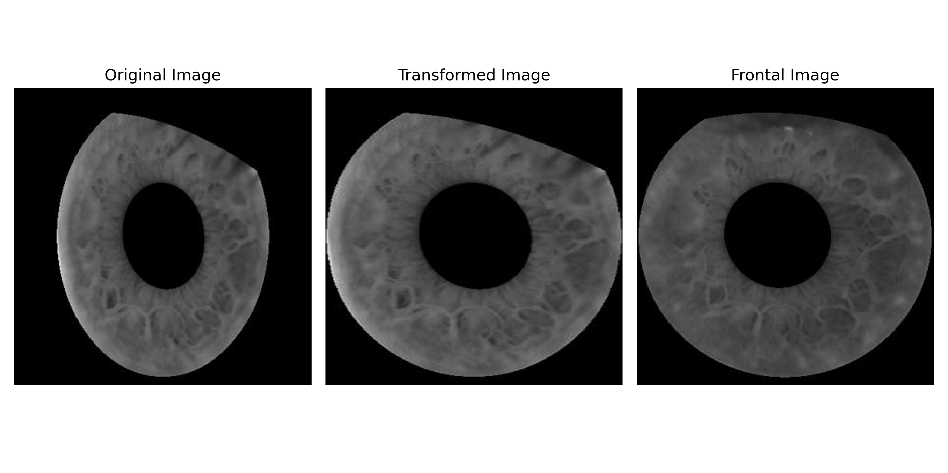
Angle Correction Preprocessing
Apply a static transformation based on capture angle
Example angle -50 transformation:

Slide 11
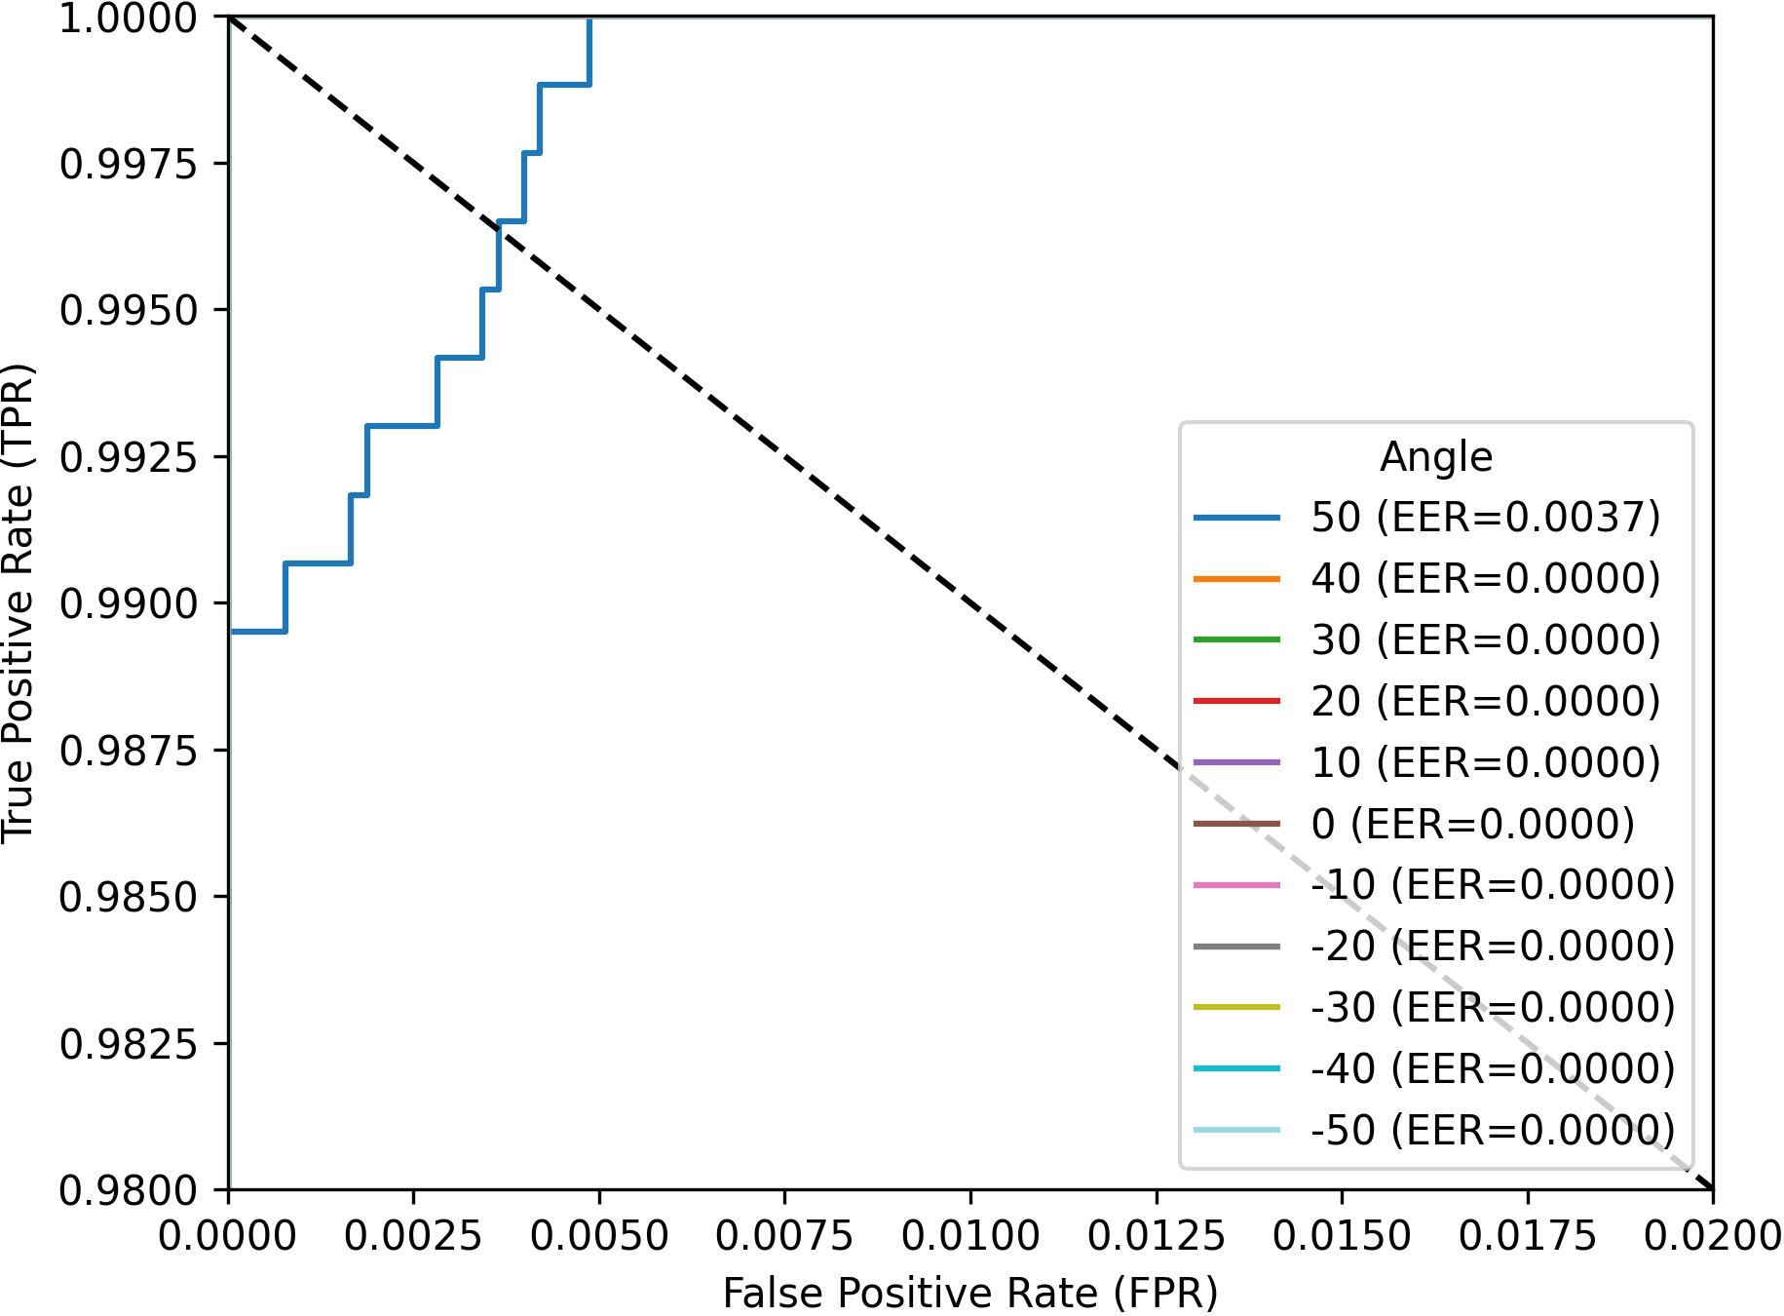
Angle vs Angle Results
ConvNeXt
Angle Correction + ConvNeXt

Slide 12
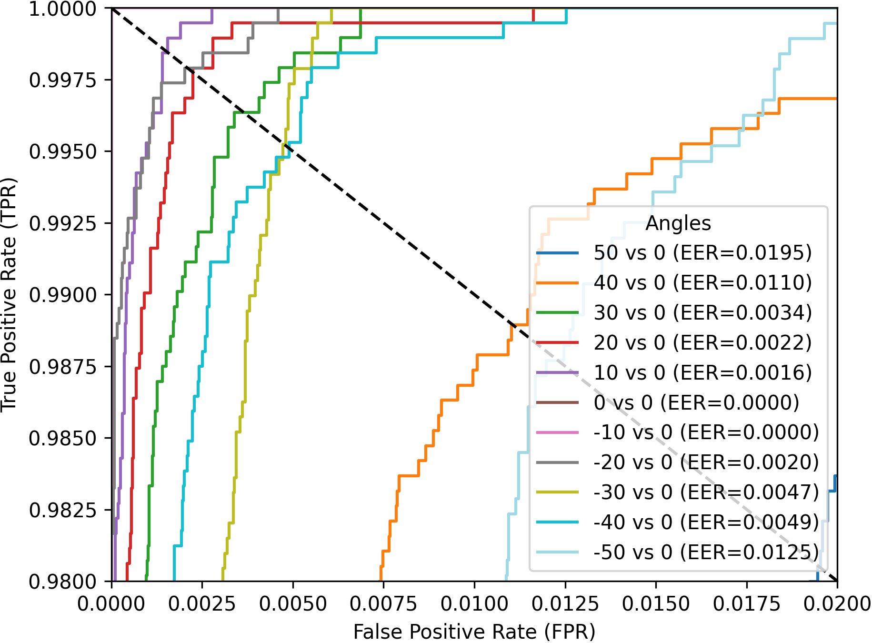
Angle vs Frontal Results
ConvNeXt
Angle Correction + ConvNeXt

Slide 13
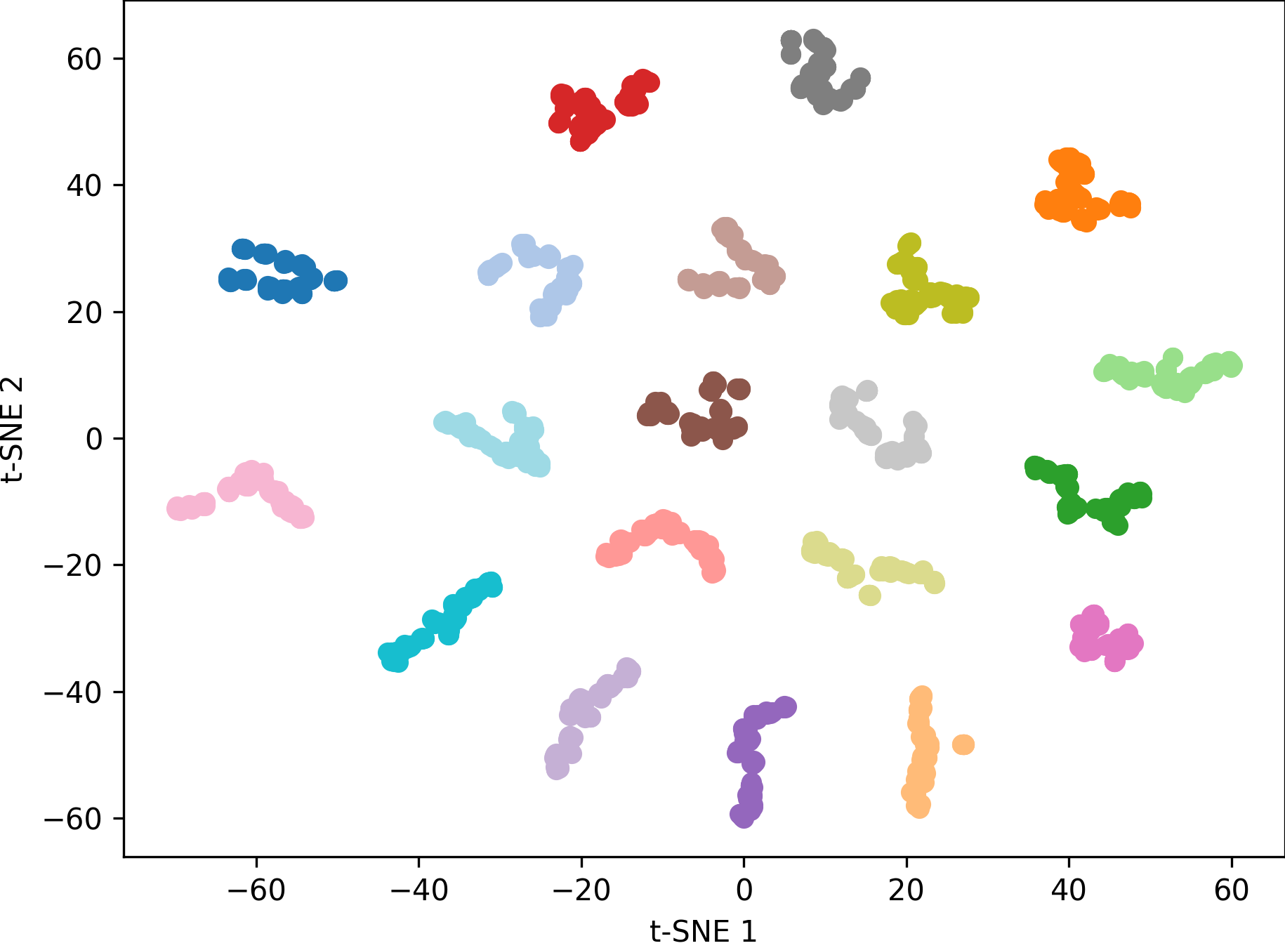
t-SNE Results
ConvNeXt
Angle Correction + ConvNeXt

Slide 14
ConvNeXt Histograms
0 vs 0
50 vs 0

Slide 15
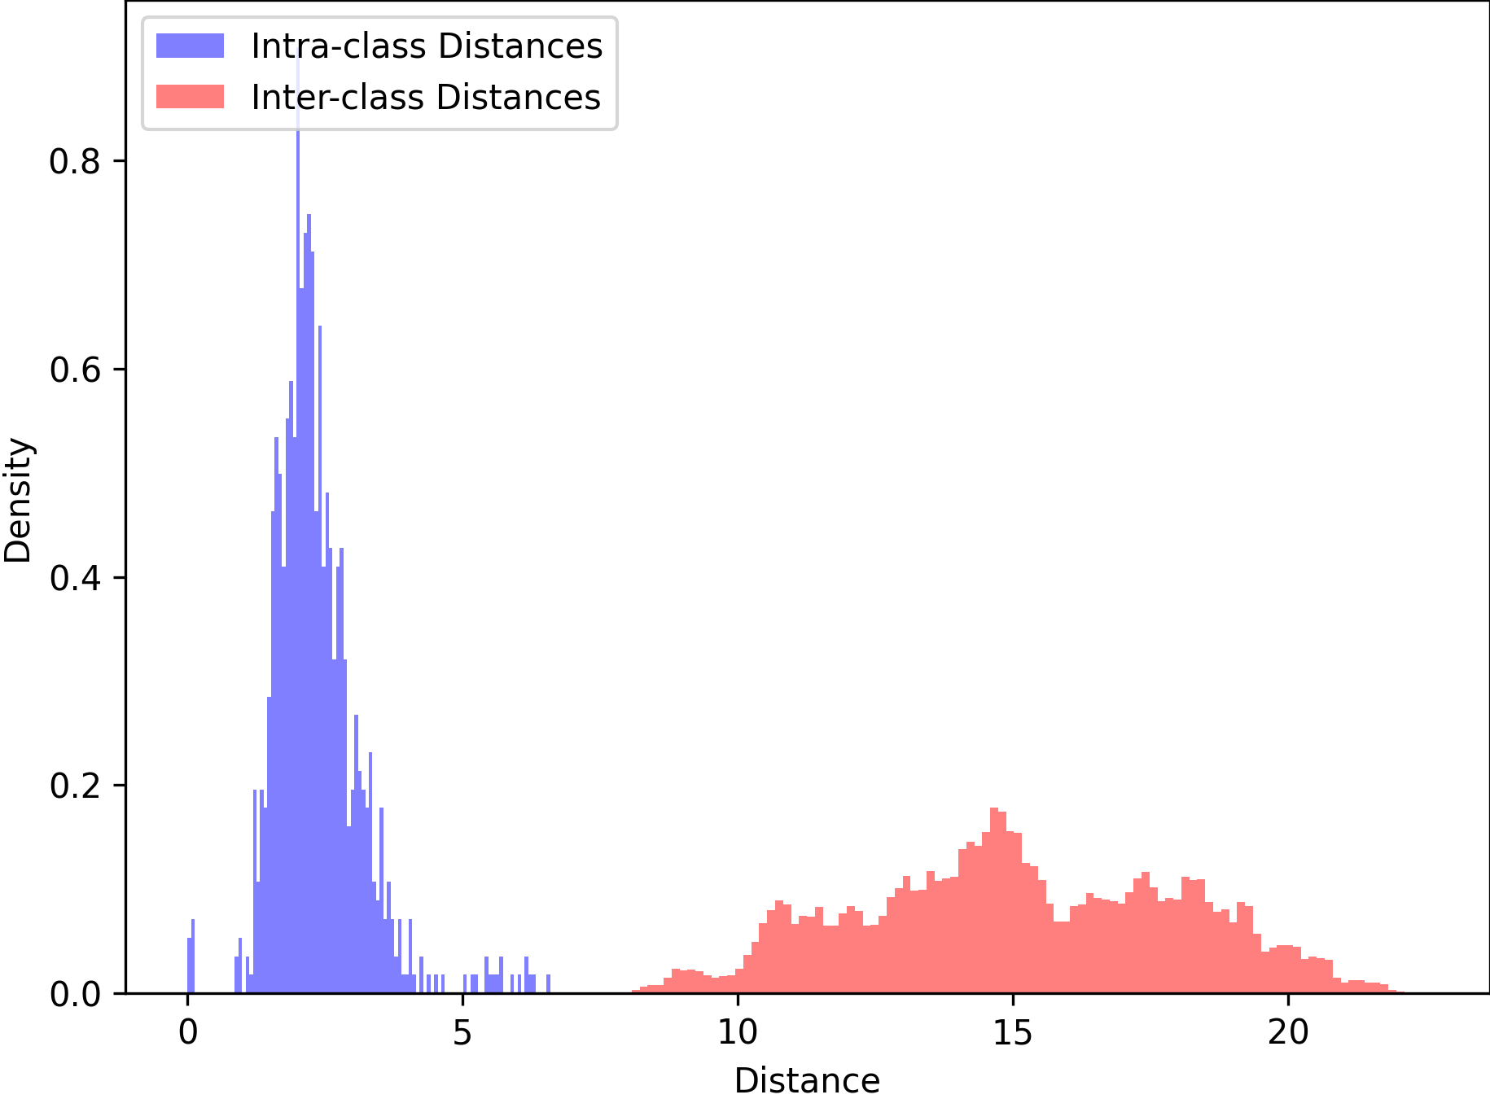
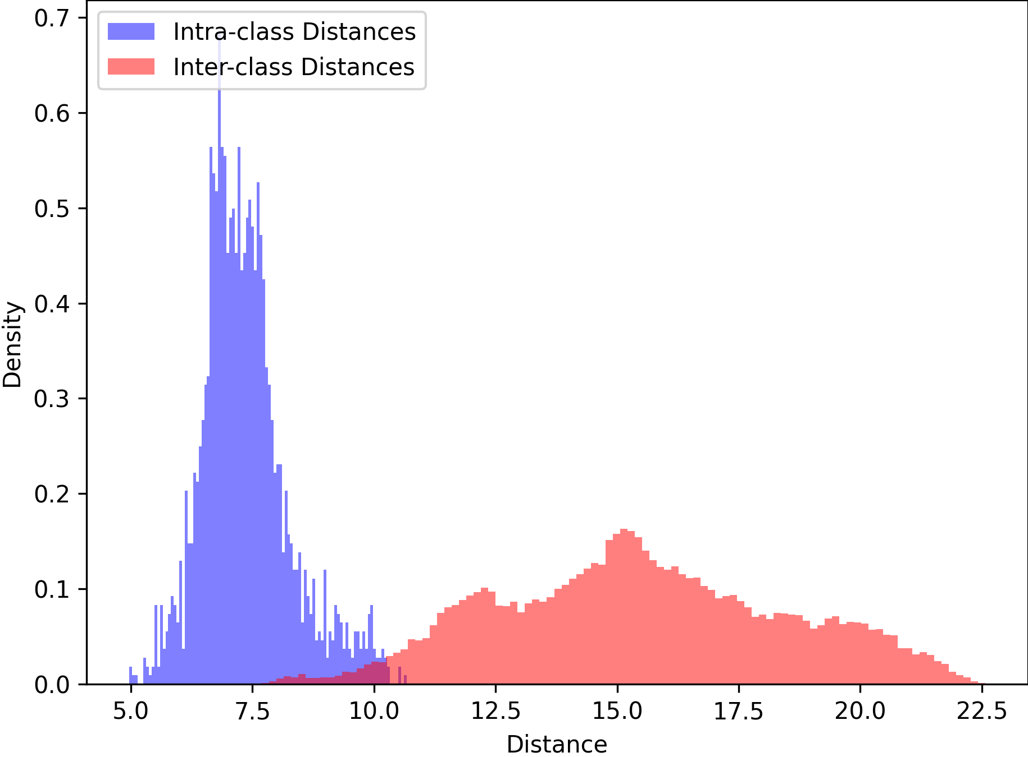
Angle Correction + ConvNeXt Histograms
0 vs 0
50 vs 0

Slide 16
Discussion
Transformed images worse for ConvNeXt
ConvNeXt learns set of filters for different angles
All angles looking same makes it difficult for model to differentiate angles.

